Slide 1

Trump
2nd Presidential term

Slide 2
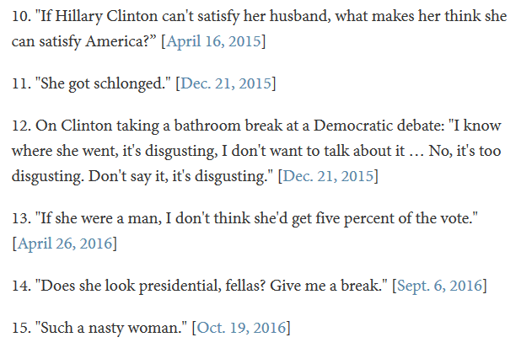
Trump’s tweets
Main focus on: China virus, North Korea, Making fun of Obama and Hillary Clinton, fake news, global warmning, etc.

Slide 3
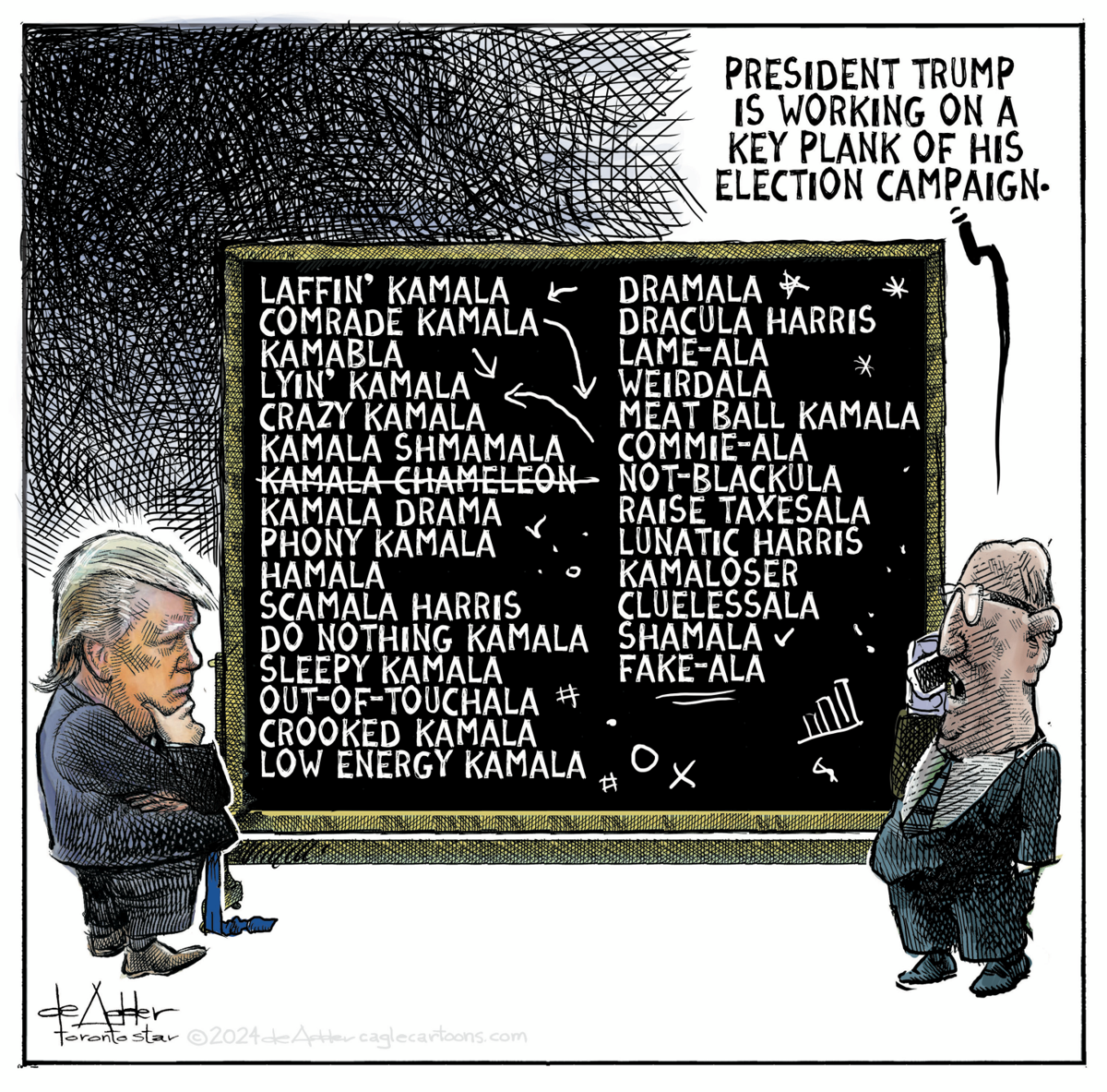
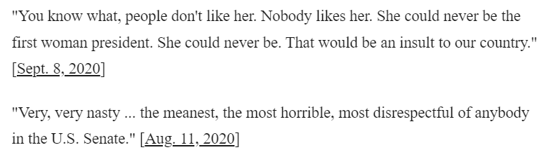
Trump’s posts about kamala Harris

Slide 4
Key themes from Trump’s address – jan. 19th 2025
Rebuild America
Rebuild the American Dream
Closing borders to Mexico
More fossil fuel
Launch Project Stargate (AI)
Wants to stop the wars
Wants Panama Canal back
Only two genders: male & female
Education system will change
Employees in the public sector will work full time and no work at home
Deportation of illegal immigrants
Higher taxes on impor
Leave the Paris Agreement
Leave WHO (World Health Organization)
Create a colony on Mars

Slide 5
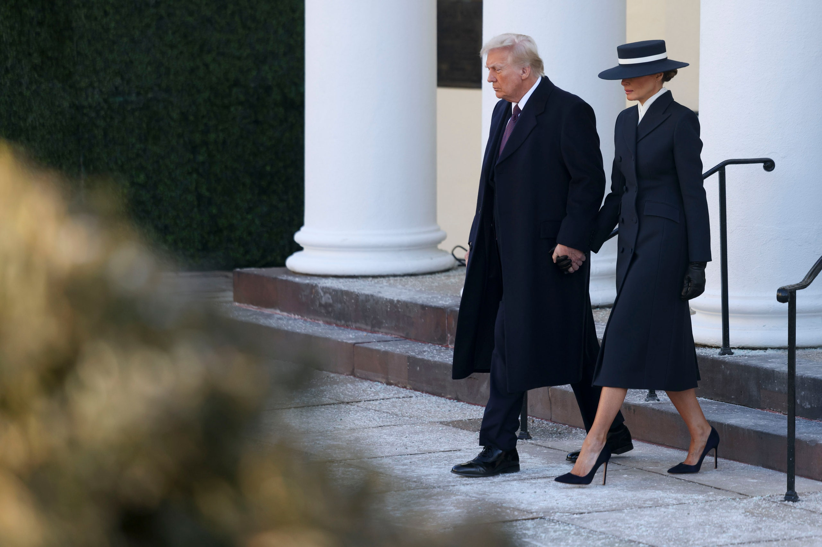

Slide 6
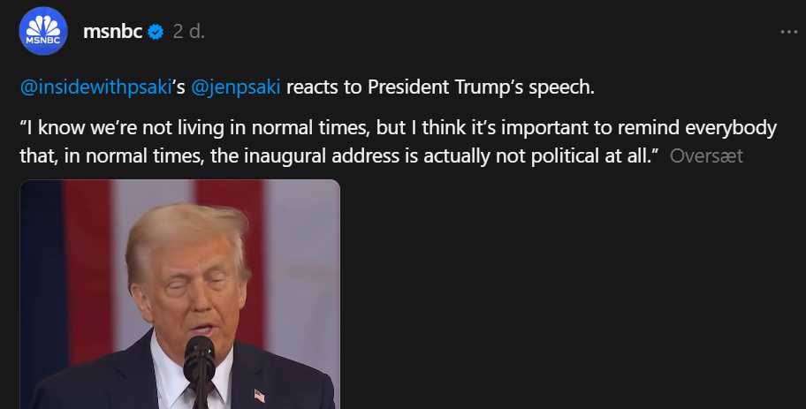

Slide 7
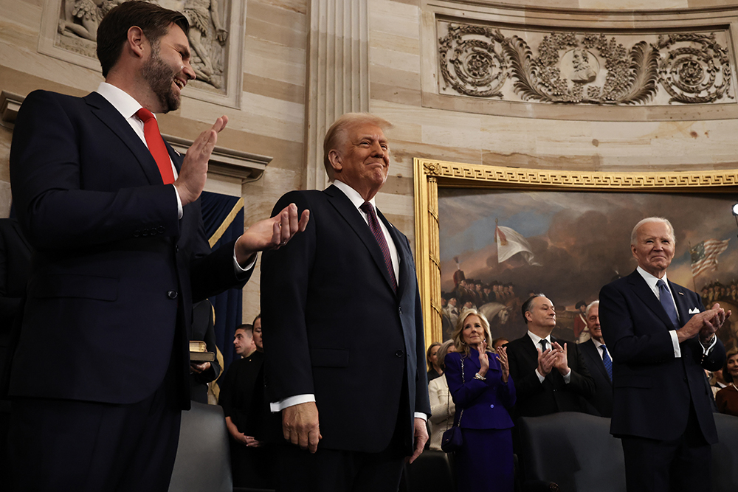

Slide 8
