Slide 1
The Election
How to run for President of the United States

Slide 2
The early stages
In order to run for US president there are only there basic requirements
The person must be a ”natural born citizen”
The person must be at least 35 years old
The person must have been a resident in the United States for the last 14 years

Slide 3
The early stages
A politician with presidential ambition usually forms an exploratory committee to test the waters and raise money.
This can begin up to two years before the election.
In the last 70 years, major party presidential nominee has been either a sitting or former US senator, governor, vice-president or five-star general
Trump is the exception!

Slide 4
The nomination fight
After declaring, the candidates begin trying to win their party’s nomination for the presidency.
Typically - but not always - they spend the next several months campaigning heavily in the early primary and caucus states of Iowa, New Hampshire and South Carolina.
Those states hold the first contests of the campaign in the January before the election, and good performances there can make ar break a candidacy

Slide 5
The Convention
The national party conventions are held in the late summer about two and a half months before the election.
There, the parties formally nominate the candidates chosen by party voters in the state primaries and caucuses.
Before or at the convention, the nominee picks a running-mate, sometimes from among the defeated rivals.
Because the nominee is almost always known before the start of the convention, the conventions are mostly geared toward promoting and celebrating the nominee and laying out the party’s message and agenda.

Slide 6
The final lap
After the conventions, the candidates fully square up against each other on the campaign trail, over the airwaves and in widely viewed debates.
Each spends millions of dollars on advertising and a major flurry of state-by-state campaigning.
In the final weeks, the contenders typically concentrate their attention on big so-called “battleground” states, where the electorate is more or less evenly divided and hence the outcome is uncertain.
Hordes of campaign volunteers and paid staif converge on the key states, where they work the telephones and go door to door to try and persuade voters to go to the polls to support their candidate.

Slide 7
The election
American presidential elections are always held on the flrst Tuesday after the first Monday in November.
Voters do not, technically, participate in the direct election of the president.
They choose “electors”, who are pledged to one or another candidate, in a process known as the US electoral college.
Each state has a certain number of electors to the college, based on the size of its population.
In almost every state, the winner of the popular vote gets all the eiectoral college votes in that state.
Because of this system, a candidate can take the White House without winning the popular vote, such as in the 2016 contest between Hillary Clinton and Donald Trump.

Slide 8
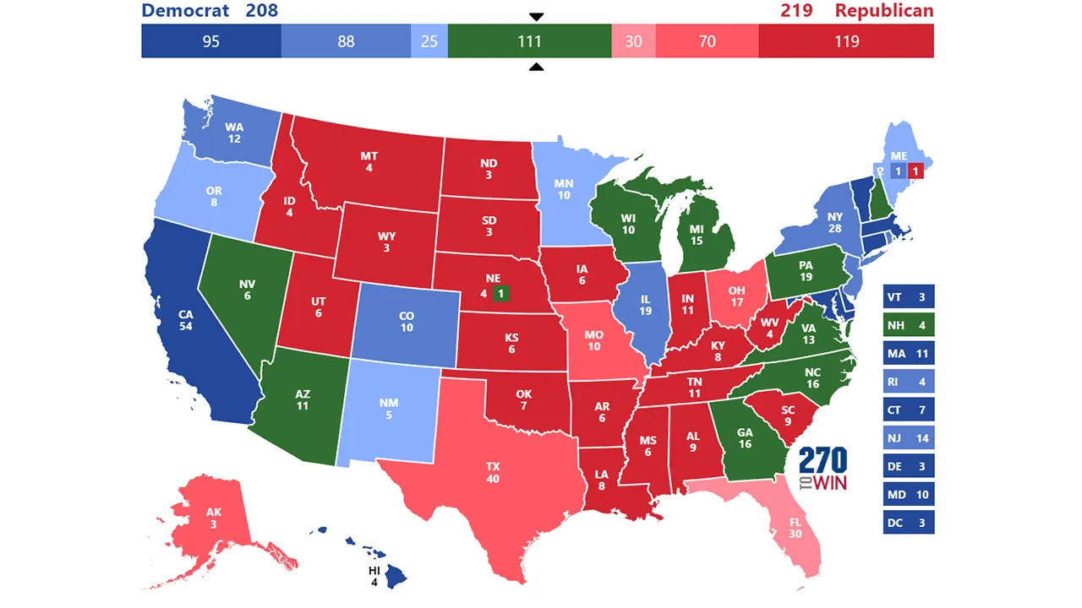

Slide 9
The inauguration
In the days and weeks after the election the winner will assemble a cabinet and begin crafting a more thorough policy agenda.
The sitting president now becomes a so-called ”lame duck” president
Under the US constitution, the president is inaugurated in January of the year following the election.

Slide 10
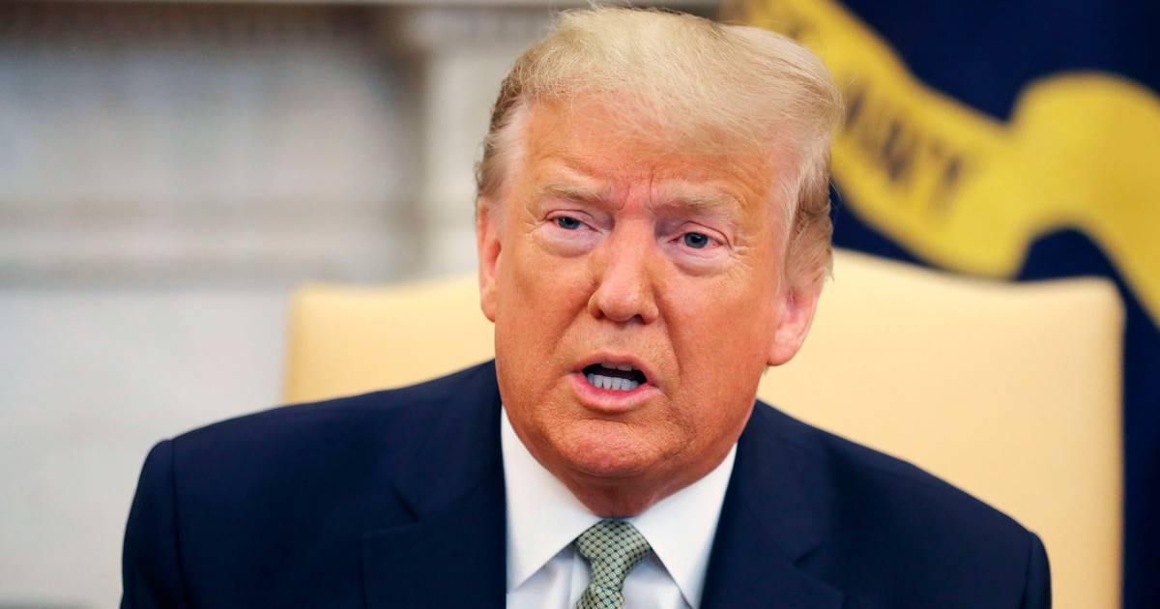
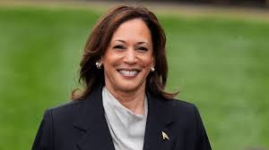
You win!

Slide 11
Congratulations!
For your efforts, you become a virtual prisoner in the White House, unable even to walk across the street without a contingent of Secret Service agents and a crowd of aides.
You will have to endure 24-hour scrutiny and cnticism of your every word and action, while working 12 hour days
But you will have the chance to put your personal stamp on a country of 333 million people and indeed on the entire world.

