Slide 1
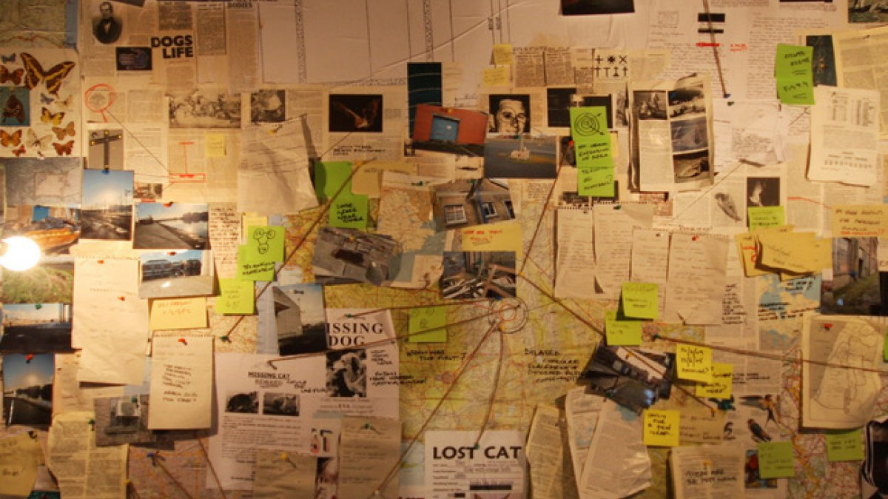
Conspiracy theories

Slide 2
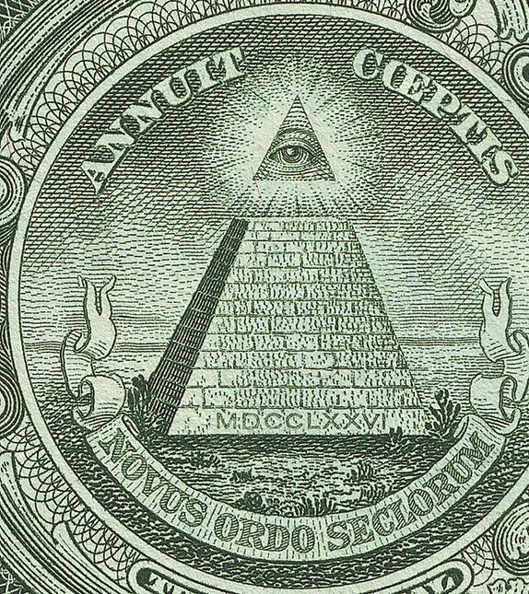
Conspiracy theory
A conspiracy theory is a belief that a secret group is controlling events behind the scenes.

Slide 3
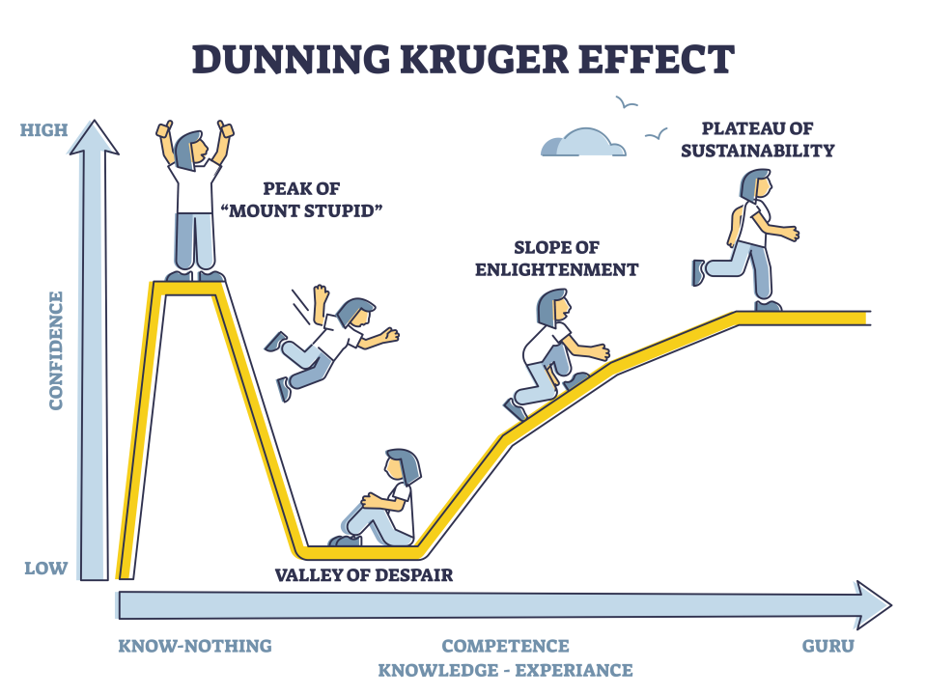
The Dunning-Kruger effect
This is when people with little knowledge think they understand something better than experts.

Slide 4
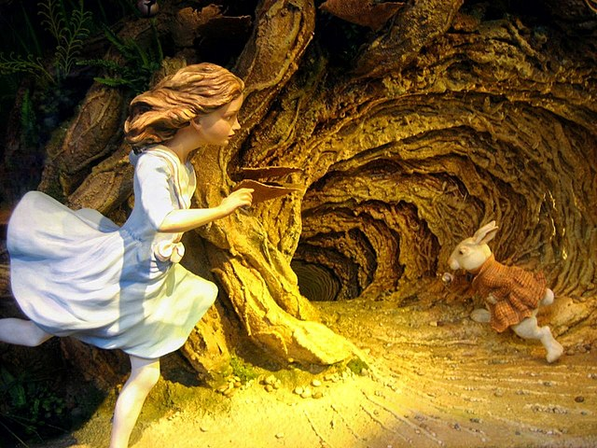
Rabbit holes
A rabbit hole is when someone falls deeper and deeper into a conspiracy theory, often through the internet.

Slide 5
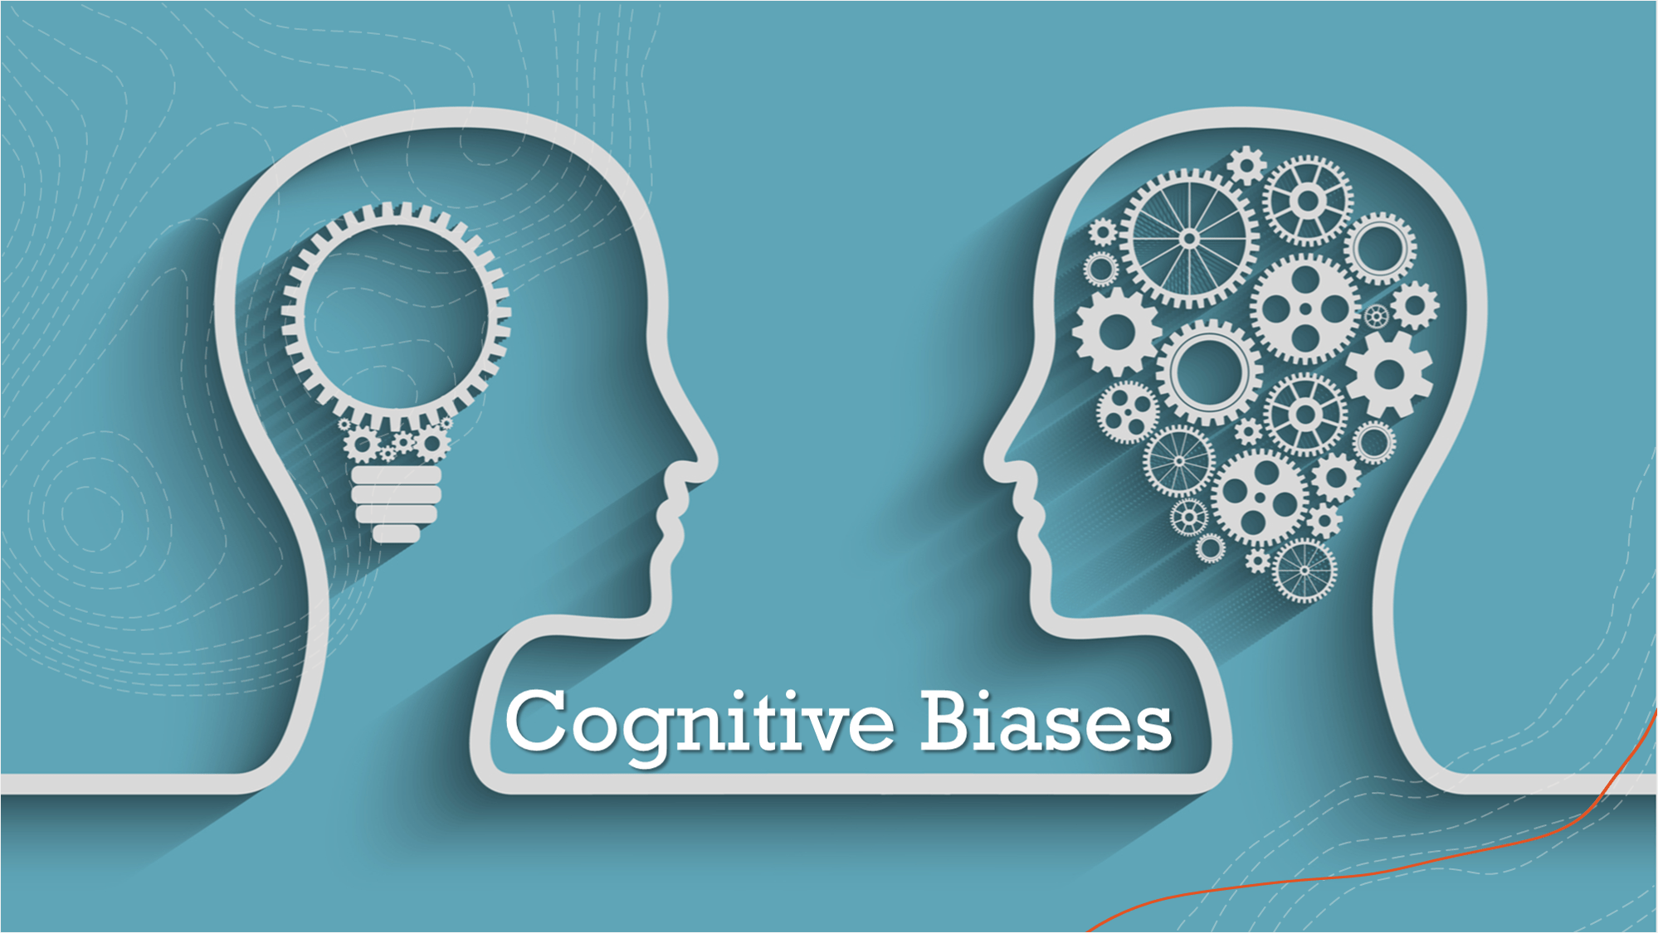

Slide 6
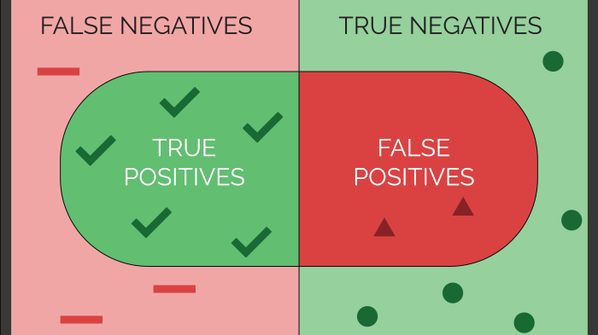

Slide 7
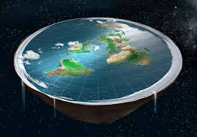
Debunking
Using science / evidence
Example: Flat Earth
Some people still believe it
They feel the truth is part of the cover-up

Slide 8
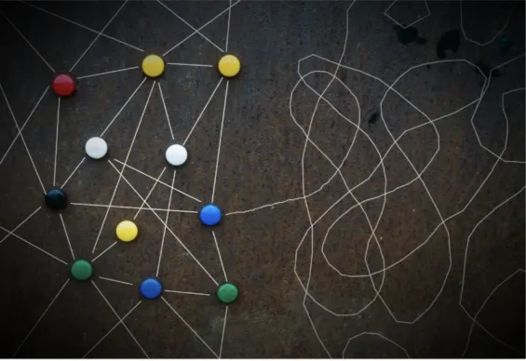
The idea of “connecting the dots”
“Connecting the dots”
Looks for secret patterns
Example: A celebrity dies → then a new law → people think it’s connected
Feels like solving a mystery
Makes people feel smart or special: “I see what others don’t”

Slide 9
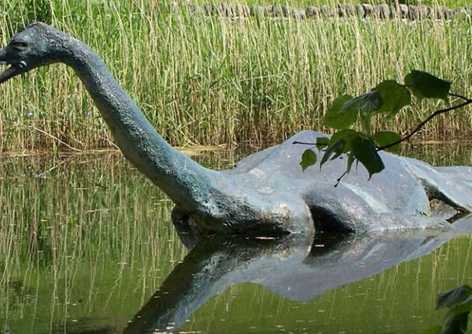
The idea of “overcoming the monster”
A common story idea: hero vs. big evil force
“Monster” = government, rich elites, secret groups
Conspiracy believers see themselves as the hero
They think they are fighting lies and control
Gives them purpose – especially if they feel powerless

