Slide 1
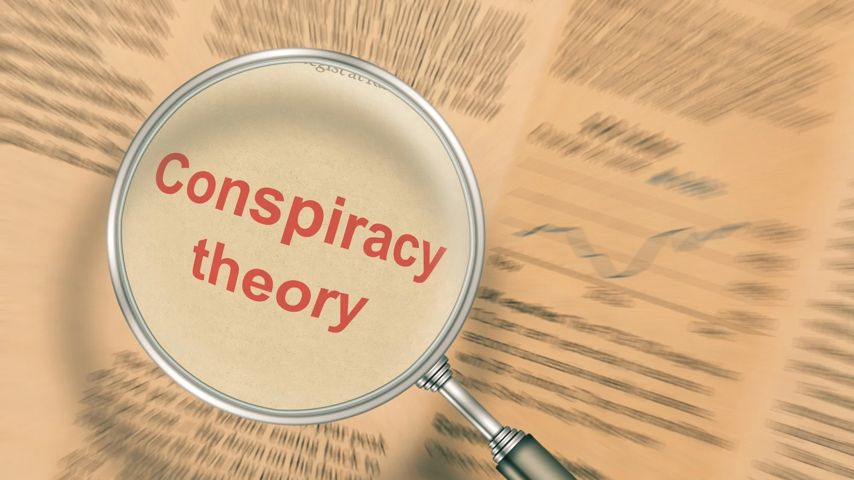
Conspiracy Theories

Slide 2
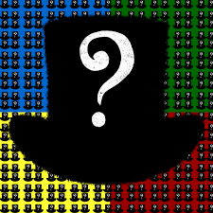
Conspiracy theory
A conspiracy theory is the belief that powerful groups secretly control events, often as an alternative explanation for major historical or political events—typically without solid evidence.
Famous: Why:
. Moon landing - Need for explainations
911 inside job - Distrust in authority
Flat earthers - Feeling special

Slide 3
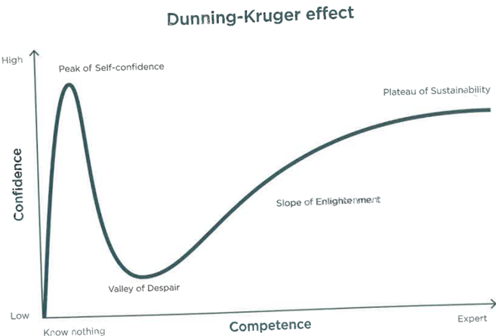
The Dunning-Kruger effect
The Dunning-Kruger effect is a cognitive bias where people with low ability overestimate their competence, while experts tend to underestimate theirs. Described by psychologists Dunning and Kruger in 1999, it explains why beginners often feel overly confident until they realize how much they don’t know (the "valley of despair"). As knowledge deepens, confidence gradually returns.
Conclusion:
If you think you know a lot, you probably don’t.
If you doubt yourself despite experience, you might know more than you think.

Slide 4
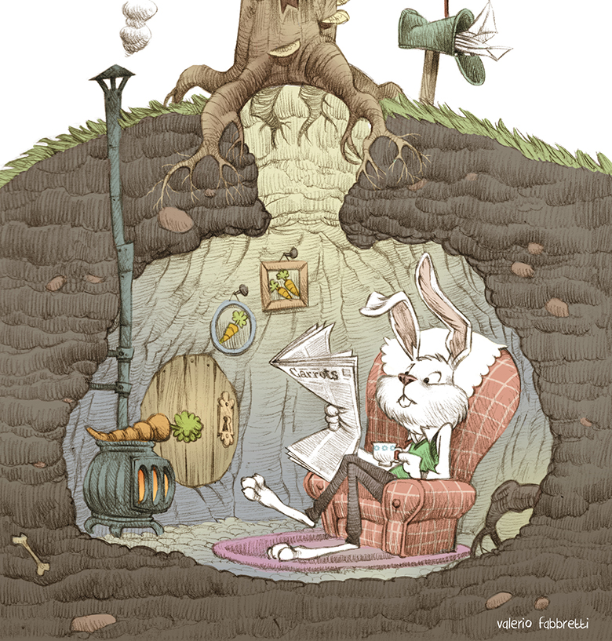
Rabbit holes
Deep dive
Echo
Denial of other ideas

Slide 5
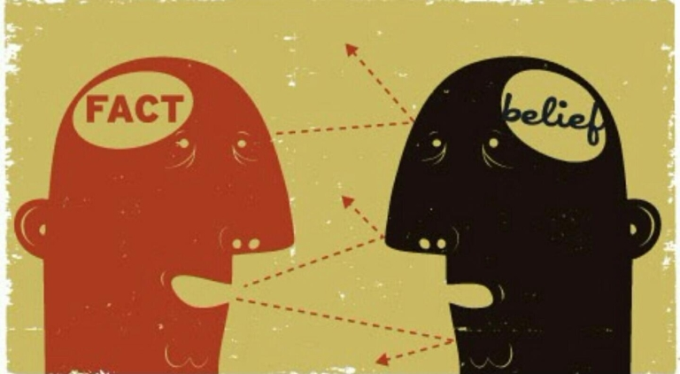
Cognitive bias
Shortcuts
Struggle to change mind

Slide 6
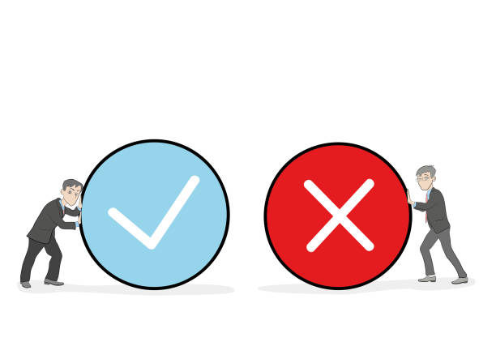
False positives and false negatives
A false positive is running from a noise in the woods, fearing a bear, but there’s nothing there.
A false negative is ignoring a noise—until a bear attacks.
False positives are safer, which is why we often assume the worst to stay protected.

Slide 7
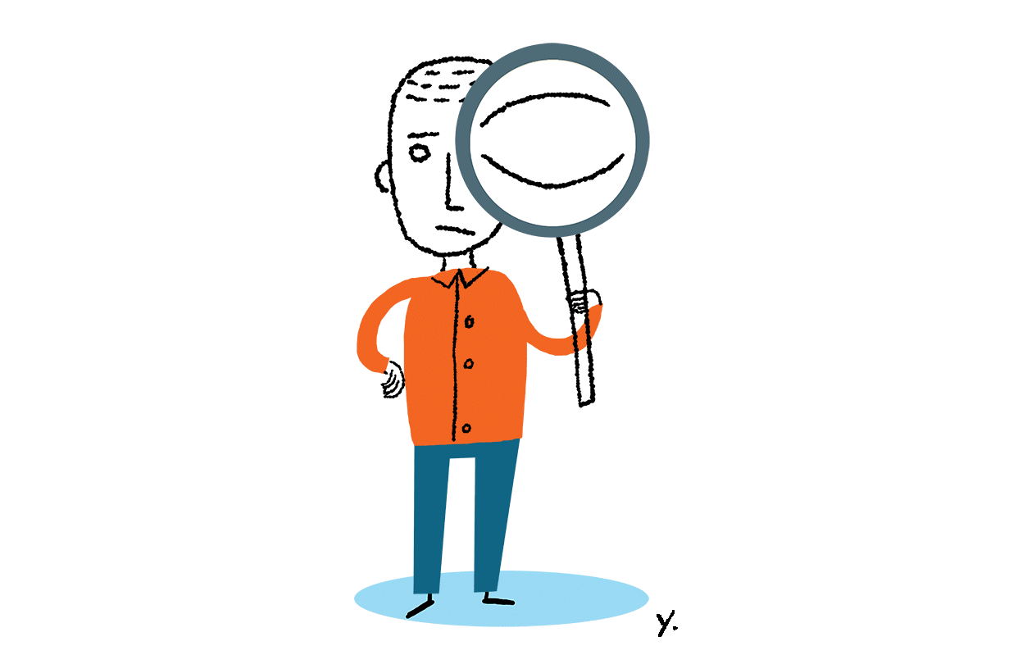
Debunking
Debunking a conspiracy theory means proving it false with facts and logic.
However, some see debunkers as suspicious, since real cover-ups exist. Disproving a theory can make believers more convinced.
Some conspiracies, like The Protocols of the Elders of Zion, persist despite being exposed as frauds. Others, like those about JFK’s murder, the moon landing, and 9/11, have been investigated and answered—just not in ways that satisfy believers.
It's easier to start a conspiracy than to disprove one, and debunking can sometimes backfire.

Slide 8
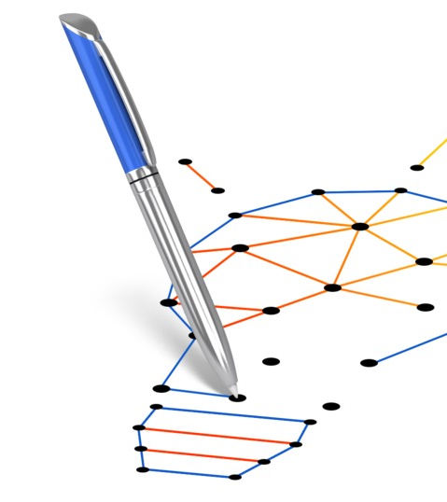
The idea of “connecting the dots”
Humans look for patterns to understand the world, filling in gaps when information is missing.
This can lead to false conclusions if we pick facts selectively.
Conspiracy theories arise this way, linking unrelated facts into false stories.
Awareness of this helps us think critically and avoid biased conclusions.

Slide 9
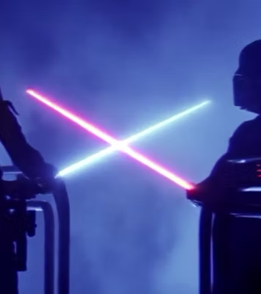
The idea of “overcoming the monster”
A common story where a hero struggles, wins, and gives hope that good defeats evil.
But sometimes, people imagine enemies, turning small problems into big battles.
Understanding this helps us see real vs. made-up problems.

