Slide 1
conspiracy theories
Zaineb, Sarah, Stefan og Kevin

Slide 2
Conspiracy theories
What is a conspiracy theory?
  A conspiracy theory is a belief that certain events or situations are secretly controlled by powerful groups.
Why do people believe in them?
  People believe in conspiracy theories because they offer simple explanations, a sense of control, and a feeling of belonging while reinforcing existing biases and distrust of authority.
How do they spread?
  They spread through social media, word of mouth, pop culture, and during times of fear and uncertainty.

Slide 3
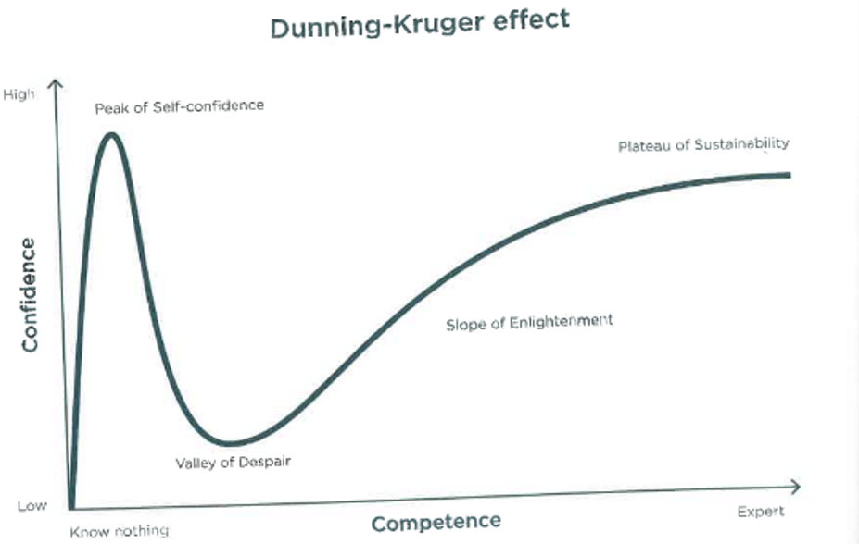
The Dunning-Kruger effect
When people know there limitation of there knowlege it lowers ther confidence.
When people become experts they regain the confidence.
When you know a little you think you know everything.

Slide 4
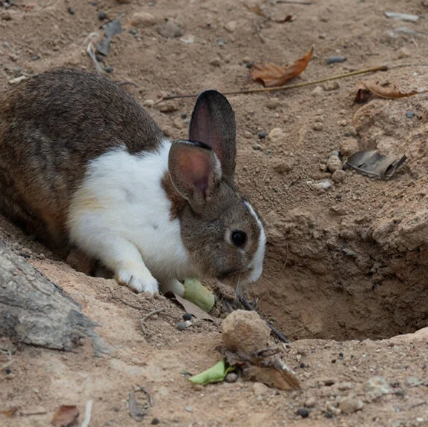
Rabbit holes
Describes falling deeper into online content
People can go from casual questions to extreme beliefs fast

Slide 5
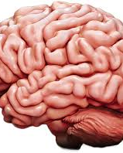
Cognitive bias
Mental shortcuts that distort our thinking
Only noticing info that supports what we already believe
Anchoring, availability bias, and more

Slide 6
False positives and false negatives
False Positive: Thinking something is there when it isn’t.
False Negative: Thinking nothing is there when there actually is something
Example:
False Positive: Hearing a noise, assuming it’s a lion, and running away—but there was no lion.
False Negative: Ignoring the noise, assuming it’s nothing—only to be attacked by a real lion.

Slide 7
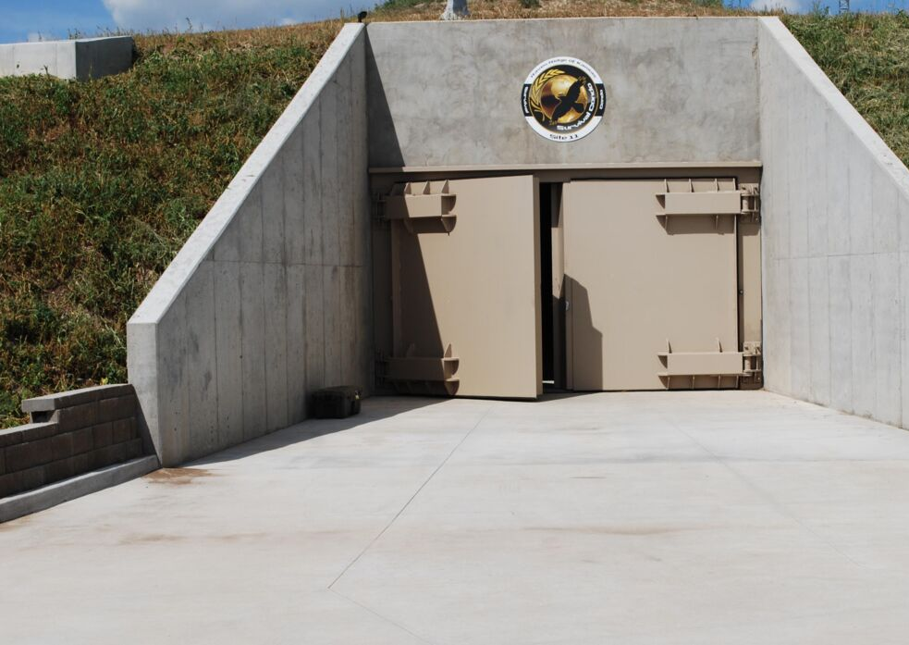
Debunking
Fact-checking and showing the evidence
Important for fighting misinformation
Doesn’t always work—people may double down when challenged

Slide 8
The idea of “connecting the dots”
Disagreement on facts: People argue based on different sets of facts.
Connecting information: We form stories by connecting bits of info.
Incomplete story: We often lack the full picture; conclusions can be wrong.
Cherry-picking facts: Selective facts can lead to different conclusions.

Slide 9
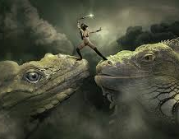
The idea of “overcoming the monster”
Many conspiracies are framed this way
“We’re the heroes” vs. “They (the elites, the media) are the monster”
Makes believers feel powerful and important

