Slide 1
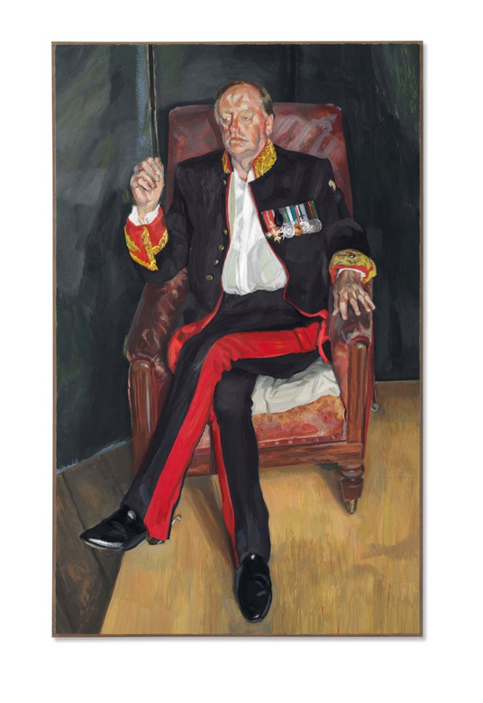
Lucien Freud
The Brigadier
2003/2004

Slide 2
