Slide 1

Punching the Air pages 106-127

Slide 2

How is Amal’s encounter with the juvenile detention center described? (pages 96-106)

Slide 3
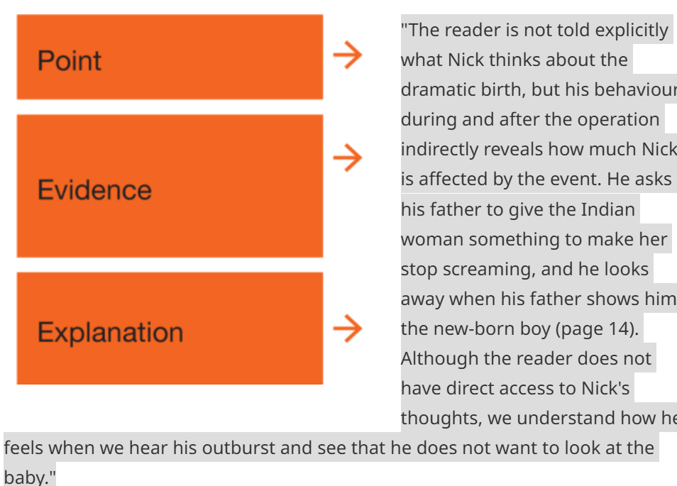
Use the pee structure https://writeon.systime.dk/?id=158

Slide 4
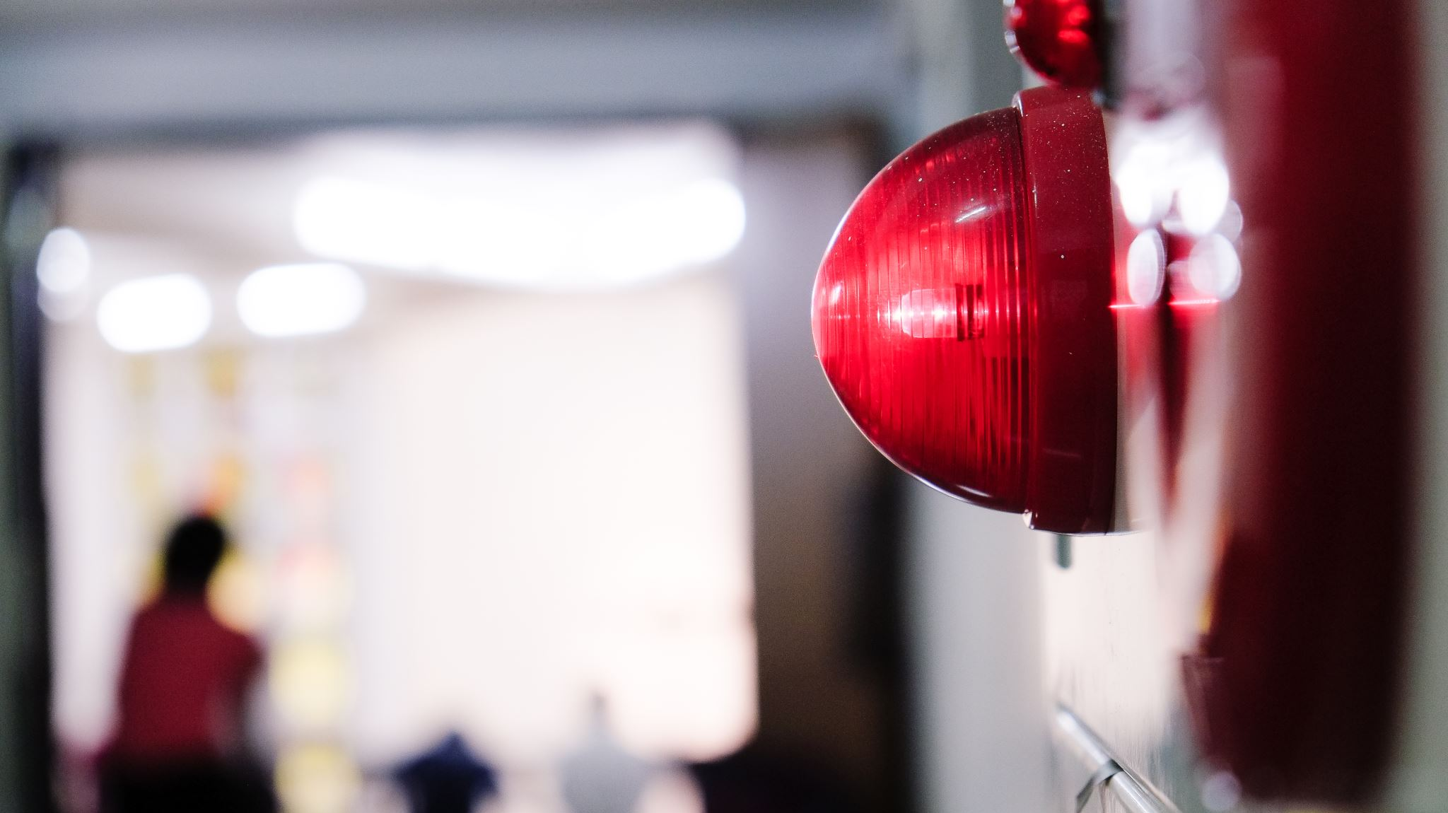
An inside look at life at juvenile detention

Slide 5

How is life in a juvenile detention center described in the video? https://www.theatlantic.com/video/index/555659/inside-juvenile-detention/ 10.41

Slide 6

Read pages 106-127
How would you at this stage characterize our protagonist Amal?
(external, internal, social and personal characteristics)
https://theenglishhandbook.systime.dk/?id=c814.

Slide 7
Antagonist?
Who is the antagonist to Amal?
Antagonist=
a person who strongly opposes somebody/something

Slide 8

Notes to your assigned feature
Take notes to your assigned feature in your groups.

