Slide 1

Analytical essay non-fiction

Slide 2

Analysis of Mamdani’s speech

Slide 3

How to analyze a speech
In the following slides, I will outline how you could analyze a speech. However, I will not disclose which aspects I am going to select for your test.

Slide 4
What characterizes a speech?
A speech belongs to the non-fiction genre and persuasive or expository writing.
It is an oral presentation, often to a group of people, concerning a certain topic.

Slide 5
Aristoteles’ types of speeches
The deliberative speech (the political speech) where the purpose of the speech is to consider political/economical questions and discuss/present future actions. It focuses on convincing the audience to either take action or not take action based on the arguments put forward.
The judicial speech primarily takes place in a courtroom. The focus is on previous actions and its purpose is to decide whether the accused is innocent or guilty. The audience's role is to decide whether the person in question has been rightly or wrongly accused.
The epideictic speech (the ceremonial speech) is often held on specific occasions such as birthdays, weddings, at certain ceremonies etc. Unlike the two other types of speeches, the rhetoric in this type of speech is not to convince the audience but to give praise or criticism, while at the same time it expresses common values and thereby creates engagement and cohesion.

Slide 6
Which type of speeh is Mamdani’s speech?

Slide 7
Introduction
Introducer emnet bredt. | Hand in hand with Trump being elected president back in 2016, the term fake news has been thrown around quite frequently on the American political scene. As a result of this, people have started doubting who you can trust and who you cannot. Therefore, it has become increasingly important to cite sources and to be well documented regarding emotional, political and financial topics.
Nævn titel og forfatternavn. Angiv tema og fokus. | This essay will give an example of exactly this, through a rhetorical analysis of the article "The Trump Administration Says Poverty Is Over. They're Lying", by Bryce Covert, which will focus firstly, on the language and linguistic features of the article, secondly, the use of modes of appeal by the author, and lastly, the argumentation and use of argumentative features which the author uses to get her message across to the reader.

Slide 8
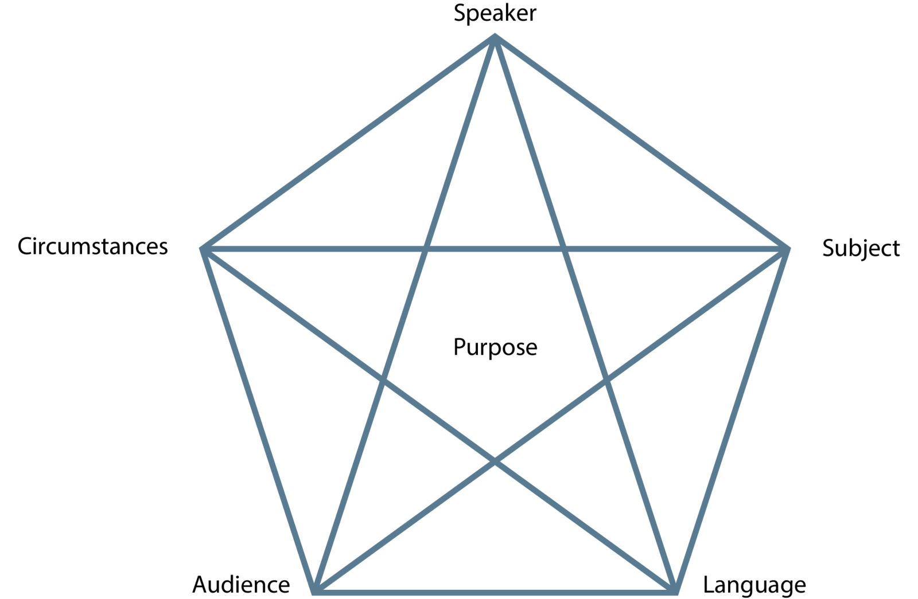
Communication situation
Rhetorical pentagram or The Laswell/Weaver model.

Slide 9
language
https://theenglishhandbook.systime.dk/?id=147#c1330
The connotative and denotative meaning of a word
https://theenglishhandbook.systime.dk/?id=167#c413

Slide 10
Denotation and connotation
Denotation refers to the exact meaning of a word and not the feelings or ideas that the word suggests.
Connotation refers to the idea or feeling a word invokes in a person.

Slide 11
Semantic fields
A semantic field is a group or pattern of words that are connected in a text in the way that they all relate to the same subject – e.g. "hat", "suit", "tie", "moustache" may all be connected to the semantic field of "stereotypical English gentleman". When you map the semantic field(s) of a text, you identify and sort the words in the text that all draw the image of the same theme or subject. https://everyoneishere.systime.dk/?id=162

Slide 12

Linguistic features
(rhetorical devices)

Slide 13

Rhetorical devices
https://worldsofenglish.systime.dk/?id=175&L=0%3Fid%3D175

Slide 14
Questions to consider when working with linguistic features
 | Why has the writer chosen to use various linguistic features? What effect does it have on the reader? Are there any quotations? Is the sentence structure simple or complex?

Slide 15
Argumentative features
https://theenglishhandbook.systime.dk/?id=147#c1332 (Toulmin’s model of argumentation)
01
https://theenglishhandbook.systime.dk/?id=168#c449 (Types of arguments)
02
https://app.minlaering.dk/bog/42/kapitel/66567/sektion/66568 Bias
03

Slide 16
Modes of persuasion
Logos, pathos and ethos.

Slide 17
Intention
What is the writer's intention?
Does he want to inform, persuade or entertain?

Slide 18
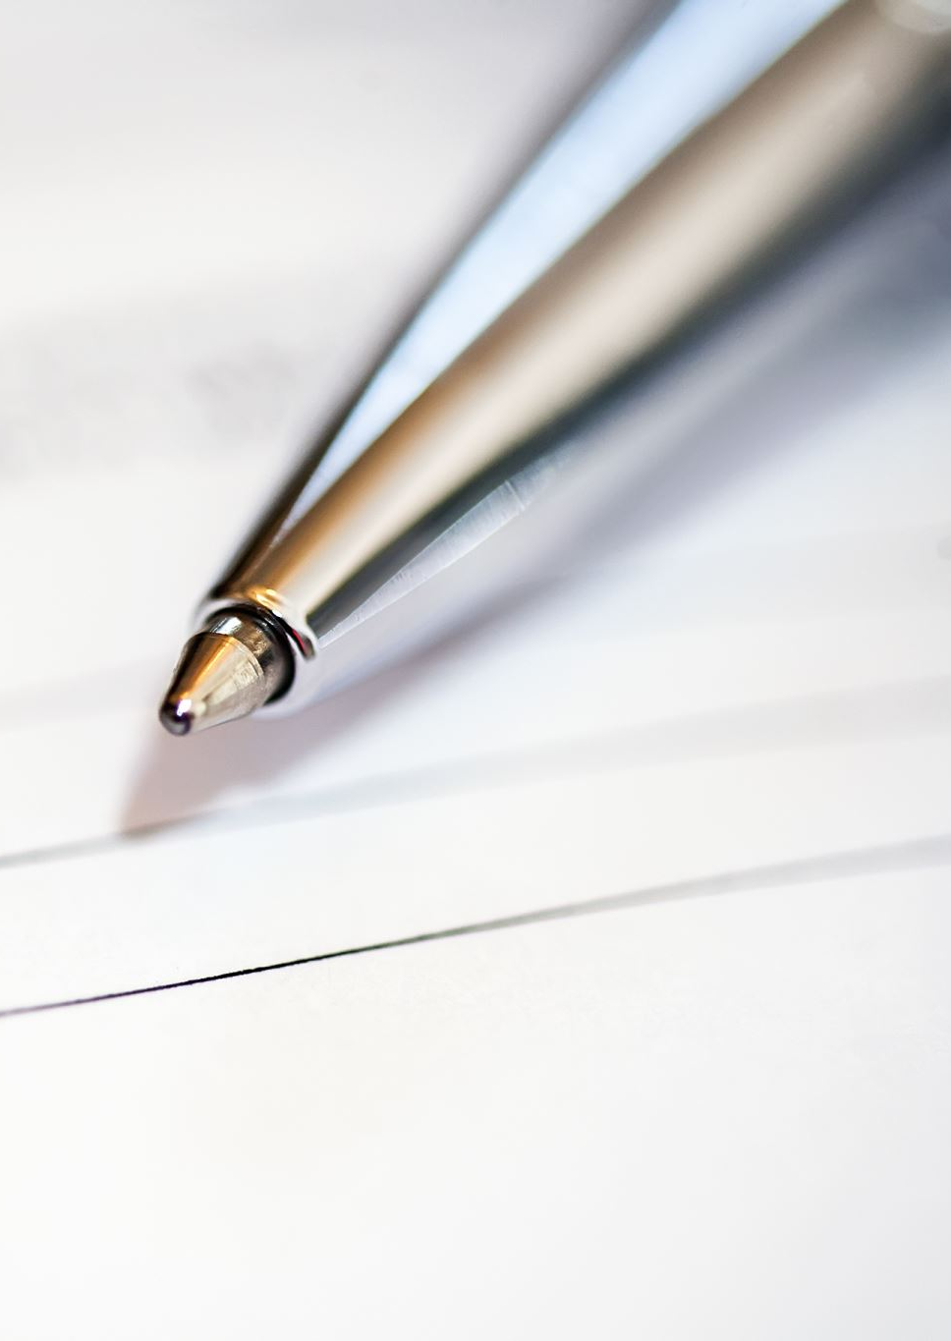
Conclusion
Din analyses afsluttes med en konklusion, hvor du opsummerer de væsentlige punkter fra dit essay.

