Slide 1

Presentation about Zohran Momdani’s victory speech

Slide 2
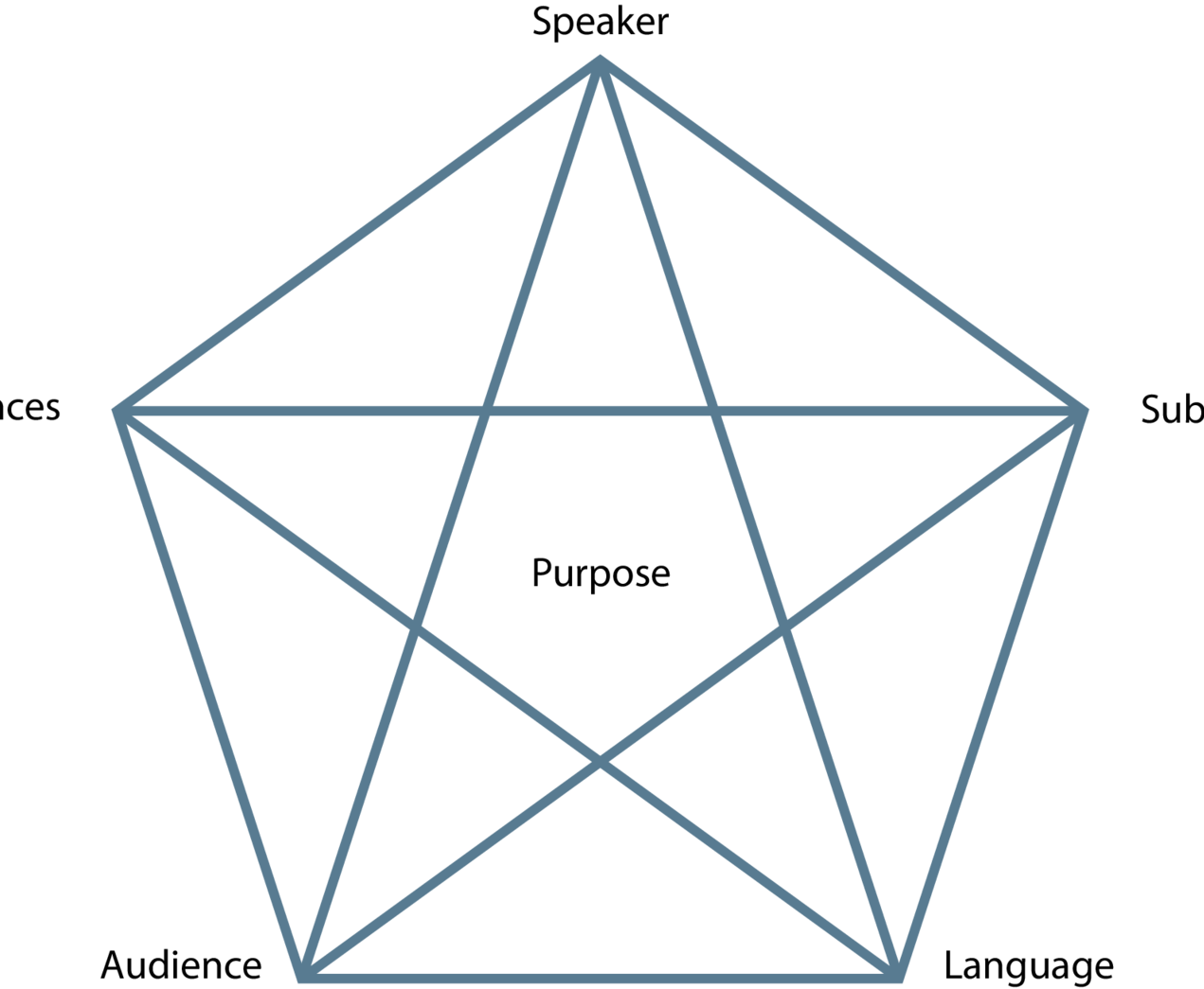
Communication situation
Rhetorical pentagram or The Laswell/Weaver model.

Slide 3
language
https://theenglishhandbook.systime.dk/?id=147#c1330
The connotative and denotative meaning of a word
https://theenglishhandbook.systime.dk/?id=167#c413

Slide 4
Pre-exercise discourse analysis.
https://theenglishhandbook.systime.dk/?id=167#c420

Slide 5
Discourse analysis (could be included in relation to language)
The word discourse comes from the French word discours which means talk or conversation.
A discourse is a certain way to talk about a certain topic. Therefore, in a discourse you have a certain perspective on a certain topic which is reflected by your use of words and concepts in the discourse.
You can, for example, talk about a working-class discourse, a business discourse or a gender discourse.

Slide 6
Purpose with discourse analysis
The main focus of discourse analysis is, therefore, to analyse the discourse used in a text.
This involves looking at the way the text talks about or understands a certain problem, notion, concept or phenomenon.
In other words, discourse analysis will reveal hidden motivations behind a text or a speech

Slide 7
Nodal point
The nodal point of a text is very central as it is the key problem/concept or notion to be analysed.
A nodal point of a text or speech could be democracy. Then, you will have to analyse how the discourse concerning democracy is expressed implicitly in the text or speech.

Slide 8

Chain of equivalence
Words connected to the nodal point are called the chain of equivalence.
It is through the chain of equivalence that value is added to the nodal point. Therefore, the choice of words is very important.
The value of a word is rarely neutral, so it is important for the sender to choose the right words to add the proper meaning and value to the nodal point

Slide 9
Denotation and connotation
Words have a denotative and a connotative meaning.
Denotation refers to the exact meaning of a word and not the feelings or ideas that the word suggests.
Connotation refers to the idea or feeling a word invokes in a person.

Slide 10
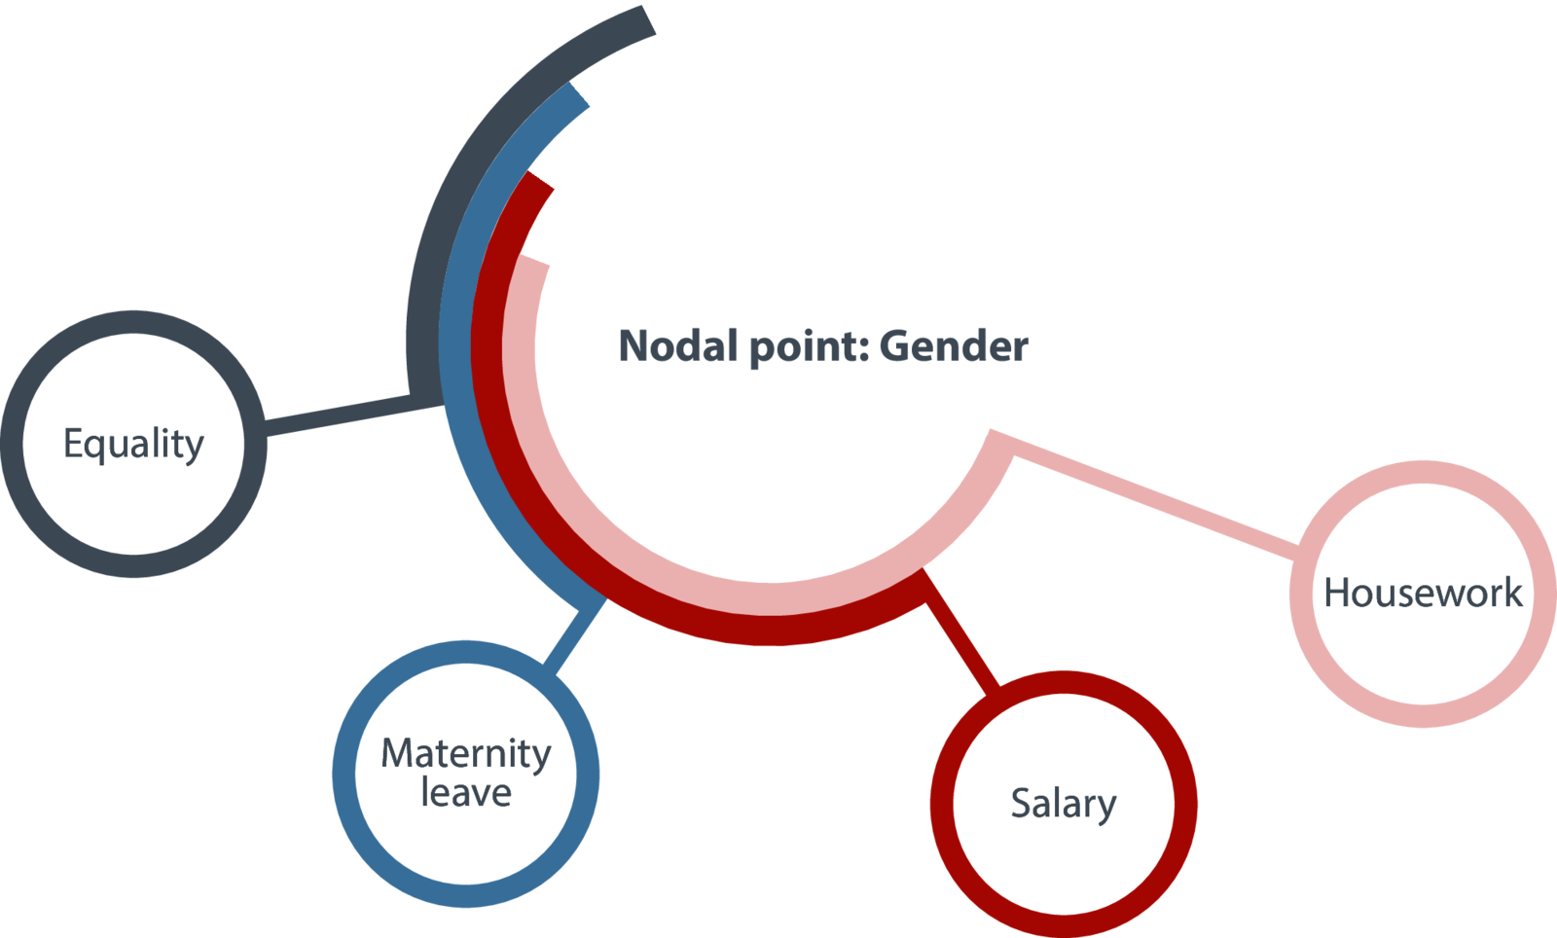

Slide 11

Chain of difference
Some texts may set up nodal points in opposition to each other. Then you talk about a chain of difference. A chain of difference is defined by two opposed chains of equivalence.

Slide 12

Chain of difference
In the immigration debate one chain of equivalence could use words such as positive resource, added cultural dimension where the other chain of equivalence would use words such as burden, criminals, lazy. In this way, the text establishes opposite nodal points where one has positive words and the other negative words. In such a case, you talk about a chain of difference.

Slide 13
Political discourse concerning immigrants
In 2017, Kristina Bakkær Simonsen, a PhD student at The University of Aarhus, published her PhD study of the political discourse concerning immigrants. Her study includes findings from 19 Western European countries. Her conclusion is that the discourse used by politicians influences the immigrants in the country in question. In countries such as Denmark where the dominating political discourse is negative, immigrants and descendants of immigrants have a lower level of political trust and confidence in democracy. Through the negative discourse, immigrants and descendants of immigrants feel alienated and excluded from society.

Slide 14
Your exercise
https://theenglishhandbook.systime.dk/?id=167#c407

Slide 15
Your exercise
1. Find a nodal point in Zohran Momdani’s victory speech.
2. When you have found the words which, you believe, are part of the chain of equivalence, ask yourself the following questions:
  What is the exact meaning of the words in the chain of equivalence?
  Which connotations do the words invoke?
  What effect do the words have?
3. Sum up your findings and draw a conclusion regarding your findings.
4. Did you find any opposing chains of equivalence? When there are two nodal points and two opposing chains of equivalence, you have a chain of difference. Do the same analysis of the chain of difference by asking the same questions and sum up by making a comparison of the two chains of equivalence.

Slide 16

Linguistic features
https://skriftligeksameniengelskhhx.systime.dk/?id=157 (rhetorical devices)

Slide 17
Argumentative features
https://theenglishhandbook.systime.dk/?id=147#c1332 (Toulmin’s model of argumentation)
01
https://theenglishhandbook.systime.dk/?id=168#c449 (Types of arguments)
02
https://app.minlaering.dk/bog/42/kapitel/66567/sektion/66568 Bias
03

Slide 18
Modes of appeal
Logos, pathos and ethos.

Slide 19
Intention
What is the writer's intention?
Does he want to inform, persuade or entertain?

