Slide 1

Analytical essay non-fiction

Slide 2
Introduction
Introducer emnet bredt. | Hand in hand with Trump being elected president back in 2016, the term fake news has been thrown around quite frequently on the American political scene. As a result of this, people have started doubting who you can trust and who you cannot. Therefore, it has become increasingly important to cite sources and to be well documented regarding emotional, political and financial topics.
Nævn titel og forfatternavn. Angiv tema og fokus. | This essay will give an example of exactly this, through a rhetorical analysis of the article "The Trump Administration Says Poverty Is Over. They're Lying", by Bryce Covert, which will focus firstly, on the language and linguistic features of the article, secondly, the use of modes of appeal by the author, and lastly, the argumentation and use of argumentative features which the author uses to get her message across to the reader.

Slide 3
What characterises a speech?
A speech belongs to the non-fiction genre and persuasive or expository writing.
It is an oral presentation, often to a group of people, concerning a certain topic.

Slide 4
Aristoteles’ type of speeches
The deliberative speech (the political speech) where the purpose of the speech is to consider political/economical questions and discuss/present future actions. It focuses on convincing the audience to either take action or not take action based on the arguments put forward.
The judicial speech primarily takes place in a courtroom. The focus is on previous actions and its purpose is to decide whether the accused is innocent or guilty.
The epideictic speech (the ceremonial speech) is often held on specific occasions such as birthdays, weddings, at certain ceremonies etc.

Slide 5
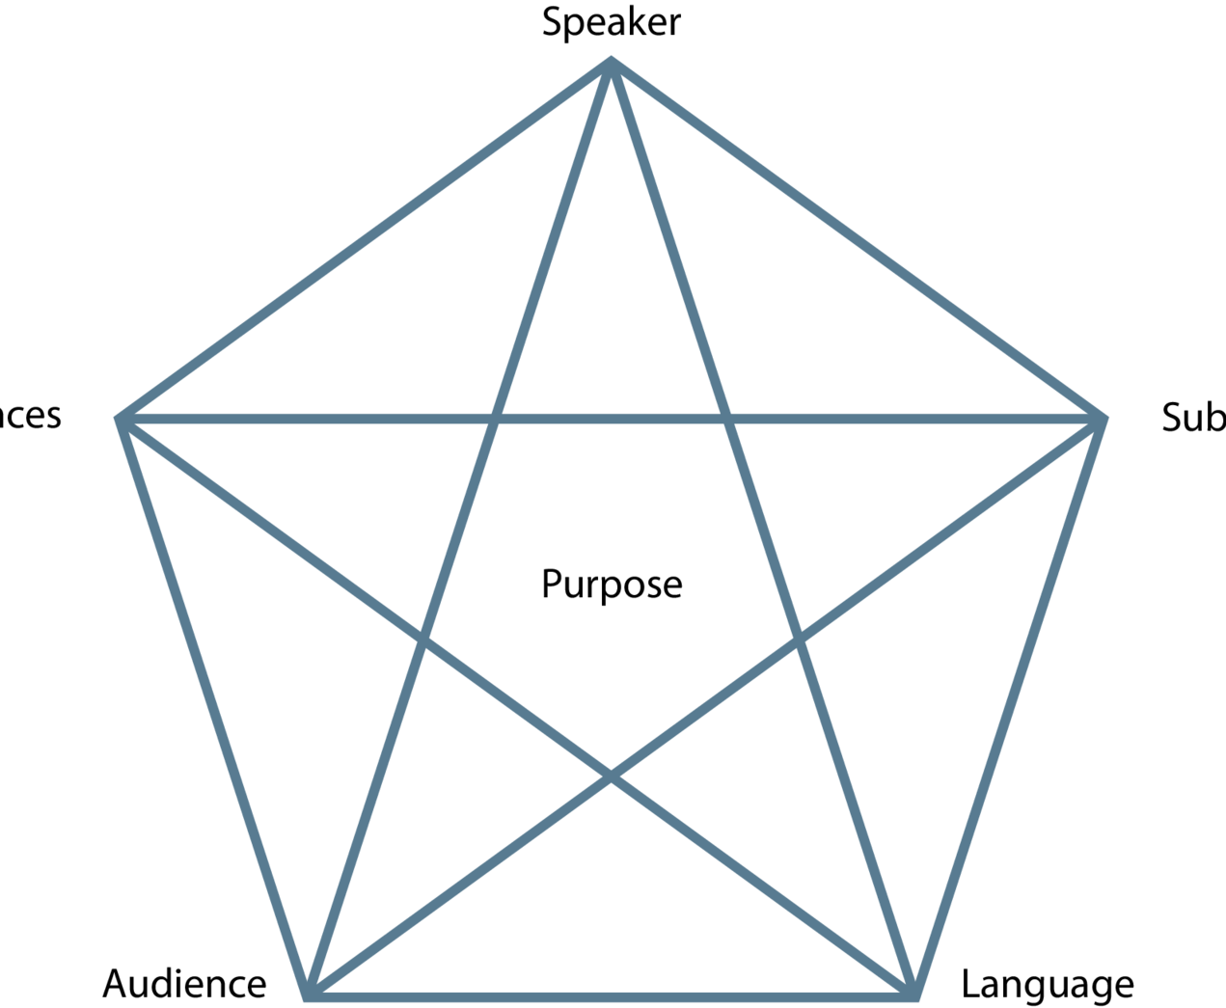
Communication situation
Rhetorical pentagram or The Laswell/Weaver model.

Slide 6
language
https://theenglishhandbook.systime.dk/?id=147#c1330
The connotative and denotative meaning of a word
https://theenglishhandbook.systime.dk/?id=167#c413

Slide 7
Pre-exercise discourse analysis.
https://theenglishhandbook.systime.dk/?id=167#c420

Slide 8
Discourse analysis (could be included in relation to language)
The word discourse comes from the French word discours which means talk or conversation.
A discourse is a certain way to talk about a certain topic. Therefore, in a discourse you have a certain perspective on a certain topic which is reflected by your use of words and concepts in the discourse.
You can, for example, talk about a working-class discourse, a business discourse or a gender discourse.

Slide 9
Purpose with discourse analysis
The main focus of discourse analysis is, therefore, to analyse the discourse used in a text.
This involves looking at the way the text talks about or understands a certain problem, notion, concept or phenomenon.
In other words, discourse analysis will reveal hidden motivations behind a text or a speech

Slide 10
Nodal point
The nodal point of a text is very central as it is the key problem/concept or notion to be analysed.
A nodal point of a text or speech could be democracy. Then, you will have to analyse how the discourse concerning democracy is expressed implicitly in the text or speech.

Slide 11

Chain of equivalence
Words connected to the nodal point are called the chain of equivalence.
It is through the chain of equivalence that value is added to the nodal point. Therefore, the choice of words is very important.
The value of a word is rarely neutral, so it is important for the sender to choose the right words to add the proper meaning and value to the nodal point

Slide 12
Denotation and connotation
Words have a denotative and a connotative meaning.
Denotation refers to the exact meaning of a word and not the feelings or ideas that the word suggests.
Connotation refers to the idea or feeling a word invokes in a person.

Slide 13
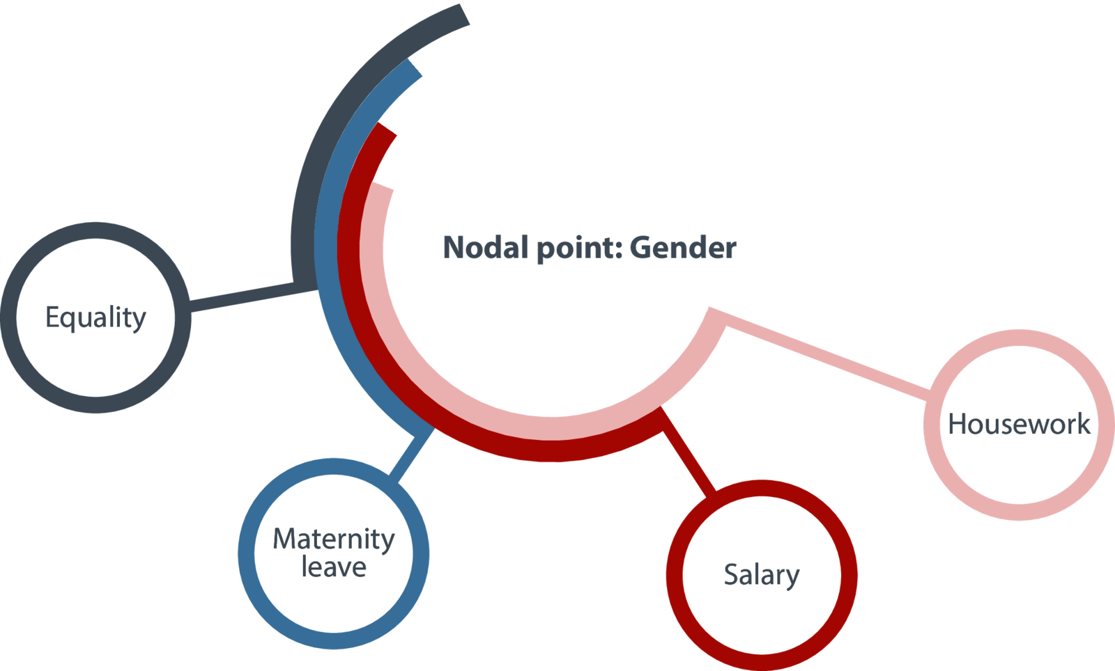

Slide 14

Chain of difference
Some texts may set up nodal points in opposition to each other. Then you talk about a chain of difference. A chain of difference is defined by two opposed chains of equivalence.

Slide 15

Chain of difference
In the immigration debate one chain of equivalence could use words such as positive resource, added cultural dimension where the other chain of equivalence would use words such as burden, criminals, lazy. In this way, the text establishes opposite nodal points where one has positive words and the other negative words. In such a case, you talk about a chain of difference.

Slide 16
Political discourse concerning immigrants
In 2017, Kristina Bakkær Simonsen, a PhD student at The University of Aarhus, published her PhD study of the political discourse concerning immigrants. Her study includes findings from 19 Western European countries. Her conclusion is that the discourse used by politicians influences the immigrants in the country in question. In countries such as Denmark where the dominating political discourse is negative, immigrants and descendants of immigrants have a lower level of political trust and confidence in democracy. Through the negative discourse, immigrants and descendants of immigrants feel alienated and excluded from society.

Slide 17
Your exercise
https://theenglishhandbook.systime.dk/?id=167#c407

Slide 18
Your exercise
1. Find a nodal point in Zohran Mamdani’s speech:
2. When you have found the words which, you believe, are part of the chain of equivalence, ask yourself the following questions:
  What is the exact meaning of the words in the chain of equivalence?
  Which connotations do the words invoke?
  What effect do the words have?
3. Sum up your findings and draw a conclusion regarding your findings.
4. Did you find any opposing chains of equivalence? When there are two nodal points and two opposing chains of equivalence, you have a chain of difference. Do the same analysis of the chain of difference by asking the same questions and sum up by making a comparison of the two chains of equivalence.

Slide 19

Linguistic features
https://skriftligeksameniengelskhhx.systime.dk/?id=157 (rhetorical devices)

Slide 20
Argumentative features
https://theenglishhandbook.systime.dk/?id=147#c1332 (Toulmin’s model of argumentation)
01
https://theenglishhandbook.systime.dk/?id=168#c449 (Types of arguments)
02
https://app.minlaering.dk/bog/42/kapitel/66567/sektion/66568 Bias
03

Slide 21
Modes of appeal
Logos, pathos and ethos.

Slide 22
Intention
What is the writer's intention?
Does he want to inform, persuade or entertain?

Slide 23

Conclusion
Din analyses afsluttes med en konklusion, hvor du opsummerer de væsentlige punkter fra dit essay.

Slide 24
Please take notes in the schedule below:
https://skriftligeksameniengelskhhx.systime.dk/?id=157

Slide 25
Remember that you are supposed to write a five-paragraph essay.

