Slide 1

Email

Slide 2
The structure of an email
1. Header
2. Opening greeting
3. Body text
4. Closing greeting
5. Contact information

Slide 3

The Header
To: [Receiver's email]
From: [Sender's email]
Date: [Date]
Subject: [Topic]

Slide 4

Dates
In British English, the date is written as Day-Month-Year (14 March 2019 or 24 October 2019).
In American English, the date is written as Month-Day-Year (January 21, 2016).

Slide 5
Opening greeting
You know the receiver's name/sex | Dear Mr (surname), → Man, regardless of marital status Ms (surname), → Woman, both married and unmarried
You know the receiver's name/sex/civil status | Dear Mr (surname), → Man, regardless of marital status Mrs (surname), → Woman, married Miss (surname), → Woman, unmarried Ms (surname), → Woman, both married and unmarried. Used if the receiver's civil status should not be expressed in the email.
You do not know the receiver's name | Dear Sirs,/Sir,/Madam,/Sir or Madam, To whom it may concern,

Slide 6
Body text
Body text
If this is this the first email you send to the receiver, it would be a good idea to start the body text of your email by introducing yourself and stating your business.
You should also remember to include all details in your body text and inquire about the information you want the receiver to give you.
Avoid using abbreviations unless you are sure that your receiver is familiar with their meaning.
In an exam situation, you should be aware that there might be specific requirements for the content of your email.

Slide 7
Closing greeting
Closing greeting
Always end your email with a polite greeting, especially if you do not have a close relationship with the receiver.
Remember a comma after the closing greeting.
Examples of closing greetings:
Yours sincerely, Yours faithfully, Best regards, Regards,

Slide 8
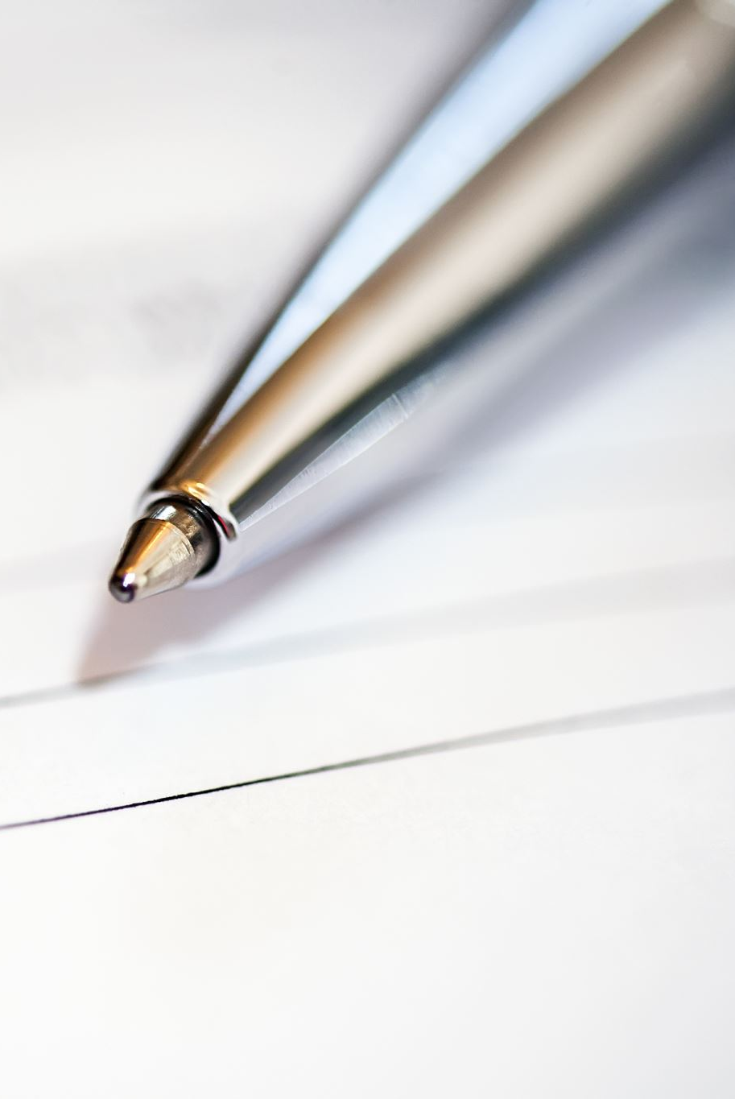
Assignment
You work as a personal assistant for the American ambassador in Denmark and you write to me Maria Seis Flyvholm and ask me whether U/Nord Lyngby would be interested in a lecture from the ambassador about American society.
Try to write the header to this email and the opening as well as the closing.

Slide 9
More information
https://app.minlaering.dk/bog/42/kapitel/56687/sektion/56702

Slide 10
Grammar in the e-mail
– Et adverbium, der lægger sig til et adjektiv
Adverbier lægger sig til:
Verber: He shouted angrily
Adjektiver: The computer is incredibly expensive
Adverbier: My computer warms up extremely quickly
Hele sætninger: Unfortunately, the woman did not turn up for the job interview

Slide 11
Do-omskrivning
Omskrivning med do bruges til at danne nægtende sætninger med not, og i spørgende hovedsætninger samt ved "emfatisk do" til understregning af hovedverbet:
They did not give up. (nægtende sætning, hvor not indgår)
Does he have what it takes (spørgende)
I do appreciate your effort (understregende emfatisk)
https://app.minlaering.dk/bog/1/kapitel/37995/sektion/45367

Slide 12
Et possessivt pronomin
Possessive pronominer er pronominer, der betegner et ejendoms- eller tilhørsforhold, og som bøjes i person, tal og køn. Formen afhænger af, hvor det possessive pronomen er placeret. Enten står de foran et substantiv og udfylder et adjektivs funktion - dvs. de står adjektivisk. Ellers står de alene – i stedet for et substantiv – dvs. de står substantivisk.

Slide 13
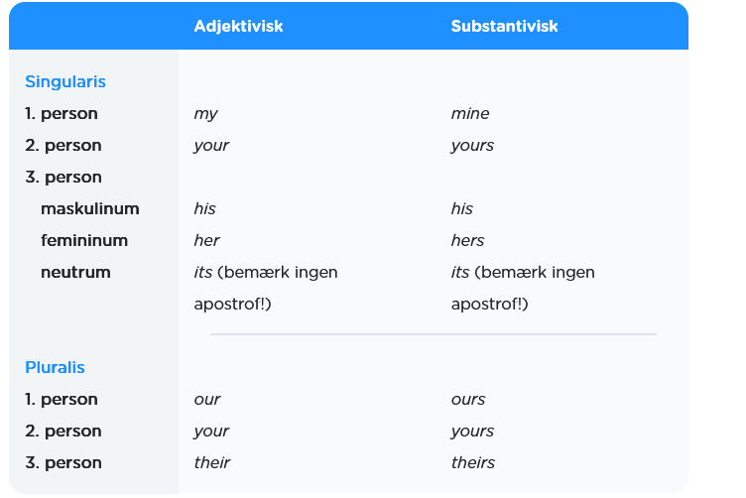
Possessivt pronomin

Slide 14
https://app.minlaering.dk/bog/1/kapitel/48786/sektion/49137

