Slide 1

Written assignment
Manuscript

Slide 2
Instructions Assignment 4A
The Impact of Brexit
You are a student at the University of Bristol. You have been asked to give a speech to a group of international students at the university on issues raised in the UK debate after Brexit.
Write the manuscript for the speech in English and give it an appropriate title.
Word count: 800-1200 words
Your manuscript must include references to the source material.
All applied sources must be documented.
Use the following sources (one text and four video clips):

Slide 3
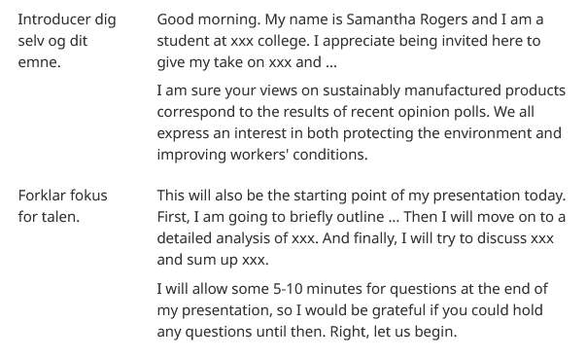
The structure

Slide 4

The body of your manuscript
Behandl emnet punkt for punkt. Følg gerne samme 5-paragraph struktur som i argumentative essay. Det betyder, at du starter hvert afsnit med en topic sentence, dvs. en vigtig pointe, som du forklarer med et eller flere eksempler, eller en påstand, som du underbygger med en forklaring (se → Sådan strukturerer du et argumentative essay og Nyttige vendinger).

Slide 5
The body of your manuscript
Det er vigtigt, at du skaber belæg for dine påstande. Til dette formål kan du fx bruge formuleringer som Experts say that …, According to statistics …, In a recent article in the Economist, I discovered/learned that …, hvor du bruger oplysninger, udsagn osv. fra kildematerialet. Husk at bruge fodnoter, så man tydeligt kan se, hvor du har dine oplysninger fra.

Slide 6
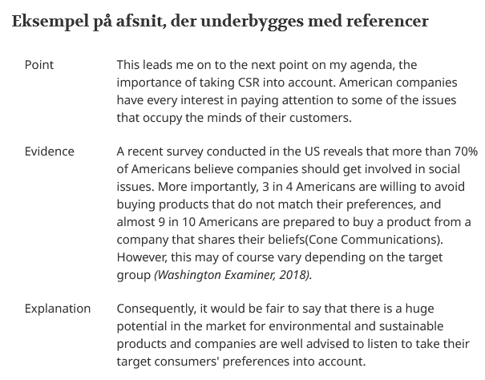
The body of your manuscript

Slide 7
Rhetorical devices
Brug retoriske/sproglige virkemidler til at holde publikums opmærksomhed:
rhetorical questions
Don't we all know the feeling of dissatisfaction over the negative impact of the clothing industry on the environment? Of course we do!),
Anaphora (Beginning two or more sentences with the same word(s):
I have a dream that one day this nation will rise up and live out the true meaning of its creed....
I have a dream that one day on the red hills of Georgia, the sons of former slaves and the sons of former slave owners will be able to sit down together at the table of brotherhood.
kontraster (antithesis when two contrasting words or ideas are put together)
(This is not a good argument; it is in fact a horrible one!).

Slide 8
Task
Identify the rhetorical devices:
"O my love is like a red, red rose“
"the promise of ours ideals and the reality of their time" (B. Obama)
"What is that promise?”
"It's a story that hasn't made me […] But it is a story that has seared …" (B. Obama)

Slide 9
More examples of rhetorical devices
https://skriftligeksameniengelskhhx.systime.dk/index.php?id=159
https://worldsofenglish.systime.dk/?id=175&L=10

Slide 10

Different angles
Husk at behandle emnet fra forskellige vinkler. I har tre kilder I skal benytte til emnet (video, digt og dokumentar).

Slide 11

Conclusion
Rund af med en konklusion. Du trækker en tråd tilbage til indledningen og sammenfatter de væsentligste pointer og argumenter. Vær præcis og kortfattet! Til sidst takker du for publikums opmærksomhed og giver mulighed for at stille spørgsmål.

Slide 12
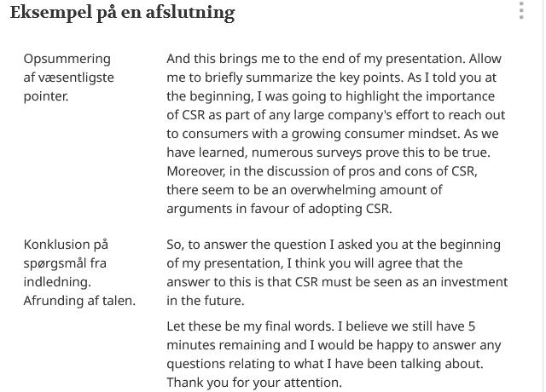
Conclusion

Slide 13

Please take notes to your assignment. You must follow the described structure which is also reflected here:
https://skriftligeksameniengelskhhx.systime.dk/?id=159

Slide 14
Task
Brainstorm with your partner and make an outline of your manuscript. You may find this schedule handy:
https://skriftligeksameniengelskhhx.systime.dk/?id=159
Write your introduction with focus points and present to your teacher for approval.

