Slide 1

Email

Slide 2
The structure of an email
1. Header
2. Opening greeting
3. Body text
4. Closing greeting
5. Contact information

Slide 3
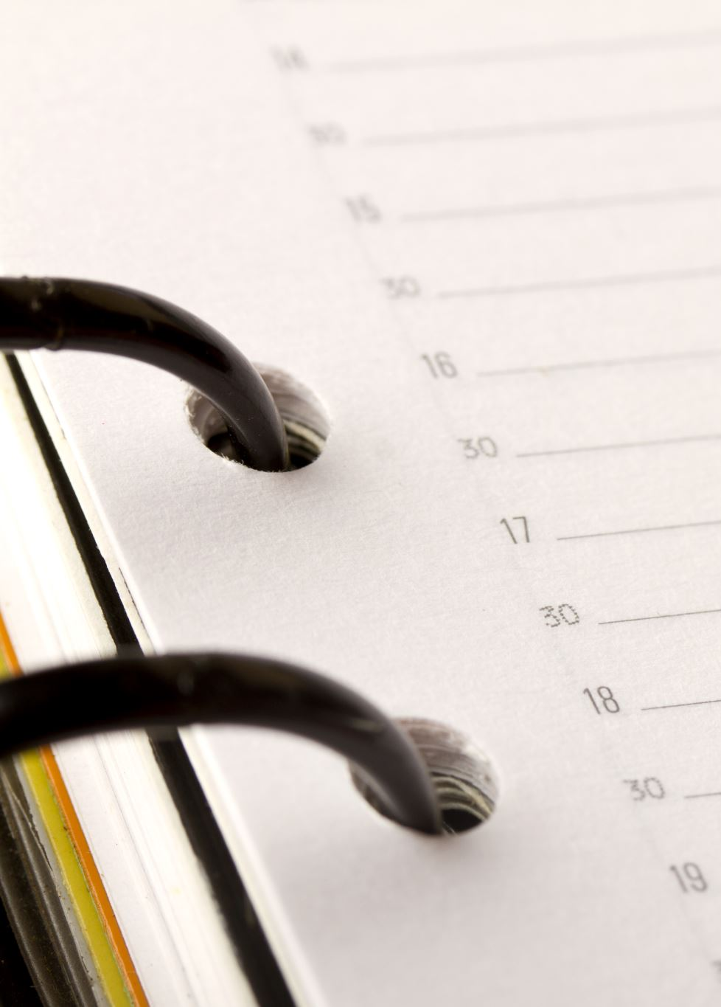
The Header
To: [Receiver's email]
From: [Sender's email]
Date: [Date]
Subject: [Topic]

Slide 4

Dates
In British English, the date is written as Day-Month-Year (14 March 2019 or 24 October 2019).
In American English, the date is written as Month-Day-Year (January 21, 2016).

Slide 5
Opening greeting
You know the receiver's name/sex | Dear Mr (surname), → Man, regardless of marital status Ms (surname), → Woman, both married and unmarried
You know the receiver's name/sex/civil status | Dear Mr (surname), → Man, regardless of marital status Mrs (surname), → Woman, married Miss (surname), → Woman, unmarried Ms (surname), → Woman, both married and unmarried. Used if the receiver's civil status should not be expressed in the email.
You do not know the receiver's name | Dear Sirs,/Sir,/Madam,/Sir or Madam, To whom it may concern,

Slide 6
Body text
Body text
If this is this the first email you send to the receiver, it would be a good idea to start the body text of your email by introducing yourself and stating your business.
You should also remember to include all details in your body text and inquire about the information you want the receiver to give you.
Avoid using abbreviations unless you are sure that your receiver is familiar with their meaning.
In an exam situation, you should be aware that there might be specific requirements for the content of your email.

Slide 7
Closing greeting
Closing greeting
Always end your email with a polite greeting, especially if you do not have a close relationship with the receiver.
Remember a comma after the closing greeting.
Examples of closing greetings:
Yours sincerely, Yours faithfully, Best regards, Regards,

Slide 8
More information
https://app.minlaering.dk/bog/42/kapitel/56687/sektion/56702

Slide 9
Grammar in the e-mail
Adverbialled (se mere i min powerpoint om adverbialled)
Adverbier lægger sig til:
Verber: He shouted angrily
Adjektiver: The computer is incredibly expensive
Adverbier: My computer warms up extremely quickly
Hele sætninger: Unfortunately, the woman did not turn up for the job interview

Slide 10
Relative pronominer
Relative pronominer henviser til substantiver, andre pronominer eller hele forudgående sætninger.
 | We are men who know how to kiss

Slide 11
Relative pronominer
Video relative pronominer
https://app.minlaering.dk/bog/1/kapitel/48786/sektion/49945

Slide 12
Relative pronominer
Who og whom bruges, når der henvises til personer.
She is a woman who is very strong.
Which bruges, når der henvises til ting, begreber og til hele sætninger.
I have a lot of pigs which are ready to be sold
Whose bruges, når der henvises til både mennesker, dyr, ting og begreber, men kun hvis det står som genitiv i sætningen. I spoke to the man whose hat was missing.

Slide 13
Modalverber
https://app.minlaering.dk/bog/1/kapitel/37995/sektion/44789#section-44977
Eksempler på modalverber:
Can
Could
May
Might
Must
Ought to, shall, should, will, would.

