Slide 1
Ananlyse af brug af ing-form på engelsk

Slide 2
Verbets ing-form kan anvendes i mange sammenhænge
1. udvidet tid
2. efter visse verber
3. efter præpositioner
4. Ing-formen fungerer
  a. som adjektiv
  b. som verbalsubstantiv
  c. som præposition

Slide 3
1. Udvidet tid: TO BE + ing-form af et verbum
The sun is shining (igangværende, midlertidig)
I was sleeping when the door bell rang (samtidig med anden handling som afbryder)
We are leaving for France tomorrow (fremtidig plan)
She is always being mum’s nice little girl (følelsesladet, misbilligelse) Ofte med: always, never, constantly, continually)
I’m learning Chinese this autumn (vane, afgrænset periode)
Her feelings were gradually changing (gradvis udvikling)
Notes:
I stood waiting (emfase) vs I was waiting

Slide 4
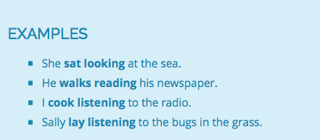
2. Udvidet tid efter verber, der udtrykker bevægelse, handling

Slide 5
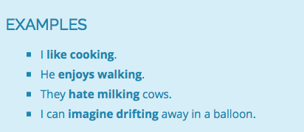
2. En lang række verber følges af en ing-form
Admit, advice, appreciate, avoid, be worth, consider, delay, deny, detest, dislike, endure, enjoy, escape, excuse, give up, fancy, feel like, finish, forbid, imagine, mind, miss, postpone, practise, risk, stop, suggest, understand
OBS: Like/hate + inf/ing-form
Notes:
Ing-formen star som objekt i sætningen

Slide 6
3. Efter præposition skal verbet sættes i –ing-form
Some people are not interested in learning English
He left without saying another word
I look forward to seeing you
Lav selv eksempler med følgende udtryk: to be tired of, to begin by, to be against, to be bad at , to be ashamed of, to be suspected of, to know about, to be shocked about, to be better at
Notes:
Ing-formen fungerer som et substantiv: ex. People are interested in Languages

Slide 7
4. a. Ing-formen fungerer som adjektiv
Foran et substantiv
I read an interesting article in the newspaper today
Efter et copulaverbum (be, look, sound)
Your new book sounds really interesting
Efter et substantiv som en reduceret relativsætning Who is that man standing over there?
Notes:
Copulaverber: be, become, appear, feel, look, remain, seem, sound

Slide 8

Almindelige adjektiver med ing-endelse

Slide 9
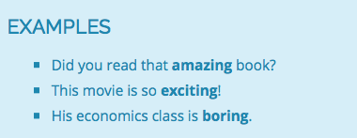
a. Lang tillægsmåde/præsens participium anvendes som adjektiv/tillægsord, der lægger sig til et substantiv

Slide 10
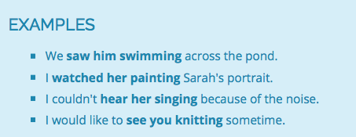
Ing-form som adjektiv anvendes efter sanseverber
see, watch, hear, smell, etc.
Ing-formen beskriver objektet.Her him, her, you
Kan omskrives til en bisætning: We saw that he was swimming

Slide 11
Et substantiv + et verbum i Ing-form giver ekstra information i en sætning og erstatter en relativsætning
The woman wearing a red dress is sitting by the window
I was awaken by wolves howling
Students handing in their essay late will lose ten marks
Indsæt det relative pronomen:
The woman who is wearing a red dress is sitting by the window
I was awoken by wolves which were howling
Students who hand in their essays late will lose ten marks

Slide 12
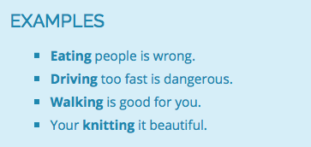
b. Verbets ing-form bruges som verbalsubstantiv og placeres i starten af sætningen
På dansk anvender vi en infinitiv: At spise mennesker er forkert

Slide 13
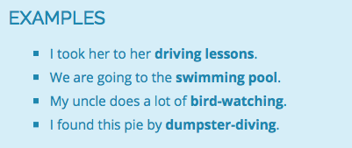
Ing-form i sammensatte substantiver

Slide 14
c. Verbum i ing-form fungerer som præposition
Concerning this matter, I’m not sure what to say
He refused to give any information regarding the man’s whereabouts
Synonym betydning: about, as to, on the subject of, respecting, in the matter of, as regards, with reference to, apropos

