Slide 1
Please prepare a presentation of the ”Return”
Use the following slides as well as the following links for your preparations:
https://widercontexts.systime.dk/?id=250
https://theenglishhandbook.systime.dk/?id=148
https://app.minlaering.dk/bog/42/kapitel/66483/sektion/66486

Slide 2

Analysis of fiction

Slide 3
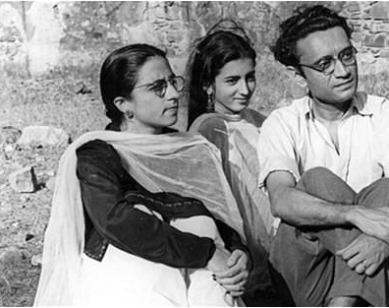
Biopic: Nandita Das: Manto (2018)
https://www.youtube.com/watch?v=FYmnoTXBIrE

Slide 4
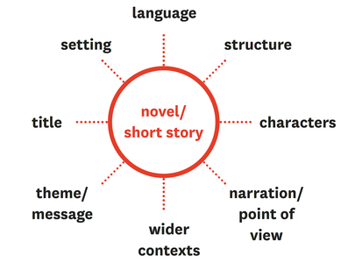

Slide 5
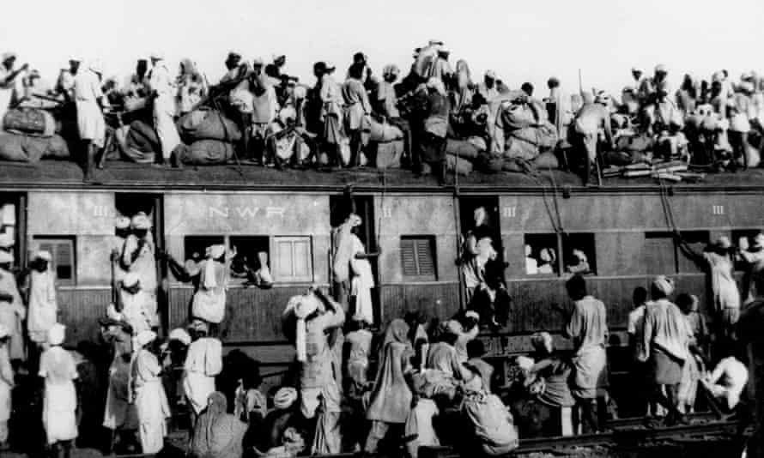

Slide 6
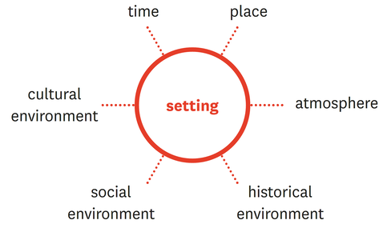
Setting
Does the setting create a particular atmosphere?
Does the setting reflect a character’s mood or underline emotions?
Does the setting comment on the character in an indirect way?
Has the setting shaped the character and his/her values?
Does the setting have symbolic significance in the text?

Slide 7
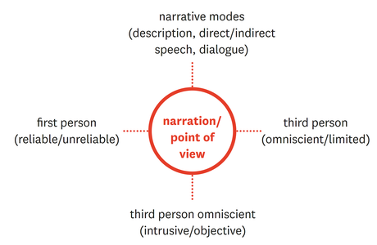
narration/point of view
Does the narrative voice reflect the narrator’s personality?

Slide 8
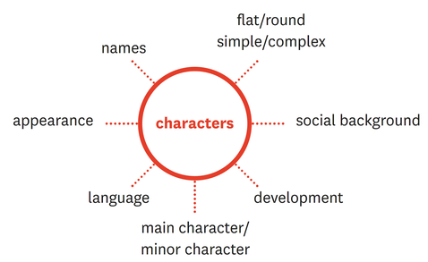
Characters
Who are the characters, and what do we learn about them? (Age, appearance, family situation, background, education, job, language, thoughts, opinions)
Are all characters introduced at once, or do they appear gradually?
Who is the main character? Why do you consider him/her the main character?
Do the characters’ personalities remain the same throughout the story or do they develop?

Slide 9
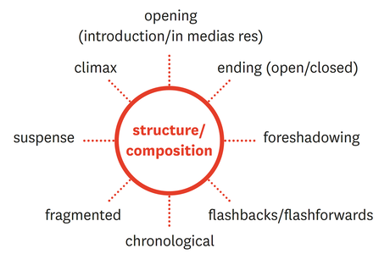
Structure and composition
How does the writer capture the reader’s interest?
The ending:
Does the ending provide some kind of resolution?
Is it an open and ambiguous ending?
Is the ending predictable/unpredictable, expected/unexpected?
What is the effect of the ending on the reader: surprise, astonishment, relief, fulfilment?
Composition:
What is the initial situation, the development, and the final situation? Will there be any future development?
Is there a conflict in the story? If yes, does it come from outside or inside?
What is the relationship between characters and events? Is the protagonist controlled by events or does the protagonist shape events?

Slide 10
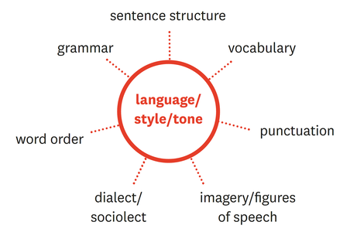
Language/tone/style
Is the sentence structure long or short, simple or complex, paratactic or hypotactic? Are the sentences incomplete?
Is the vocabulary concrete or abstract, colloquial, formal or neutral? Is a particular word class predominant in the text? Is there a use of or a lack of adjectives and adverbs? Are specific words or phrases repeated?
Is there anything characteristic about the punctuation or the word order?
Does the language belong to a certain dialect or sociolect?
Are there connotations? Positive or negative?
Sound effects: are there examples of alliteration or assonance?
Are there examples of the use of imagery, symbolism, metaphors, simile or personification?
What is characteristic of the general tone? Is it positive, negative, neutral, happy, depressed, optimistic, ironic …?

Slide 11
Title
What is the link between the title, the characters and the course of events?
Does the title create expectations about the text? Arouse curiosity? Suggest an interpretation?

Slide 12
Theme
What subject(s) does the text fundamentally deal with, or what is the main idea of the text?
Is there more than one theme? If so, what are they?
Which elements in the story support the theme? Are there elements which oppose the theme?
Is it an overt or an implied theme?

Slide 13
Message
What has the writer tried to tell the reader through the text?
Does the writer intend to entertain, educate or influence the reader?

Slide 14
Wider contexts
Relate the text to other texts on the same or a similar theme. What are the similarities and differences? Which do you prefer and why? What is conveyed or achieved by the comparison?
In what way does the text reflect the period in which it was written?

Slide 15
Wider contexts: Gender critisism
The focus of gender critisism is to examine the presence and agency of the ones who have historically been neclected.
How are men and women portrayed?
Are there stereotypical portrayals of gender in the text?
3. Is the author able to portray the female experience?

Slide 16
Historical critisism
Historical critisism examines the society and time in which the text was written and it can also include the author’s life and ideological views.
What was society like in the place and at the time in which it was written?
How does the text reflect the attitudes and beliefs?
How would characters and events have been viewed by the writer’s contemporaries?
How important is the historical context to interpreting the work?

