Slide 1

The Return

Slide 2
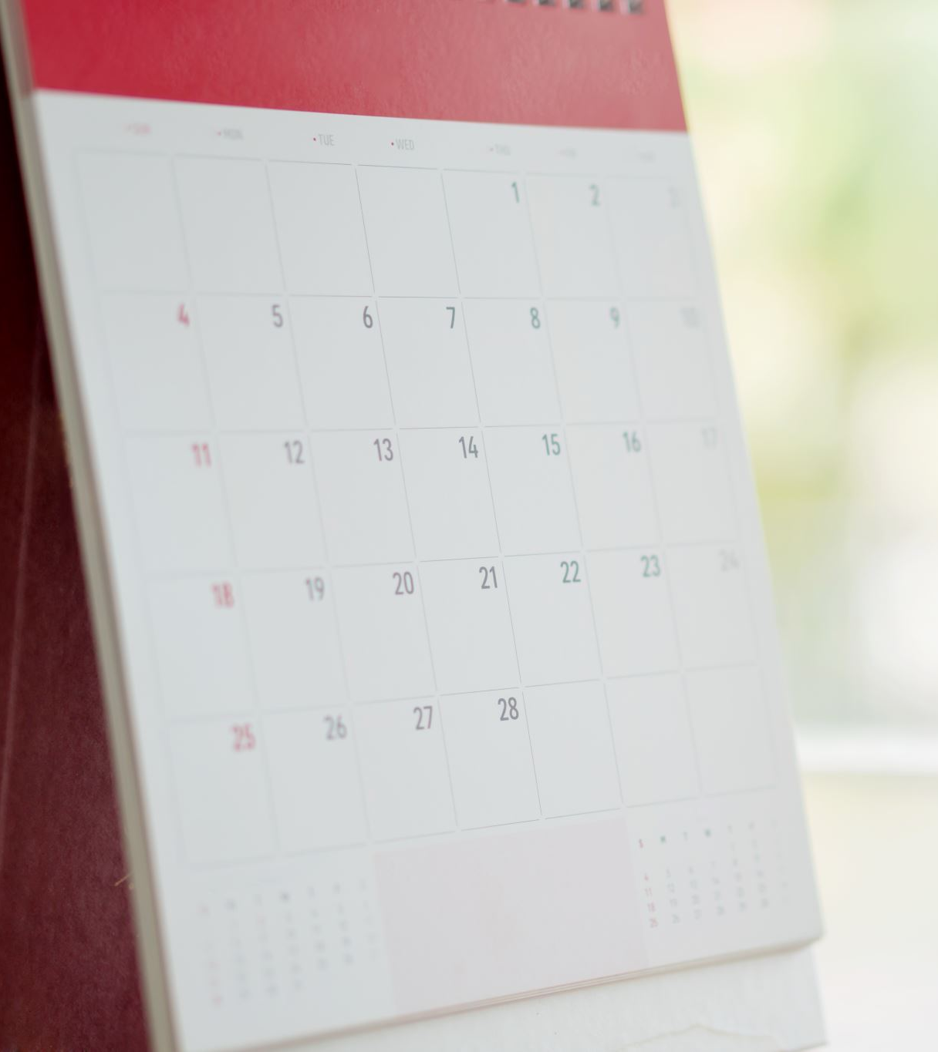
Pre-discussion
Briefly account for the main contents of the partition of India.

Slide 3

The Return

Slide 4
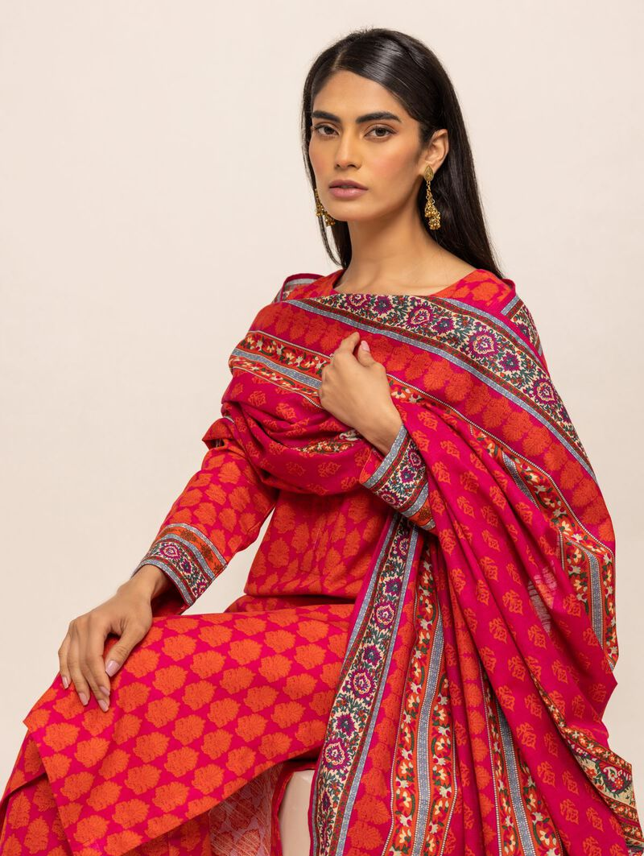
What is a dupatta? Describe the picture and explain what a dupatta is. Include at least three relative pronouns in your description.

Slide 5

Prepare a presentation of the text.

