Slide 1

Revision of Aspects of life in the Uk

Slide 2
Post-war immigration to Britain
After WWII Great Britain needed economic assistance and labour to rebuild society.
They received money from America and manual labour from their colonies

Slide 3
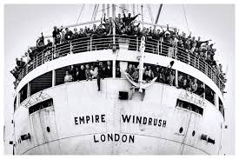
Ship Empire Windrush
In 1948, 492 Jamaicans arrived on the ship Empire Windrush.
They had received British passports through the British Nationality Act which gave citizenship to people from colonies.

Slide 4
Open door policy
Lasted until 1962 when the immigration policy became more restricted.

Slide 5
Restricted immigration policy
Free immigration was replaced with secondary immigration which means that immigrants had to have family members living in Britain or have a job to go to in order to stay in the country.

Slide 6
Multiculturalism and interculturalism
What is the difference according to the text?

Slide 7
Draw parallels
Analyze the pictures/ painting and draw parallels to texts which we have worked with in class to the topic of Brexit and immigration
John Agard - Listen Mr. Oxford Don
https://www.youtube.com/watch?v=Ywy-Tthdg7w
https://worldsofenglish.systime.dk/?id=107
Englands fattigste By, Dr
https://www.dr.dk/drtv/episode/horisont_-5-dage-i-englands-fattigste-by_584229
Post-War Immigration, Being British, Jan Erik, Gyldendal, 2014
is uploaded in Lectio
Brexit assignment
http://homepages.knord.dk/Engelskopgaver/Engelsk_A_HHX_11082023/ (4A)

Slide 8
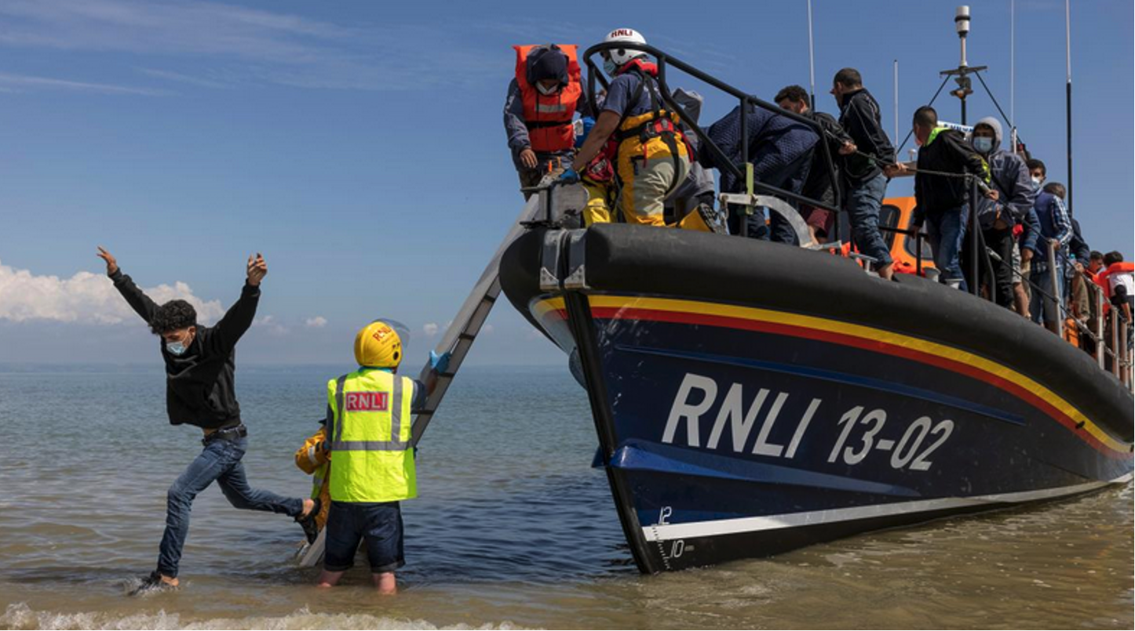
Uk

Slide 9
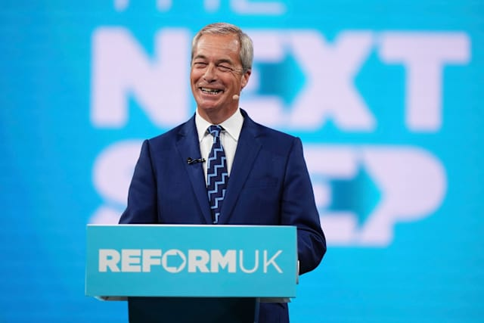
Nigel Farage

Slide 10
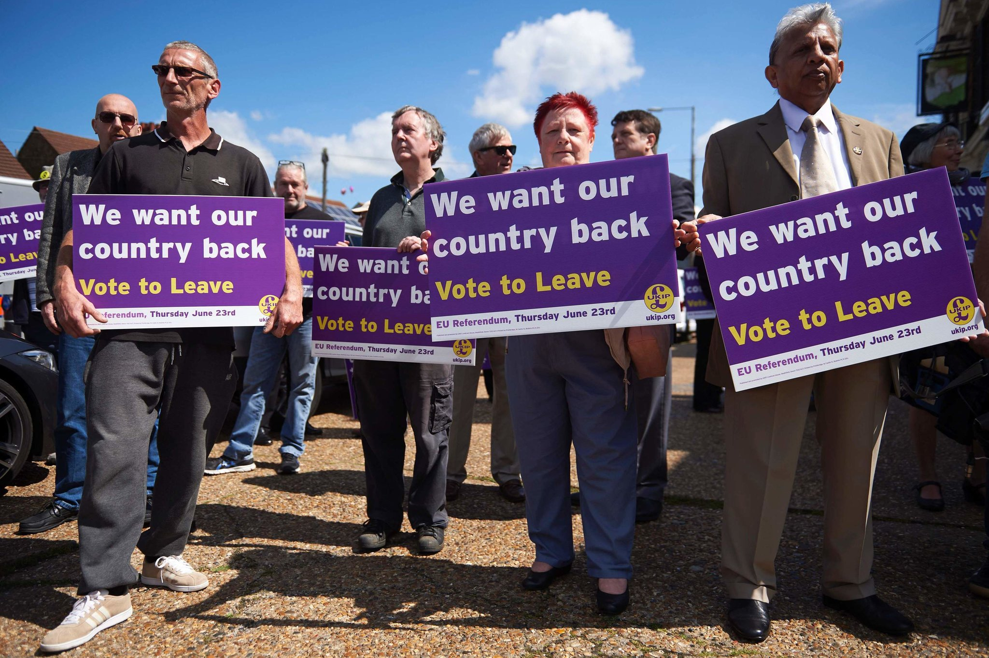
Uk and Brexit

Slide 11
