Slide 1
Højklassisk tid
450-400 f.Kr.

Slide 2
Højklassisk tid
Perioden afgrænses af Kalliasfreden 449 f.Kr. og Den peloponnesiske krigs afslutning 404 f. Kr.
Perioden præges af Athens imperialisme og førerskab under Perikles (461-429) samt Den peloponnesiske krig (431-404)
Det athenske demokrati blomstrer i sin fulde form
Store personligheder i Athen, der netop gjorde byen klassisk (forbilledlig)
Højklassisk tid også kendetegnet ved store kunstnere – især Phidias og Polyklet

Slide 3
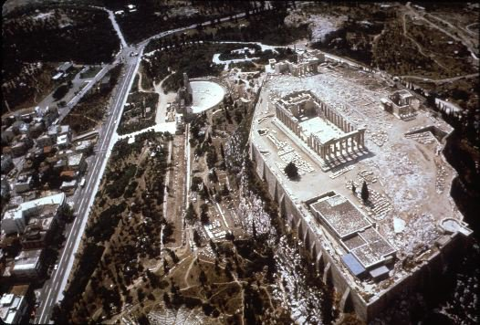
Akropolis

Slide 4
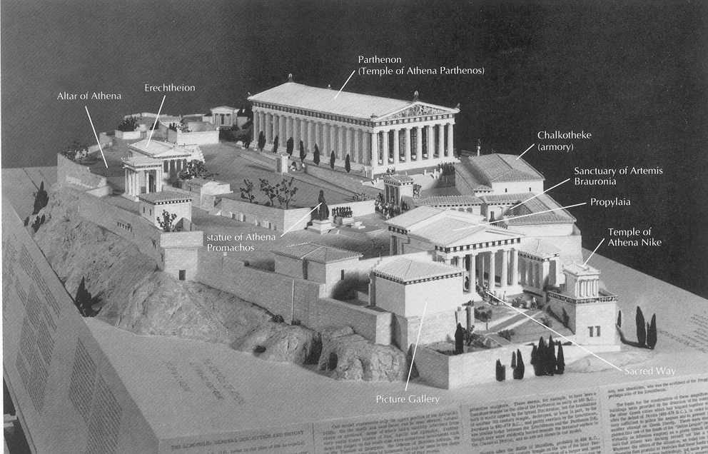

Slide 5
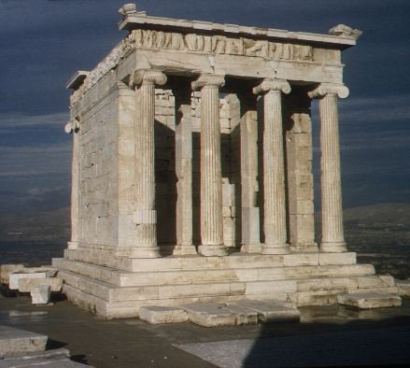
Athena Nike-templet, 427.24
Athena Nike-templet, 427-424 f. Kr.
Indviet til Pallas Athene som den sejrende gudinde

Slide 6
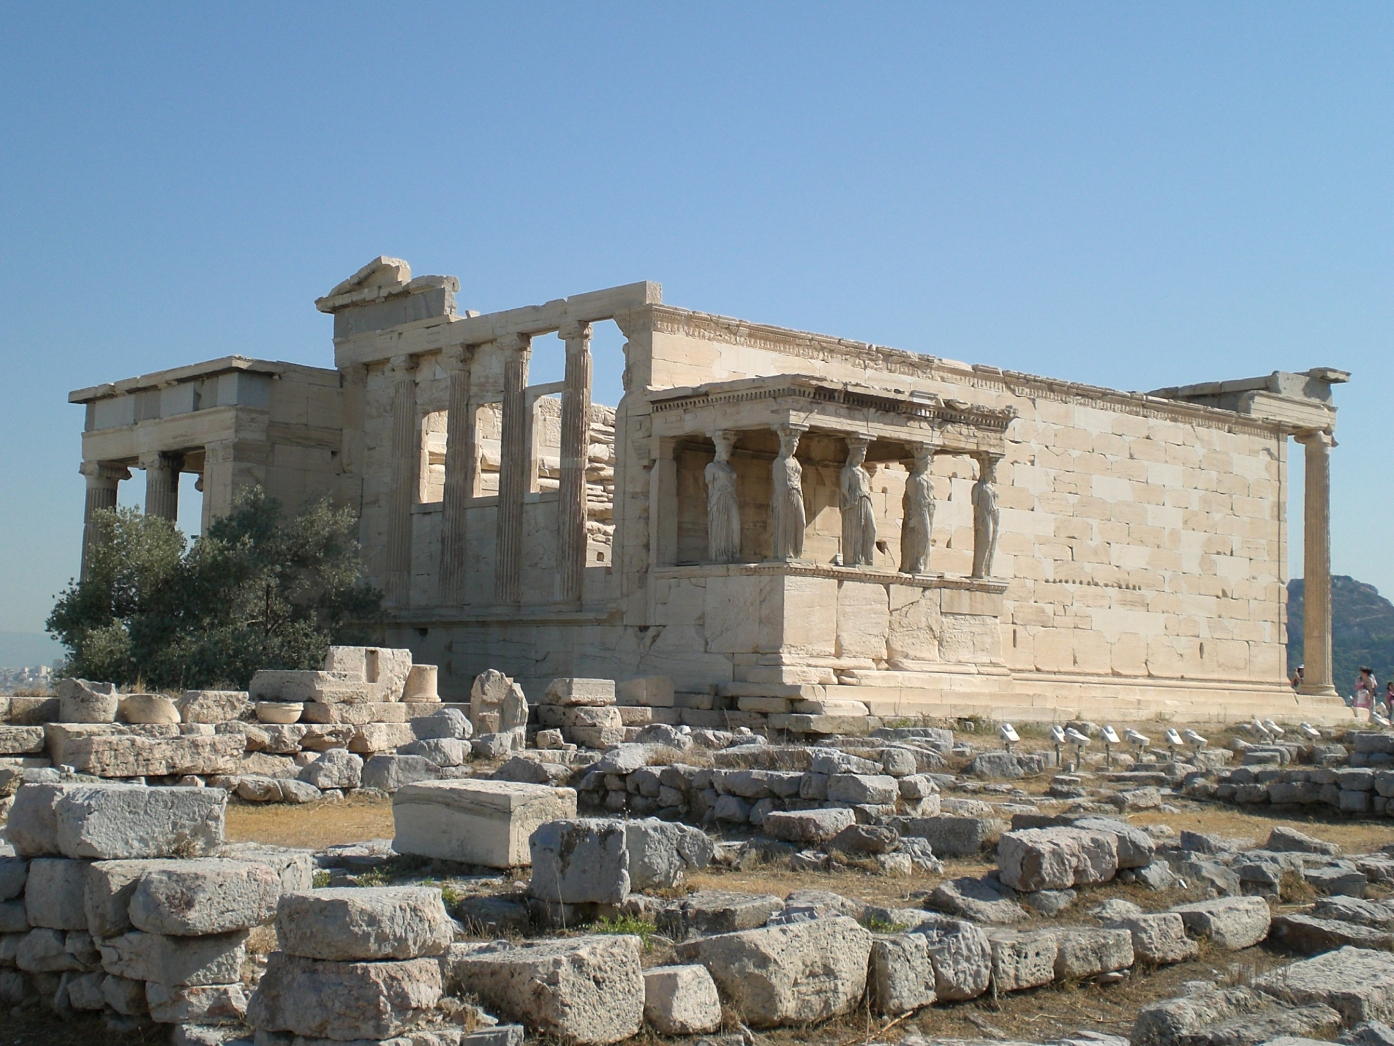
Erechtheion, Akropolis ca. 420 f.Kr.
Notes:
Fra Wikipedia
The Erechtheum (Greek: Έρέχθειον Erechtheion) is an ancient Greek temple on the north side of the Acropolis of Athens in Greece, notable for a design that is both elegant and unusual.
Contents
[hide]
Architecture
Religious functions
Late Antiquity and the Middle Ages
Modern times
Recent events
See also
External links
References
[edit] Architecture
The temple as seen today was built between 421 and 407 BCE. Its architect may have been Mnesicles, and it derived its name from a shrine dedicated to the legendary Greek hero Erichthonius. Some have suggested that it may have been built in honour of the legendary king Erechtheus, who is said to have been buried nearby. Erechtheus and Erichthonius were often syncretized. It is believed to have been a replacement for an older temple destroyed by the Persians in 480 BCE.
The need to preserve multiple adjacent sacred precincts likely explains the complex design. The main structure consists of up to four compartments, the largest being the east cella, with an Ionic portico on its east end. Other current thinking[1] would have the entire interior at the lower level and the East porch used for access to the great altar of Athena Polias via a balcony and stair and also as a public viewing platform.
The Porch of Maidens
The entire temple is on a slope, so the west and north sides are about 3 m (9 ft) lower than the south and east sides. It was built entirely of marble from Mount Pentelikon, with friezes of black limestone from Eleusis which bore sculptures executed in relief in white marble. It had elaborately carved doorways and windows, and its columns were ornately decorated (far more so than is visible today); they were painted, gilded and highlighted with gilt bronze and multi-colored inset glass beads. The building is known for early examples of egg-and-dart, and guilloche ornamental moldings.[2]
[edit] The Porch of the Caryatids
On the north side, there is another large porch with columns, and on the south, the famous "Porch of the Maidens", with six draped female figures (caryatids) as supporting columns, each sculpted in a manner different from the rest and engineered in such a way that their slenderest part, the neck, is capable of supporting the weight of the porch roof whilst remaining graceful and feminine. The porch was built to conceal the giant 15-ft beam needed to support the southwest corner over the Kekropion, after the building was drastically reduced in size and budget following the onset of the Peloponnesian war.
[edit] Religious functions
The Erectheum was associated with some of the most ancient and holy relics of the Athenians: the Palladion, which was a xoanon (defined as a wooden effigy fallen from heaven - not man-made) of Athena Polias (Protectress of the City); the marks of Poseidon's trident and the salt water well (the "salt sea") that resulted from Poseidon's strike; the sacred olive tree that sprouted when Athena struck the rock with her spear in her successful rivalry with Poseidon for the city; the supposed burial places of the mythical kings Cecrops and Erechtheus; the sacred precincts of Cecrops' three daughters, Herse, Pandrosus and Aglaurus; and those of the tribal heroes Pandion and .
The temple itself was dedicated to Athena Polias and Poseidon Erechtheus. Within the foundations lived the sacred snake of the temple, which represented the spirit of Cecrops and whose well-being was thought essential for the safety of the city. The snake was fed honey-cakes by Canephorae, the priestesses of Athena Polias, by custom the women of the ancient family of , the supposed descendants of the hero Boutes. The snake's occasional refusal to eat the cakes was thought a disastrous omen.
[edit] Late Antiquity and the Middle Ages
The intact Erechtheum was extensively described by the Roman geographer Pausanias (1.26.5 - 27.3), writing a century after it had been restored in the 1st century AD. The internal layout has since been obscured by the temple's later use as a church and possibly as a Turkish harem.
[edit] Modern times
Erechtheum, from SW
One of the caryatids was removed by Lord Elgin in order to decorate his Scottish mansion, and was later sold to the British Museum (along with the pedimental and frieze sculpture taken from the Parthenon). Athenian legend had it that at night the remaining five Caryatids could be heard wailing for their lost sister. Elgin attempted to remove a second Caryatid; when technical difficulties arose, he tried to have it sawn to pieces. The statue was smashed and its fragments were left behind. It was later reconstructed haphazardly with cement and iron rods. Nowadays the five original Caryatids are displayed in helium-filled glass cases in the Acropolis Museum and are replaced in situ by exact replicas.
[edit] Recent events
The Caryatids are in the process of being transferred to the New Acropolis Museum. The first was carried over safely on December 9th, 2007, via an elaborate system of aerial cranes[3][4]. Within the new museum, the statue was reunited with its long-missing sandalled left foot, which was identified among rubble in the 1980s. The reassembled Caryatid, along with the four others remaining in Athens, will have its decayed patina thoroughly restored by laser, and will be displayed in the new museum, encased within noble gas-filled glass chambers.

Slide 7
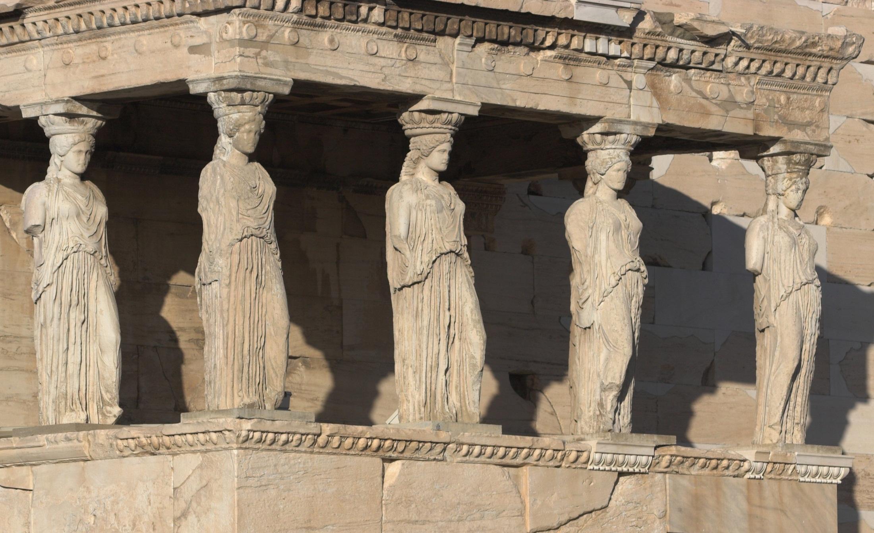
Erechtheion, Akropolis, ca. 420 f.Kr.

Slide 8
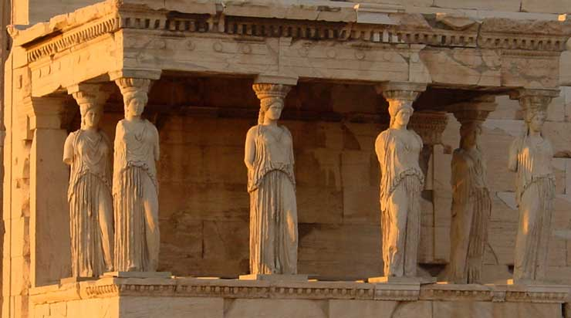
Erechtheion, Akropolis, ca. 420 f.Kr.

Slide 9
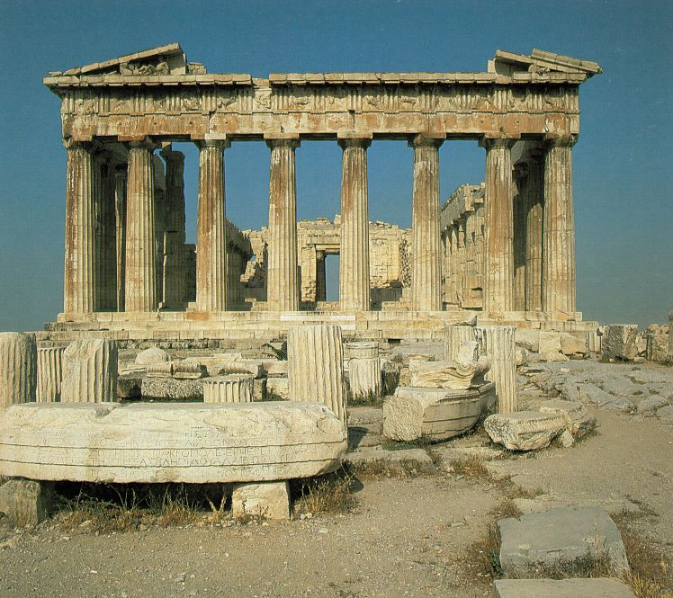
Parthenon
447-432 f.Kr.
vestgavlen

Slide 10
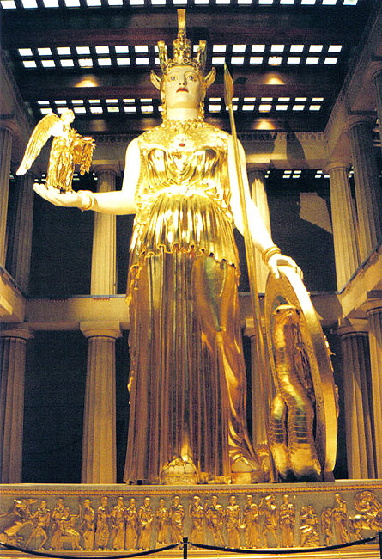
Den Chryselefantinske Athene-statue
Kultstatuen af Athene. Udført af billedhuggeren Fidias
Kultstatuen var 12 m høj
Udført i træ, beklædt med guld (1,15 ton) og elfenben
( græsk: chryselefantin)
Den vingede Nike-statue hvilede på en korinthisk søjle

Slide 11
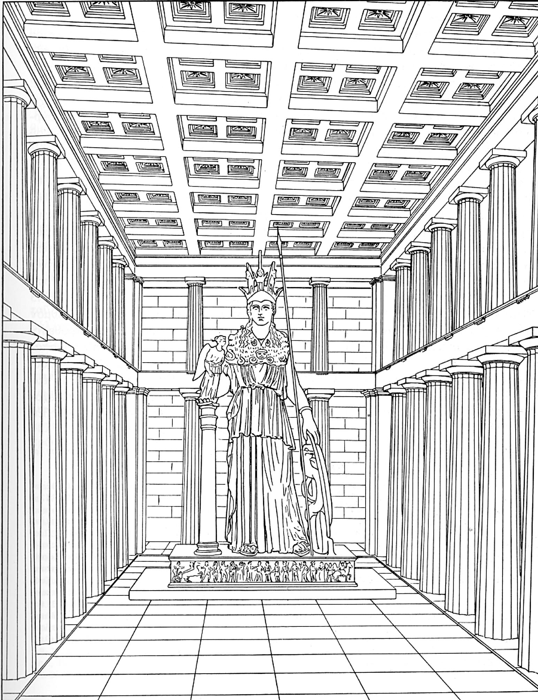
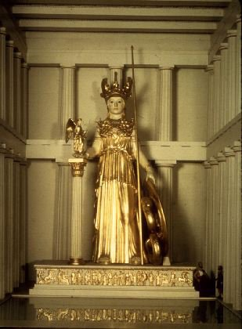
Notes:
Rekonstruktioner af Athena Parthenos

Slide 12
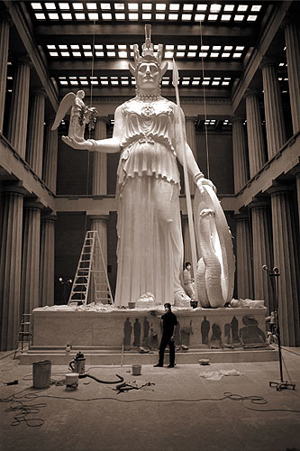
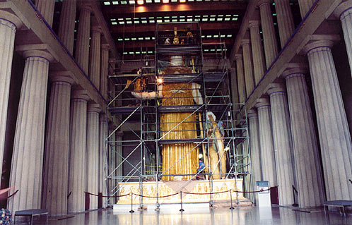
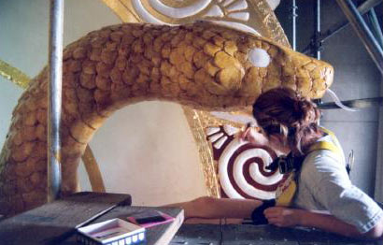
Notes:
Athena Parthenos i Nashville

Slide 13
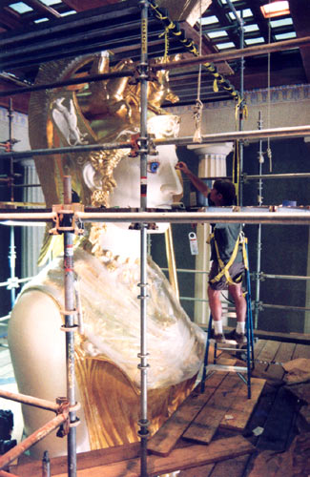
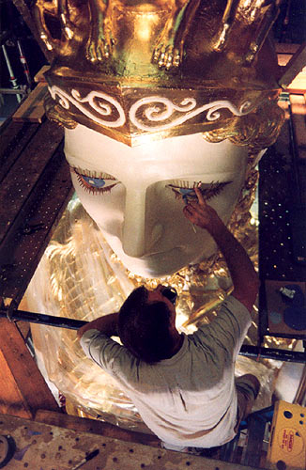
Notes:
Nashville

Slide 14
Peloponnesiske krig
Krigene mellem Sparta og Athen i perioden 431-404
Beskrevet af Thukydid og Xenofon
Årsag til krig, iflg. Thukydid: Spartas frygt for Athens voksende magt
Athen: stærkeste flådemagt
Sparta: stærkeste hær (professionel)
Spartanerne invaderer Athens opland og ødelægger markerne
Athenerne trækker sig tilbage bag murene – pest 430-426
421: Nikiasfreden – status quo
Athens allierede i Det deliske søforbund falder fra – Athens flåde mister sin magt – Udslettes af Spartas flåde i 405
404: Athen må overgive sig – Spartanerne indsætter de 30 tyranner

Slide 15
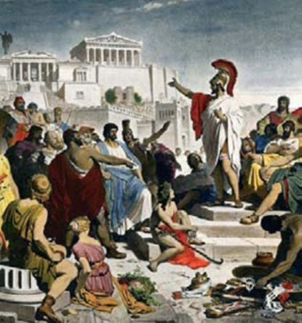
Athens demokrati
Demos = alle voksne, frie, mandlige borgere
Kvinder, slaver og tilflyttere havde ingen politiske rettigheder
Alle borgere havde lige muligheder
Lodtrækning om embeder
Diæter til embedsmænd
Alle embeder var årlige
Direkte demokrati

Slide 16
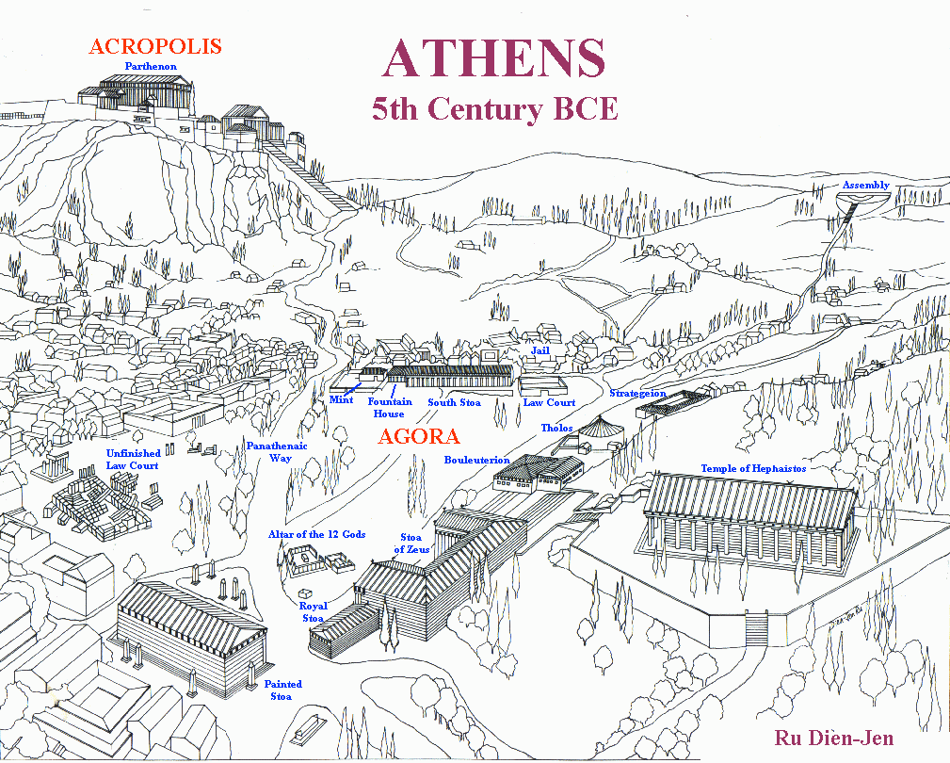

Slide 17
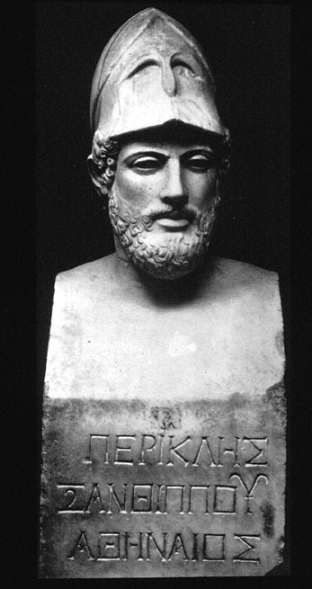
Perikles ca. 495-429

Slide 18
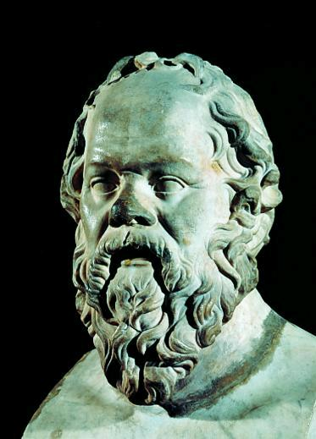
Sokrates
469-399

Slide 19
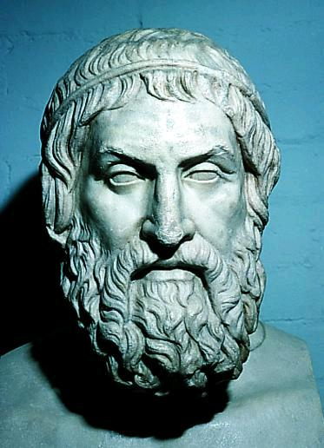
Sofokles
496-406

Slide 20
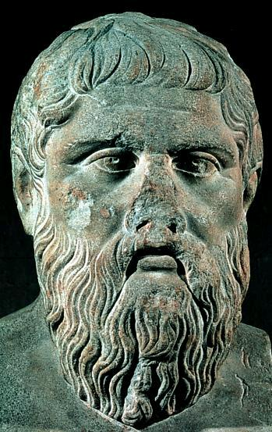
Platon
427-347

Slide 21
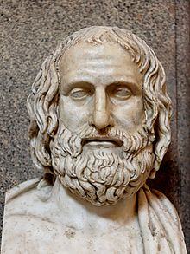
Euripides ca. 480-406

Slide 22
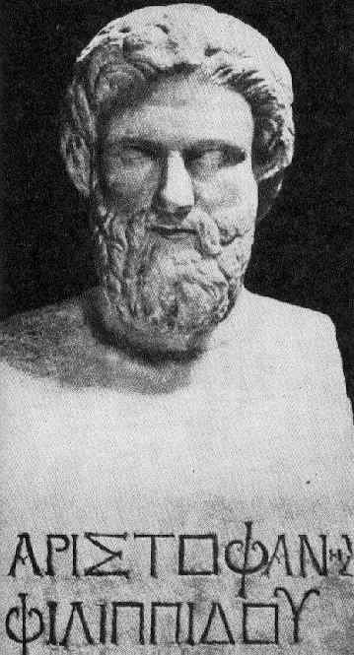
Aristofanes ca. 450-385

Slide 23
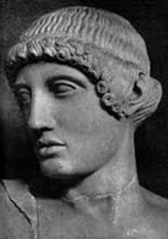
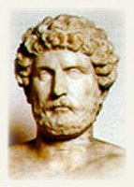
Sofisterne
Gorgias, ca. 480-380
Protagoras ca. 481-411

Slide 24
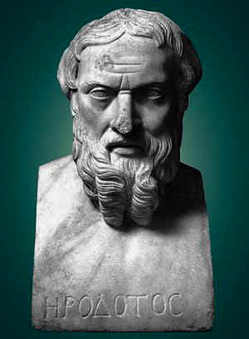
Herodot ca. 485-425

Slide 25
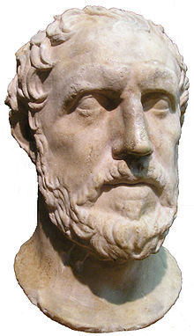
Thukydid ca. 460-400

Slide 26
Billedhuggerne
Polyklet
  Doryphoros
  Diadoumenos
Phidias
  Parthenon
    Frise – metoper - gavlskulptur
    Kultstatuen (Athena Parthenos)
  Zeusstatuen i Olympia
Paionios
  Nikestatuen i Olympia

Slide 27
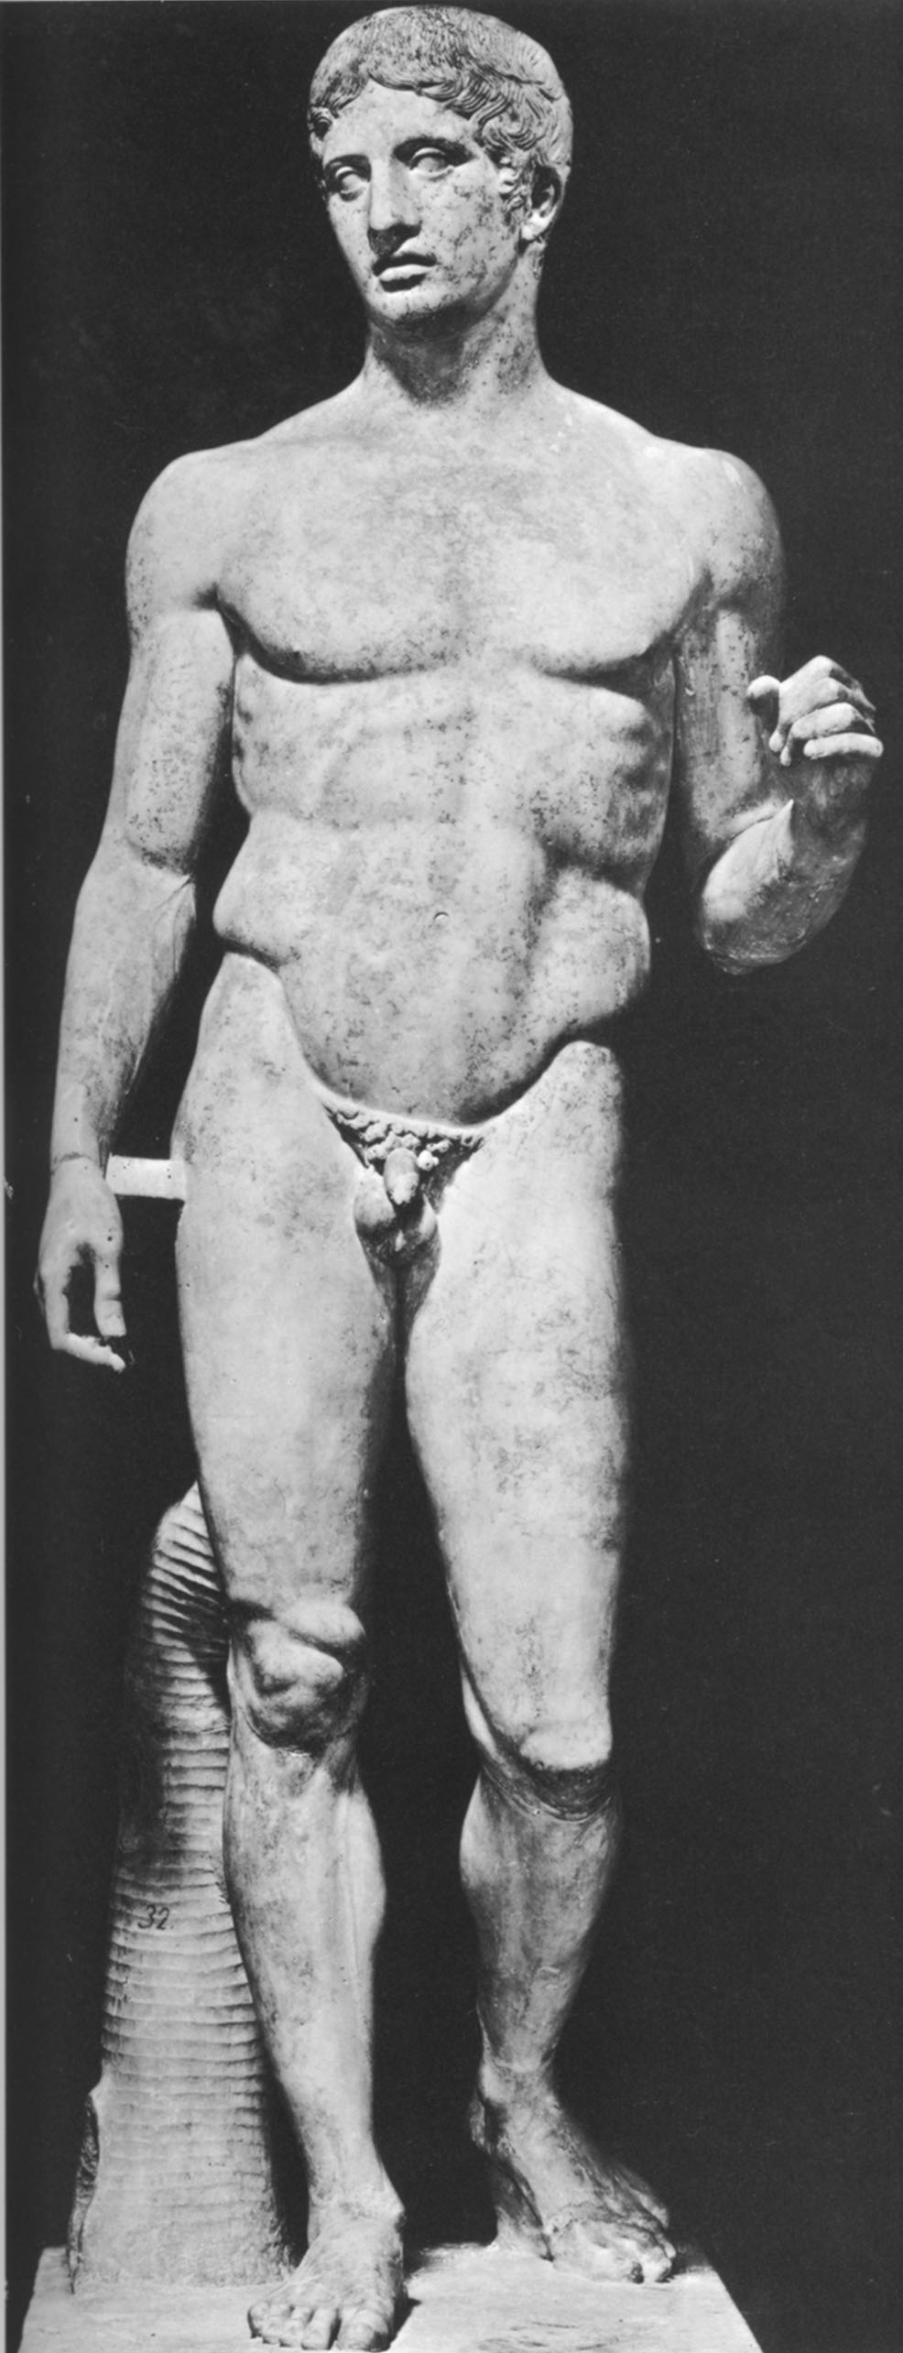
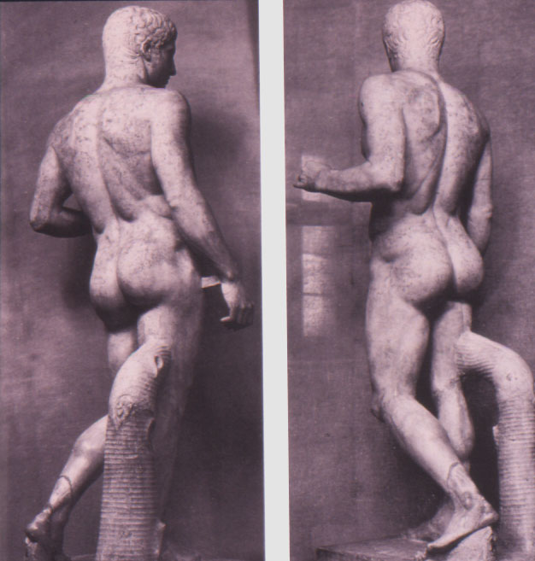
Polyklet
Notes:
Doryphoros, Napoli, Mus. Naz. Polyklets Kanon figur.

Slide 28
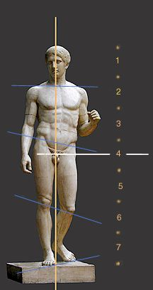
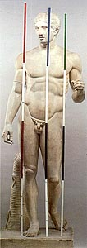
Polyklets ”Kanon” eksemplificeret ved Doryphoros:
Proportionerne relateres til hinanden:
Doryphoros’ hoved = 1/7 af kroppens længde
Ansigtet indtil hårgrænsen = 1/10
Afstanden fra hårgrænsen til nøglebenet = 1/6
Brystets bredde = ¼
Underbenet = ¼
En fod = 1/6
En hånd = 1/10
Desuden kan skulpturen indskrives i en cirkel med navlen som centrum. Hvis skulpturens arme er udstrakte, kan den omskrives af et kvadrat
Notes:
Proportioner er beskrevet hos Vitruv III,1. Om målene (og målepindene se: Polyklet. Der Bildhauer der griechischen Klassik, Mainz 1990, s. 156-184)

Slide 29
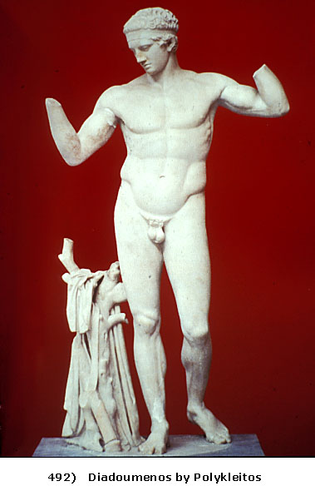
Notes:
Diadoumenos

Slide 30
Højklassisk stil
Den strenge stils religiøsitet udviklede sig efter århundredets midte yderligere til en kunst, der ved siden af guderne begyndte at interessere sig for mennesket.
Denne klassiske kunst var præget af harmoni, mådehold og ophøjet værdighed
Kunstnerne søgte, ligesom tidens store dramatikere, at skildre idéen bag den ydre, omskiftelige virkelighed.
Kunstværket blev således både naturalistisk og idealiserende
Under den peloponnesiske krig mærkedes en tendens mod større ydre effekt
Kunstnerne søgte nu også at skildre de menneskelige følelser – senklassisk – hellenistisk tid

