Slide 1



Global Carbon Budget
2022
2023
The GCP is a Global
Research Project of
and a Research
Partner of
Published on 5 December 2023
PowerPoint version 1.0

Slide 2
Acknowledgements
The work presented here has been possible thanks to the enormous observational and modelling efforts of the institutions and networks below
Atmospheric CO₂ datasets
NOAA/GML (Lan et al., 2023)
Scripps (Keeling et al., 1976)
Atmospheric O₂ datasets
Scripps (Keeling 2023)
Fossil CO₂ emissions
Andrew and Peters, 2023
CDIAC-FF (Hefner and Marland, 2023)
UNFCCC 2023
Energy Institute 2023
Consumption emissions
Peters et al., 2011
GTAP (Narayanan et al., 2015)
Land-use change
Houghton and Castanho 2023
BLUE (Hansis et al., 2015)
OSCAR (Gasser et al., 2020)
GFED4 (van der Werf et al., 2017)
FAO-FRA and FAOSTAT
HYDE (Klein Goldewijk et al., 2017)
LUH2 (Hurtt et al., 2020)
MapBiomas (Souza et al., 2020)
Land models
CABLE-POP | CLASSIC | CLM5.0 | DLEM | eDV3 | ELM | IBIS | ISAM | ISBA-CTRIP | JSBACH | JULES-ES | LPJ-GUESS | LPJml | LPJ-wsl | LPX-Bern | OCN | ORCHIDEEv3 | SDGVM | VISIT
Climate forcing CRU (Harris et al., 2014) | JRA-55 (Kobayashi et al., 2015)
Ocean models
ACCESS | CESM-ETHZ | FESOM-2.1-REcoM2 | MICOM-HAMOCC (NorESM-OCv1.2) | MOM6-COBALT (Princeton) | MPIOM-HAMOCC6 | MRI-ESM2-2 | NEMO3.6-PISCESv2-gas (CNRM) | NEMO-PISCES (IPSL) | NEMO-PlankTOM12
fCO₂ based ocean flux products
CMEMS-LSCE-FFNNv2 | Jena- MLS | JMA-MLR | LDEO-HPD | MPI-SOMFFN | NIES-ML3 | OS-ETHZ-GRaCER | UoEx-Watson
Surface Ocean CO₂ Atlas SOCATv2023
Atmospheric inversions
CAMS | CAMS-Satellite | CarbonTracker Europe | COLA | CT-NOAA | CMS-Flux | GCASv2 | GONGGA | IAPCAS | Jena CarboScope | MIROC4-ACTM | NISMON-CO2 | THU | UoE in-situ
Earth system models
CanESM2 | IPSL-CM6—CO₂-LR | MIROC-ES2L | MPI-ESM1-2-LR
Full references provided in Friedlingstein et al 2023

Slide 3
Contributors 121 people | 95 organisations | 17 countries
P Friedlingstein | M O’Sullivan | MW Jones | RM Andrew | DCE Bakker | J Hauck
P Landschützer | C Le Quéré | IT Luijkx | GP Peters | W Peters | J Pongratz
C Schwingshackl | S Sitch | JG Canadell | P Ciais | RB Jackson
SR Alin | P Anthony | L Barbero | NR Bates | M Becker | N Bellouin | B Decharme | L Bopp
M Brasika | P Cadule | MA Chamberlain | N Chandra | Thi-Tuyet-Trang Chau | F Chevallier
LP Chini | M Cronin | X Dou | K Enyo | W Evans | St Falk | RA Feely | L Feng | DJ Ford
T Gasser | J Ghattas | T Gkritzalis | G Grassi | L Gregor | N Gruber | Ö Gürses | I Harris
J Heinke | RA Houghton | GC Hurtt | Y Iida | T Ilyina | AR Jacobson | A Jain | T Jarníková
A Jersild | F Jiang | Z Jin | F Joos | E Kato | RF Keeling | D Kennedy | K Klein Goldewijk
J Knauer | JI Korsbakken | A Körtzinger | N Lefèvre | H Li | J Liu | Z Liu | L Ma | N Mayot
P McGuire | GA McKinley | G Meyer | EJ Morgan | DR Munro | S-I Nakaoka | Y Niwa
KM O'Brien | A Olsen | A McOmar | T Ono | ME Paulsen | D Pierrot | K Pocock | B Poulter
C Powis | G Rehder | L Resplandy | E Robertson | C Rödenbeck | TM Rosan | J Schwinger
R Séférian | L Smallman | S Smith | R Sospedra-Alfonso | Q Sun | AJ Sutton | C Sweeney
S Takao | H Tian | B Tilbrook | H Tsujino | F Tubiello | G van der Werf | E van Ooijen
R Wanninkhof | M Watanabe | C Wimart-Rousseau | D Yang | X Yang | W Yuan | X Yue
S Zaehle | J Zeng | B Zheng
Atlas Team Members at LSCE, France
P Ciais | P Brockmann
Communications Team
A Hayward | G Davies | A Morrison
C Bartman | N Hawtin | K Mansell

Slide 4
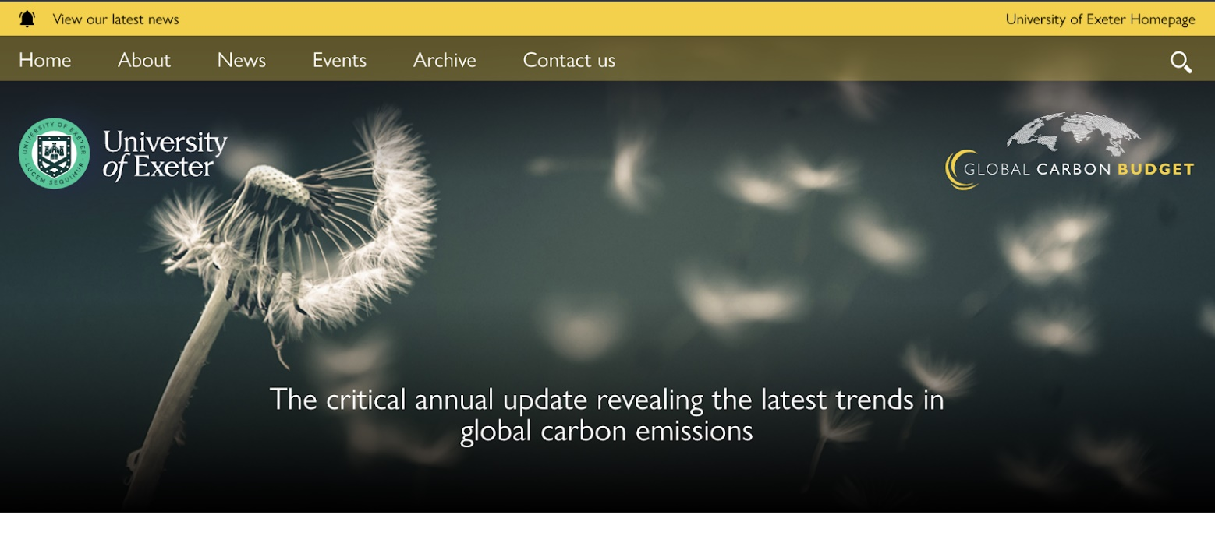
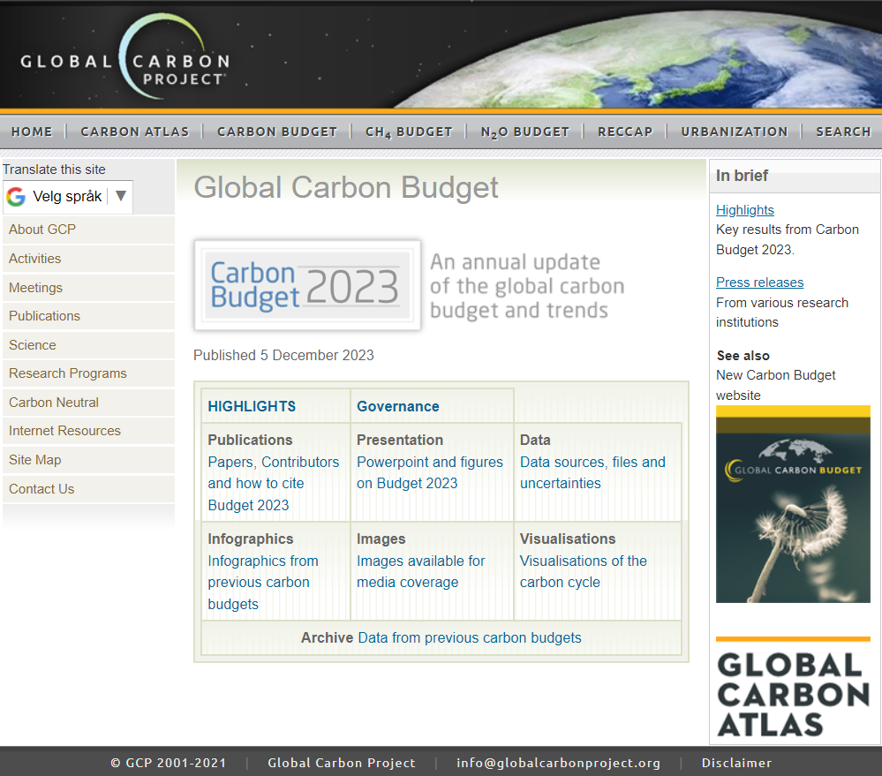
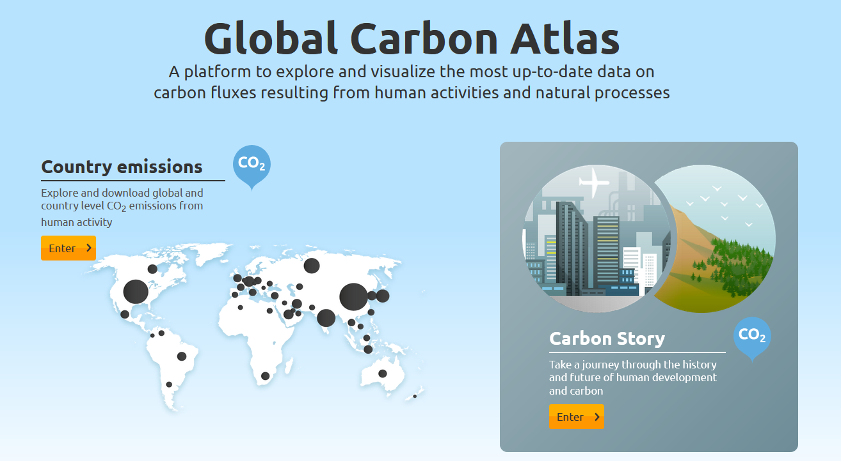
Data Access and Additional Resources
More information, data sources and data files:
https://globalcarbonbudget.org/carbonbudget
Needs update!
More information, data sources and data files:
http://www.globalcarbonproject.org/carbonbudget Contact: Pep.Canadell@csiro.au
More information, data sources and data files:
www.globalcarbonatlas.org
(co-funded in part by BNP Paribas Foundation)

Slide 5
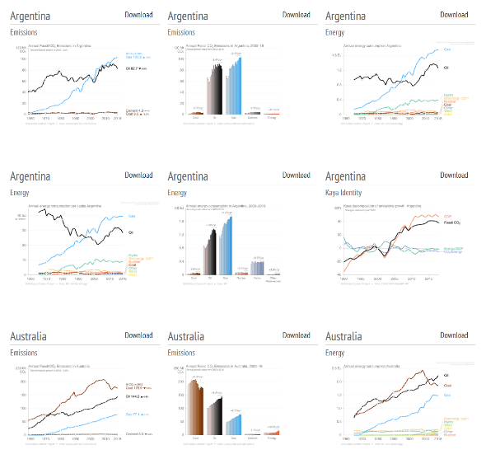
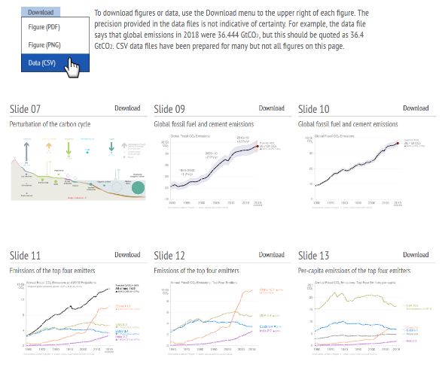
Download of figures and data
Global Carbon Budget
Additional country figures
Figures and data for most slides available from tinyurl.com/GCB23figs
and from https://globalcarbonbudget.org/carbonbudget

Slide 6
All the data is shown in billion tonnes CO₂ (GtCO₂)
1 Gigatonne (Gt) = 1 billion tonnes = 1×10¹⁵g = 1 Petagram (Pg)
1 kg carbon (C) = 3.664 kg carbon dioxide (CO₂)
1 GtC = 3.664 billion tonnes CO₂ = 3.664 GtCO₂
(Figures are available from https://globalcarbonbudget.org/carbonbudget)
Most figures in this presentation are available for download as PNG, PDF and SVG files
from tinyurl.com/GCB23figs along with the data required to produce them.
Disclaimer
The Global Carbon Budget and the information presented here are intended for those interested in learning about the carbon cycle, and how human activities are changing it. The information contained herein is provided as a public service, with the understanding that the Global Carbon Project team make no warranties, either expressed or implied, concerning the accuracy, completeness, reliability, or suitability of the information.

Slide 7

License
Our intention is that these figures and data are used. That’s why they’re released under the Creative Commons Attribution 4.0 International license. Simply put, you may freely copy and modify these figures and data, and use them in both commercial and non-commercial works, as long as you give credit to the Global Carbon Project.
If you’re just tweeting a figure or using a figure in a presentation, then it already says at the bottom that it’s by the Global Carbon Project, so you’re good to go! If you use the data directly or modify the figure then you will need to make sure the attribution is in place.
For details on the license, visit the Creative Commons website.
Suggested citation for use in a book: “Used with permission of the Global Carbon Project under the Creative Commons Attribution 4.0 International license.”

Slide 8
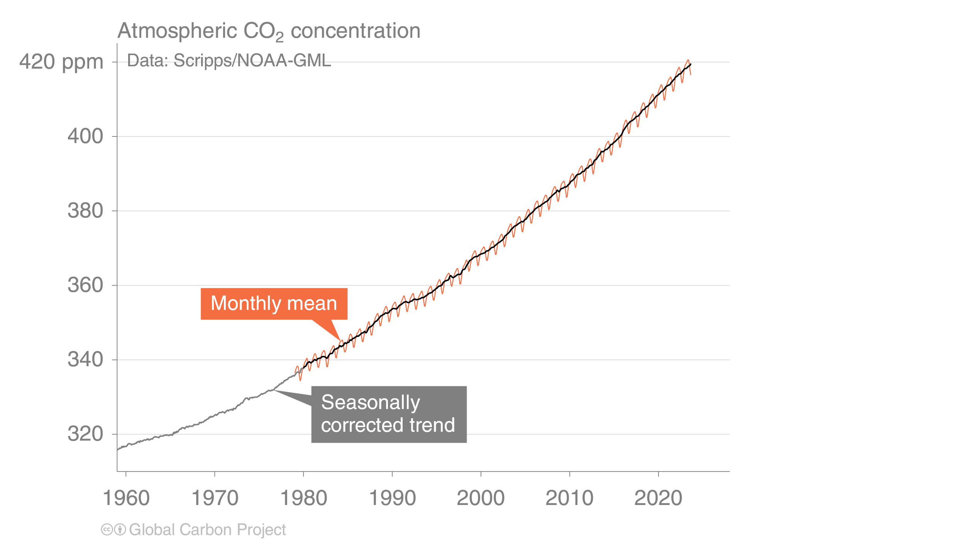
Atmospheric CO₂ concentration
The global CO₂ concentration increased from ~277 ppm in 1750 to 419.3 ppm in 2023 (up 51%)
Globally averaged surface atmospheric CO₂ concentration. Data from: NOAA-GML after 1980;
the Scripps Institution of Oceanography before 1980
Source: NOAA-GML; Scripps Institution of Oceanography; Friedlingstein et al 2023; Global Carbon Project 2023

Slide 9
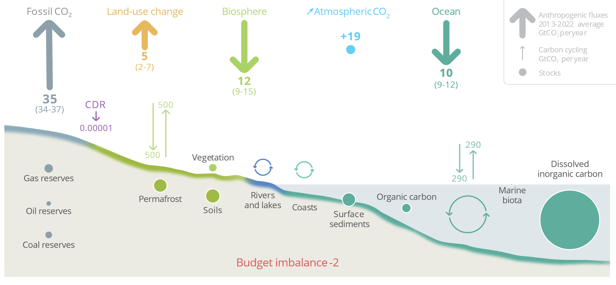
Anthropogenic perturbation of the global carbon cycle
Perturbation of the global carbon cycle caused by anthropogenic activities,
global annual average for the decade 2013–2022 (GtCO₂/yr)
CDR here refers to Carbon Dioxide Removal besides those associated with land-use that are accounted for in the Land-use change estimate.
The budget imbalance is the difference between the estimated emissions and sinks.
Source: NOAA-GML; Friedlingstein et al 2023; Canadell et al 2021 (IPCC AR6 WG1 Chapter 5); Global Carbon Project 2023

Slide 10
Key Highlights in 2023

Slide 11
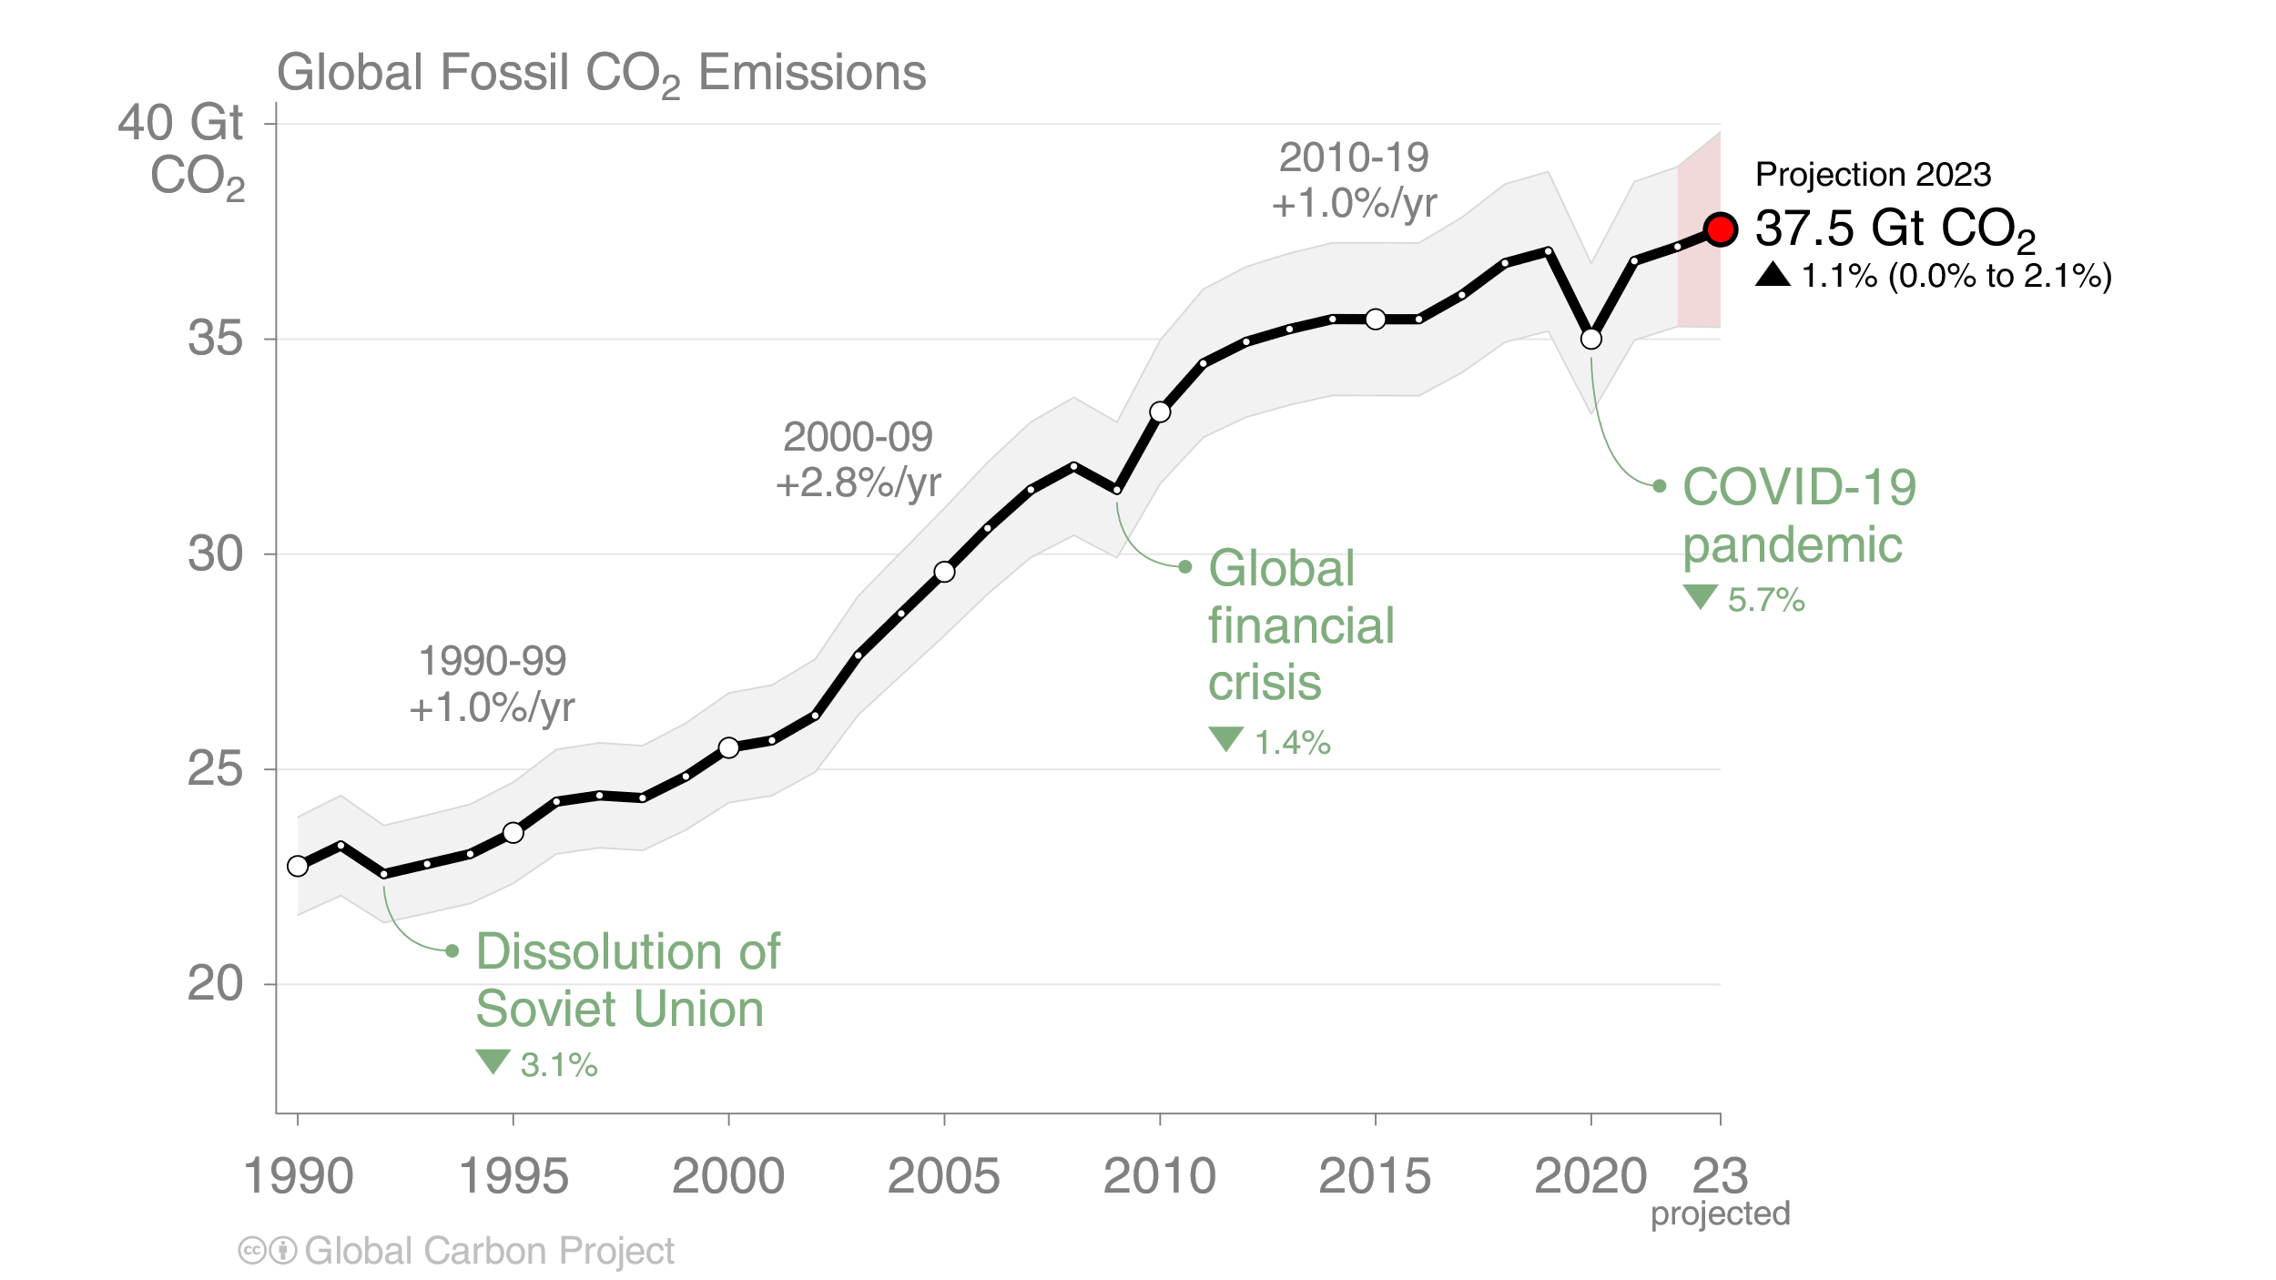
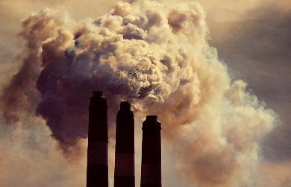
Global Fossil CO₂ Emissions
Global fossil CO₂ emissions: 37.1 ± 2 GtCO₂ in 2022, 63% over 1990
Projection for 2023: 37.5 ± 2 GtCO₂, 1.1% [0.0% to +2.1%] higher than 2022
Uncertainty is ±5% for one standard deviation (IPCC “likely” range)
When including cement carbonation, the 2022 and 2023 estimates amount to 36.4 ± 2 GtCO₂ and 36.8 ± 2 GtCO₂ respectively
The 2023 projection is based on preliminary data and modelling.
Source: Friedlingstein et al 2023; Global Carbon Project 2023

Slide 12
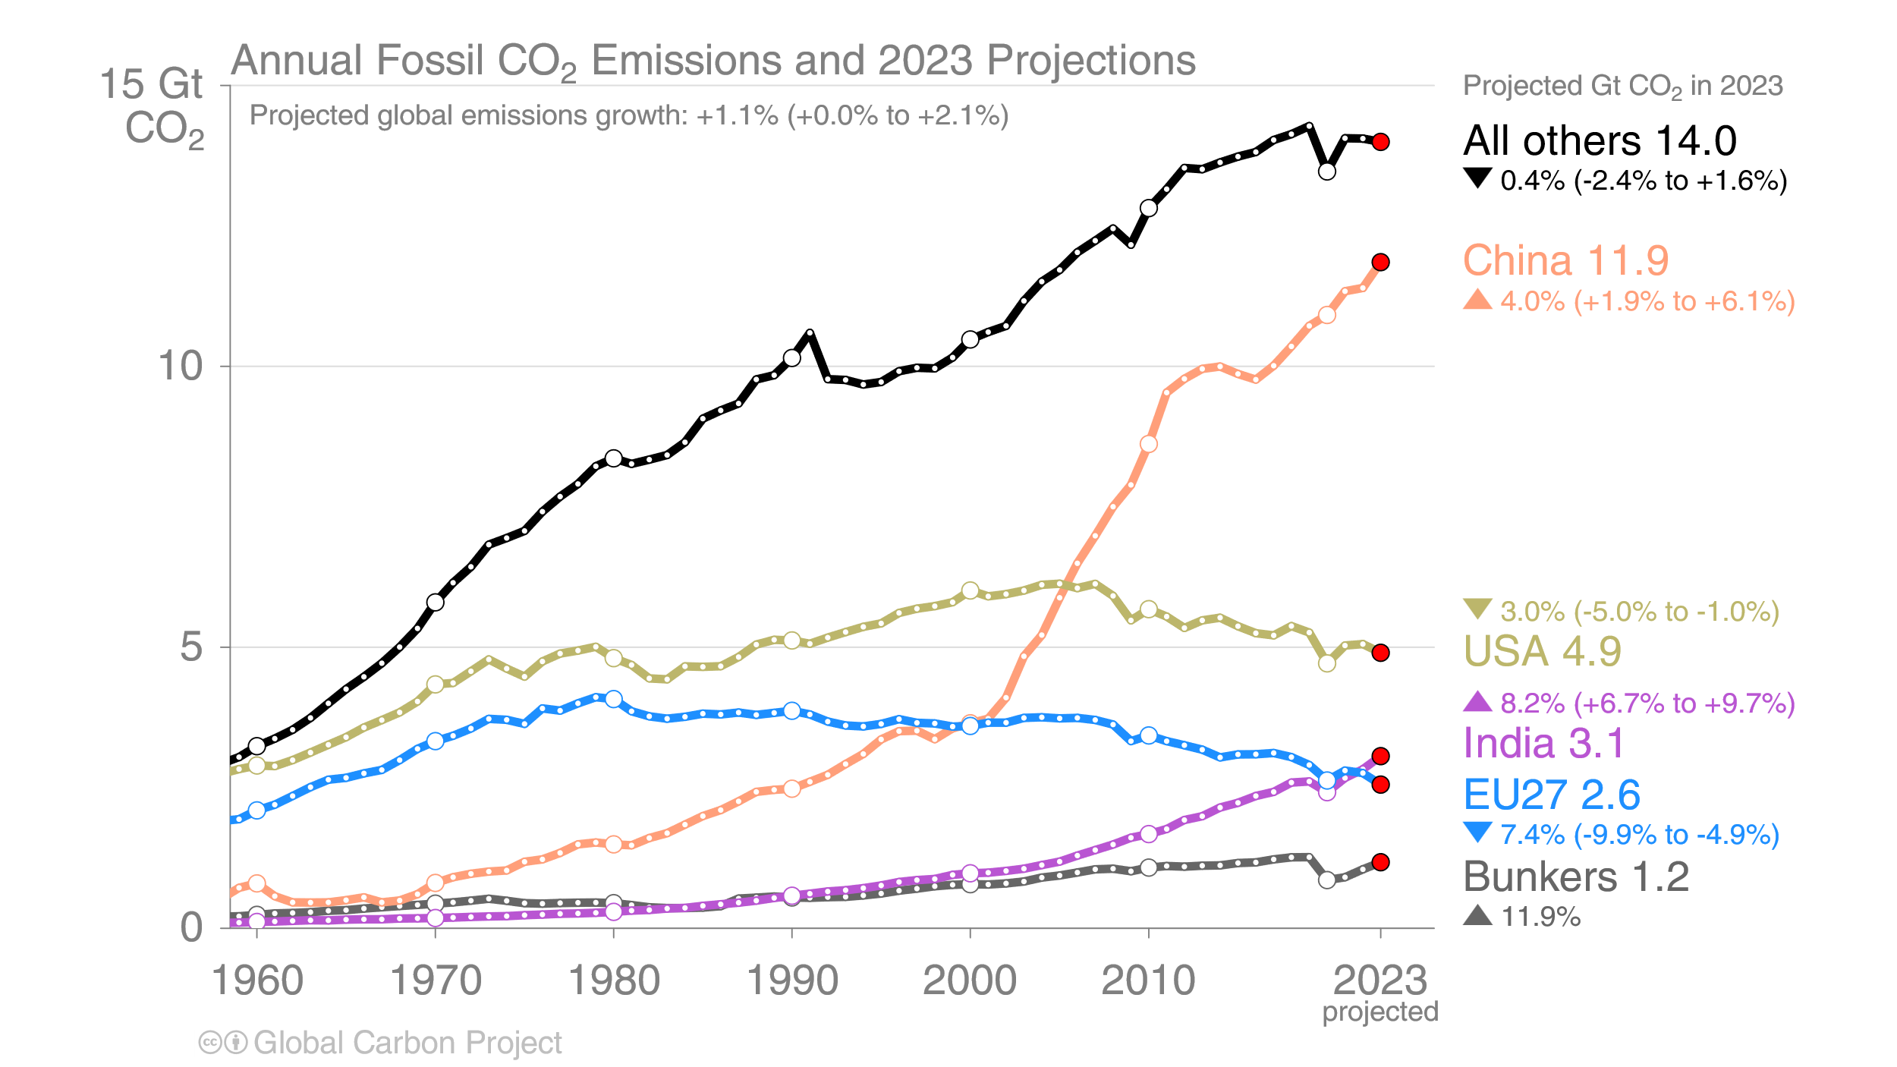
Emissions Projections for 2023
There are sharp contrasts between the projected emissions changes for the top emitters
The 2023 projections are based on preliminary data and modelling.
‘Bunkers’ are fossil fuels (oil) used for shipping and aviation in international territory
Source: Friedlingstein et al 2023; Global Carbon Project 2023

Slide 13
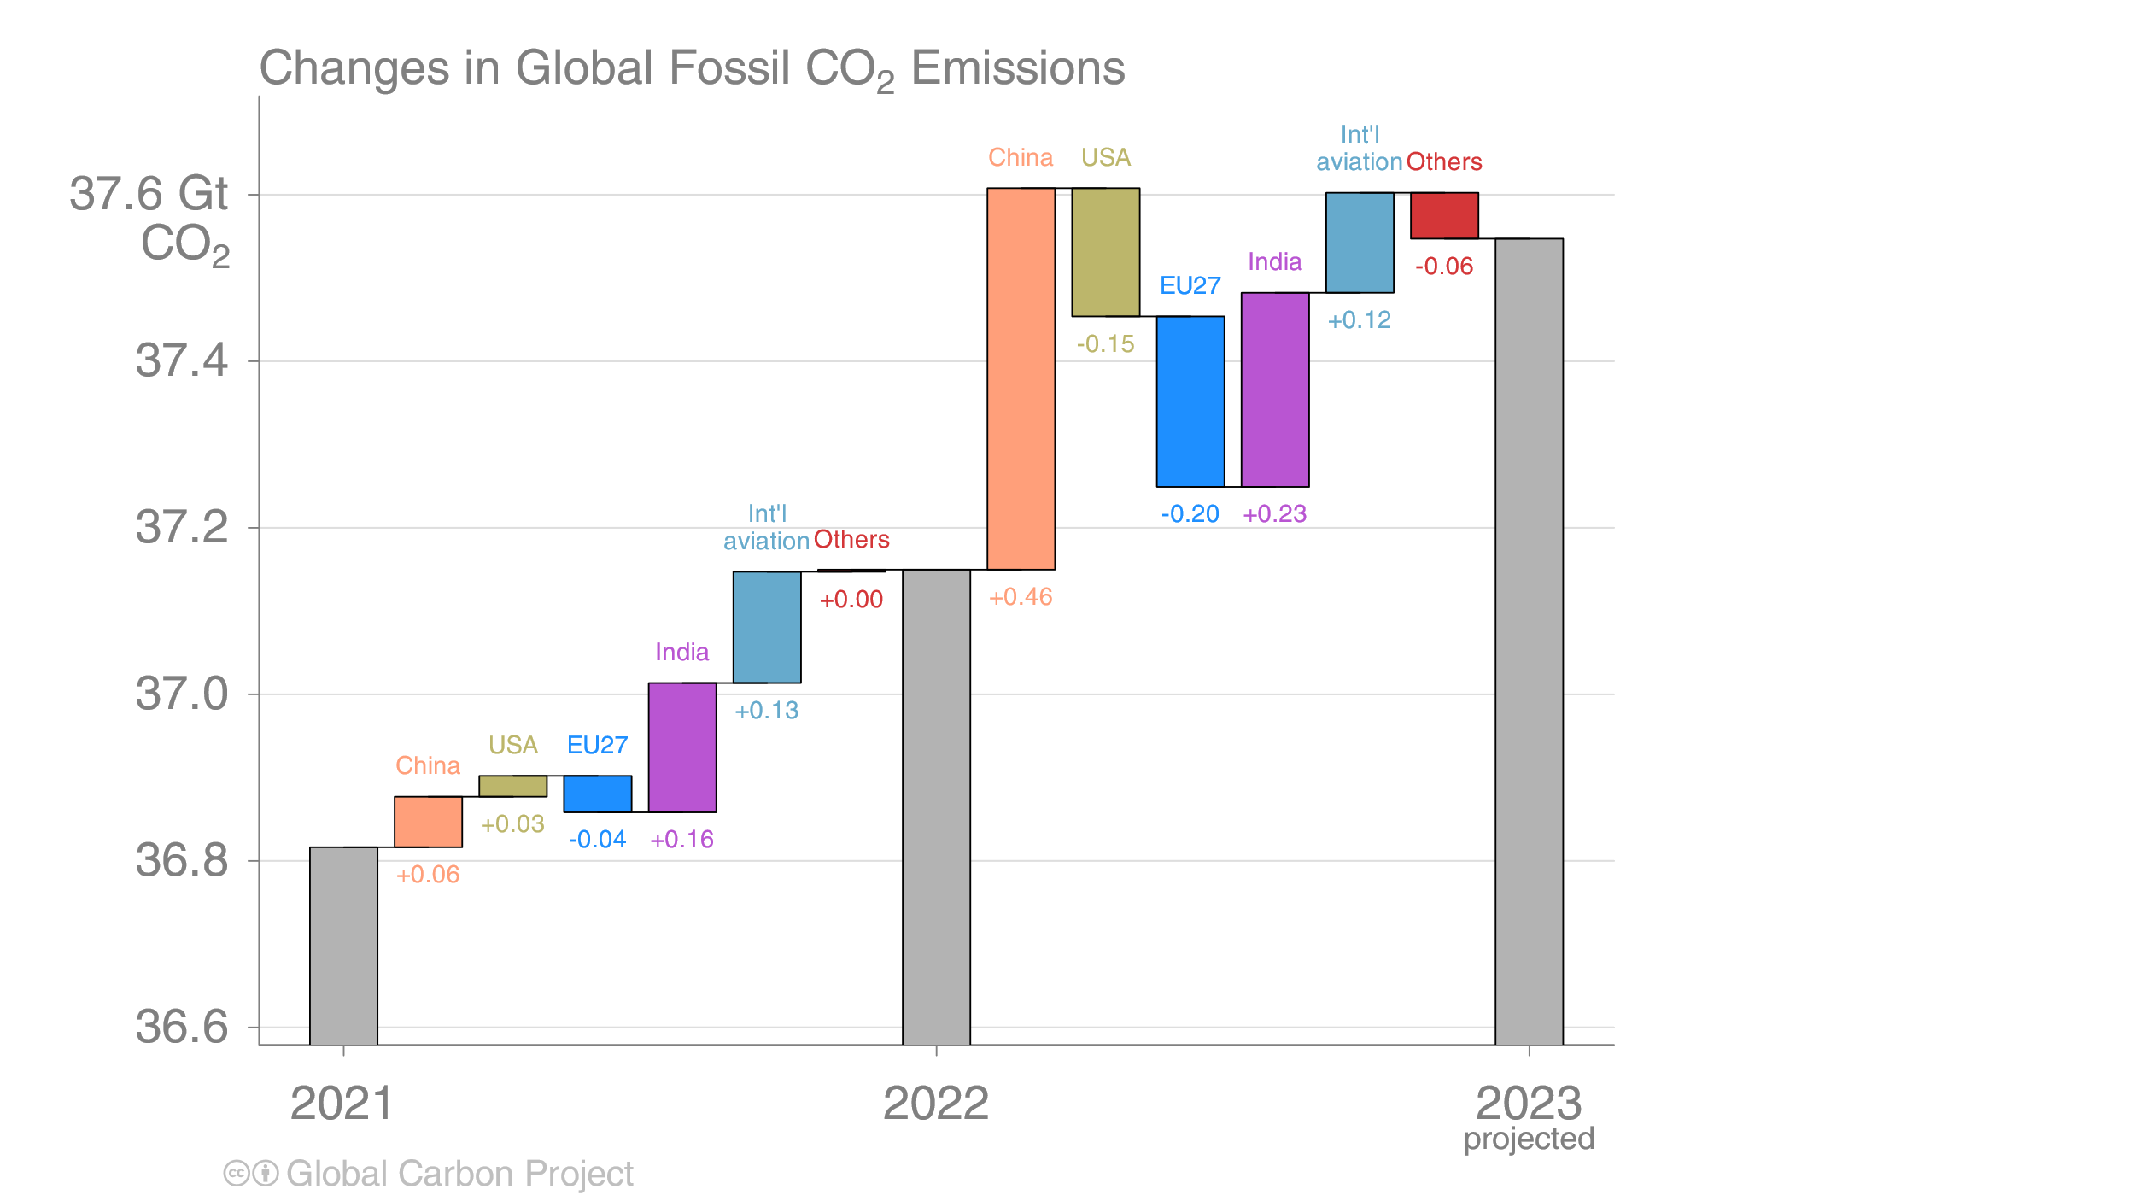
Fossil CO₂ emissions growth: 2021–2023
Emissions are expected to increase in China, India and international aviation in 2023,
and decline in USA, the EU, and the combined rest of the world (Others)
The 2023 projections are based on preliminary data and modelling.
Source: Friedlingstein et al 2023; Global Carbon Project 2023

Slide 14
Summary of fossil CO₂ emissions in 2022 and 2023
Region / Country | 2022 emissions (billion tonnes/yr) | 2022 growth (percent) | 2023 projected emissions growth (percent) | 2023 projected emissions (billion tonnes/yr)
China | 11.4 | +0.5% | +4.0% | 11.9
USA | 5.1 | +0.5% | -3.0% | 4.9
India | 2.8 | +5.8% | +8.2% | 3.1
EU27 | 2.8 | -1.6% | -7.4% | 2.6
International bunkers* | 1.0 | +15.6% | +11.9% | 1.2
All others | 15.1 | +0.0% | -0.4 | 14.0
World | 37.1 | +0.9% | +1.1% | 37.5
World (incl. cement carbonation) | 36.4 | +0.9% | +1.1% | 36.8
*Emissions from use of international aviation and maritime shipping bunker fuels are not usually included in national totals.
Cement carbonation sink only included in global (World) estimate.
Source: Friedlingstein et al 2023; Global Carbon Project 2023

Slide 15
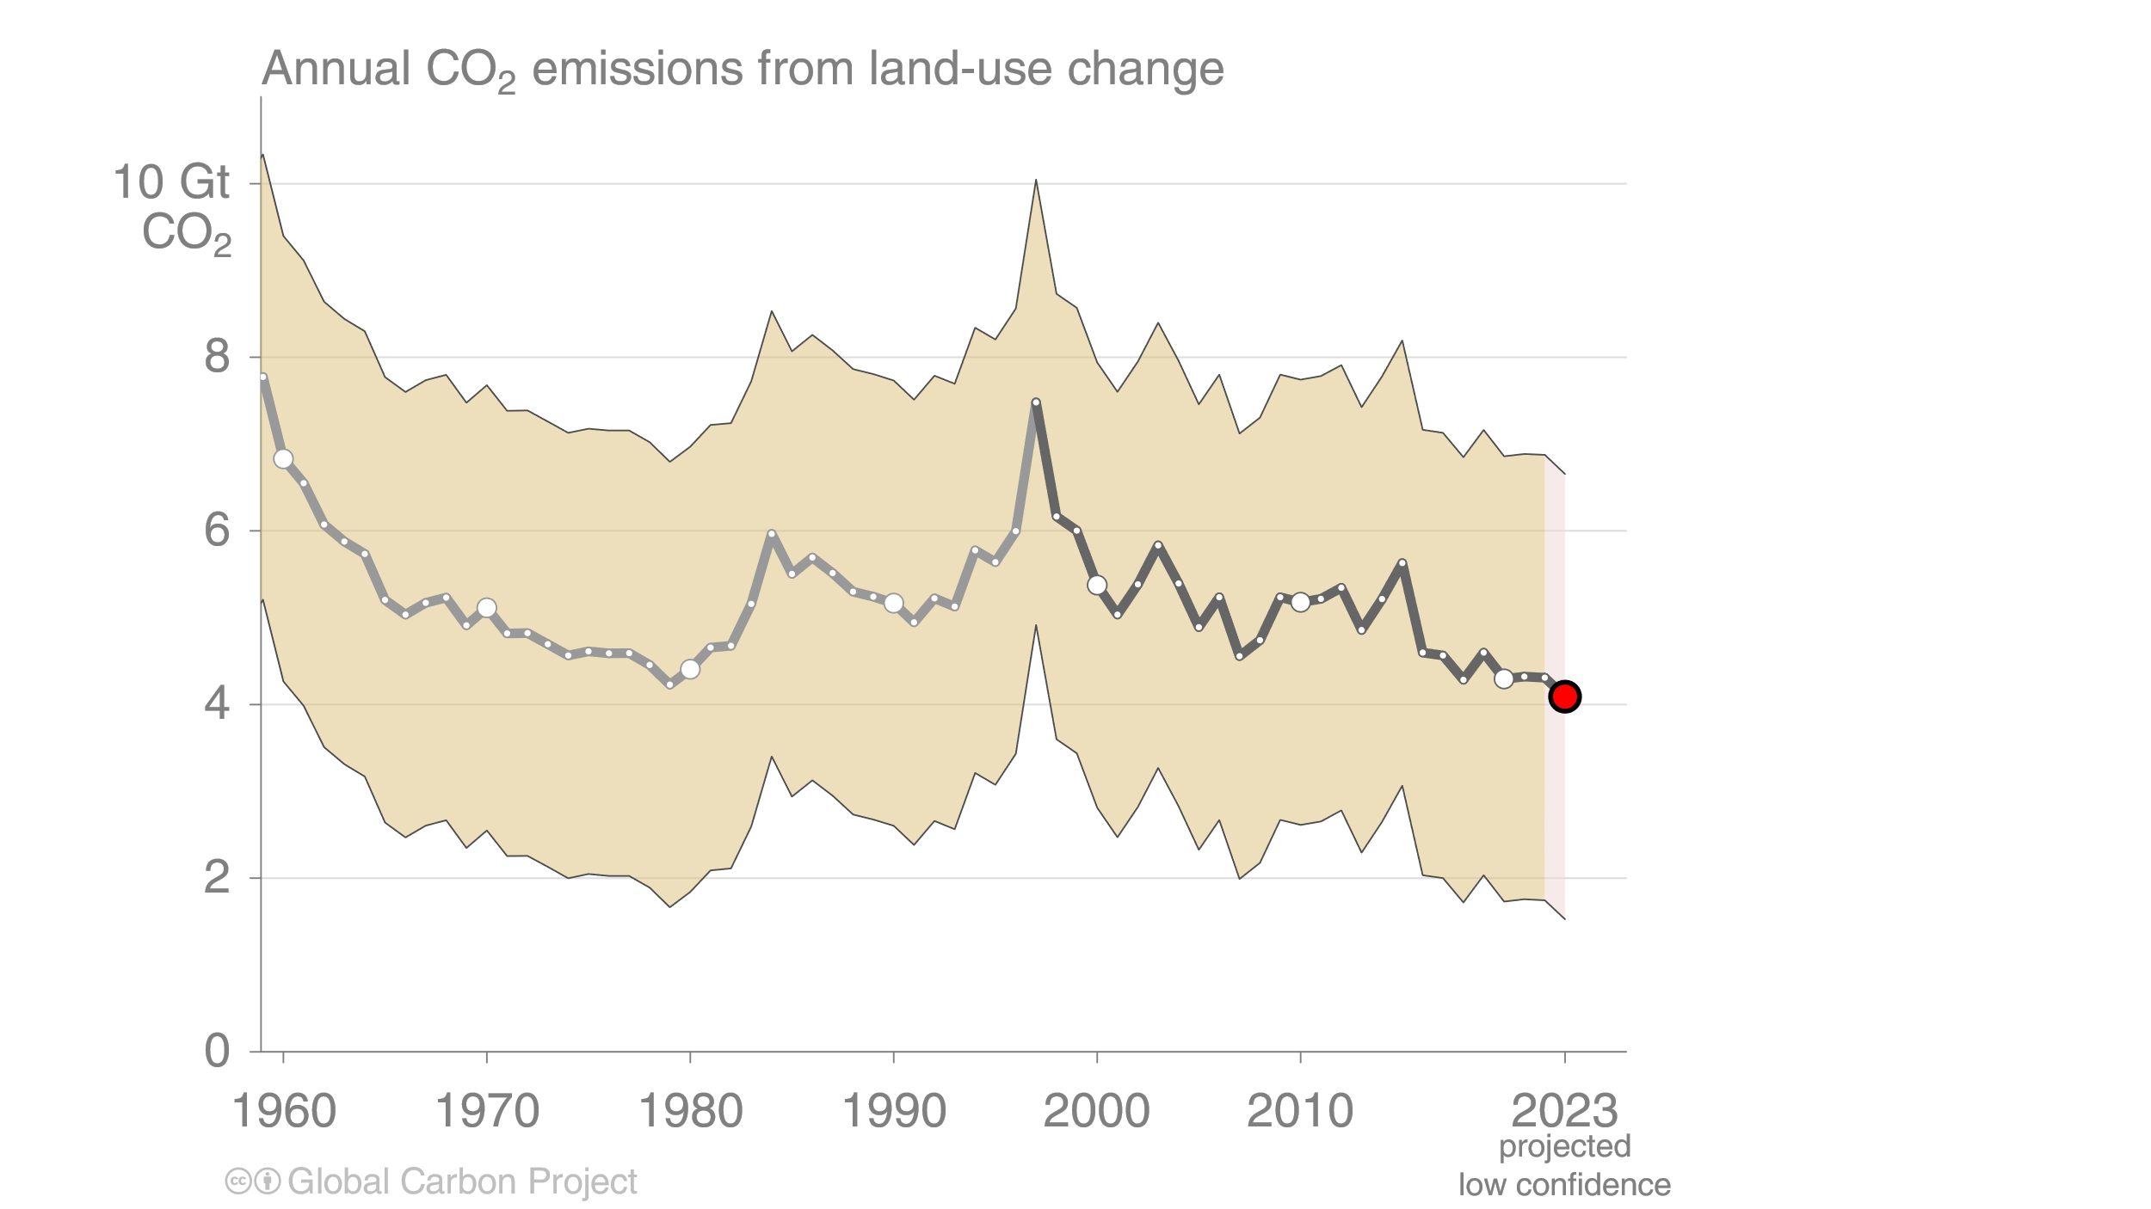
Land-use change emissions
Land-use change emissions are 4.7 ± 2.6 GtCO₂ per year for 2013–2022, and show a negative trend in the last two decades,
but estimates are still highly uncertain. Projection for 2023: 4.1 ± 2.6 GtCO₂
Indonesian fires
Estimates from three bookkeeping models
Source: Friedlingstein et al 2023; Global Carbon Project 2023

Slide 16
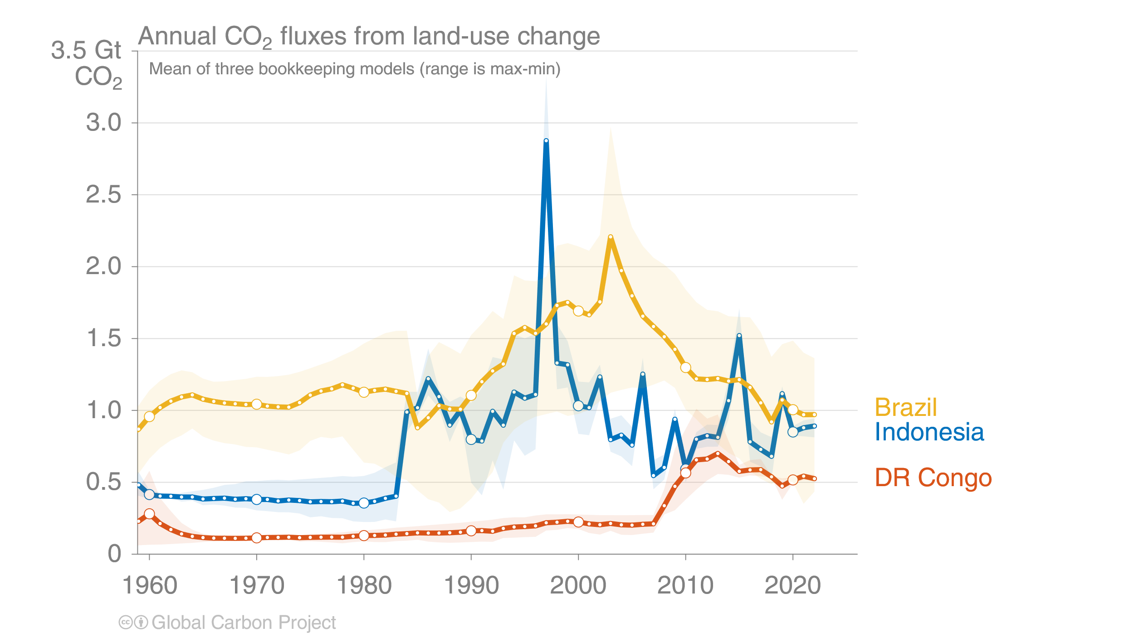
Land-use change emissions
Combined land-use change emissions from Brazil, Indonesia, and the Democratic Republic of the Congo
make up 55% of the global net land-use change emissions
Estimates from three bookkeeping models
Source: Friedlingstein et al 2023; Global Carbon Project 2023

Slide 17
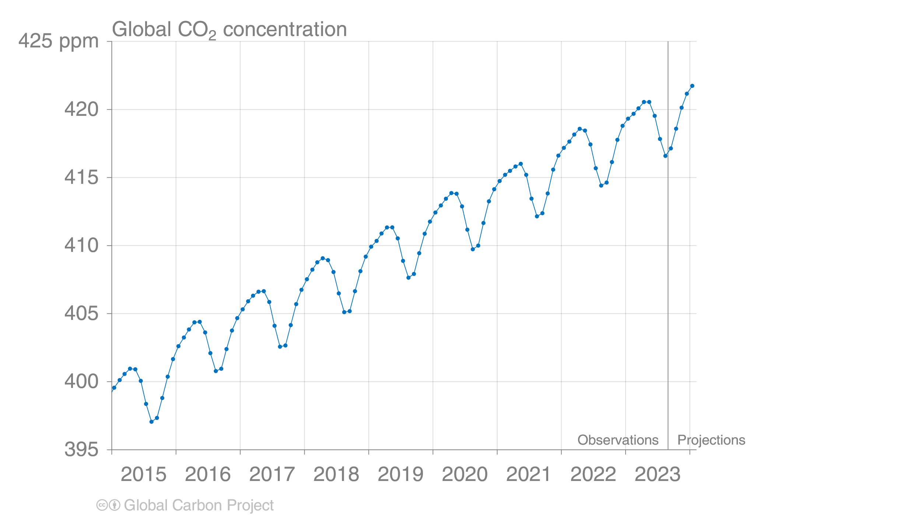
Forecast of global atmospheric CO₂ concentration
The global atmospheric CO₂ concentration is forecast to average 419.3 parts per million (ppm) in 2023, increasing by 2.4 ppm.
A bigger increase is expected in 2024 when the current El Niño has full effect.
Source: Friedlingstein et al 2023; Global Carbon Project 2023

Slide 18
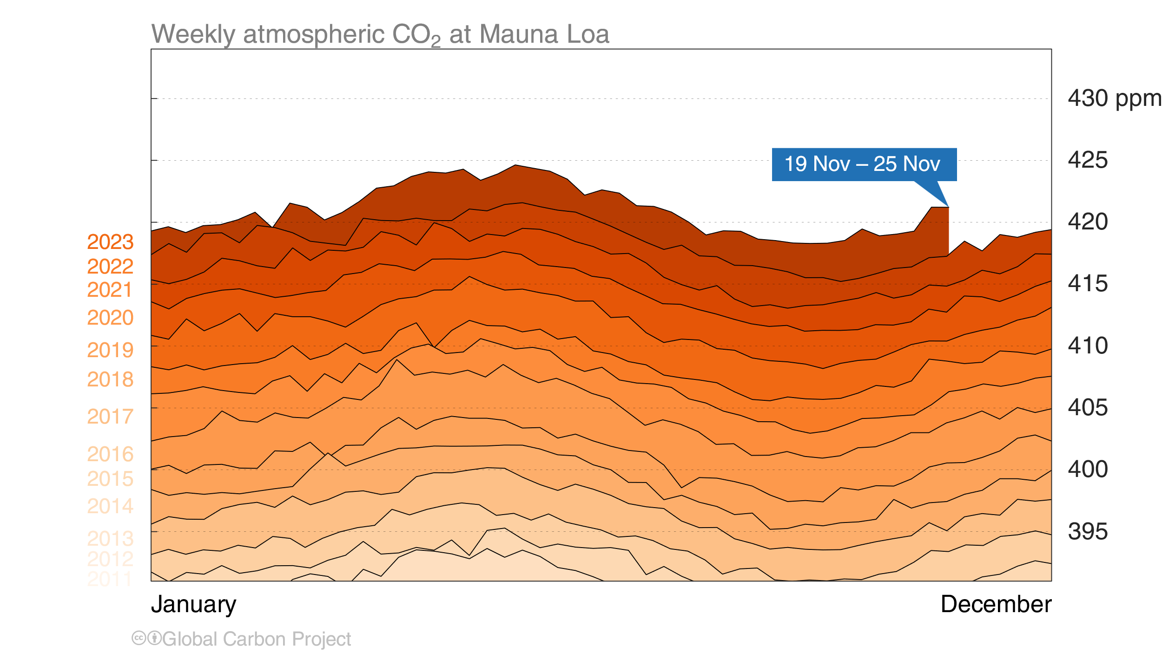
Mauna Loa atmospheric CO₂
Atmospheric CO₂ concentration has increased every single year,
including in 2020 – despite the drop in fossil CO₂ emissions – because of continued emissions
Source: Friedlingstein et al 2023; Global Carbon Project 2023

Slide 19
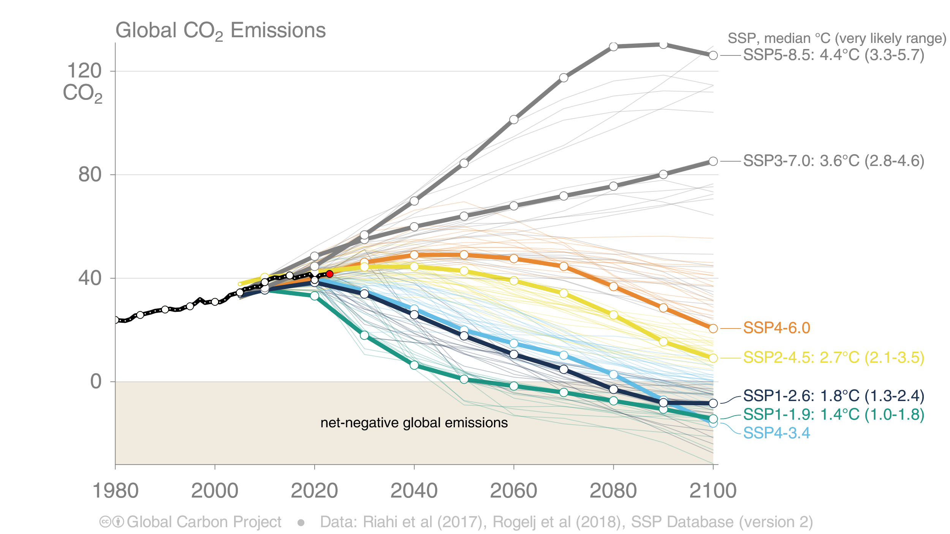
Shared Socioeconomic Pathways (SSPs)
The SSPs were designed to span the range of potential outcomes. Total CO₂ emissions are currently tracking in the middle of the range. The temperature outcomes are based on assessed scenarios in IPCC AR6 Working Group I.
This set of quantified SSPs are based on the output of six Integrated Assessment Models (AIM/CGE, GCAM, IMAGE, MESSAGE, REMIND, WITCH).
Net emissions include those from land-use change and bioenergy with CCS.
Source: Riahi et al. 2016; Rogelj et al. 2018; IIASA SSP Database; IAMC; Global Carbon Project 2023

Slide 20
Global fossil CO₂ emissions

Slide 21
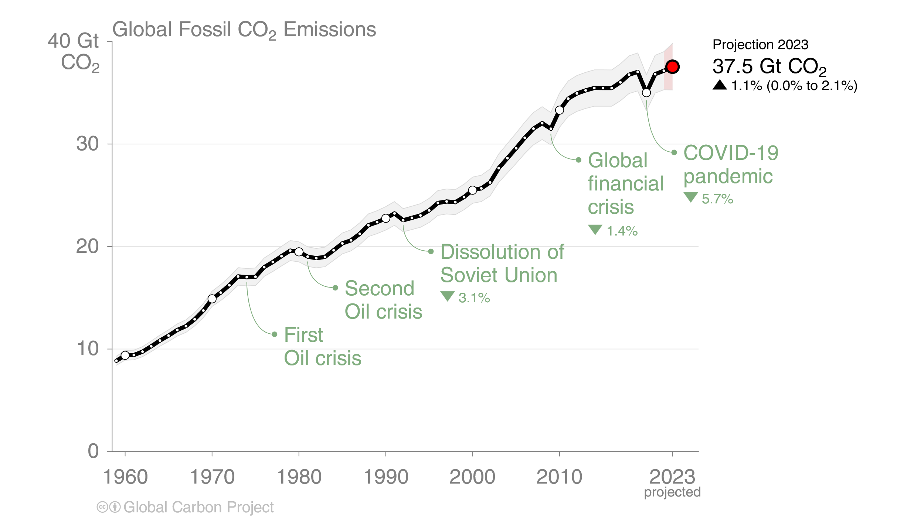
Global fossil CO₂ emissions
Global fossil CO₂ emissions have risen steadily over the last decades.
Emissions are set to grow again in 2023.
When including cement carbonation, the 2023 estimate is 36.8 ± 2 GtCO₂.
The 2023 projection is based on preliminary data and modelling.
Source: Friedlingstein et al 2023; Global Carbon Project 2023

Slide 22
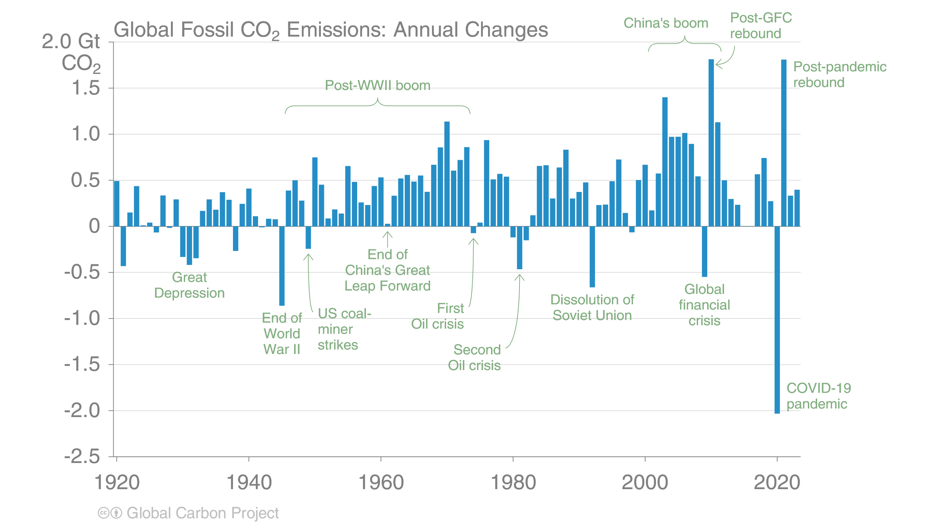
Global fossil CO₂ emissions
For the last 100 years, it has generally taken a crisis to drive global emissions reductions.
To stabilise temperatures, intentional, planned, sustained global reductions must begin.
The 2023 projection is based on preliminary data and modelling.
Source: Friedlingstein et al 2023; Global Carbon Project 2023

Slide 23
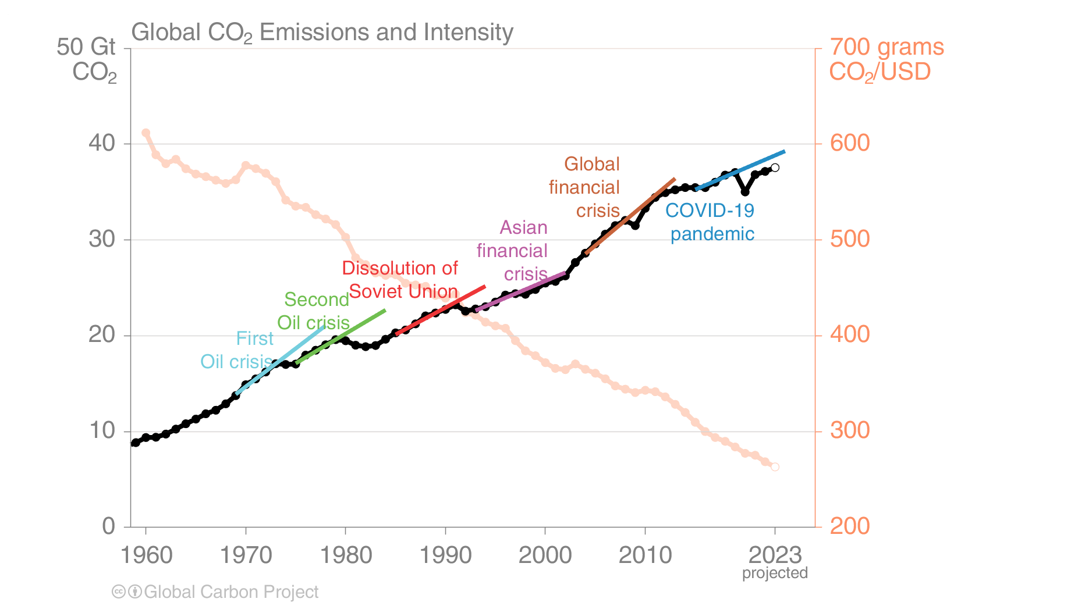
Fossil CO₂ emission intensity
Global CO₂ emissions growth has generally resumed quickly from global crises.
Emission intensity has steadily declined but not sufficiently to offset economic growth.
Each trend line is based on the five years before the crisis and extended to five years after.
Economic activity is measured in purchasing power parity (PPP) terms in 2017 US dollars.
Source: Friedlingstein et al 2023; Global Carbon Project 2023

Slide 24
Fossil CO₂ emissions by country

Slide 25
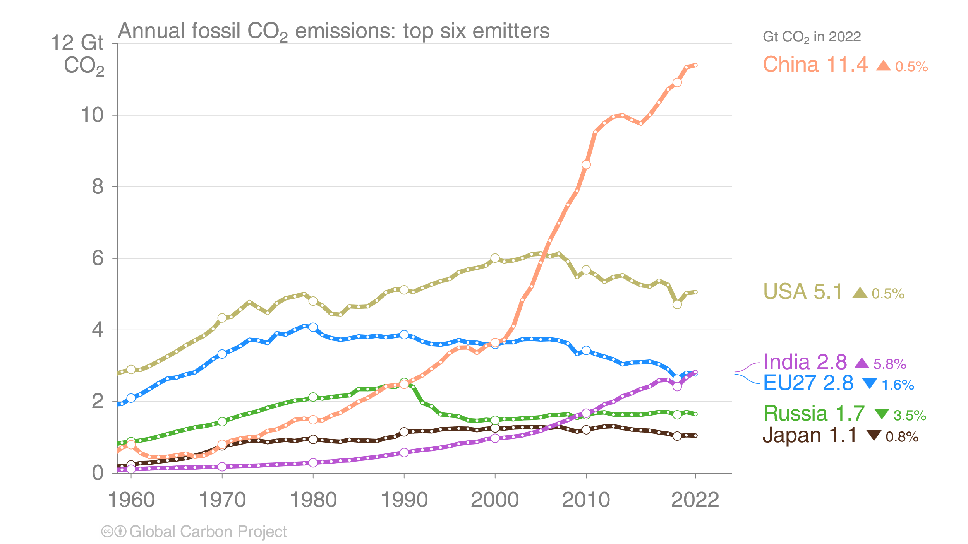
Top emitters: Fossil CO₂ emissions to 2022
The top six emitters in 2022 covered 67% of global emissions
China 31%, United States 14%, India 8%, EU 7%, Russia 4%, and Japan 3%
International aviation and maritime shipping (bunker fuels) contributed 2.8% of global emissions in 2022.
Source: Friedlingstein et al 2023; Global Carbon Project 2023

Slide 26
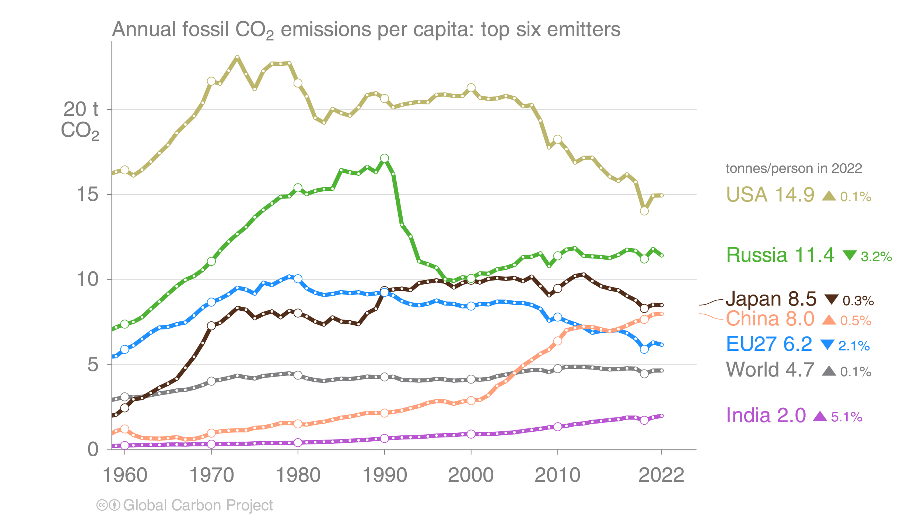
Top emitters: Fossil CO₂ emissions per capita to 2022
Countries have a broad range of per capita emissions reflecting their national circumstances
International aviation and maritime shipping (bunker fuels) contributed 2.8% of global emissions in 2022.
Source: Friedlingstein et al 2023; Global Carbon Project 2023

Slide 27
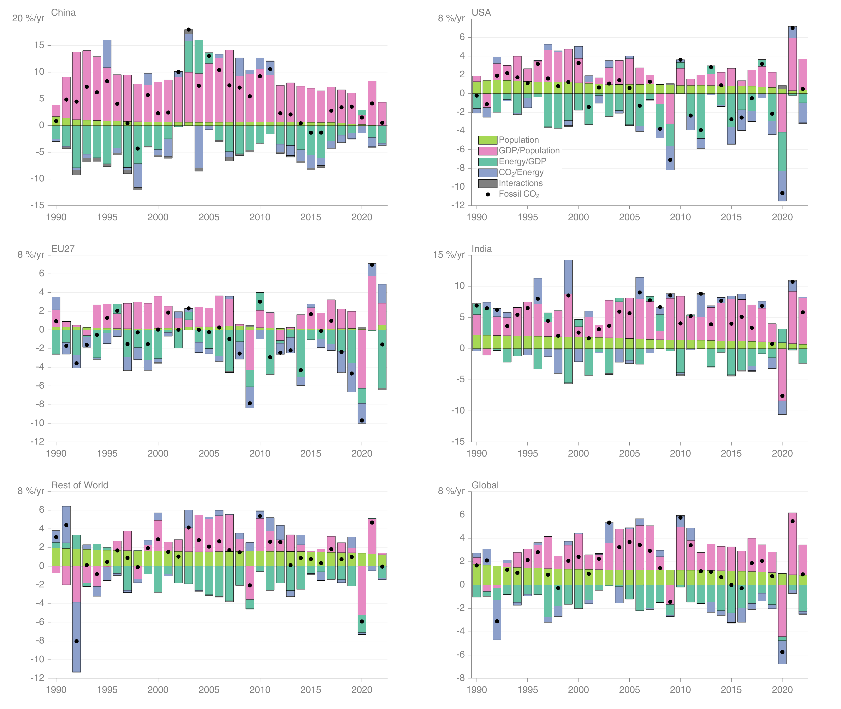
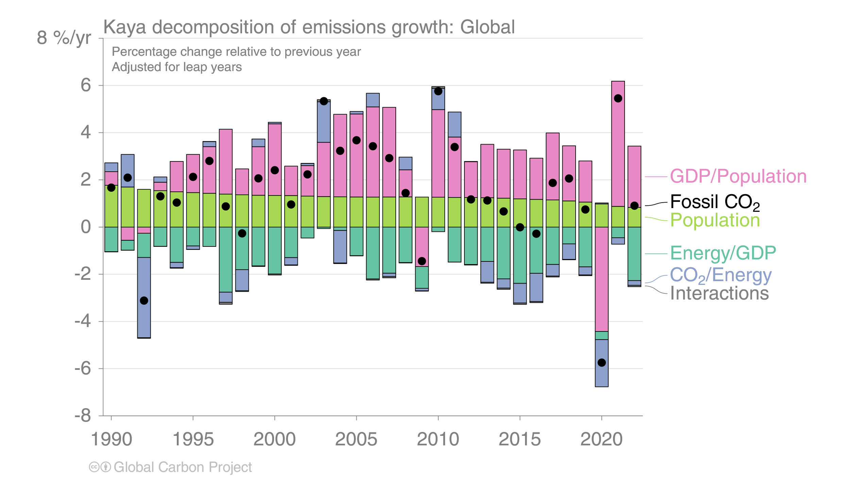
Fossil CO₂ emissions — Kaya decomposition
Globally, decarbonisation and declines in energy per GDP are largely responsible for the reduced growth rate in emissions over the last decade. 2020 was a clear outlier with a sharp decline in GDP.
Source: Friedlingstein et al 2023; Global Carbon Project 2023

Slide 28
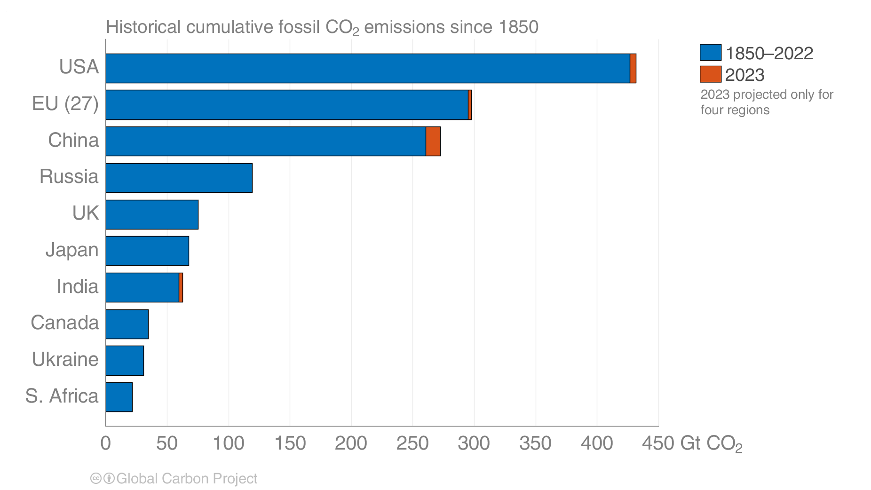
Historical cumulative fossil CO₂ emissions
The USA and EU have the highest accumulated fossil CO₂ emissions since 1850, but China is a close third.
Calculated using territorial emissions.
Source: Friedlingstein et al 2023; Global Carbon Project 2023

Slide 29
Fossil CO₂ emissions by source

Slide 30
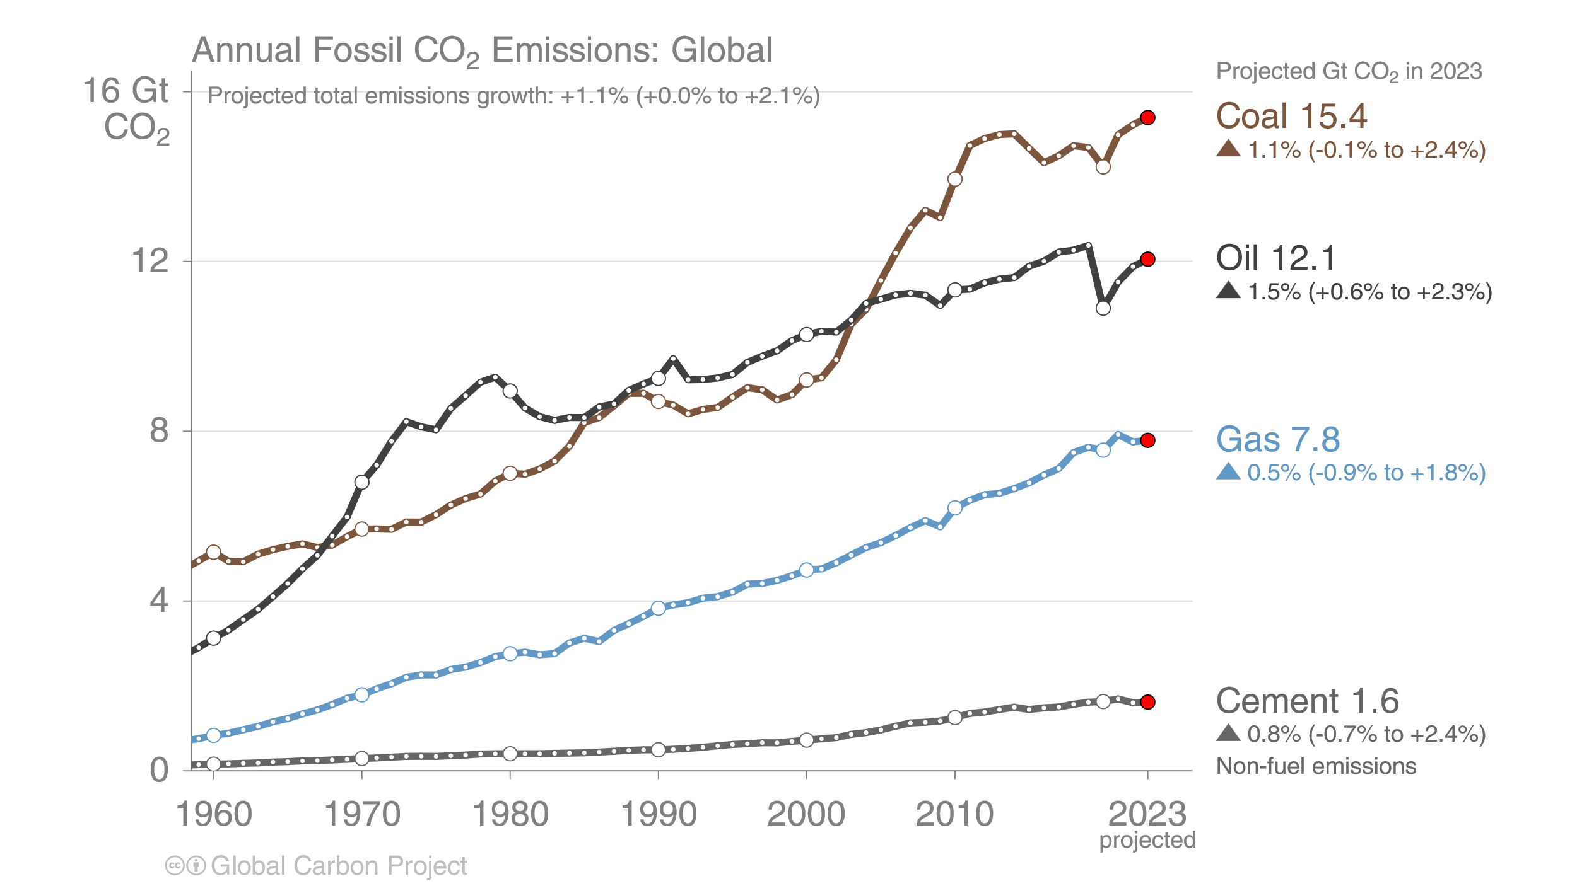
Fossil CO₂ emissions by source
Share of global fossil CO₂ emissions in 2023: coal (41%), oil (32%), gas (21%),
cement (4%), flaring and others (2%, not shown)
The 2023 projection is based on preliminary data and modelling.
Source: Friedlingstein et al 2023; Global Carbon Project 2023

Slide 31
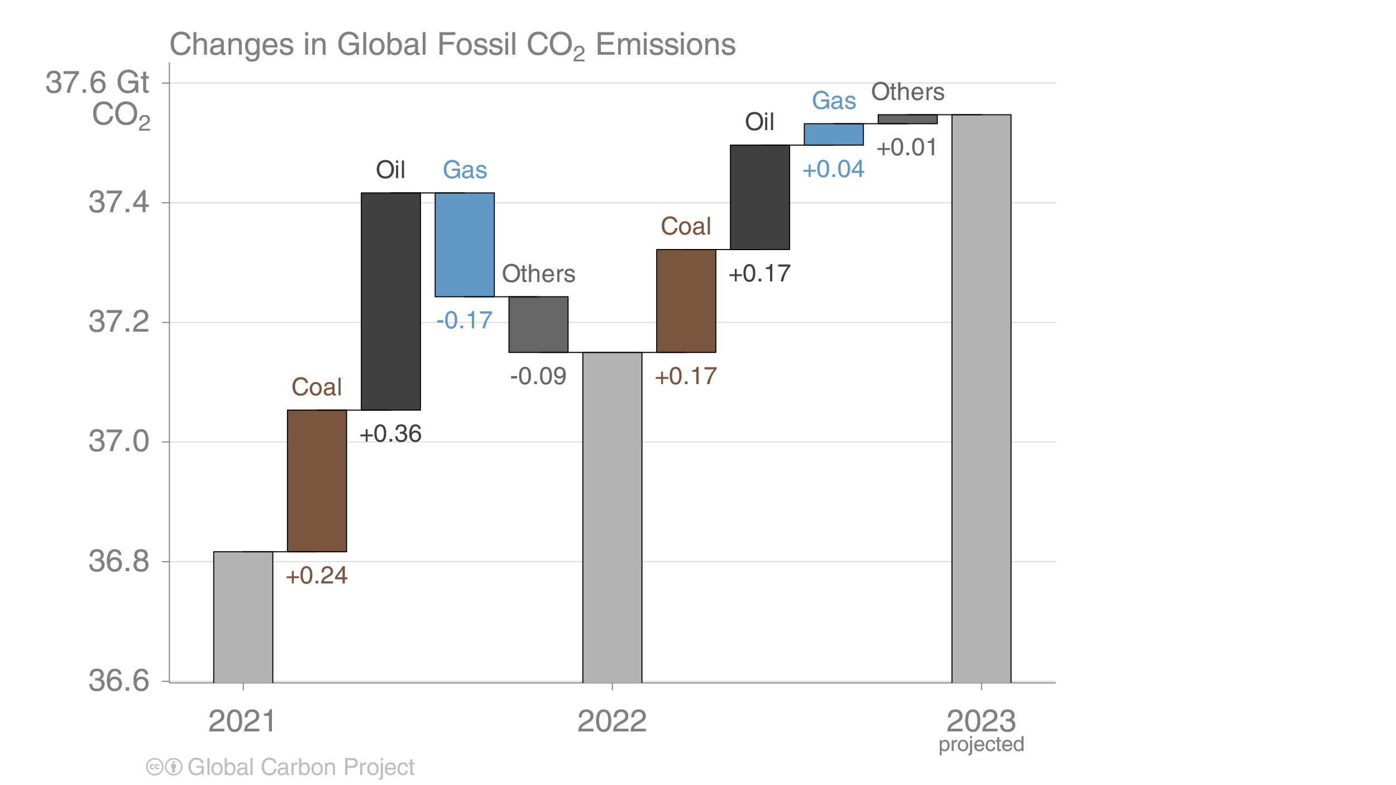
Fossil CO₂ emissions growth: 2021–2023
Global emissions from oil continued to rebound in both 2022 and 2023 with recovery of aviation.
In 2022 natural gas declined because of supply constraints but returns to growth in 2023. Coal continues to climb.
Source: Friedlingstein et al 2023; Global Carbon Project 2023

Slide 32
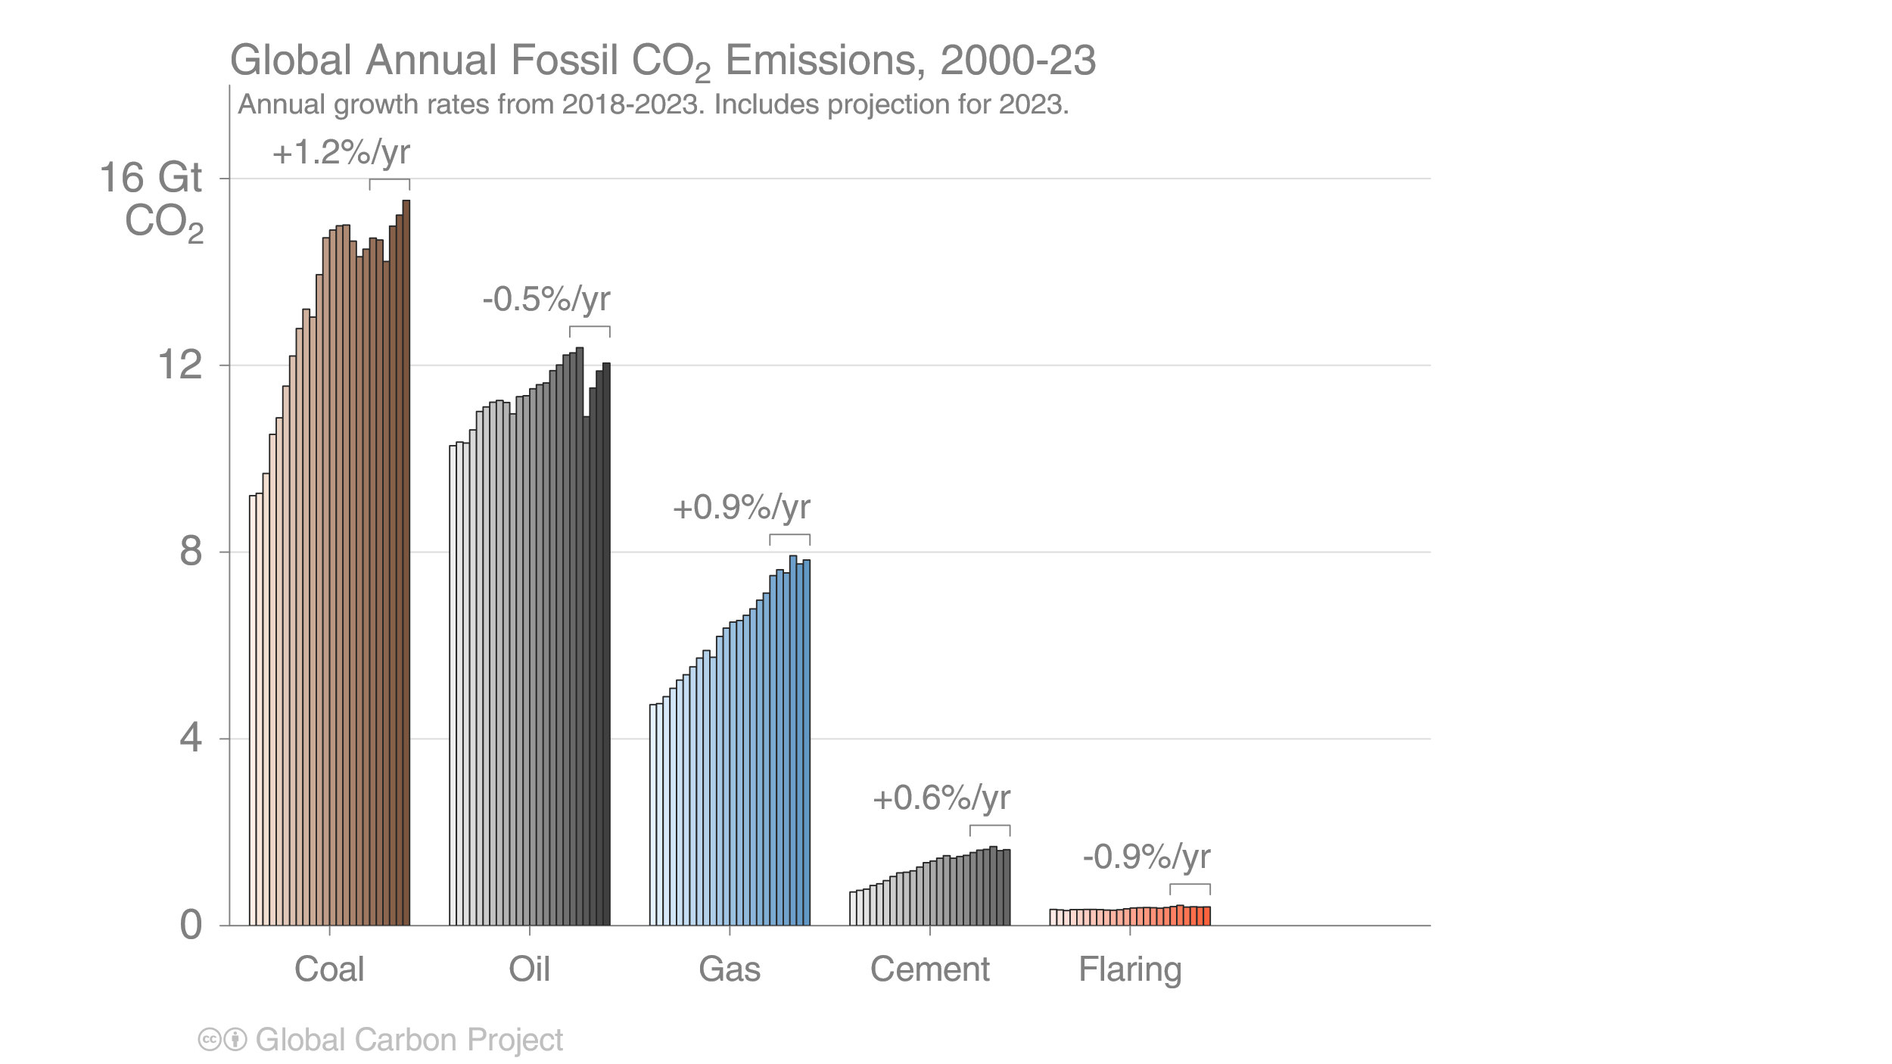
Fossil CO₂ emissions by source
Emissions by category from 2000 to 2023, with growth rates indicated for the more recent period of 2018 to 2023
Coal use has returned to growth, and both coal and oil declined sharply in the pandemic year 2020
Source: Friedlingstein et al 2023; Global Carbon Project 2023

Slide 33
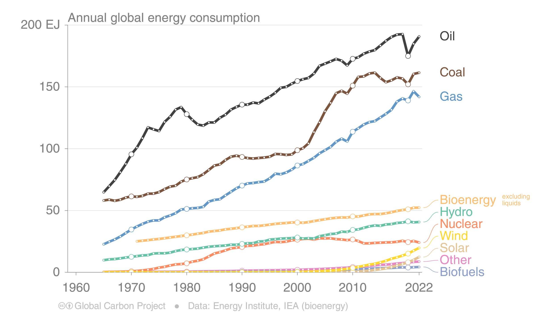
Energy use by source
Consumption of natural gas declined in 2022, but oil recovered most of its pandemic-period losses.
Renewable energy continued to grow, but needs to grow even faster to replace fossil energy consumption.
This figure shows “primary energy” using the substitution method
(non-fossil sources are scaled up by an assumed fossil efficiency of approximately 0.38)
Source: Energy Institute 2023; Global Carbon Project 2023

Slide 34
Fossil CO₂ emission by source for top emitters

Slide 35
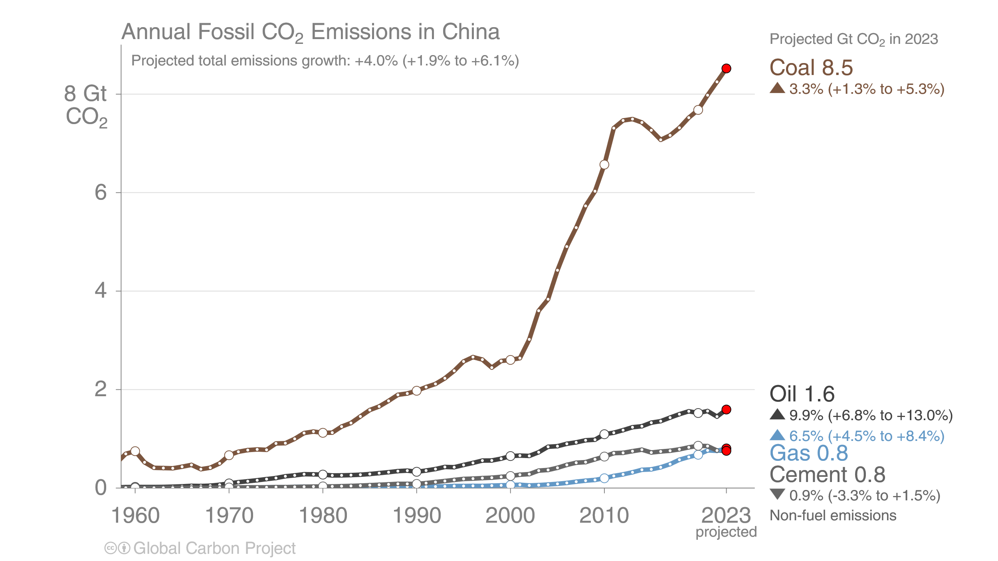
Fossil CO₂ emissions in China
China’s coal consumption continued to grow strongly in 2023,
while emissions from oil recovered their losses from 2022’s COVID-19 lockdowns
Source: Friedlingstein et al 2023; Global Carbon Project 2023

Slide 36
Fossil CO₂ emissions in USA
The USA’s emissions from coal are expected to drop again in 2023, to their lowest level since 1903,
as the transition to natural gas continues. Emissions from oil are still below 2019’s level.
Source: EIA 2023; Friedlingstein et al 2023; Global Carbon Project 2023

Slide 37
Fossil CO₂ emissions in India
India’s emissions continue to grow sharply in 2023. Increases in solar and wind capacity were far from sufficient to meet a large increase in power demand as the economy grows strongly.
Source: Friedlingstein et al 2023; Global Carbon Project 2023

Slide 38
Fossil CO₂ emissions in the European Union
The EU’s emissions from all three fossil fuels are expected to have declined in 2023, resulting from high prices and other economic headwinds on top of existing trends.
Source: Friedlingstein et al 2023; Global Carbon Project 2023

Slide 39
Fossil CO₂ emissions in Rest of World
In the Rest of the World, emissions from coal grow slightly while natural gas is flat.
Oil in international aviation grew strongly again, but total oil in all other countries declined.
The Rest of the World is the global total less China, US, EU, and India.
Source: Friedlingstein et al 2023; Global Carbon Project 2023

Slide 40
Cement carbonation sink

Slide 41
Cement carbonation sink
The production of cement results in ‘process’ emissions of CO₂ from the chemical decomposition of carbonates.
During its lifetime, cement re-absorbs some CO₂ from the atmosphere.
Source: Friedlingstein et al 2023; Global Carbon Project 2023

Slide 42
Land-use change emissions

Slide 43
Land-use change emissions
Land-use change emissions are 4.7 ± 2.6 GtCO₂ per year for 2013–2022, and show a negative trend in the last two decades, but estimates are still highly uncertain.
Net land use emissions are the result of multiple anthropogenic activities on land that lead to CO₂ emissions or removals
Indonesian fires
Projection for 2023:
4.1 ± 2.6 GtCO₂
Estimates from three bookkeeping models
Source: Friedlingstein et al 2023; Global Carbon Project 2023

Slide 44
Land-use change emissions
Emissions from permanent deforestation are 4.2 GtCO₂ per year for 2013–2022.
Carbon dioxide removals through permanent af/reforestation are 1.9 GtCO₂ per year over the same period.
Estimates from three bookkeeping models
Source: Friedlingstein et al 2023; Global Carbon Project 2023

Slide 45
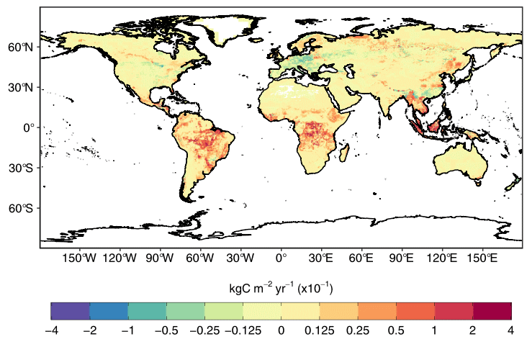
Regional patterns of land-use change emissions
The top three emitters over 2013–2022 – Brazil, Indonesia, and the Democratic Republic of the Congo – contribute 55% of the global net land-use emissions.
Land-use emissions are high in the tropics, driven largely by deforestation. Net sinks occur in regions of re/afforestation such as parts of Europe and China.
Land-use emissions, decadal average 2013–2022
Estimates from three bookkeeping models
Source: Friedlingstein et al 2023; Global Carbon Project 2023
The peak in Indonesia in 1997 was the Indonesian peat fires.

Slide 46
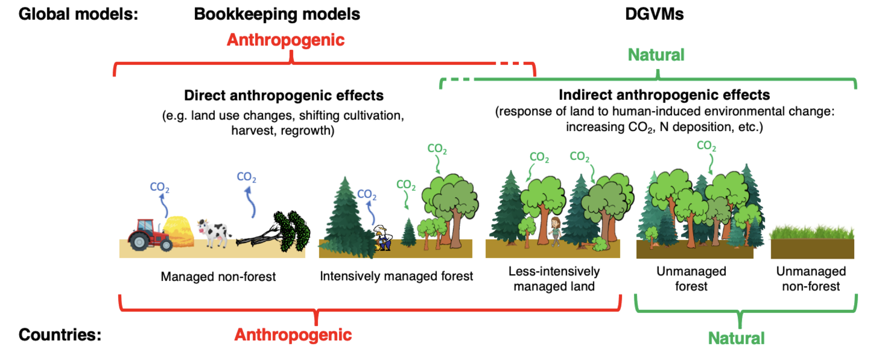
Linking global models to country reports
Mapping of global carbon cycle model land flux definitions to the definition of the LULUCF net flux used in national Greenhouse Gas Inventories (NGHGI) reported to UNFCCC
When natural fluxes on managed forests (-7.5 GtCO₂ per year for 2013–2022) are added to land-use emissions (4.7 GtCO₂ per year), the GCB2023 estimates (-2.1 GtCO₂ per year) are very similar to the country-reported data (-2.0 GtCO₂ per year), linking the anthropogenic carbon budget estimates of land CO₂ fluxes directly to the Global Stocktake as part of UNFCCC Paris Agreement.
Source: Friedlingstein et al 2023; Global Carbon Project 2023
Figure from Grassi et al., ESSD 2023

Slide 47
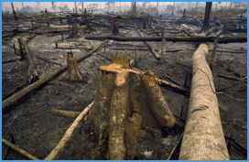
Total global emissions
Total global emissions, projected to reach 40.9 ± 3.2 GtCO₂ in 2023, 47% over 1990
Percentage land-use change: 42% in 1960, 12% averaged 2013–2022
Land-use change estimates from three bookkeeping models, using fire-based variability from 1997
Source: Friedlingstein et al 2023; Global Carbon Project 2023

Slide 48
Closing the Global Carbon Budget

Slide 49
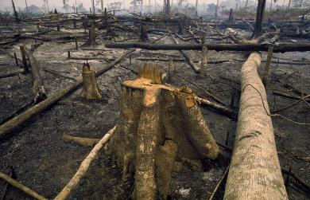
Fate of anthropogenic CO₂ emissions (2013–2022)
Sources = Sinks
18.9 GtCO₂/yr
47%
35.3 GtCO₂/yr
88%
31%
12.3 GtCO₂/yr
12%
4.7 GtCO₂/yr
26%
10.4 GtCO₂/yr
Budget Imbalance:
(the difference between estimated sources & sinks)
4%
-1.6 GtCO₂/yr
Source: Friedlingstein et al 2023; Global Carbon Project 2023

Slide 50
Global carbon budget
Carbon emissions are partitioned among the atmosphere and carbon sinks on land and in the ocean
The “imbalance” between total emissions and total sinks is an active area of research
Source: Friedlingstein et al 2023; Global Carbon Project 2023

Slide 51
Changes in the budget over time
The sinks have continued to grow with increasing emissions, but climate change will affect
carbon cycle processes in a way that will exacerbate the increase of CO₂ in the atmosphere
The budget imbalance is the total emissions minus the estimated growth in the atmosphere, land and ocean.
It reflects the limits of our understanding of the carbon cycle.
Source: Friedlingstein et al 2023; Global Carbon Project 2023

Slide 52
Global carbon budget
Fossil emissions dominate in the Northern Hemisphere, while land-use emissions are important in the tropics.
The North Atlantic and Southern Ocean are carbon sinks while the tropical ocean is a source of CO₂.
Tropical, temperate and boreal forest are the main terrestrial carbon sinks
CO₂ Sink
CO₂ Source
Source: Friedlingstein et al 2023; Global Carbon Project 2023
CO₂ Source
CO₂ Sink
CO₂ Source
CO₂ Sink

Slide 53
Atmospheric concentration
The atmospheric concentration growth rate has increased steadily.
The high growth in 1987, 1998, & 2015–16 reflect a strong El Niño, which weakens the land sink.
The effects of the currently emerging El Niño are expected to be most visible in the growth rate in 2024.
Projected 2023
Source: NOAA-GML; Friedlingstein et al 2023; Global Carbon Project 2023

Slide 54
Airborne Fraction
The airborne fraction is the proportion of the total annual CO₂ emissions that remains in the atmosphere.
The rest of the CO₂ emissions are removed by the land and ocean sinks.
Around 45% of CO₂ emissions remain in the atmosphere despite sustained growth in CO₂ emissions.
Source: Friedlingstein et al 2023; Global Carbon Project 2023

Slide 55
Ocean sink
The ocean carbon sink, estimated by Global Ocean Biogeochemical Models and observation-based data products,
amounts to 10.4 ± 1.5 GtCO₂/yr for 2013–2022 and 10.2 ± 1.5 GtCO₂/yr in 2022.
The ocean CO₂ sink has not grown since 2019 due to a triple La Niña event during 2020–2022.
Source: SOCATv2023; Bakker et al 2016; Friedlingstein et al 2023; Global Carbon Project 2023

Slide 56
Terrestrial sink
The land carbon sink, estimated by Dynamic Global Vegetation Models, was 12.3 ± 3.1 GtCO₂/yr
during 2013–2022 and 13.9 ± 3.0 GtCO₂/yr in 2022.
The total CO₂ fluxes on land (including land-use change) are also constrained by atmospheric inversions.
Source: Friedlingstein et al 2023; Global Carbon Project 2023

Slide 57
Land and ocean sinks — Effects of CO₂ vs climate change
Process models suggest that increasing atmospheric CO₂ drives the land and ocean sinks while climate change reduces the carbon sinks; the climate effect is largest in tropical and semi-arid land ecosystems.
Globally during the 2013–2022 decade, climate change reduced the land sink by ~20% and the ocean sink by ~7%.
CO₂ Sink
CO₂ Source
Source: Friedlingstein et al 2023; Global Carbon Project 2023

Slide 58
Land and ocean sinks — Estimates from atmospheric inversions
Both atmospheric CO₂ inversions and atmospheric oxygen allow to estimate the land and ocean carbon fluxes, independently from the land and ocean process-based models, confirming the global carbon budget estimates of the land and ocean partitioning of anthropogenic CO₂
Source: Friedlingstein et al 2023; Global Carbon Project 2023

Slide 59
Total land and ocean fluxes
Total land and ocean fluxes show more interannual variability in the tropics
Source: Friedlingstein et al 2023; Global Carbon Project 2023

Slide 60
Remaining carbon budget imbalance
Large and unexplained variability in the global carbon balance caused by uncertainty
and understanding hinder independent verification of reported CO₂ emissions
positive values mean overestimated emissions and/or underestimated sinks
The budget imbalance is the carbon left after adding independent estimates for total emissions, minus the
atmospheric growth rate and estimates for the land and ocean carbon sinks using models constrained by observations
Source: Friedlingstein et al 2023; Global Carbon Project 2023

Slide 61
Global carbon budget
The cumulative contributions to the global carbon budget from 1850
The carbon imbalance represents the gap in our current understanding of sources & sinks
Source: Friedlingstein et al 2023; Global Carbon Project 2023

Slide 62
Remaining carbon budget
The remaining carbon budget to limit global warming to 1.5°C , 1.7°C and 2°C is
275 GtCO₂, 625 GtCO₂, and 1150 GtCO₂ respectively, equivalent to 7, 15 and 28 years from 2024.
2590 GtCO₂ have been emitted since 1850
The remaining carbon budgets is the average of two estimates (IPCC AR6 and Forster et al., 2023), both updated by removing the most recent emissions.
Quantities are subject to additional uncertainties e.g., future mitigation choices of non-CO₂ emissions
Source: IPCC AR6 WG1; Forster et al., 2023; Friedlingstein et al 2023; Global Carbon Project 2023

Slide 63
Remaining carbon budget
Global CO₂ emissions must reach zero to limit global warming
Source: Friedlingstein et al 2023; Global Carbon Project 2023

Slide 64
Acknowledgements

Slide 65







Acknowledgements
The work presented in the Global Carbon Budget 2023 has been possible thanks to the contributions of hundreds of people involved in observational networks, modeling, and synthesis efforts.
We thank the institutions and agencies that provide support for individuals and funding that enable the collaborative effort of bringing all components together in the carbon budget effort.
We thank the sponsors of the GCP and GCP support and liaison offices.
We also want to thank the EU/H2020 project 4C (821003) that supported this coordinated effort as well as each of the many funding agencies that supported the individual components of this release. A full list is provided in Friedlingstein et al. 2023.
https://doi.org/10.5194/essd-15-5301-2023
We also thanks the Fondation BNP Paribas for supporting the Global Carbon Atlas and the Integrated Carbon Observation System (ICOS) for hosting our data.
This presentation was created by Robbie Andrew and Pierre Friedlingstein with Pep Canadell, Glen Peters and Corinne Le Quéré in support of the international carbon research community.

Slide 66
Additional Figures

Slide 67
Additional Figures
Fossil CO₂

Slide 68
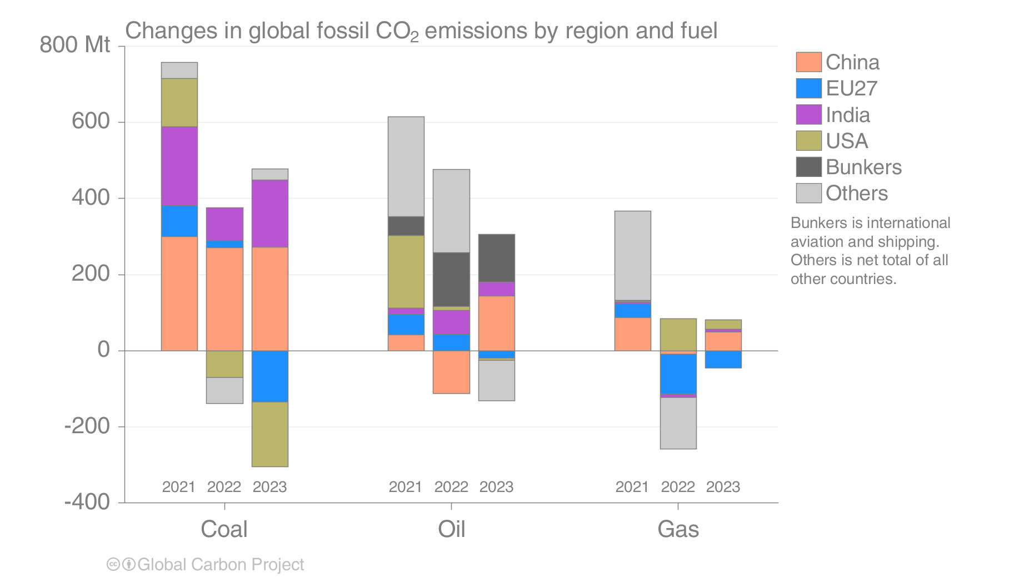
Emissions changes 2021–2023
Emissions from coal in China and India have been a core reason for global growth. Both 2022 and 2023 were marked by post-pandemic recovery in international aviation (bunkers).
Source: Friedlingstein et al 2023; Global Carbon Project 2023

Slide 69
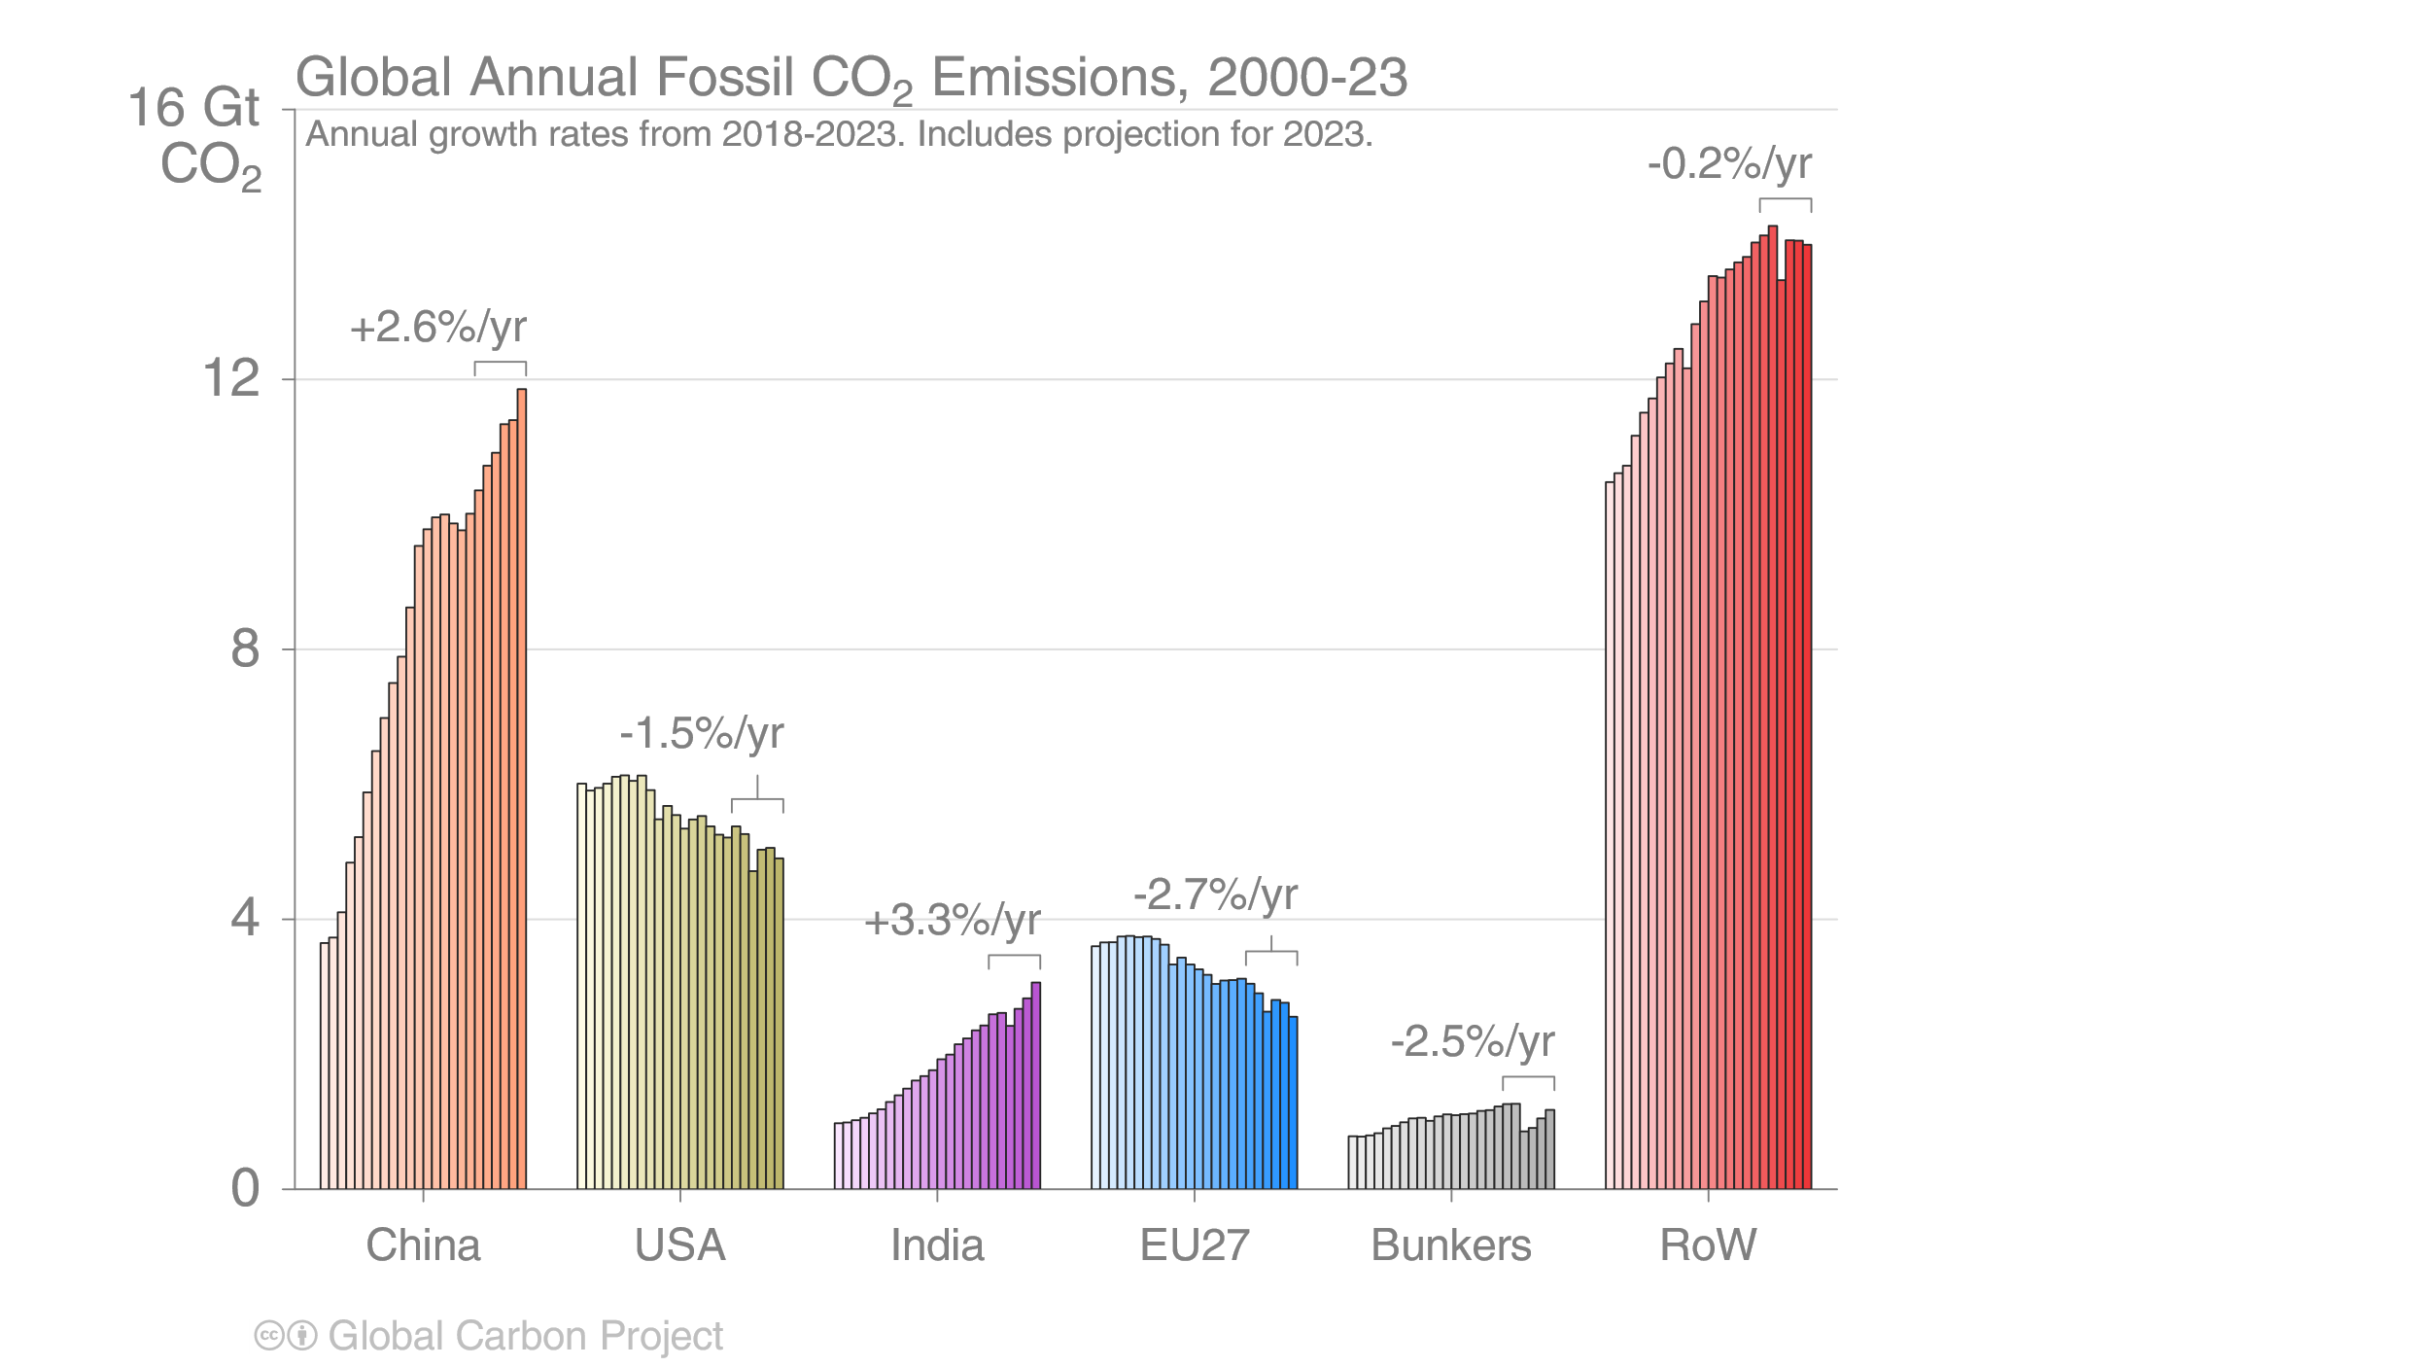
Top emitters: Fossil CO₂ Emissions
Emissions by country from 2000 to 2023, with the growth rates
indicated for the more recent period of 2018 to 2023
Source: Friedlingstein et al 2023; Global Carbon Project 2023

Slide 70
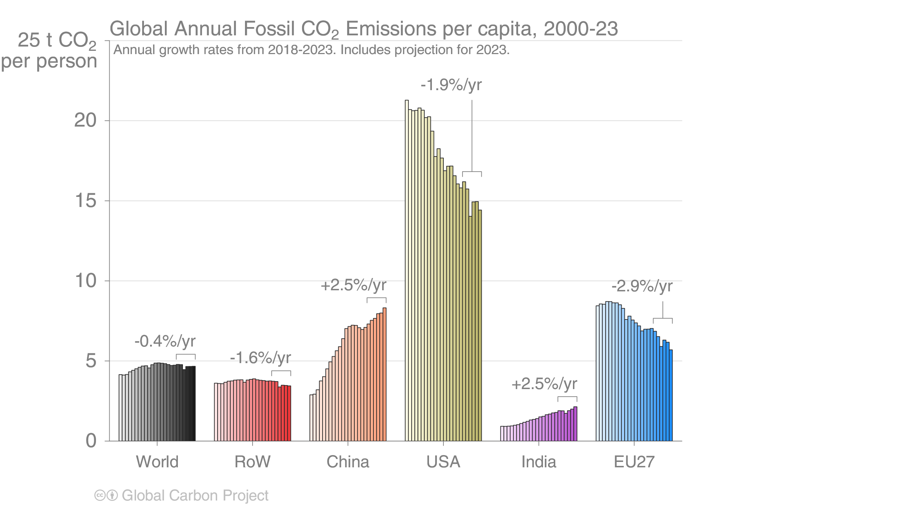
Per capita CO₂ emissions
Source: Friedlingstein et al 2023; Global Carbon Project 2023

Slide 71
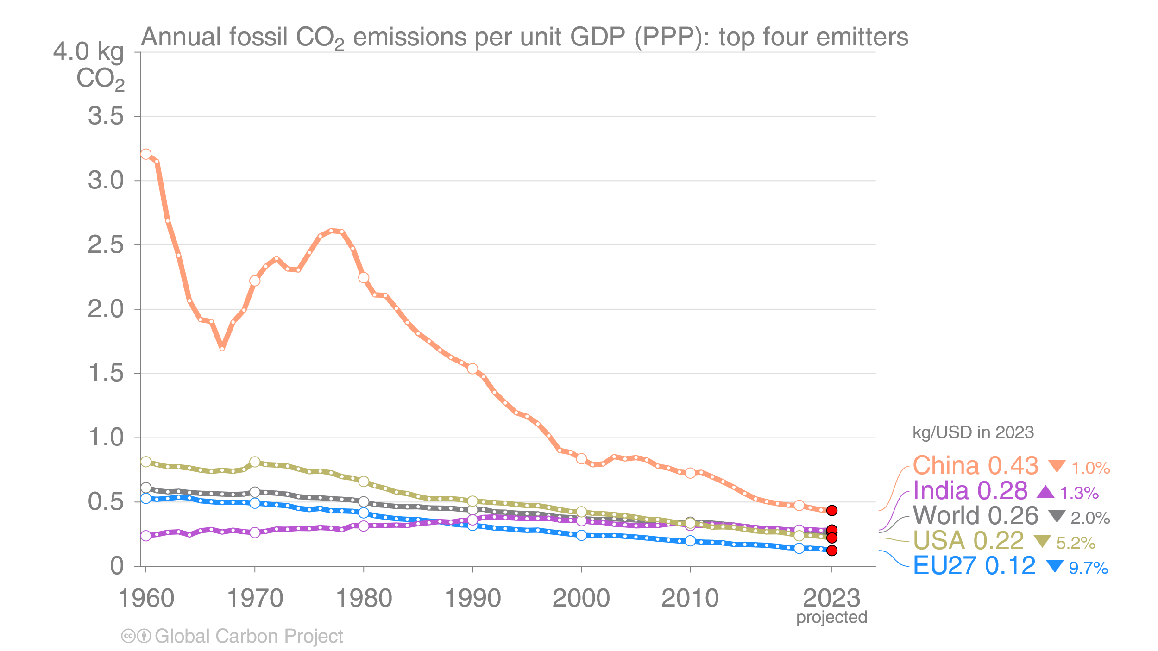
Top emitters: Fossil CO₂ Emission Intensity
Emission intensity (emission per unit economic output) generally declines over time.
In many countries, these declines are insufficient to overcome economic growth.
GDP is measured in purchasing power parity (PPP) terms in 2017 US dollars.
Source: Friedlingstein et al 2023; Global Carbon Project 2023

Slide 72
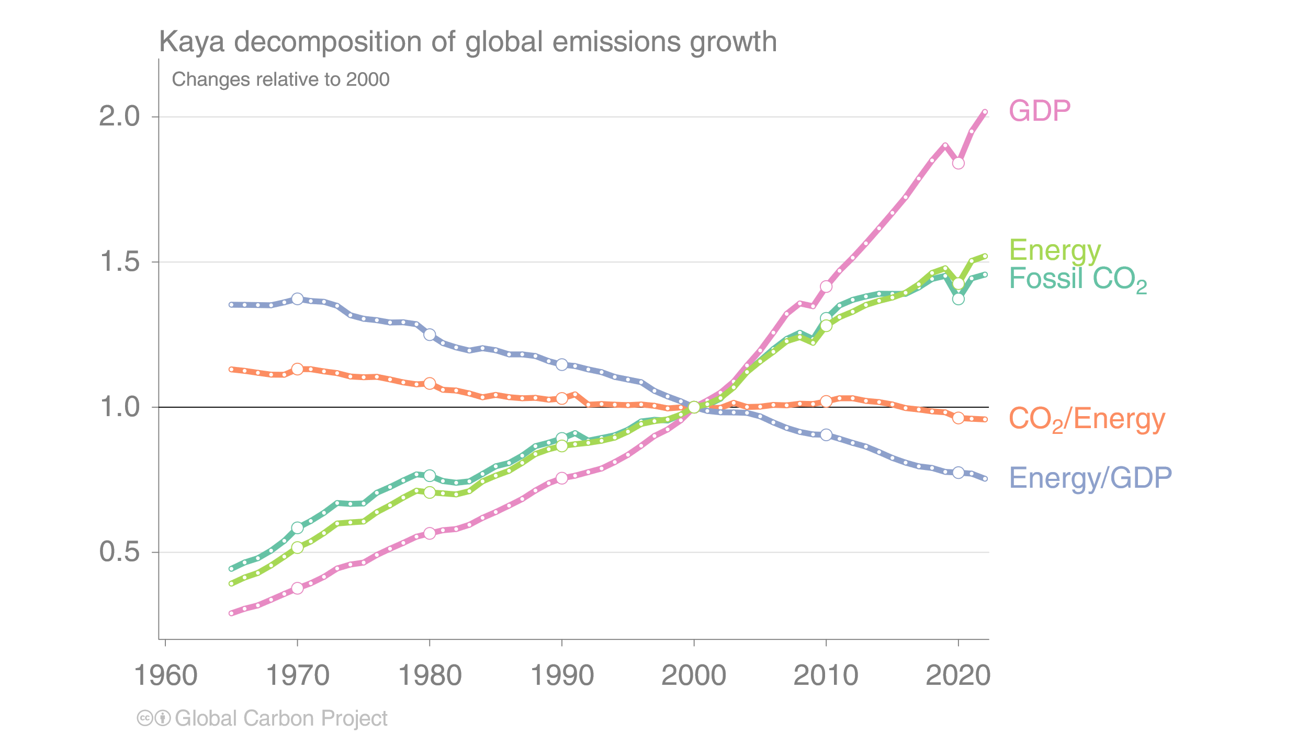
Kaya decomposition
The Kaya decomposition illustrates that relative decoupling of economic growth from CO₂ emissions
is driven by improved energy intensity (Energy/GDP) and, recently, carbon intensity of energy (CO₂/Energy)
GDP: Gross Domestic Product (economic activity)
Source: Friedlingstein et al 2023; Global Carbon Project 2023

Slide 73
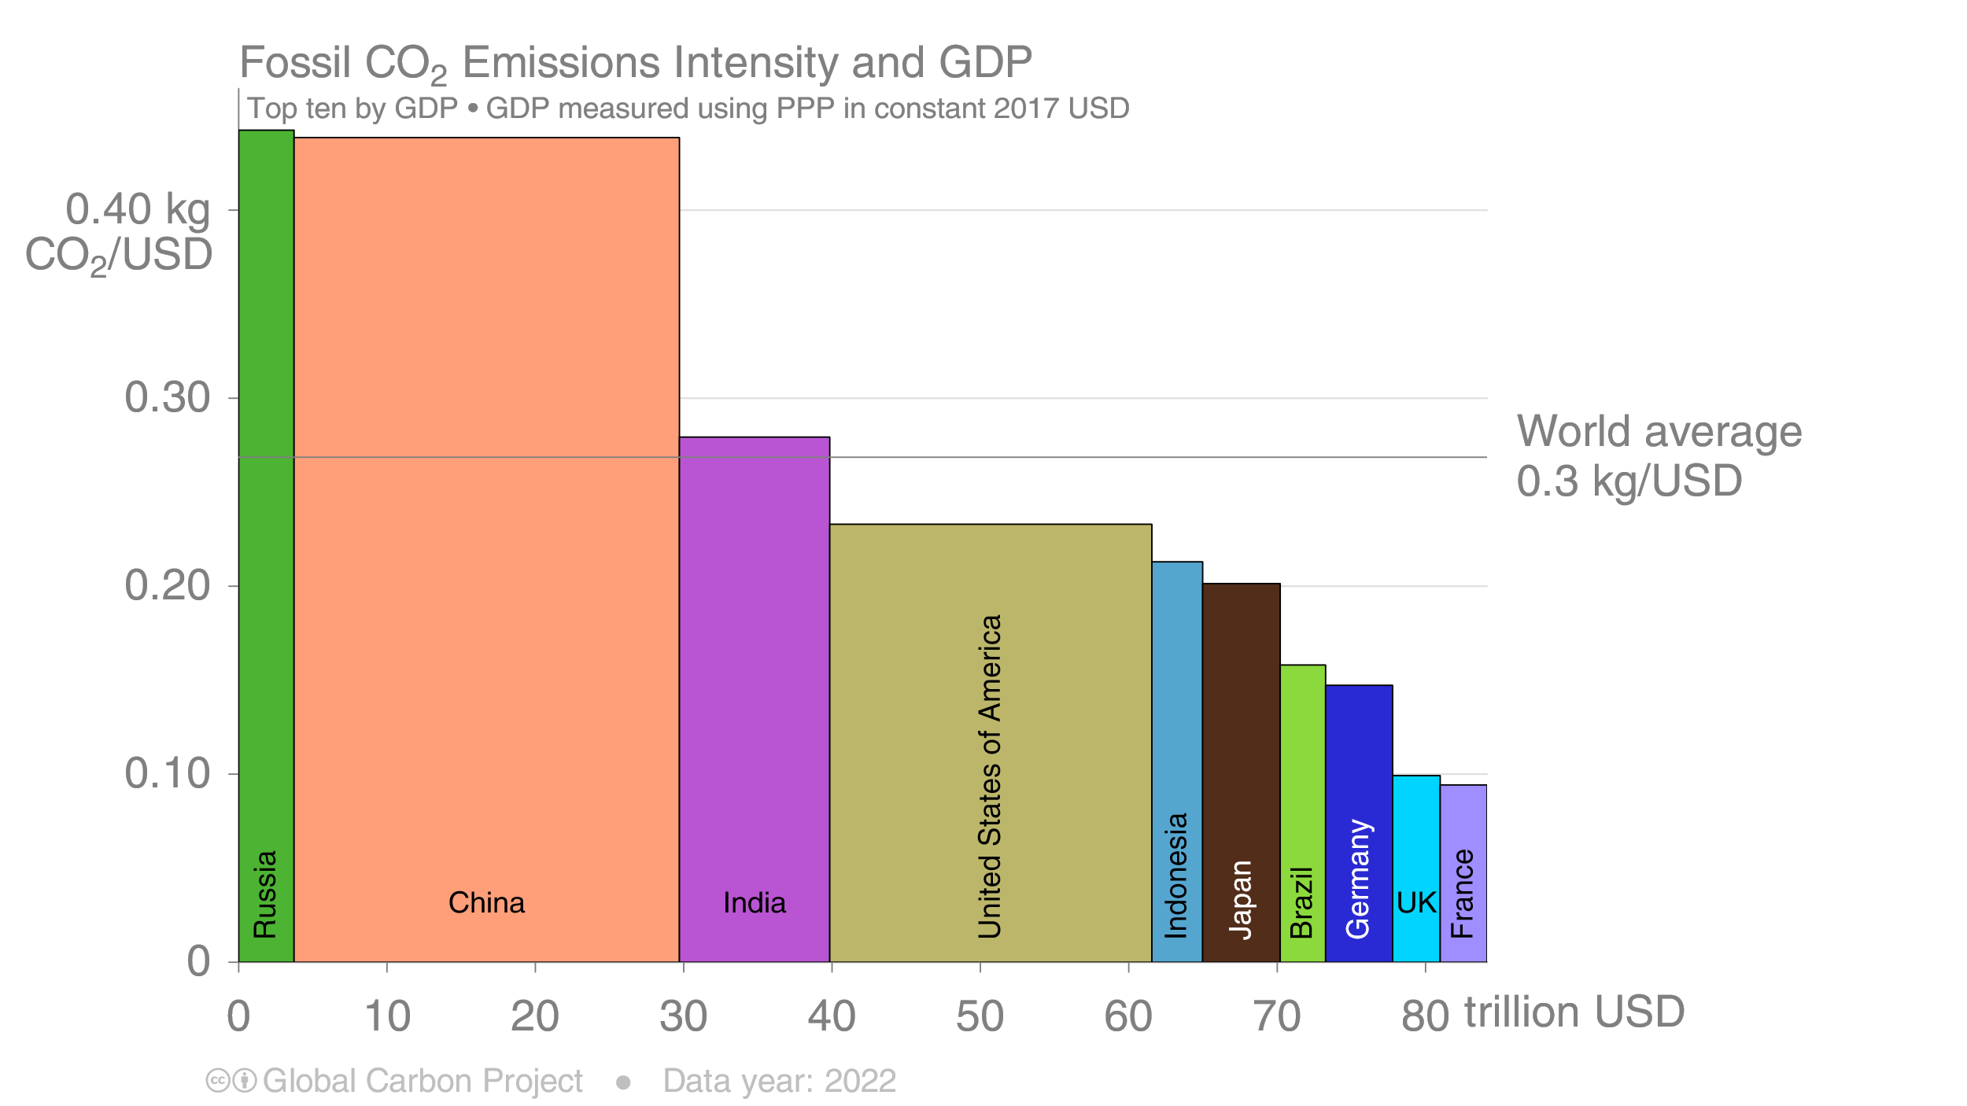
Fossil CO₂ emission intensity
The 10 largest economies have a wide range of emission intensity of economic activity
Emission intensity: Fossil CO₂ emissions divided by Gross Domestic Product (GDP)
Source: Friedlingstein et al 2023; Global Carbon Project 2023

Slide 74
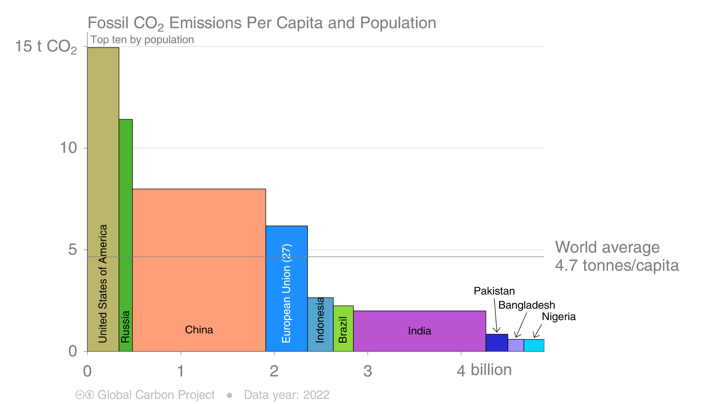
Fossil CO₂ Emissions per capita
The 10 most populous countries span a wide range of development and emissions per capita
Emission per capita: Fossil CO₂ emissions divided by population
Source: Friedlingstein et al 2023; Global Carbon Project 2023

Slide 75
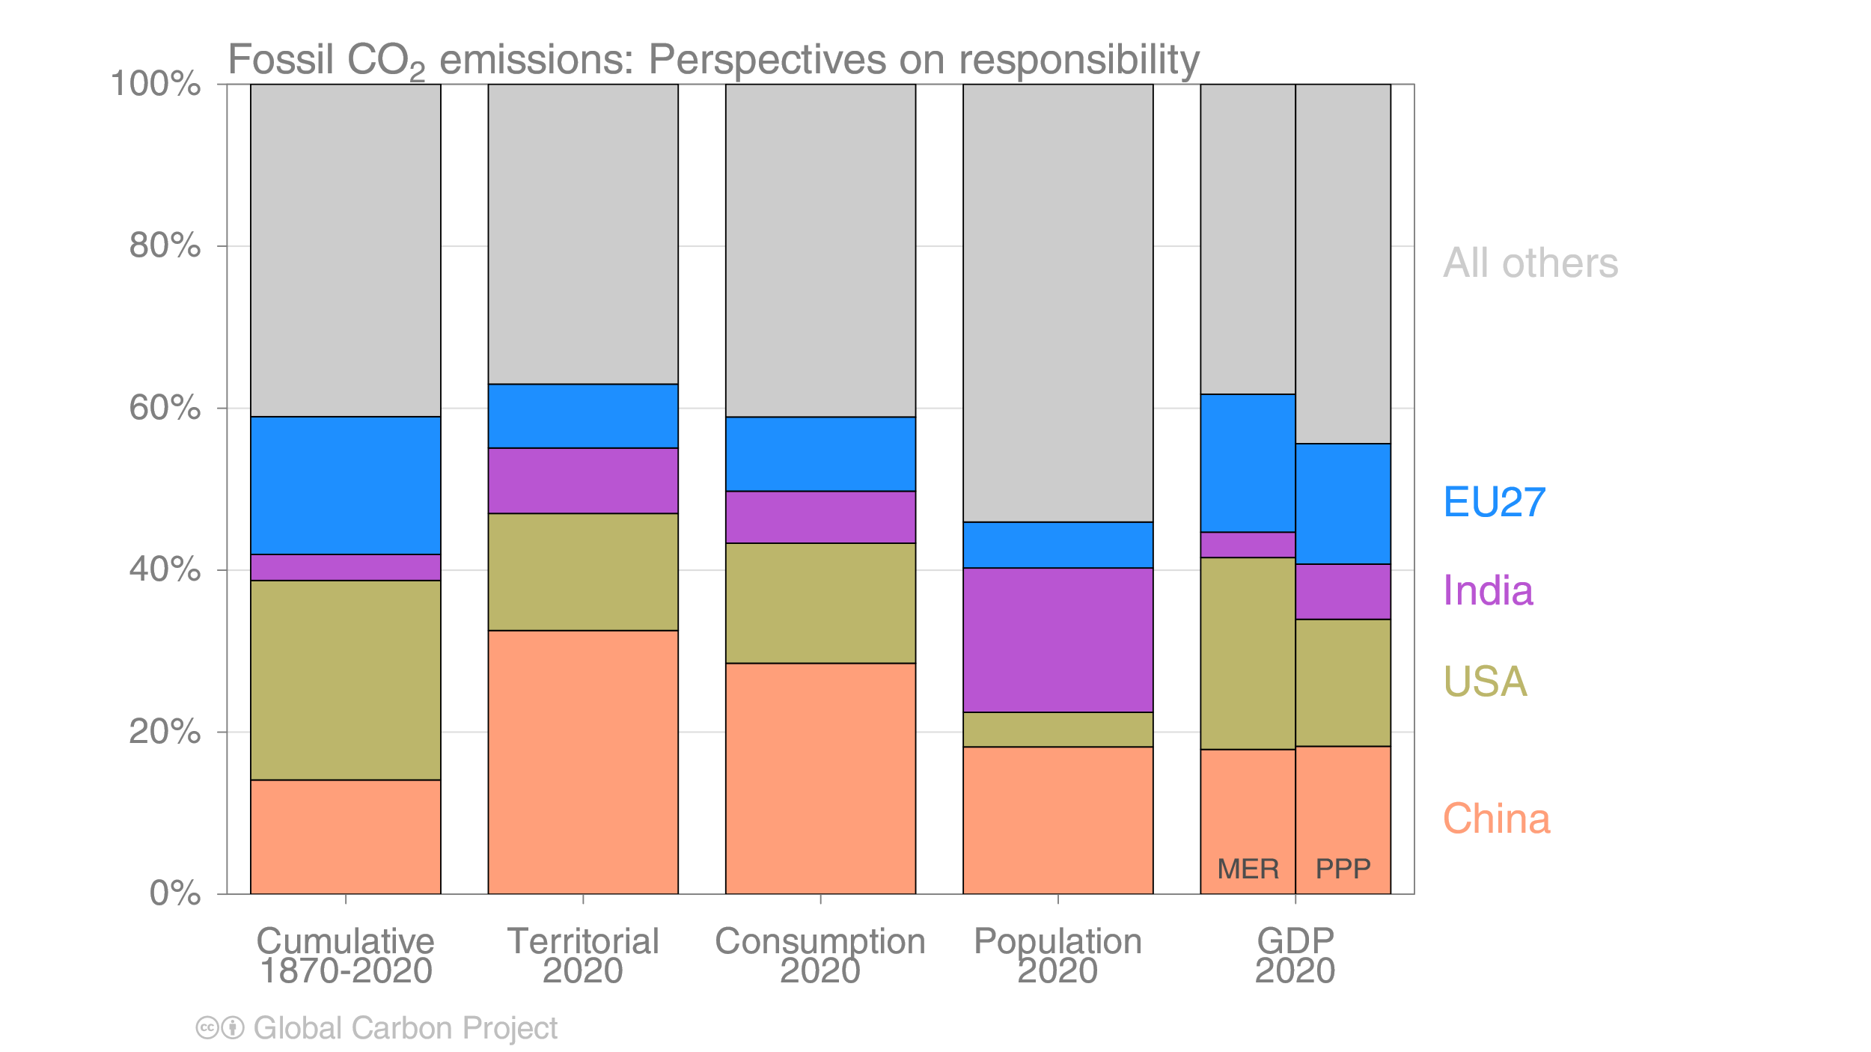
Alternative rankings of countries
The responsibility of individual countries depends on perspective.
Bars indicate fossil CO₂ emissions, population, and GDP.
GDP: Gross Domestic Product in Market Exchange Rates (MER) and Purchasing Power Parity (PPP)
Source: United Nations; Friedlingstein et al 2023; Global Carbon Project 2023

Slide 76
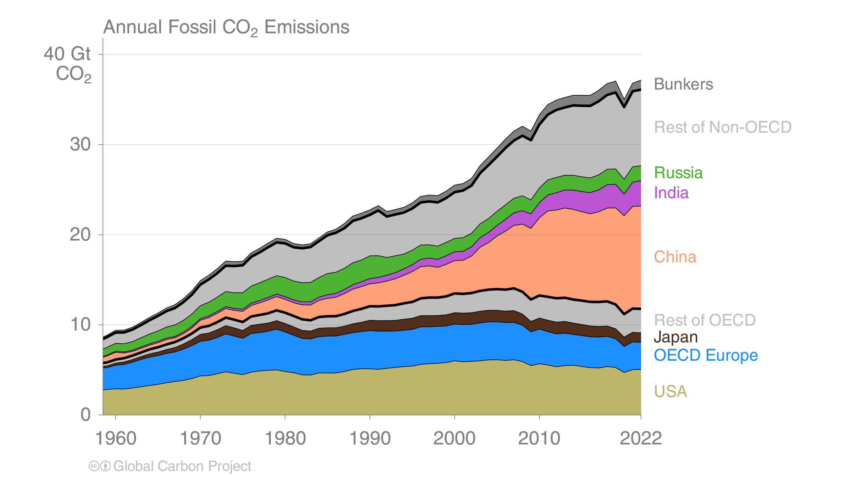
Breakdown of global fossil CO₂ emissions by country
Source: Friedlingstein et al 2023; Global Carbon Project 2023

Slide 77
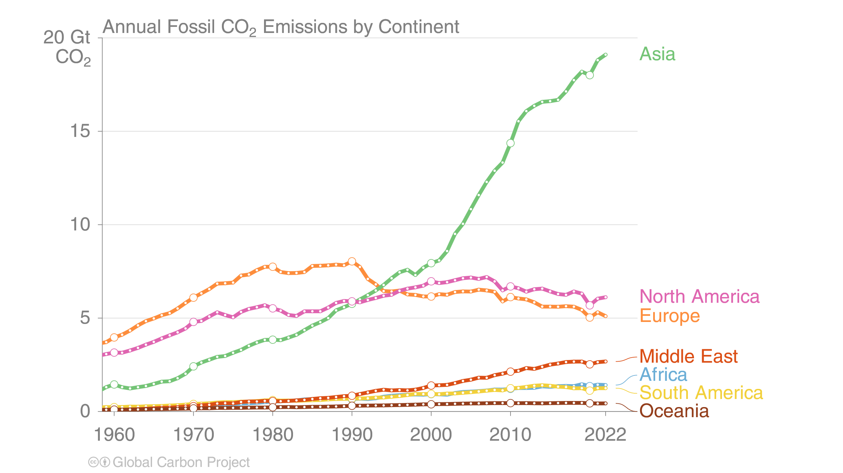
Fossil CO₂ emissions by continent
Asia dominates global fossil CO₂ emissions, while emissions in North America
are of similar size to those in Europe, and the Middle East is growing rapidly.
Source: Friedlingstein et al 2023; Global Carbon Project 2023

Slide 78
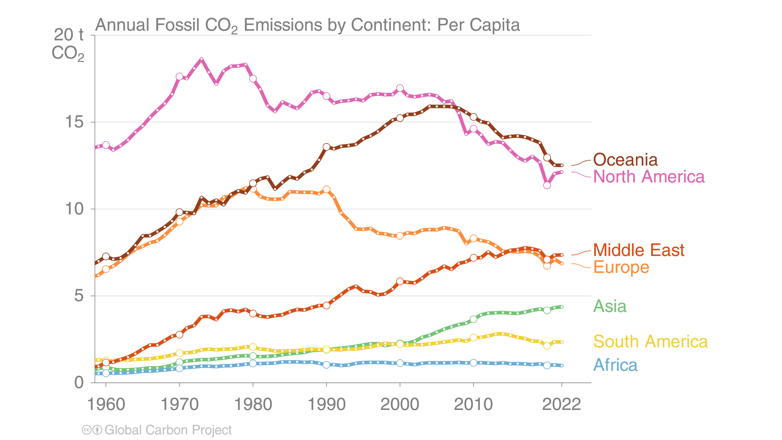
Fossil CO₂ emissions by continent: per capita
Oceania and North America have the highest per capita emissions, while the Middle East has recently overtaken Europe.
Africa has by far the lowest emissions per capita.
Source: Friedlingstein et al 2023; Global Carbon Project 2023

Slide 79
Additional Figures
Consumption-based Emissions
Consumption–based emissions allocate emissions to the location that goods and services are consumed
Consumption-based emissions = Production/Territorial-based emissions minus emissions embodied in exports plus the emissions embodied in imports

Slide 80
Consumption-based emissions (carbon footprint)
Allocating fossil CO₂ emissions to consumption provides an alternative perspective.
USA and EU are net importers of embodied emissions, China and India are net exporters.
Consumption-based emissions are calculated by adjusting the
standard emissions estimates to account for international trade
Source: Peters et al 2011; Friedlingstein et al 2023; Global Carbon Project 2023

Slide 81
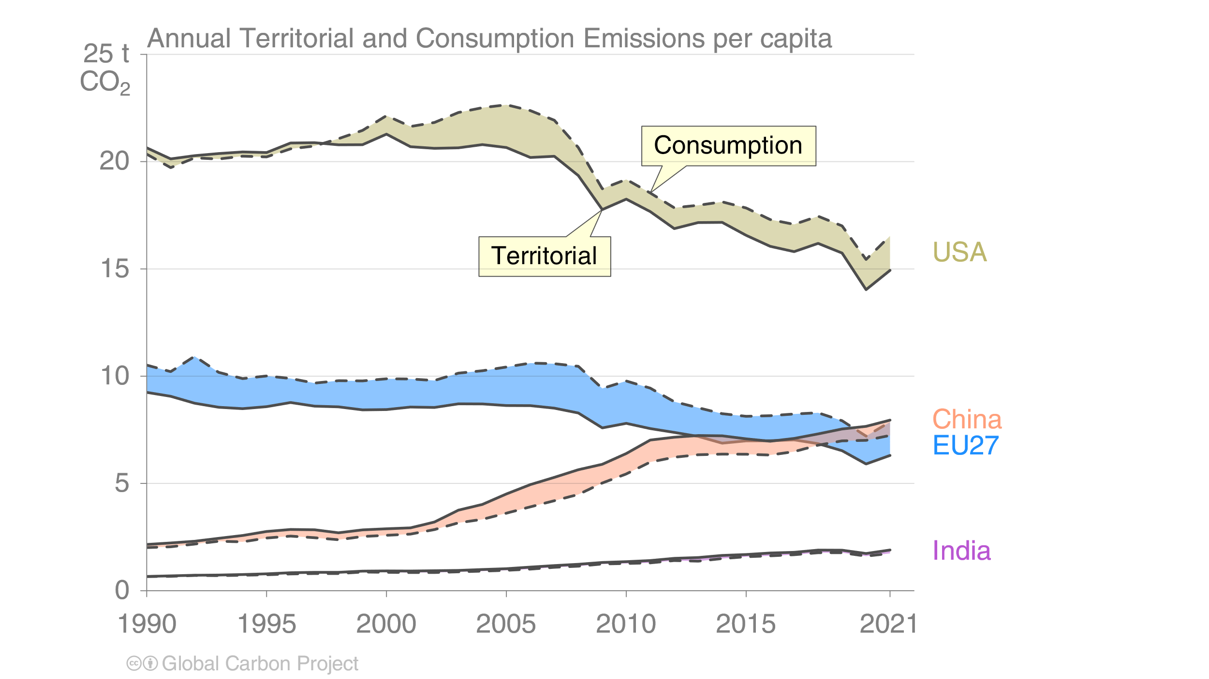
Consumption-based emissions per person
The differences between fossil CO₂ emissions per capita is larger than the
differences between consumption and territorial emissions.
Consumption-based emissions are calculated by adjusting the
standard emissions estimates to account for international trade
Source: Peters et al 2011; Friedlingstein et al 2023; Global Carbon Project 2023

Slide 82
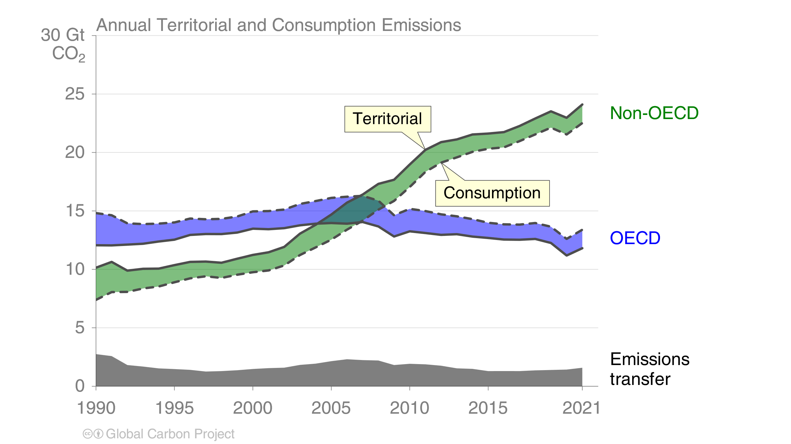
Consumption-based emissions (carbon footprint)
Transfers of emissions embodied in trade between OECD and non-OECD countries grew
slowly during the 2000’s, declined to 2015 and have been relatively flat since then.
Source: Peters et al 2011; Friedlingstein et al 2023; Global Carbon Project 2023

Slide 83
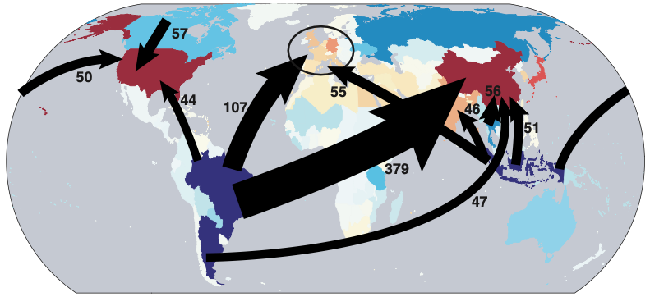
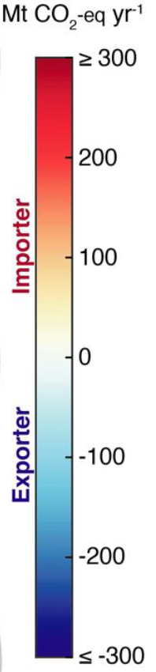
Major flows from production to consumption (2017) — Land Use Change CO₂
Global distribution of land-use change emissions embodied in trade: Arrows show largest flows from location of generation of emissions to location of consumption of agricultural and forestry goods.
MtCO₂ yr⁻¹
Values for 2017. EU27 is treated as one region. Units: MtCO₂
Source: Hong et al 2022

Slide 84
Additional Figures
Historical Emissions

Slide 85
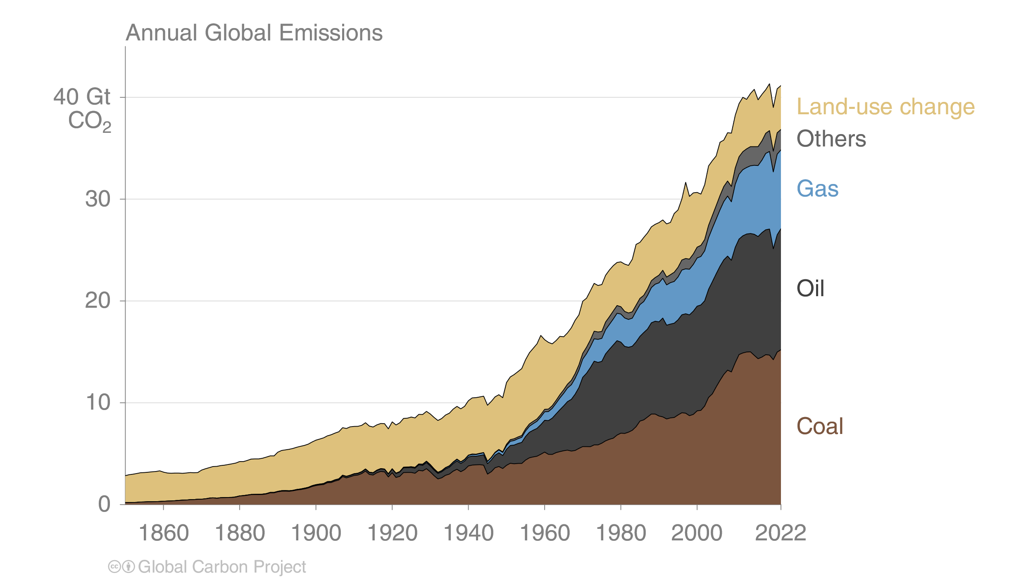
Total global emissions by source
Land-use change was the dominant source of annual CO₂ emissions until around 1950.
Fossil CO₂ emissions now dominate global changes.
Others: Emissions from cement production, gas flaring and carbonate decomposition
Source: Friedlingstein et al 2023; Global Carbon Project 2023

Slide 86
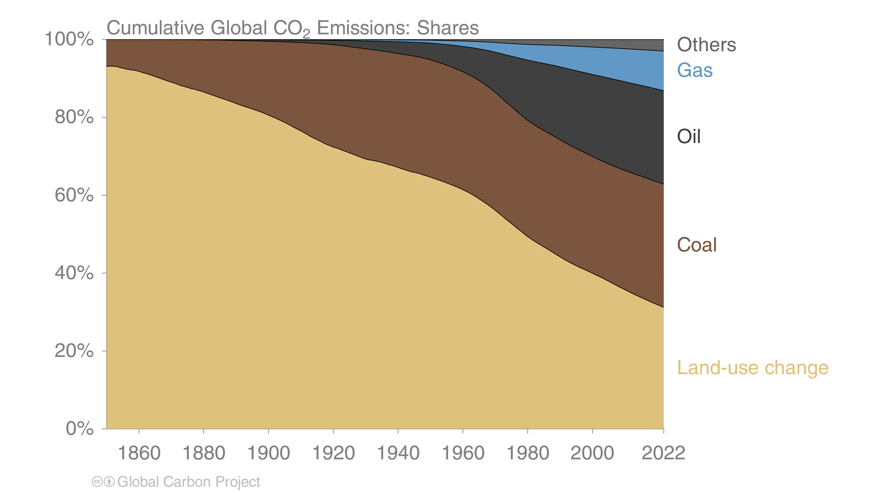
Historical cumulative emissions by source
Others: Emissions from cement production, gas flaring and carbonate decomposition
Source: Friedlingstein et al 2023; Global Carbon Project 2023

Slide 87

Historical cumulative fossil CO₂ emissions by country
‘All others’ includes all other countries along with emissions from international aviation and maritime shipping
Source: Friedlingstein et al 2023; Global Carbon Project 2023

Slide 88

Historical cumulative emissions by continent
Cumulative fossil CO₂ emissions (1850–2022). North America and Europe have
contributed the most cumulative emissions, but Asia is growing fast
The figure excludes emissions from international aviation and maritime shipping
Source: Friedlingstein et al 2023; Global Carbon Project 2023

Slide 89
Additional Figures
Energy Use

Slide 90

Energy use by source
Energy consumption by fuel source from 2000 to 2022, with growth rates
indicated for the more recent period of 2017 to 2022
This figure shows “primary energy” using the BP substitution method
(non-fossil sources are scaled up by an assumed fossil efficiency of approximately 0.38)
Source: Energy Institute, 2023; Global Carbon Project 2023

Slide 91

Energy use by source: China
Coal consumption in energy units has returned to peak levels,
while consumption of all other energy sources is growing strongly
This figure shows “primary energy” using the BP substitution method
(non-fossil sources are scaled up by an assumed fossil efficiency of approximately 0.38)
Source: Energy Institute, 2023; Global Carbon Project 2023

Slide 92

Energy use by source: USA
Coal consumption has declined sharply in recent years with the shale gas boom
and strong renewables growth. Output from nuclear power is slowly declining as stations are retired.
This figure shows “primary energy” using the BP substitution method
(non-fossil sources are scaled up by an assumed fossil efficiency of approximately 0.38)
Source: Energy Institute, 2023; Global Carbon Project 2023

Slide 93

Energy use by source: India
Pandemic year 2020 temporarily interrupted India’s strong growth in energy consumption.
Consumption of coal and oil dominate.
This figure shows “primary energy” using the BP substitution method
(non-fossil sources are scaled up by an assumed fossil efficiency of approximately 0.38)
Source: Energy Institute, 2023; Global Carbon Project 2023

Slide 94

Energy use by source: EU
Consumption of both oil and gas has rebounded in recent years, while coal continues to decline.
Renewables are growing strongly, now providing more energy than nuclear power.
This figure shows “primary energy” using the BP substitution method
(non-fossil sources are scaled up by an assumed fossil efficiency of approximately 0.38)
Source: Energy Institute, 2023; Global Carbon Project 2023

