Slide 1
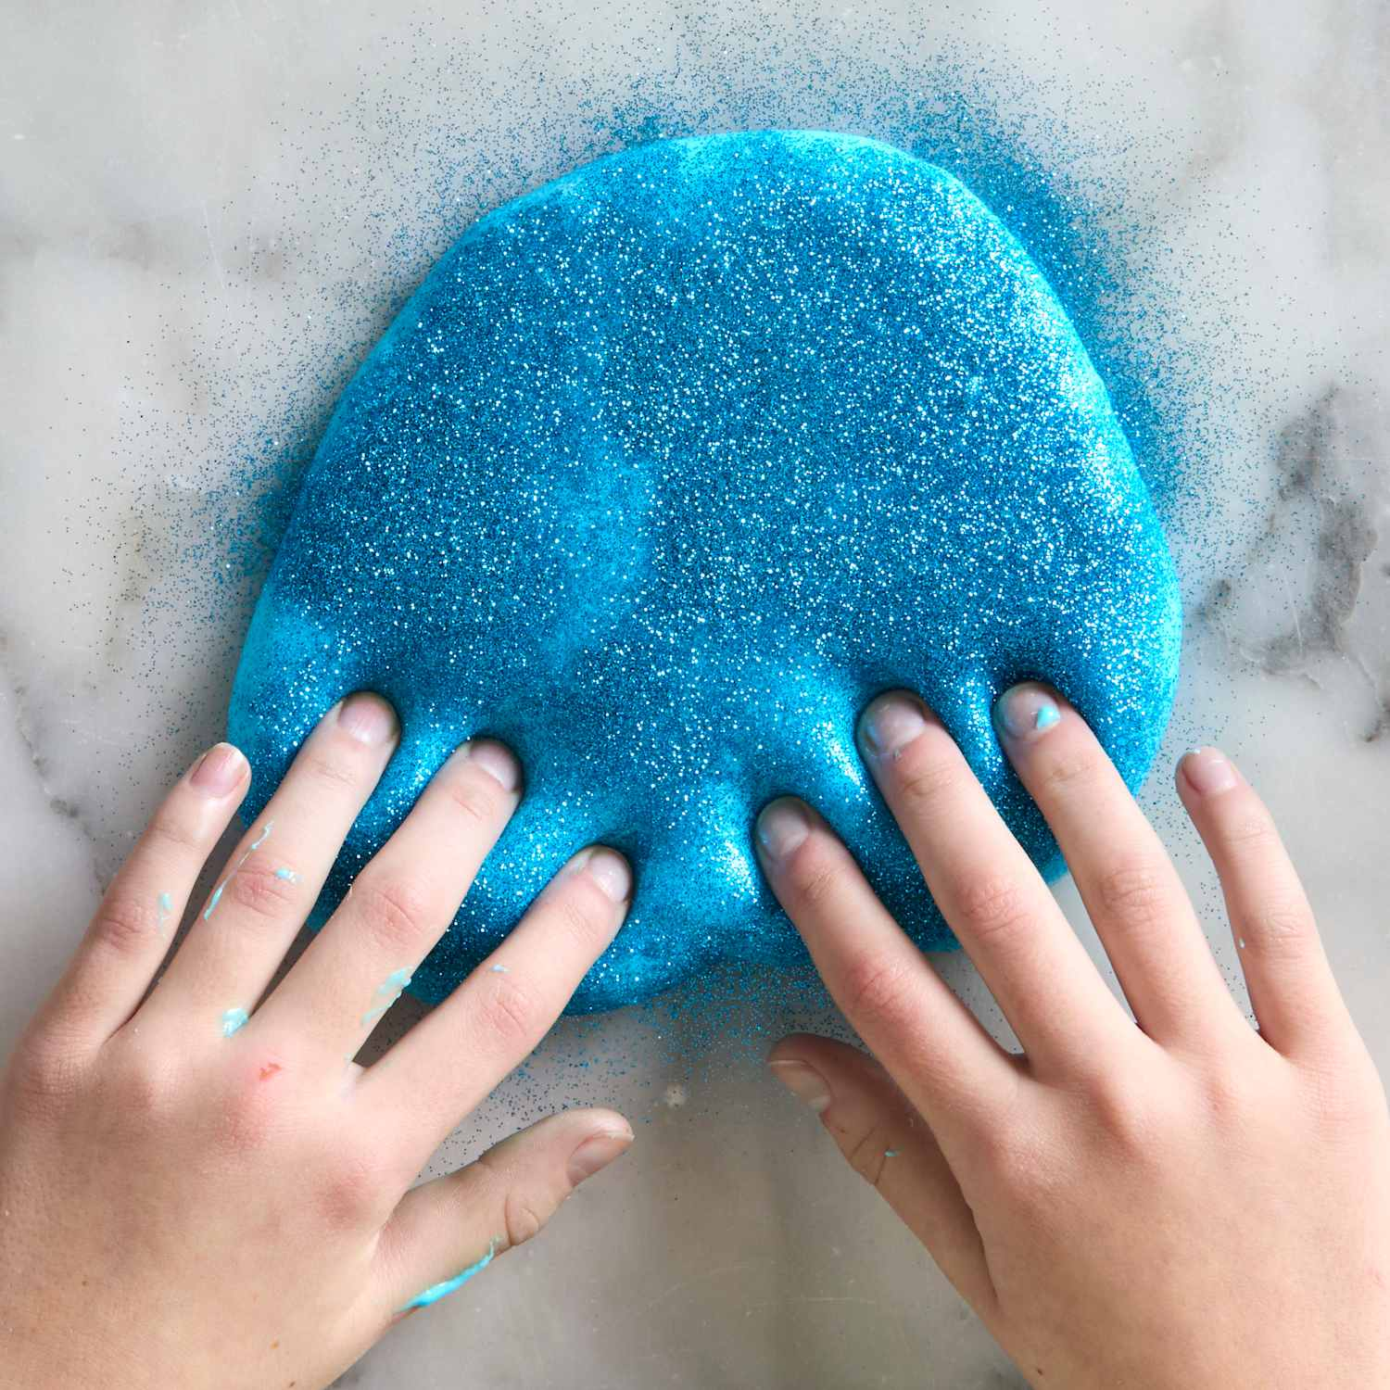
Mad og Kultur

Slide 2
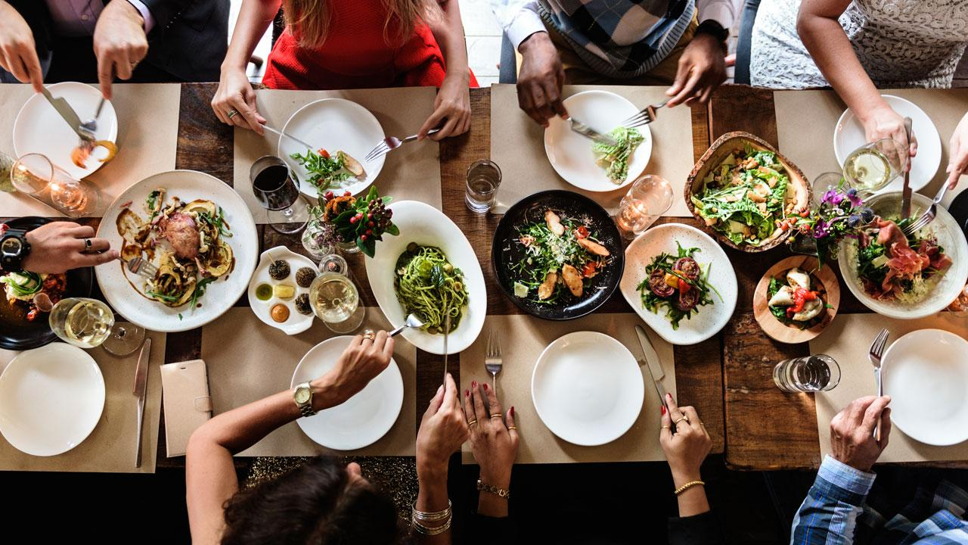
Måltidet

Slide 3
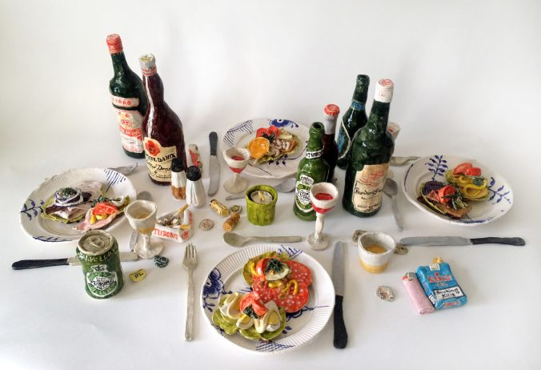
Frokosten, (2015)
Rose Eken

Slide 4
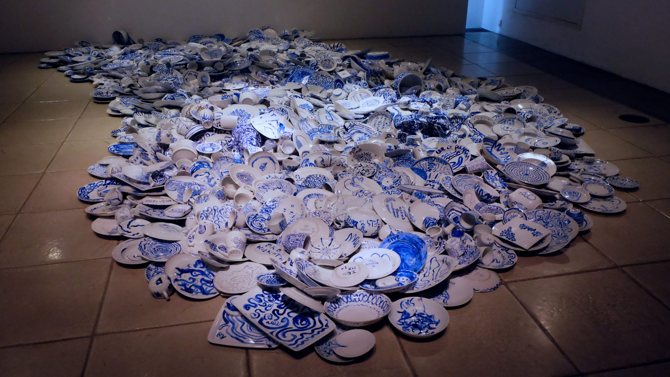
Waste Time, (2012 -2018)
Anja Franke

Slide 5
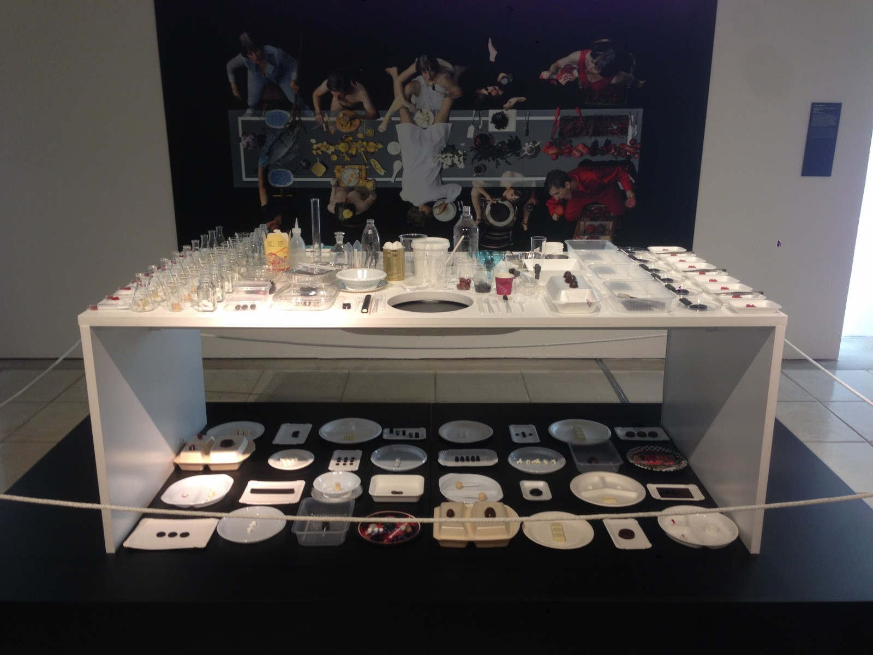
Eat Design, (2014-2017)
Honey & Bunny

Slide 6
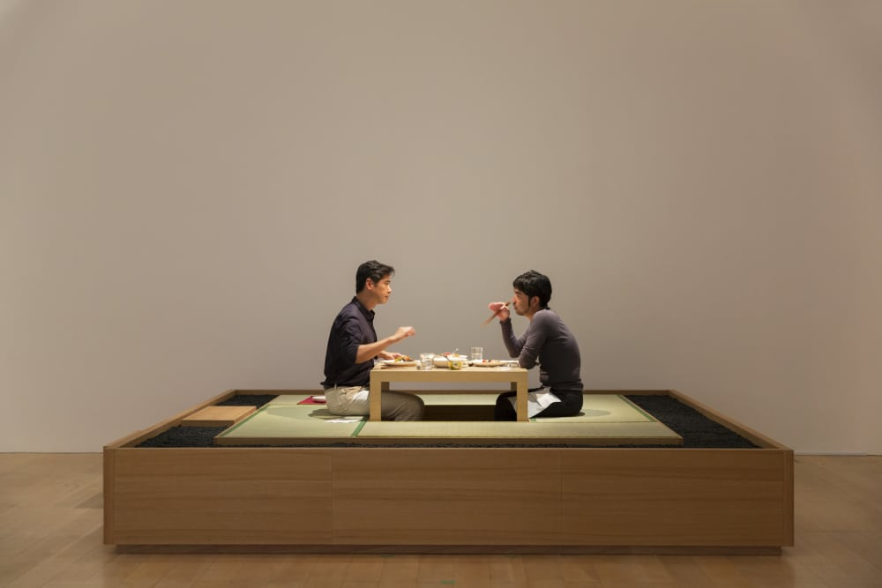
The Dining Project, (1997-2017)
LEE Mingwei

Slide 7
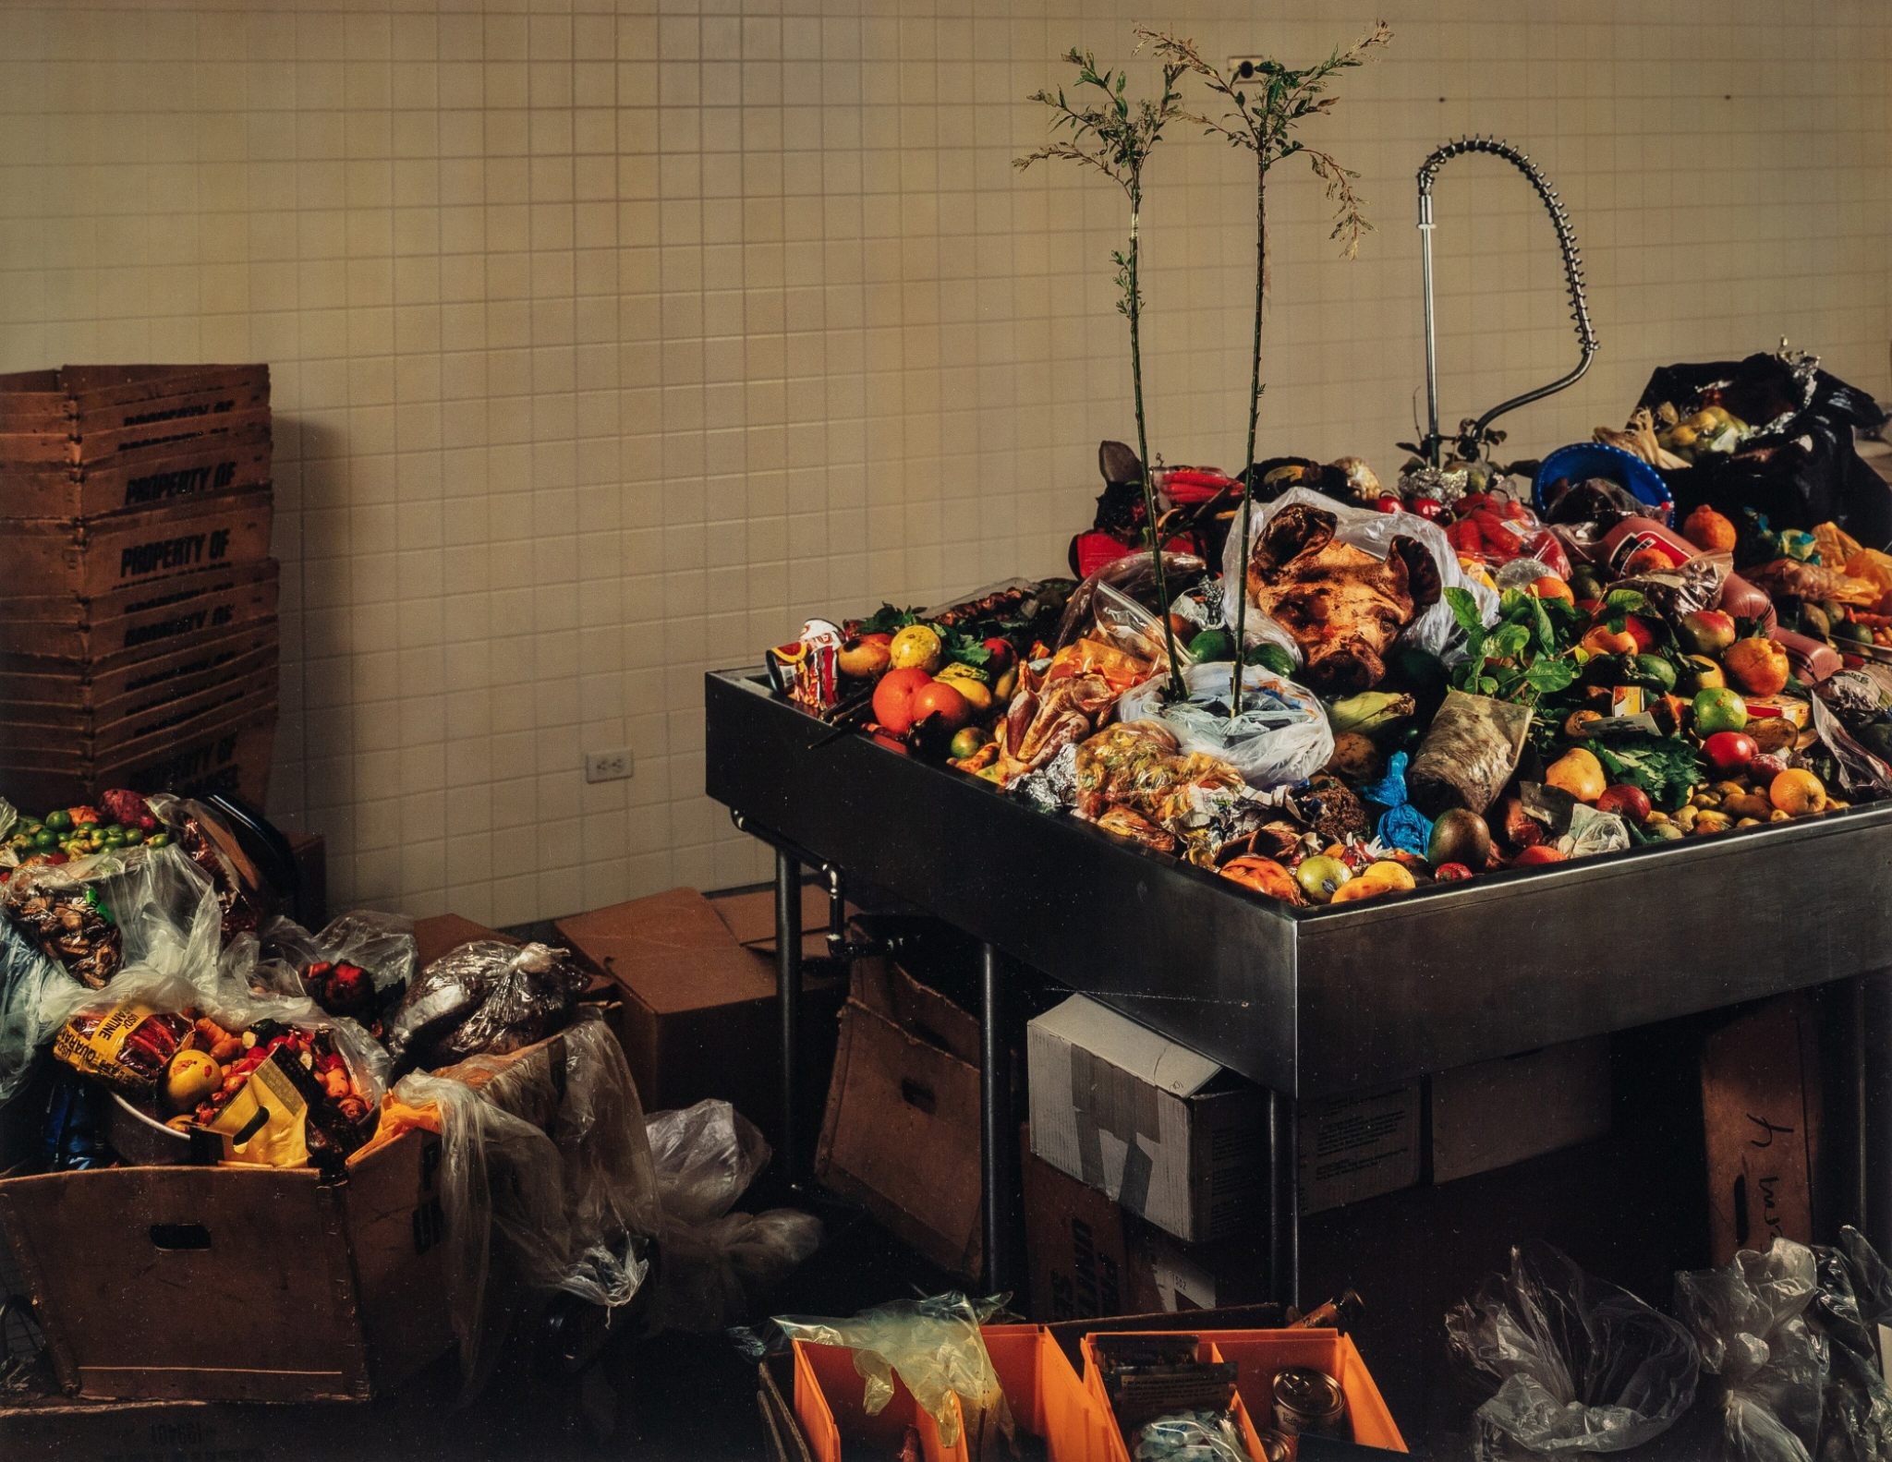
Contraband Room John F. Kennedy International Airport, (2007)
Taryn Simon

Slide 8
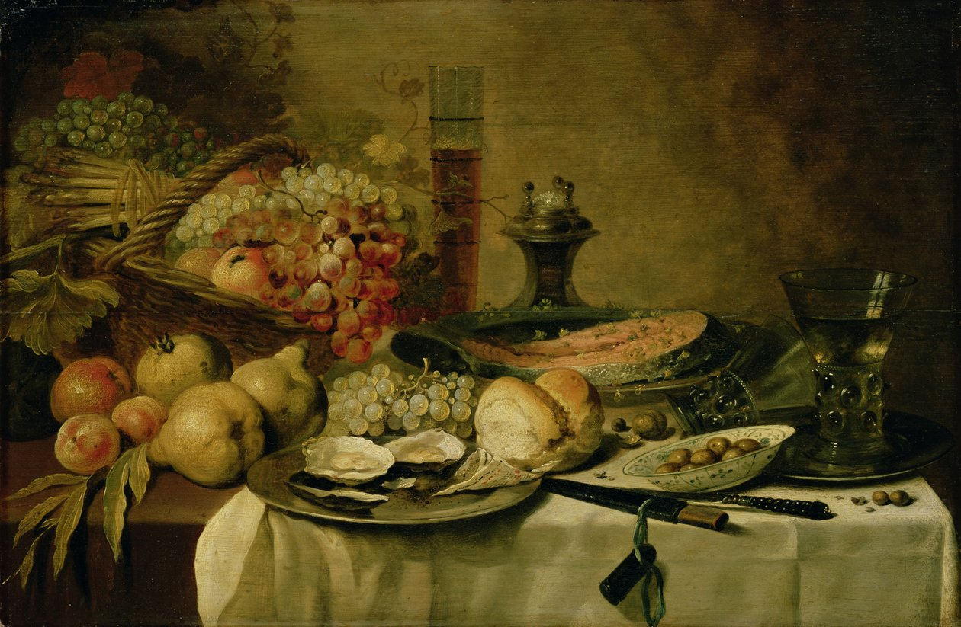
Pieter Claesz

