Slide 1

3A Engelsk
3A VK 2024-2025 august-december
Lærer: Nanna Sønderby Christensen (NSC)

Slide 2
Dagens program
3A og NSC
3A idéark– hvad vil I gerne have ud af Engelsk A i år (udfyld ark):
  Ting I vil være bedre til: fx: ‘Jeg vil gerne være bedre til mundtlighed” eller ”jeg vil vide mere om nonfiction” etc. Etc.
  Input fra jer: ideer til tekster (short stories, film, serier, digte, reklamer etc. Etc.)
Kort om Gibraltar og engelskmoduler + medieopgave
Introduktion nyt emne: True Crime
Notes:
1: Samarbejder med Jakob – overlevering men også mulighed for at starte på en frisk - + overlevering til ny…

Slide 3
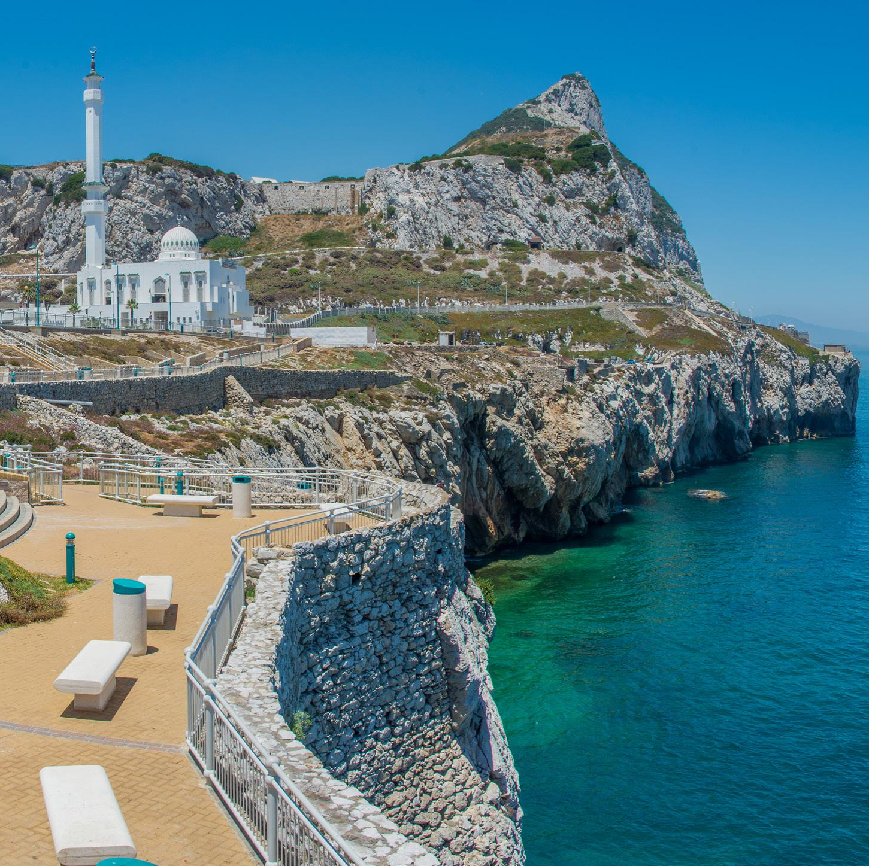
3A på Gibraltar – ENGELSK moduler
FORINDEN: 2-3 forberedelsesmoduler – UK in Gibraltar (Brexit, neocolonialism etc.)
DERNEDE: 1 modul dernede (tage billeder, interviewe indbyggere, hinanden etc. Fri opgave)
DERHJEMME: Medieopgave 2 moduler.

Slide 4

Introduction TRUE CRIME
3A VK 2024-2025 – August-October
Lærer: Nanna Sønderby Christensen (NSC)

Slide 5

4 exercises – True Crime

Slide 6
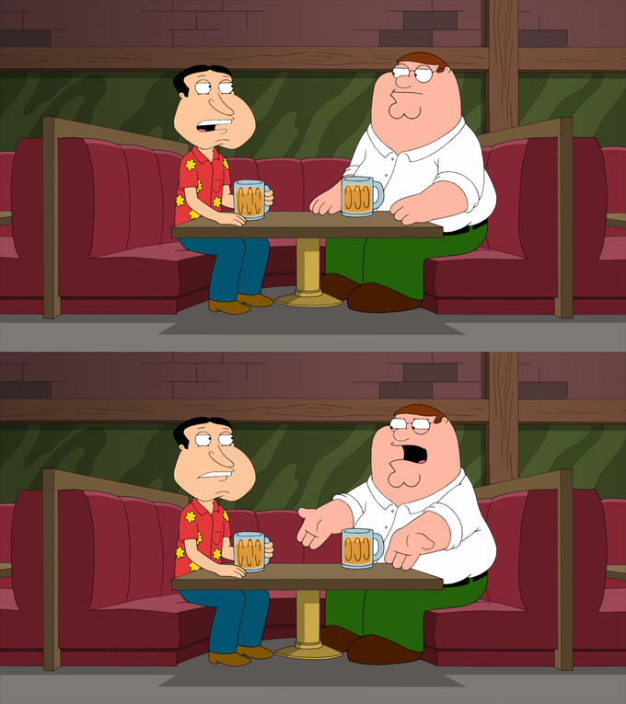
1/4
Conversation exercise
2 minutes with a partner: Talk about the tv-series, movies, books etc. you know.
2 minutes with a new partner: Talk about the tv-series, movies, books etc. you know + include what you have just learned from your previous conversation

Slide 7

2/4
Pair up
A True crime case
Example:
Student A: "In the 1960s, the Zodiac Killer terrorized Northern California. He sent cryptic letters to newspapers and claimed to have killed at least 37 people. Despite extensive investigations, his identity remains unknown."
Student B: "Why do you think he sent letters to the newspapers?”
Student A: answers briefly
1. Pair Up: pair up with a partner
2. Summarize a Case: Each student has 1 minute to summarize a true crime case they know about or have researched. Focus on the main details: the crime, key individuals involved, and the outcome.
3. Ask a Question: After the summary, the listening partner has 1 minute to ask a question or share a reaction to the case. The summarizing student responds briefly.

Slide 8
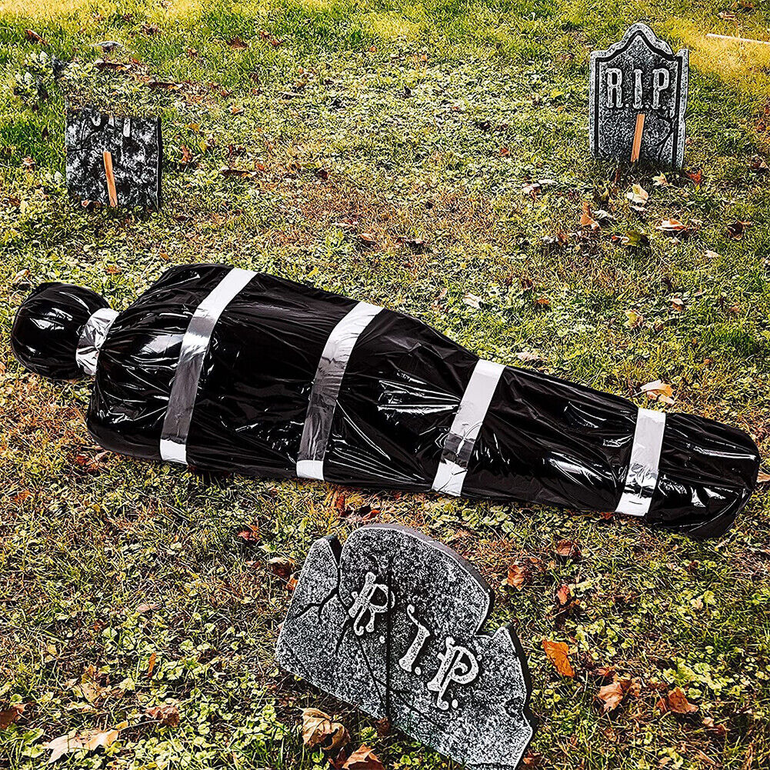
3/4
Crime scenes – tell the story
Instructions:
Group of Four
Present Clues: Each group receives evidence related to a fictional murder mystery
Discuss: In 5 minutes, the group discusses the evidence and tries to piece together what might have happened at the crime scene (no correct answer – you tell the story!).
4. Present in class/buddy groups

Slide 9
4/4
Exercise: Define True Crime in four minutes
Groups of 4
Discuss and Define: Each group has 4 minutes to discuss and come up with a concise definition of "true crime.” Consider elements such as:
  What constitutes a true crime story?
  Key characteristics and themes
  Differences between true crime and other genres (e.g., fiction, mystery)
2. Share and Compare: – share your definition in class. Compare and contrast the definitions to see different perspectives and common elements.

Slide 10
Introduction compendium

