Slide 1
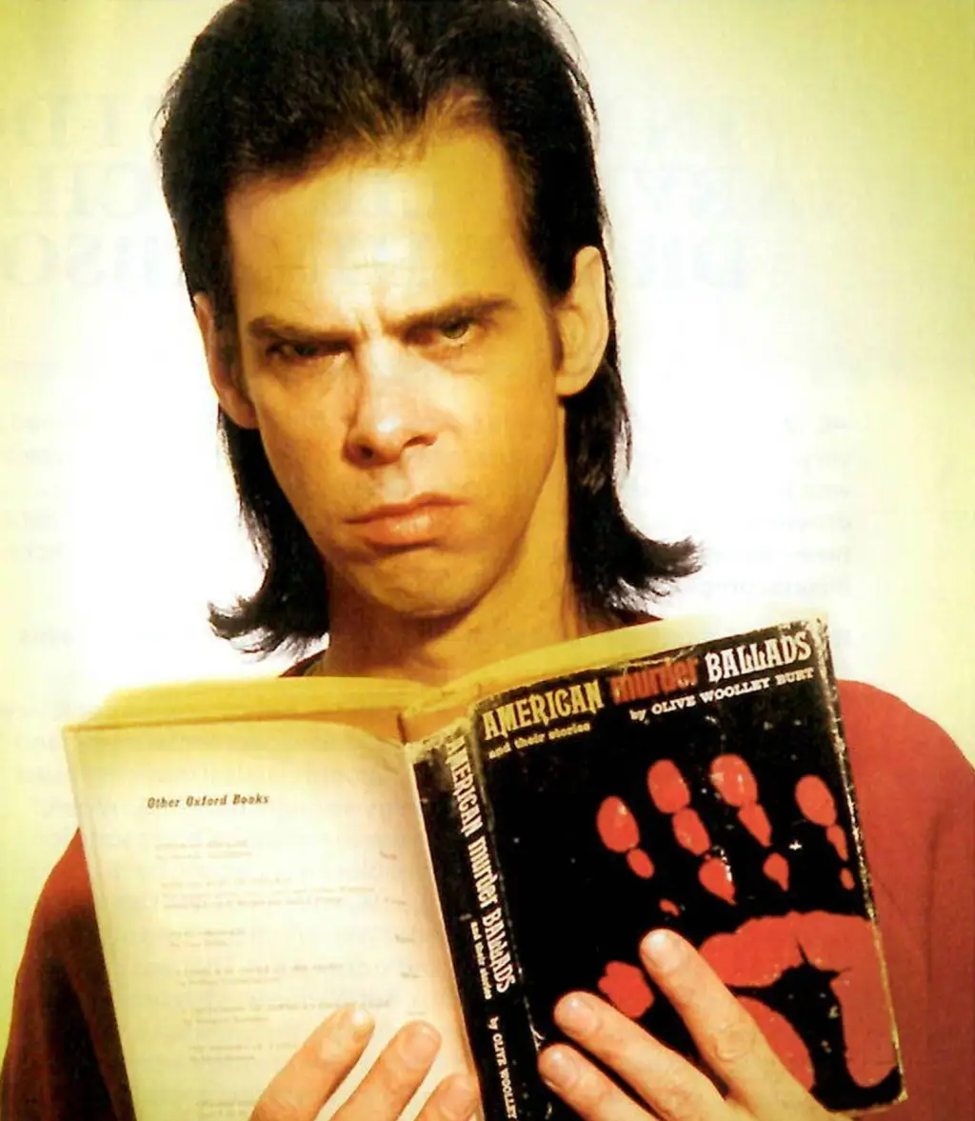
Murder ballads
Musician Nick Cave
3A True Crime
16.09.2024 – 3 modul

Slide 2
Today’s module
Definition: What is a murder ballad
Homework
Analysis of a murder ballad – in groups

Slide 3
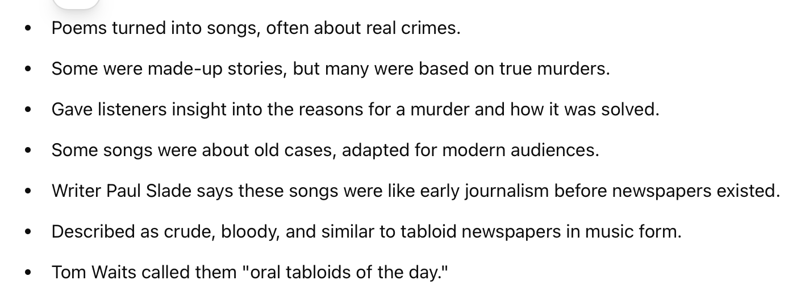

What is ‘a murder ballad’? = ‘oral tabloids of the day’
"Cheerfully vulgar, reveling in gore, and always with an eye on the main chance, these songs were tabloid newspapers set to music, carrying news of all the latest 'orrible murders to an insatiable public.’” (Paul Slade)
Notes:
so murder ballads are essentially songs about killing, and they often deal with a horrible murder.

Slide 4
Homework – share with the person sitting next to you (5 minutes)
Reflect:. Do you know of songs that deal with something gruesome and/or tragic? What is the point of writing music about something like that?
Vocab. The following words could be useful when analysing murder ballads. Look up words you are unfamiliar with: ballad motive motif chorus point of view victim

Slide 5
Murder ballad analysis (10 minutes)
Go online and search for one of the murder ballads and check out its lyrics. Which are fiction, and which are based on actual events?
  "Tom Dooley" (folk song - various recordings, even a Danish version!) GROUP 1
  "Stagger Lee" (folk song also found in a version written by Nick Cave. You may compare the different versions of the song - there is one by James Brown, and yet another one seen in the movie Black Snake Moan) GROUP 2
  "Deep Red Bells" (written and performed by Neko Case) GROUP 3
  "Little Water Song" (performed by Ute Lemper, written by Nick Cave and Bruno Pisek) GROUP 4
  "Joey” (performed by Bob Dylan, written by Dylan and Jacques Levy) GROUP 5
Notes:
Gibraltar grupper

Slide 6
Matrix groups (10 minutes)
Share your findings in matrix groups

Slide 7
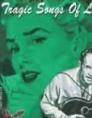
Knoxville Girl – pre-analysis – 5 minutes
2 minutes in pairs: Speculate. What do you think will be the plot of a ballad called "The Knoxville Girl”?
3 minutes in pairs: Research. Knoxville, Tennessee, is part of Appalachia, but where is that, and what are some of the things which the region is known for?

Slide 8
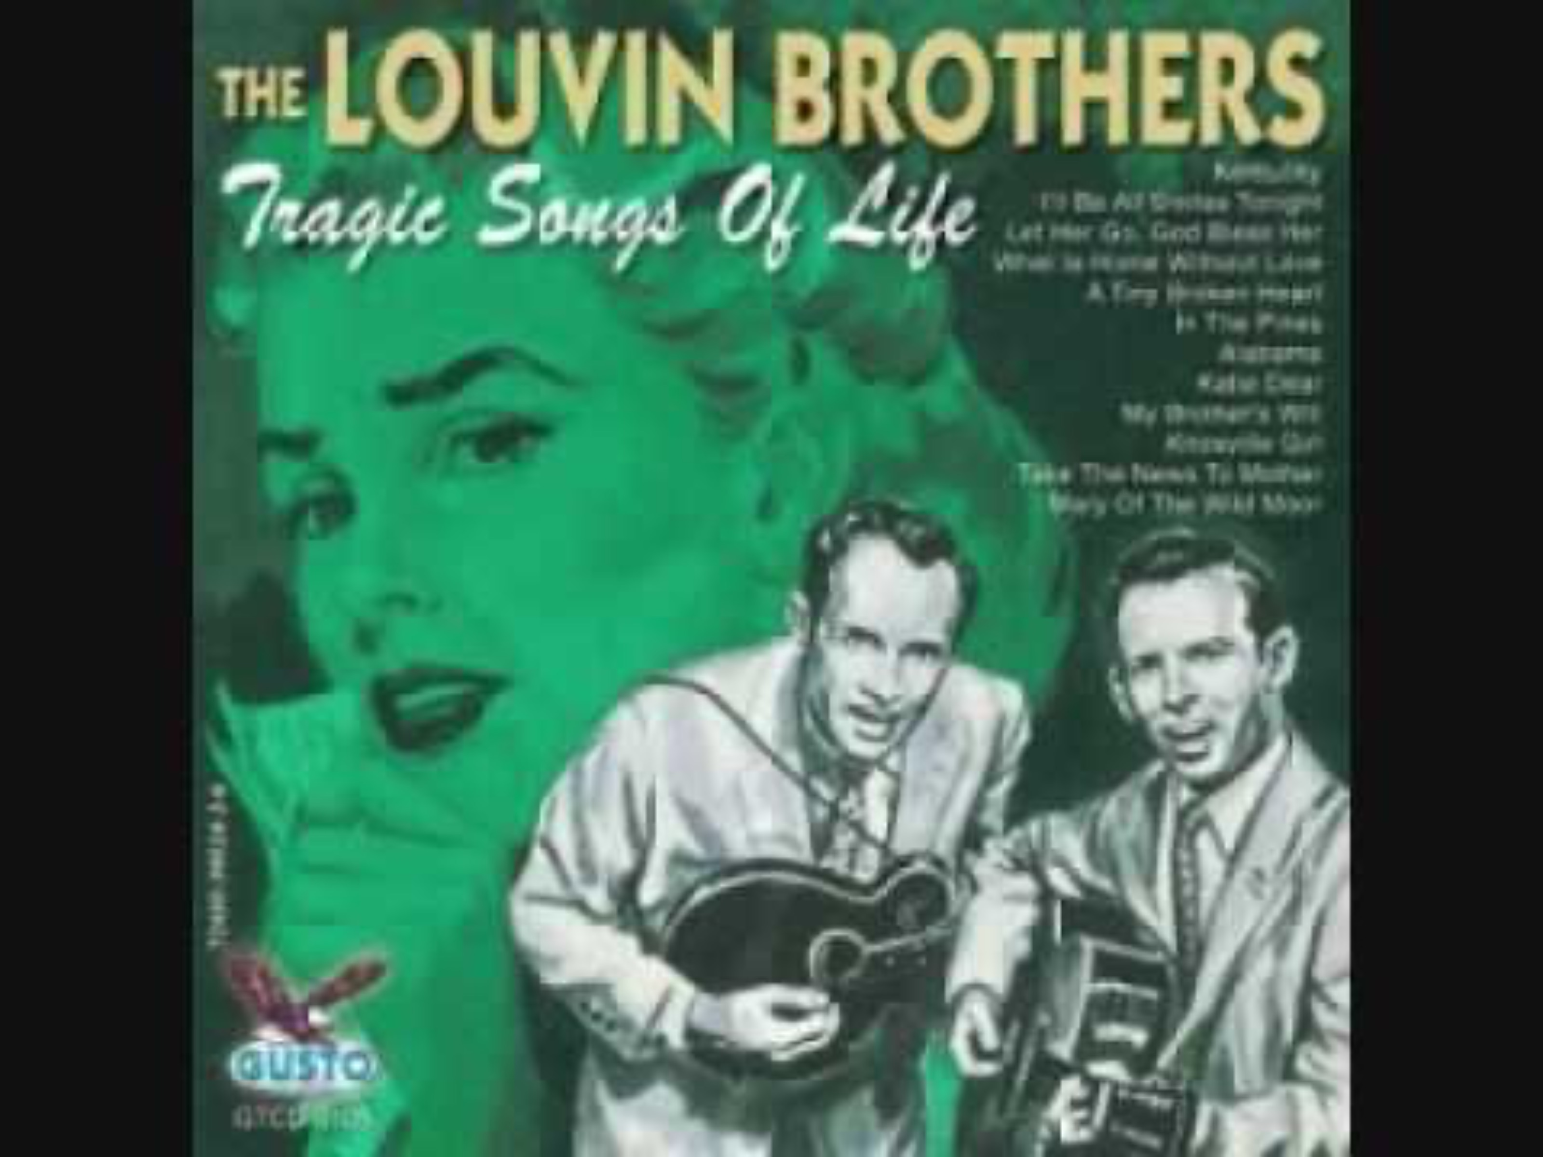
Listening☺
Notes:
This murder ballad is referred to as an "Appalachian murder ballad" recorded at the beginning of the 20th century, but according to author Paul Slade the story recounted in the lyrics can be traced as far back as the 17th century to the town of Shrewsbury in England where a young miller got a woman pregnant and then was encouraged by her father to marry her. Instead he murdered her. The story spawned various

Slide 9
Analysis Knoxville Girl (10 minutes)
Find lyrics in your compendium pp. 10-11)
Is the reason for the murder clear?
Do you sympathize with Willy? Why/why not?
Find the rhyme scheme and comment on the use of rhymes in general in a song about murder.
Comment on the role of "the girl" in the ballad.
What kind of a narrator is used to tell the story of the Knoxville girl, and what is the effect of having this type of narrator? How does this contribute to your analysis of the song as a whole?
Comment on the last verses/lines "I’m here to waste my life away down in this dirty old jail/Because I murdered that Knoxville girl, the girl I loved so well”.
STYLE OF WRITING
Comment on the use of adjectives in the song. How does this excerpt contribute to your analysis of the text as a whole?

Slide 10

CREATIVE EXERCISE - WRITING
Try writing a few stanzas about the same event but seen from the perspective of "the girl".

