Slide 1
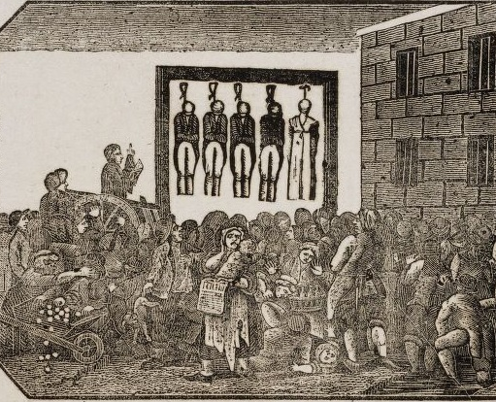
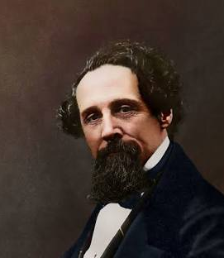
Historical perspective – True Crime in Victorian England + Charles Dickens
Lærer: NSC
17/9/24
Tekst: Charles Dickens: “Mr. Charles Dickens and the execution of the Mannings” (1849)

Slide 2
Today’s module
Research in pairs
Pair conversations
2+10 debate
Reading out loud – Charles Dickens – The Execution of the Mannings”
Summary
Style of writing
Writing exercise

Slide 3
1. Research in pairs
Do some research. Who were Maria and Frederick Manning, and why were they executed? https://www.capitalpunishmentuk.org/mannings.html

Slide 4
2. Pair conversations
Have a conversation with your classmate: What do you imagine would happen at a public hanging in 1849? What would the crowd look and act like?
Come up with some arguments for and against public execution, so that you can have a nuanced conversation about the topic. You may use the following discourse markers:
  It can be argued ...
  Furthermore...
  By the same token...
  Others might argue…
  On the other hand...
  Naturally…
  In opposition to this...

Slide 5
3. 2+10: Debate – public executions
Why would a public execution attract a large audience?
Do you think people today would behave in the same way as that Victorian era audience? Can you think of examples from today? Substantiate your answer.

Slide 6

4. Reading in groups:
Charles Dickens ”The executions of the Mannings (kompendium pp. 12-14)

Slide 7
5. Summary
Make a summary of Dickens' points in about 50-100 words. Ensure that you use your own wording.
Upload to elevfeedback

Slide 8
6. Style of writing
Comment on Dickens’ style of writing in this excerpt. Focus on the atmosphere he creates in this text,and how it is created. You may look at his use of adjectives. Substantiate your answer with examples from the text.

Slide 9
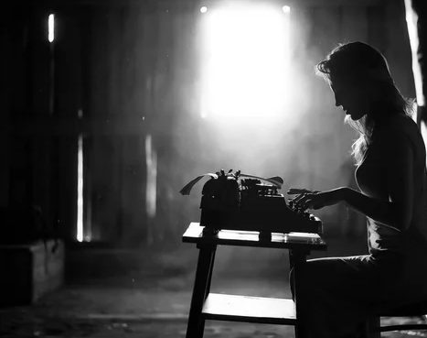
7. EXERCISE – WRITING
What do you think of the death penalty in general?
100 words – upload to elevfeedback

