Slide 1
Analytical essay:
True Crime - Social justice or entertainment?
Nonfiction

Slide 2
Hvad skal I:
Write an analytical essay (900-1200 words) where you analyze and reflect on the article "Is Our Love of True Crime Shows Really About Social Justice?" by Jennifer M. Wood from WIRED.

Slide 3
I dagens modul
10 min - individually: Read the article (in silence) – highlight and take notes
25 minutes - groups: discuss and make sure to write down notes:
  What makes us so fascinated by true crime?
  Is it about social justice, or is it something else in human nature?
  How does true crime reflect our morals and ethics?
  Are there risks or benefits to consuming this type of entertainment?
20 minutes – in groups: style of writing:
Write down examples of how Jennifer Wood uses language and see if you can add style of writing

Slide 4

Style of writing not what is said but how it is said
Analysing the style and tone involves understanding the particular way a piece is written.
Style and tone in writing is not what is said but how it is said.
Styles in writing are created deliberately by the author/writer to convey a specific mood or effect - it is his/hers unique way of communicating his/hers ideas and message.

Slide 5
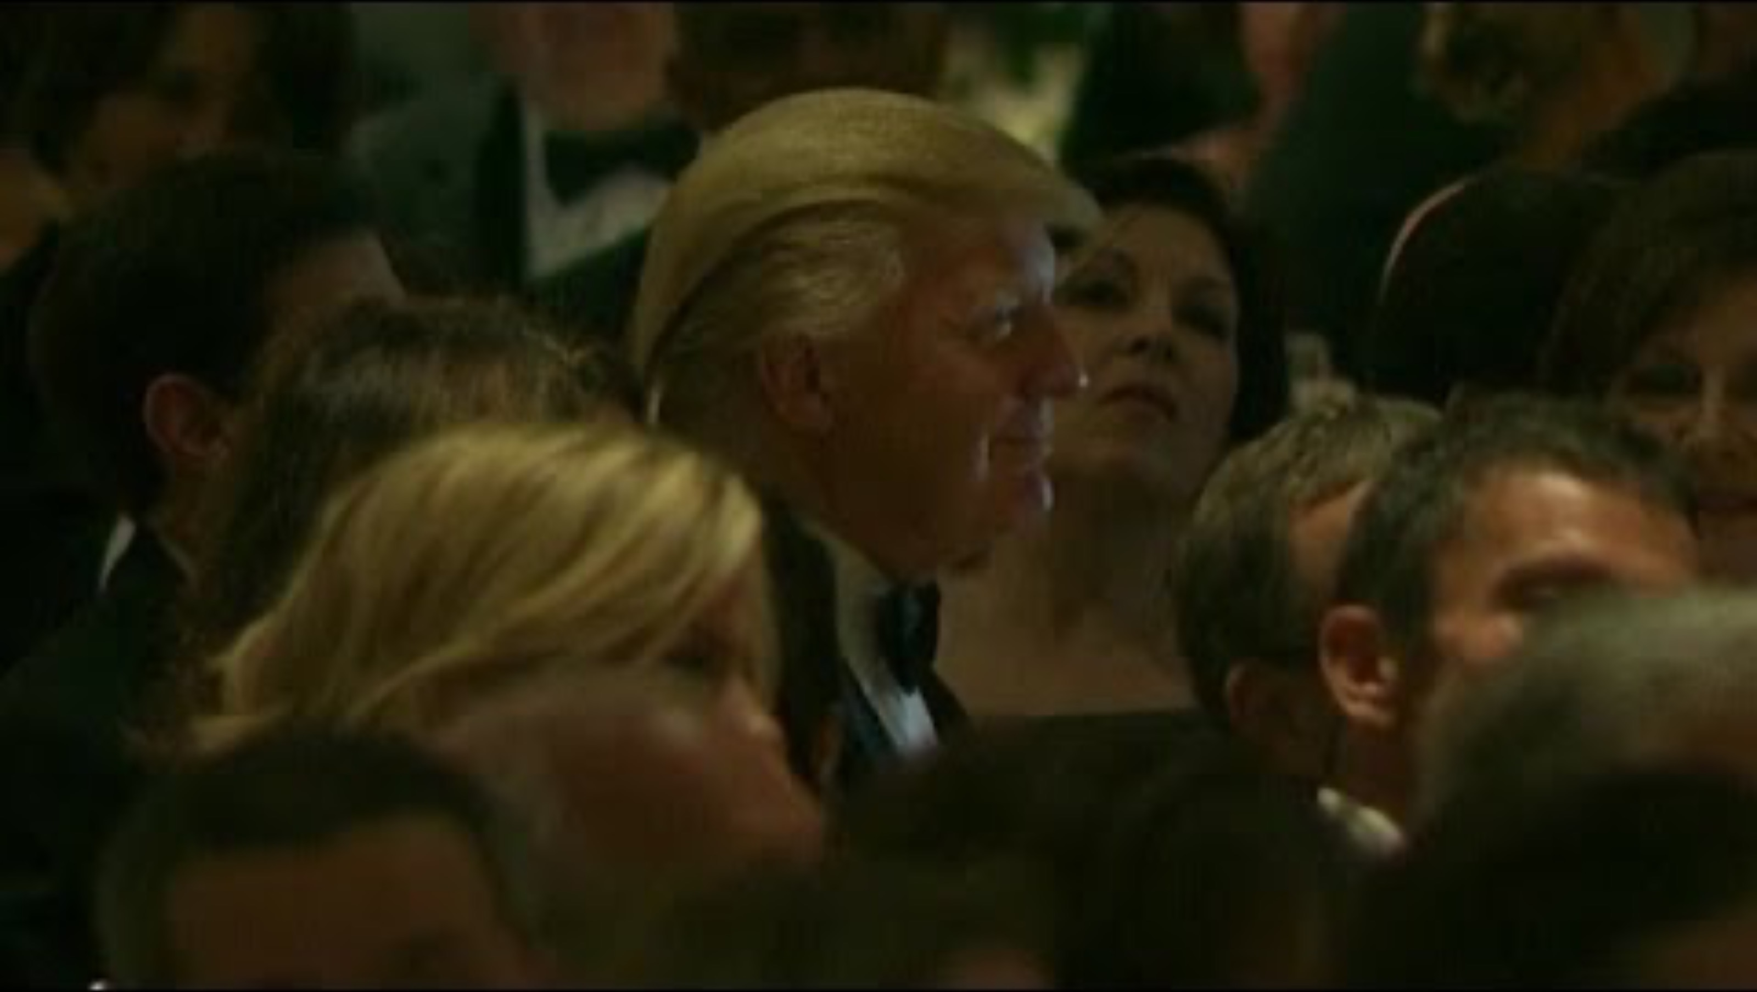
Obama roasting Trump

Slide 6
Rhetorical devices?

Slide 7
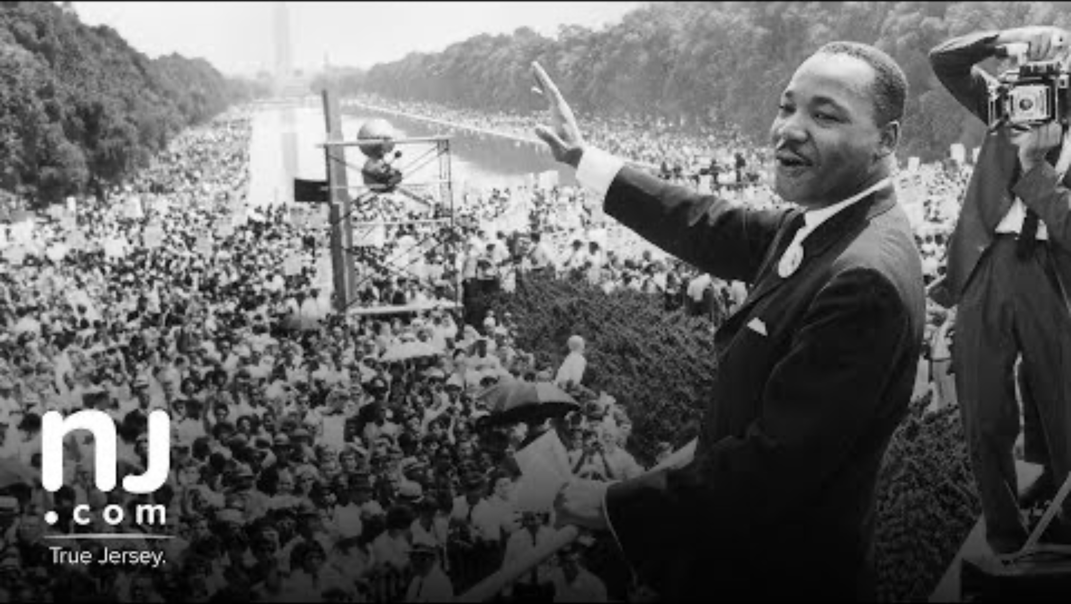
Rhetorical devices?
Notes:
I have a dream: anaphora (repetition)

Slide 8
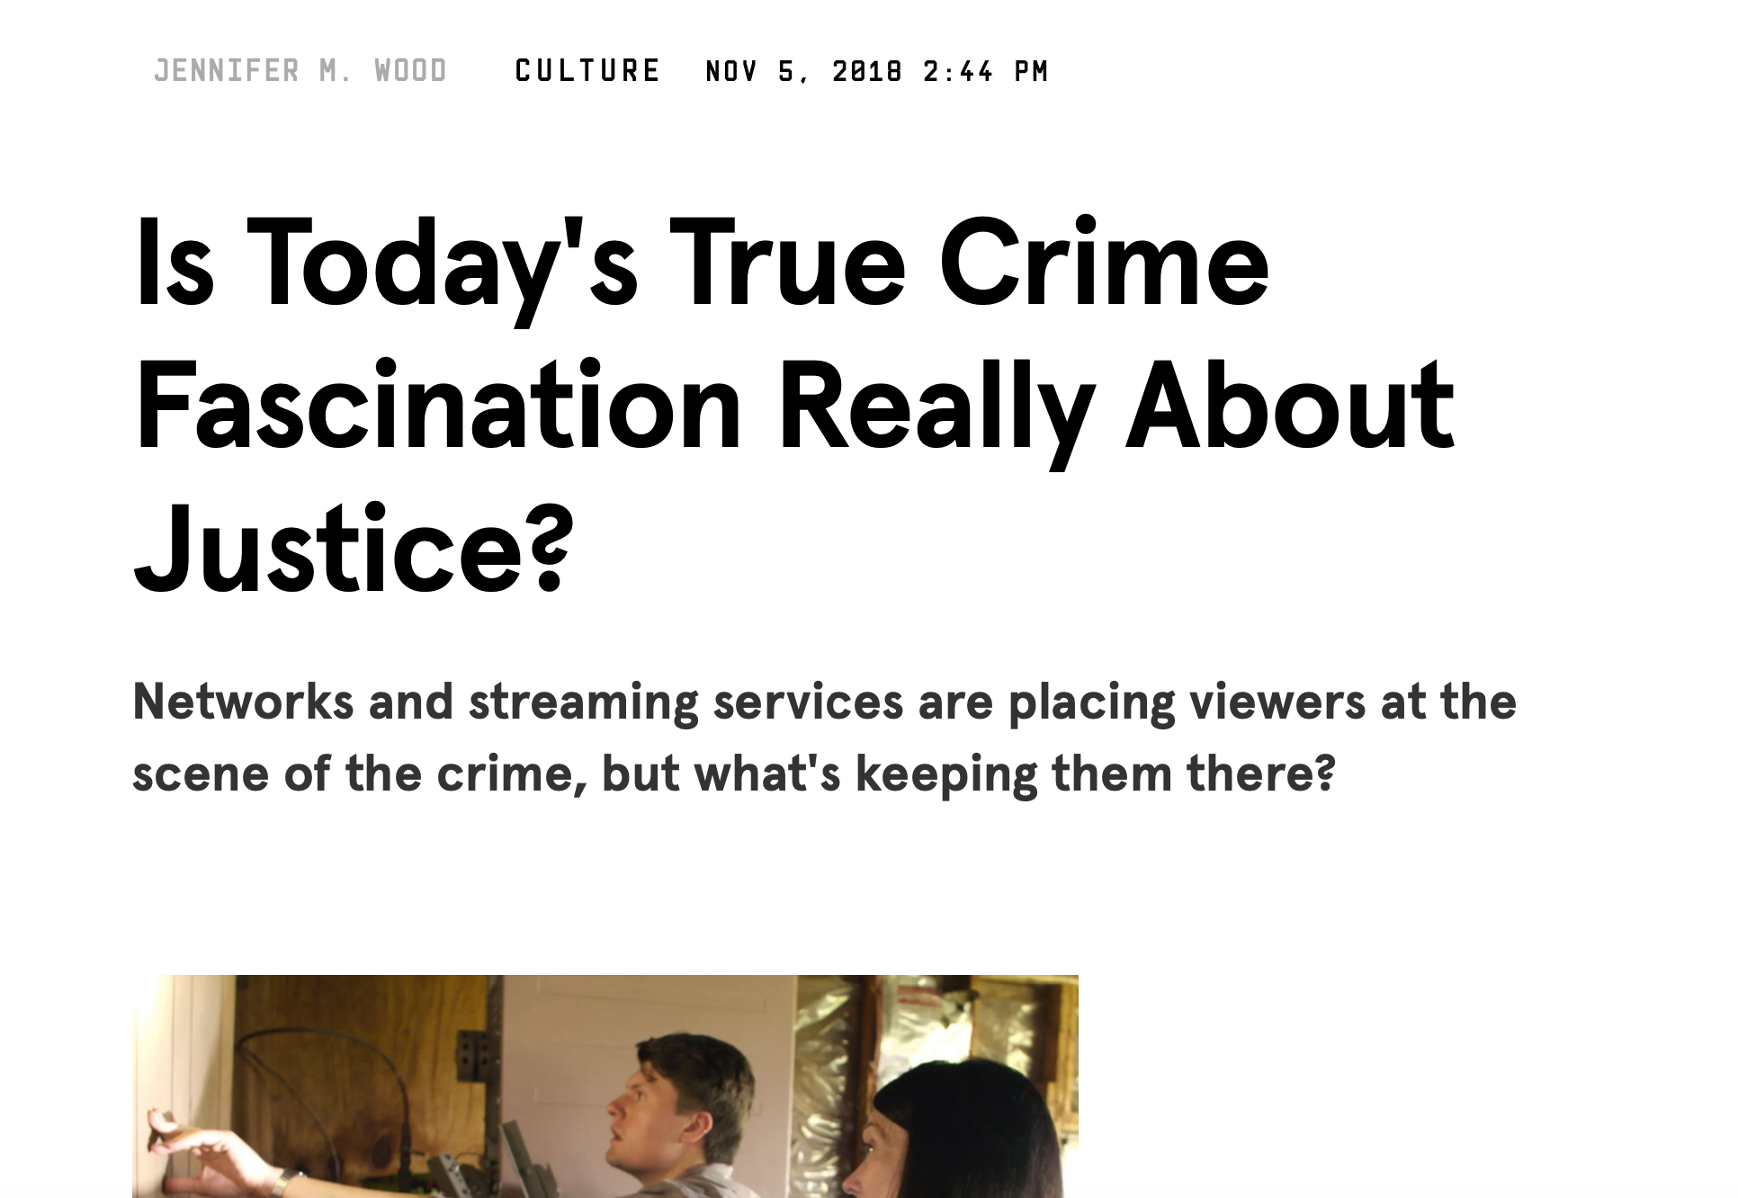
10 min - individually: Read the article (in silence) – highlight and take notes

Slide 9
25 minutes - groups: discuss and make sure to write down notes:
What makes us so fascinated by true crime?
Is it about social justice, or is it something else in human nature?
How does true crime reflect our morals and ethics?
Are there risks or benefits to consuming this type of entertainment?

Slide 10
20 minutes – in groups: style of writing:
Write down examples of how Jennifer Wood uses language and see if you can add style of writing terms

