Slide 1
Trump/Harris speeches
28/10 2024

Slide 2
A: Both are political speeches
Trump
Harris
” a purpose that consists of presenting future actions, all the things he’s going to do for the American people, the middle class, the economy and so on: “We will save our economy. We will rescue our middle class. We will reclaim our sovereignty and restore our borders. We will put America first, and we will take back our country. Together, we will make America powerful again. We will make America wealthy again. We will make America healthy again.”
“It’s a political speech. I know that because she’s talking about her campaign and pushing for re-election. She discusses their administration's achievements and compares their vision with the opposition. She’s rallying support and emphasizing the importance of voting in the upcoming election. “

Slide 3
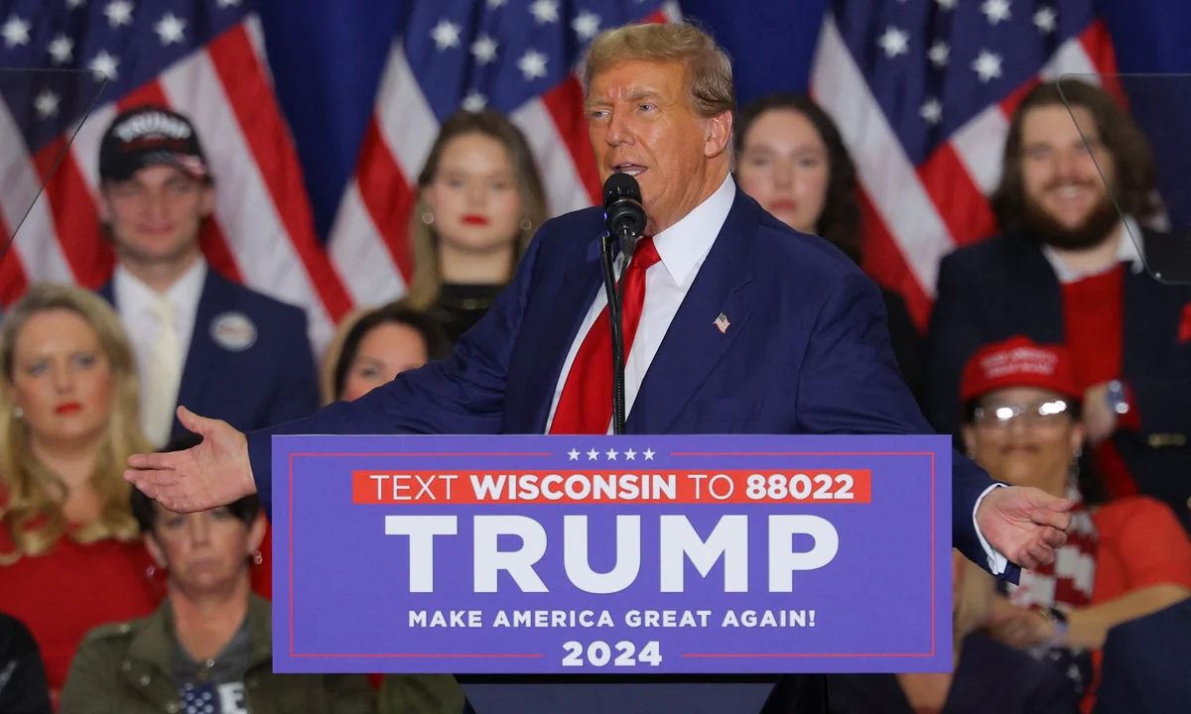
B: Rhetorical pentagram - TRUMP
Speaker: Donald Trump
Subject: His political plans for America’s future, with heavy criticism of his opponents.
Language: Informal, simple, with repetitive, short sentences and low register (e.g., "They’re ruining your life. They’re ruining your way of life").
Audience: Primarily middle-class Americans and Trump’s supporters, with language easy for all to understand – people who are supporters of Trump and or undecided voters in Wisconsin (and around).
Circumstances: Political rally, where Trump speaks directly to his voters and followers – a political swingstate (Wisconsin).
Purpose: To share his political vision and goals for America and to convince people to vote for him

Slide 4
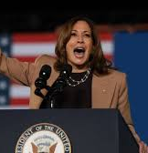
B: Rhetorical pentagram - Harris
Speaker: Kamala Harris, the Vice President, known for her work on social justice and civil rights.
Subject: She praises the current Biden administration and the work it has done. She presents her own campaign ambitions, she critiseses Trump (I know his type)
Language: Clear and inclusive, talks about her own ethos – as a previous defense lawyer.
Audience: Mostly Democratic voters and undecided voters in Wisconsin who support progressive ideas.
Circumstances A campaign event in an important swing state, meant to build support for the next election.
Purpose: To convince people she is prepared to lead, highlighting her policies in contrast to Trump’s, and focusing on a "people-centered" approach.

Slide 5
C: Modes of appeal
Trump
Harris
Ethos: ”Trump tries to builds trust by reminding people of his past experience as president, saying things like, “I’m the only one that can do it.”
Logos: He uses his nine steps plan. It makes it seem very logical. Its almost as if he says, if you just follow me and we do this in this very specific order we will succeede/I’m a tariff president... I will lower your taxes.”)
Pathos: By calling the current administration a “corrupt political class” and saying he’ll “drain the swamp.” he creates anger and a sense of injustice – or when he says: ”This may be our last election”
Ethos: highlights her own previous career as the key to stopping Trump: "I took on perpetrators of all kinds… I know Donald Trump’s type."
Logos: When our Middle class is strong, America is strong
Pathos: we believe in a future….

Slide 6
D: Rhetorical devices
Trump
Harris
Allusion: Comrade Harris (communism)
Alliteration: “…mayhem and misery…”
Antithesis:
Rhetorical question: “How about the people they’re arresting because they were praying in public?”
Anaphora: “We will make America...” is repeated at the end/ I hate to be right. I hate to be right.
Metaphor: Washingtong/government = The Swamp
Simile: “Pouring out money like it was water”
Onomatopoeia (lydord – såsom Oink, hisss, shhhh, boom):
Allusion: The path to the white house goes through Wisconsin
Alliteration: freedom, compassion
Antithesis: a country of freedom (…) or a country of chaous (…)
Rhetorical question: What kind of country do we want to live in?
Anaphora: we’re not going back x 2
Metaphor: The baton (taktstok, stafet) is in our hands

