Slide 1
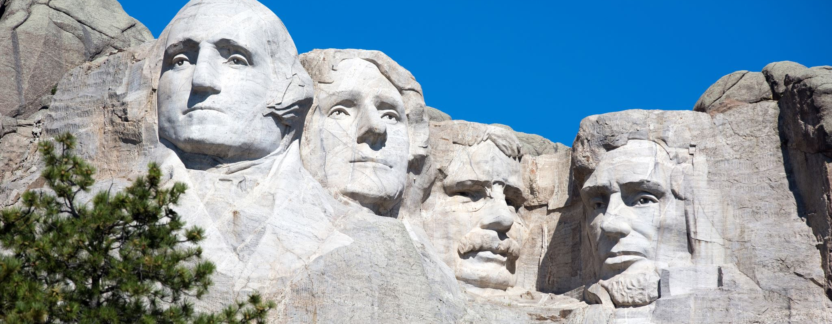
The US Political System
… and why the 2024 election might become very dramatic.

Slide 2
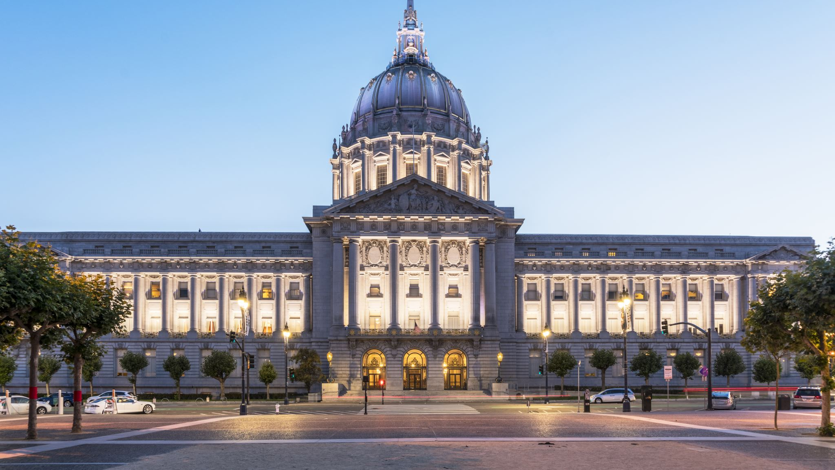
Today’s goals
You know the role of the electoral college in US presidential elections, including the concept of swing states.
You can explain the concept of checks and balances in the American political system.

Slide 3
Pick one snippet and explain its connection to as many other snippets as possible.
Vocabulary snippets

Slide 4

Arrange all the snippets in a web of connections on a piece of A3 paper – photograph it
Vocabulary snippets

Slide 5
Taboo
Electoral college
Congress
Senate
House of Representatives
Swing state

Slide 6
Taboo
President
”Winner takes all”
Two-party system
The Constitution
Secure state

Slide 7
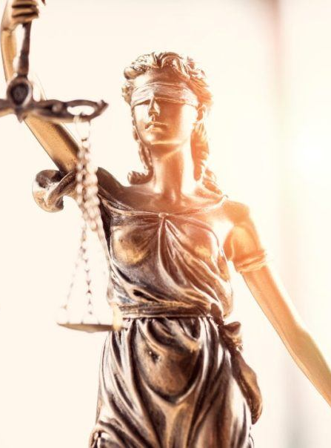
Research task: Checks and balances
What challenges did Joe Biden face from within the Democratic Party to make him decide not to run?
What is the relationship between Donald Trump and the rest of the Republican Party?
What was the result of the impeachment of Donald Trump? What does it show about the ability of Congress to hold the president accountable?

