Slide 1
The industrial revolution 1750-1850
Sources: Wider Contexts and https://www.poetryfoundation.org/collections/152982/an-introduction-to-british-romanticism

Slide 2

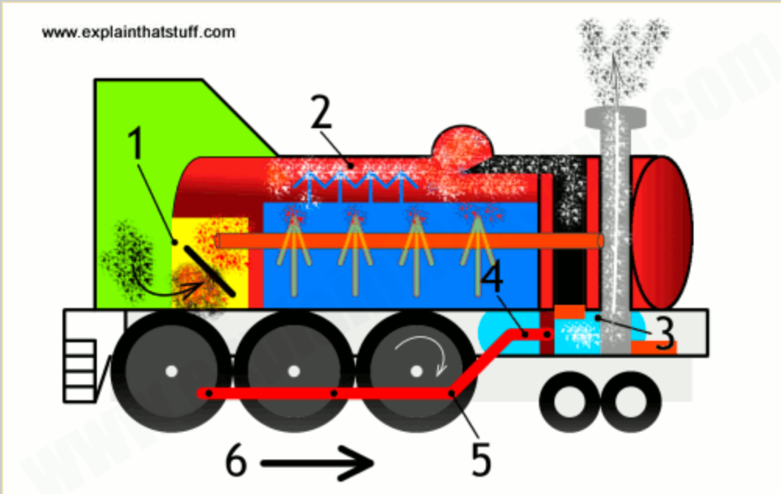

The steam engine

Slide 3
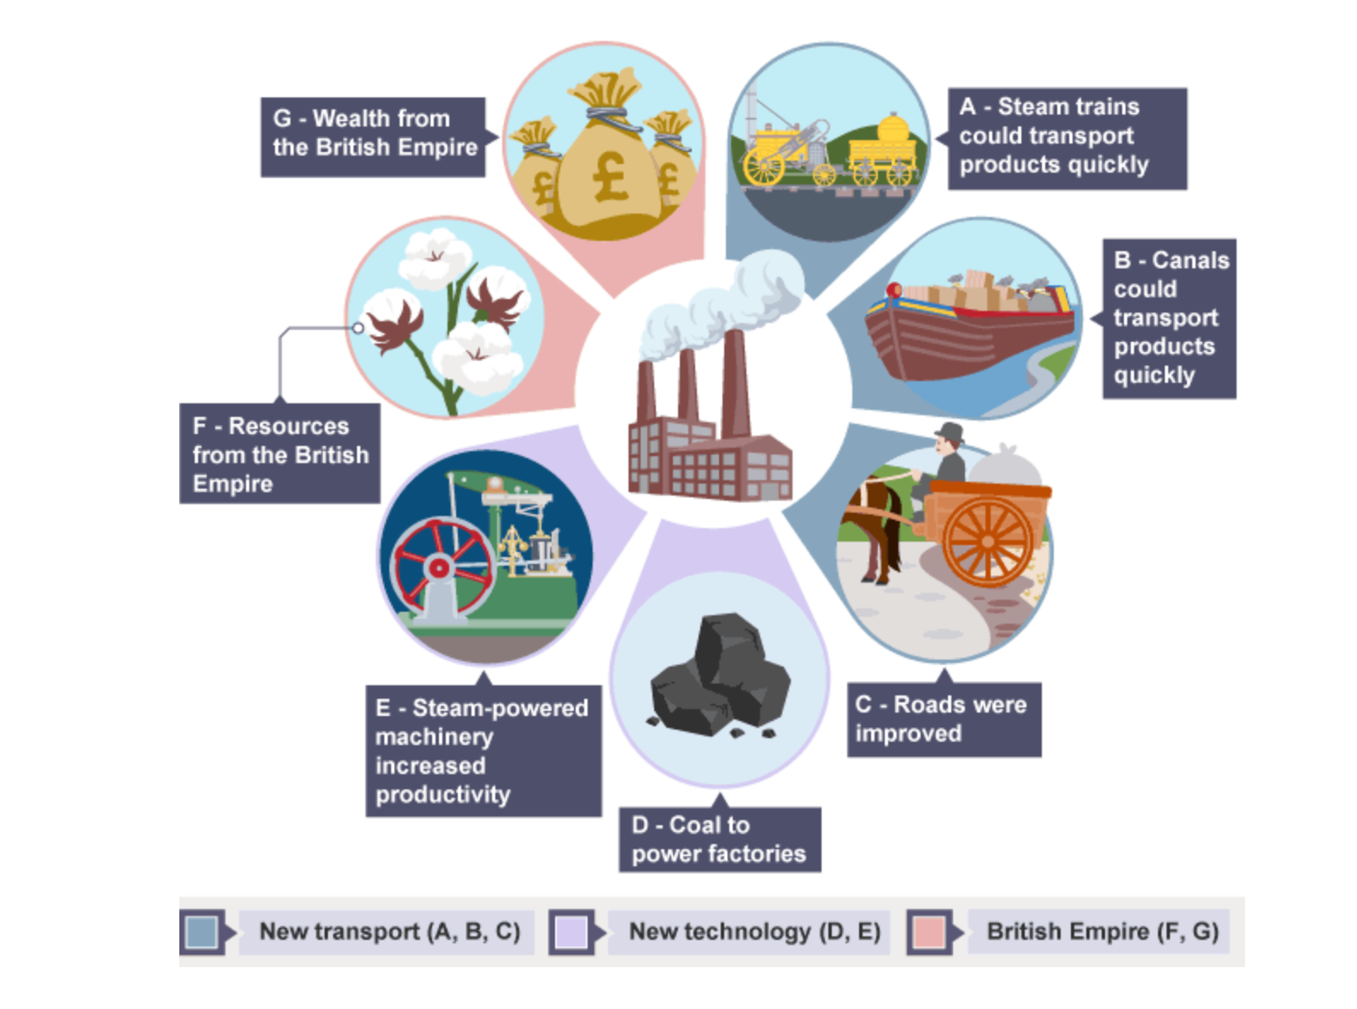
Develop-ments towards the industrial revolution

Slide 4
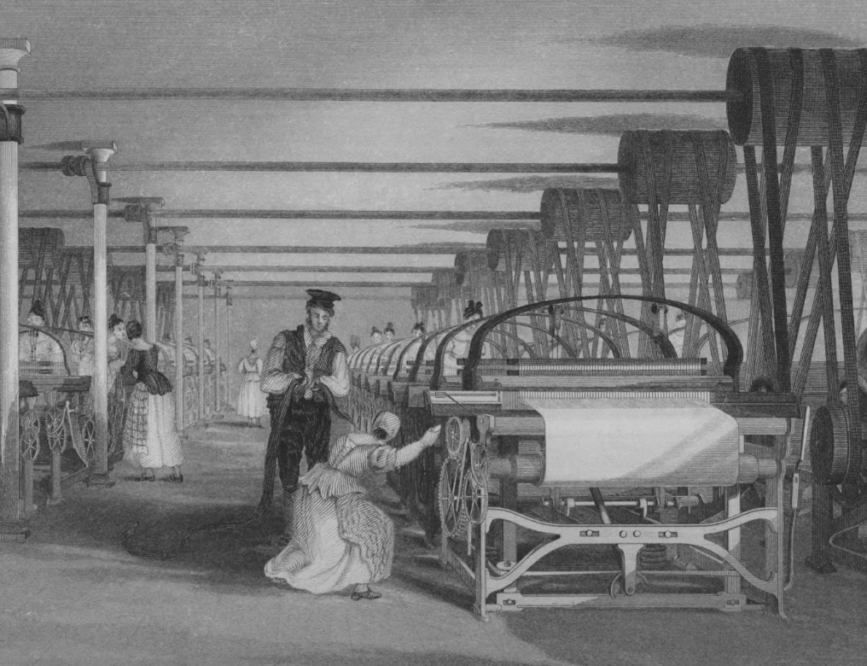

Changes
1750: Society based on farming
Machines replace manual labour and draught-animal labour
First the textile mill (wool), later other industries
Steam engines used in trains and factories -> an increased demand for coal
Money made from slave trade used to build railways, canals and roads.
Factories built away from agricultural centres --> cities --> urbanisation
1850: Society with urban slums

Slide 5
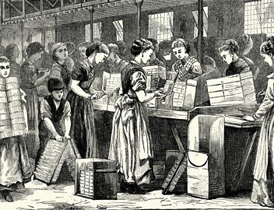
The negative consequences
Grim working conditions (mills, mines, factories)
16 hours a day
Child labour
Low pay
Poverty
Insufficient housing
Disease (cholera)
Notes:
Match factory

Slide 6
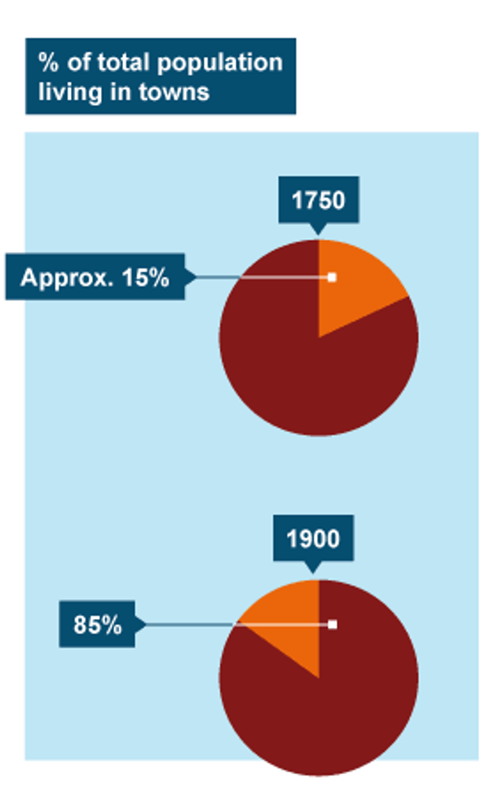
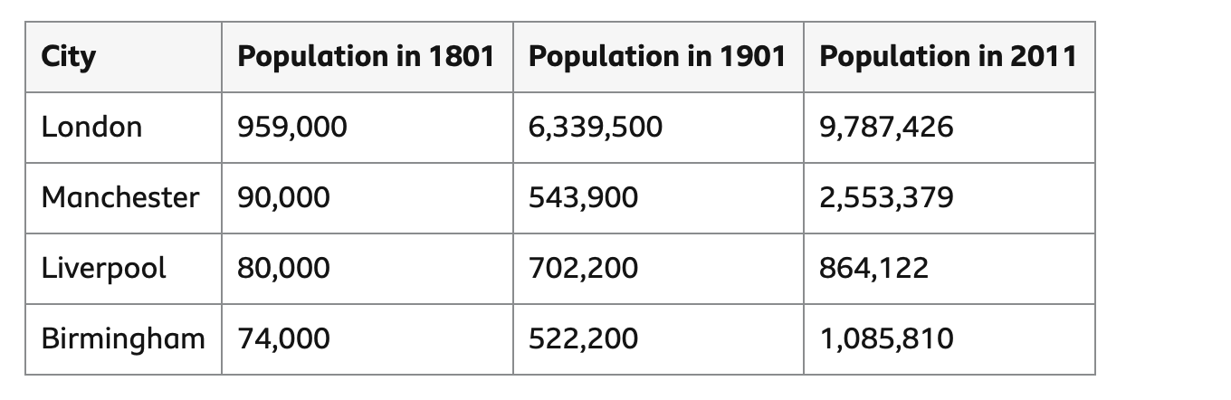
Urbanisation

Slide 7
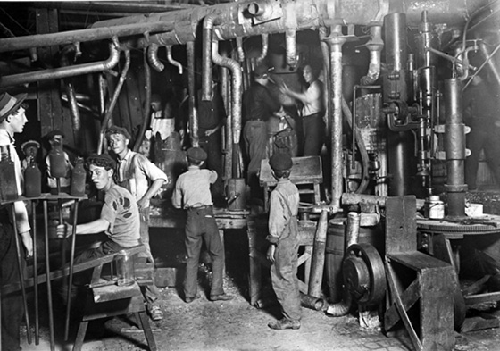
The positive consequences
1800: Britain is the most industrialised country in the world
Exports have increased by 500 % since 1700.
Factory Acts 1800s
Public Health Act of 1875 (sanitation, water, sewage, medical officer)

Slide 8
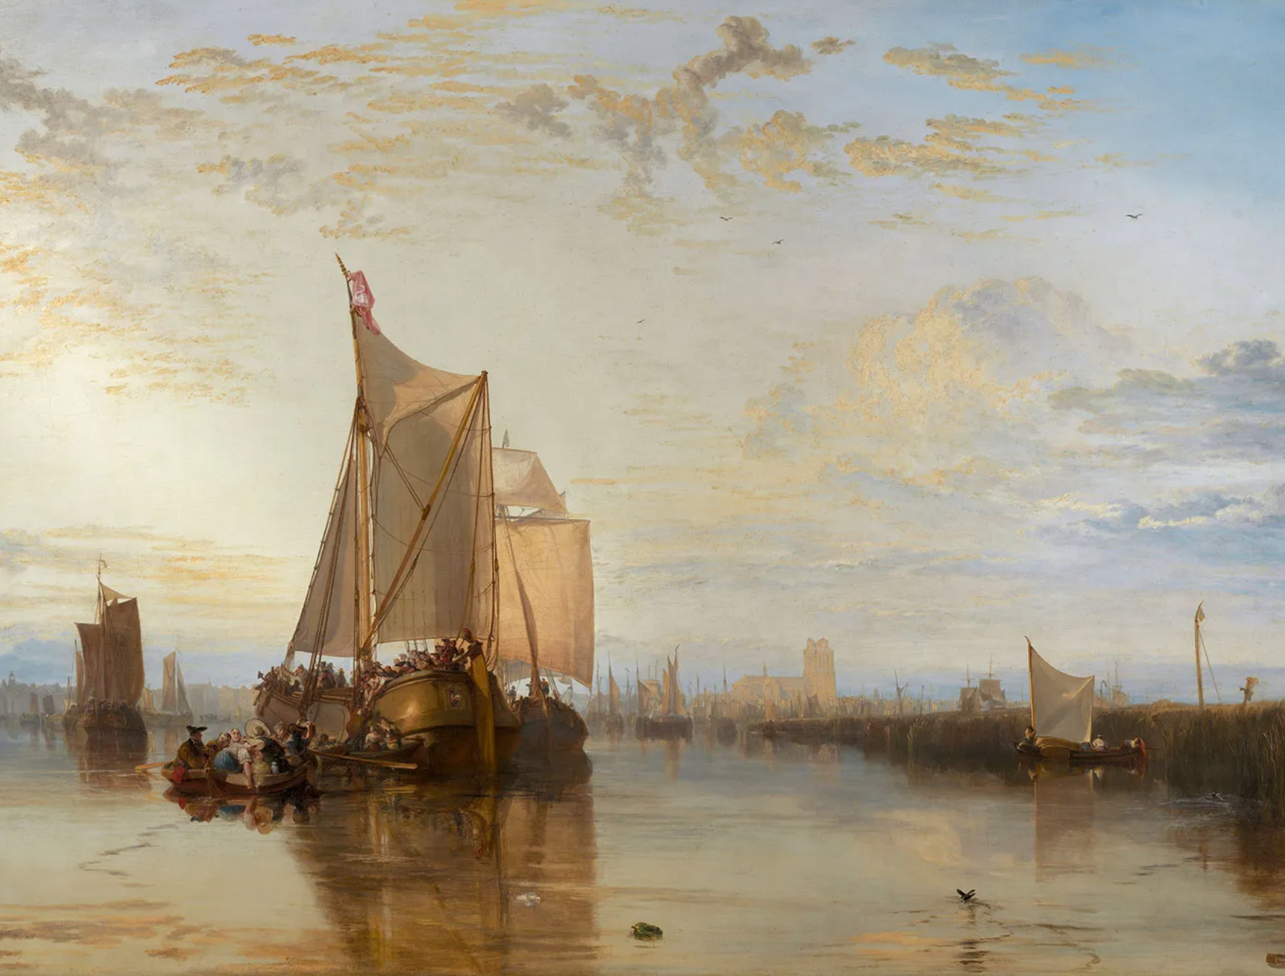
context: Literature and art
Romanticism (1789-1832)
J. M. W. Turner: Dordrecht: The Dort Packet-Boat from Rotterdam Becalmed, 1818.
Effects of light, elements of impressionism

Slide 9
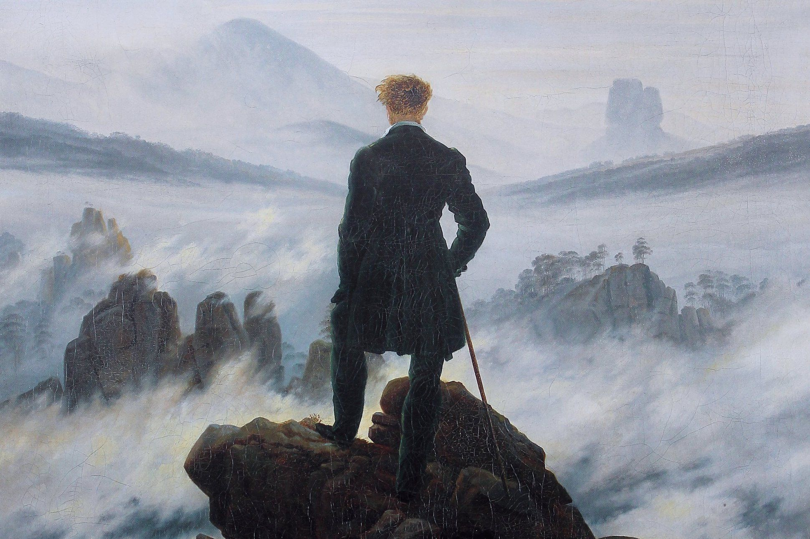
Fascination with nature
C. D. Friedrich: Wanderer Above the Sea of Fog (1818)
Duality
Pantheism
The artist is a genius, a mediator with divine inspiration

Slide 10
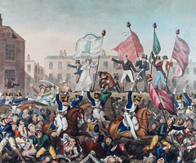
Societal changes causing changes in literature
Revolutions in the United States (1776) and France (1789)
the Industrial Revolution
the rise of liberal movements and the state’s counterrevolutionary measures
the voicing of radical ideas – Parliamentary reform, expanded suffrage, abolitionism, atheism – in pamphlets and public demonstrations.
Peterloo massacre of 1819: state cavalry killed 18 people peacefully demonstrating for a reform of parliamentary representation (requiring universal manhood suffrage) and wounded hundreds more.

Slide 11
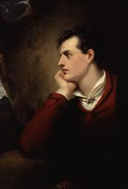
The poets
Lord Byron (left), Percy Bysshe Shelley, Keats, Samuel Coleridge, William Wordsworth – many of them died young
A life intensely lived (reckless youth, burn-out often by mid-30’s)
Carelessness in life and love which results in temptation, sin and guilt
Many contradictions, paradoxes and incompatibilities in life-style
Sensitivity substituting for sensibility
Obsession with the transitory or evanescent quality of life
A desire to be loved, self-centered, committed to true friendship
Fear of death; contemplation of suicide
The feeling of having been born with an unlucky destiny/fate
Despair, melancholy (like Goethe)
Hope for immortality; attraction to the immortality of the Classical world

Slide 12
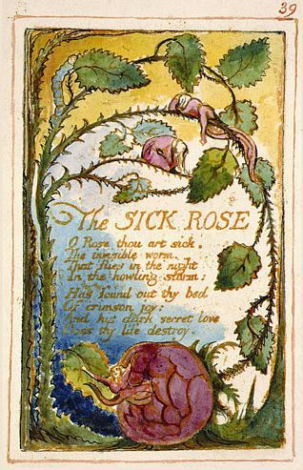
Romanticism: Key concepts
Pre-Romantic poet William Cowper [ku:pә]: “God made the country, and man made the town” (1785)
Freedom – political and religious
Imagination
Emotion
The particular/the individual /the celebration of the self
A fascination with nature
The poet (genius)
Recollection of youth; nostalgia for times past

Slide 13
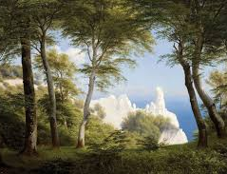
Additional characteristics
National disillusionment, love of travel, a conviction that the “grass is always greener”
Love of solitude and the mystical
Wordsworth: ‘Poetry is the spontaneous overflow of powerful feelings, it makes its origin in emotions recollected in tranquility’ (preface to Lyrical Ballads)
Despair and melancholy
Deep feelings for nature
  nature ennobles man
  universal harmony is found in and through nature
  moral lessons can be learned through nature
A belief in the moral purpose of poetry to reveal general truths to the reader which he/she would then act upon
Notes:
P.C. Skovgaard’s View of the Harbour from Mons Klint (1850)

Slide 14
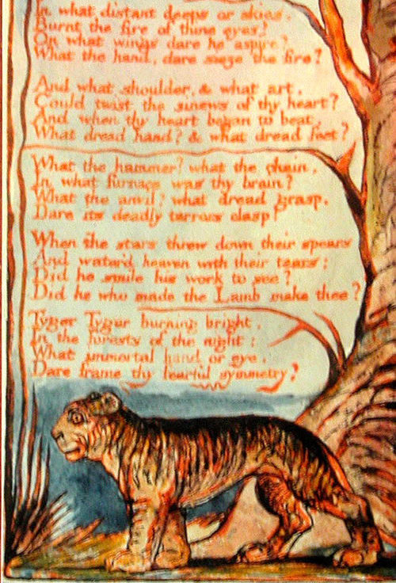
William Blake (1757-1827)
Artist, printmaker, poet, philosopher, revolutionary and fierce social critic
Famous British Romanticists
Believed in the importance of the imagination
His view of the new industrial England: a “land of poverty” with “dark Satanic Mills”
Denounced the exploitation, oppression and indoctrination of the poor by the ruling classes and the church
Apprenticed as an engraver at 14
“Illuminated Printing”: Published his poems as integrated works of poetic and visual art, etching words and drawings on copper plates, and colouring the individual prints by hand.

