Slide 1
The Victorian age
1832-1901

Slide 2
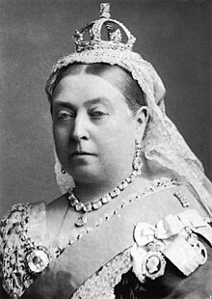
Characteristics
Queen Victoria’s reign: 1837-1901
Conservative family values
  Patriarchy, the man as the father of the house
  Women: inferior, passive, submissive, no right to vote (yet), moral and social respectability, ‘‘the angel of the house’ (cf. ‘Gunløde’)
Industrialisation continues
  poverty, grim working conditions, child labour, etc.)
Growth of the British empire in Africa and Asia
Great Irish famine 1845-1851
  Potato blight
  Bad infrastructure
  Hunger and immigration
  Societal unrest led to Irish independence in 1921
Darwin’s theory of evolution
  On the Origin of Species, 1858
  Challenges the power of religion
Portrait by Alexander Bassano, 1882

Slide 3

Utilitarianism
Founders: Jeremy Bentham and John Stuart Mill
A set of moral and ethical values
Purpose: Promote well-being amongst people
Definition: The greatest possible happiness for the greatest number of people

Slide 4
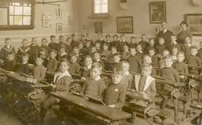
Societal progress
Societal changes reflect utilitarian ideals
  First trade unions established in 1868
  Poor Law Amendment Act 1834
    A national system to reduce the cost of looking after the poor
    The poor were housed in workhouses, clothed and fed (think of ‘Naadsensbrød’)
    Children received some education
    Beggars were taken off the streets
  Education Acts (1880-1899)
    Free, compulsory and non-religious education for all children aged 5-12 to stop child labour (but truancy was an issue)
Notes:
https://www.nationalarchives.gov.uk/education/resources/1834-poor-law/

Slide 5
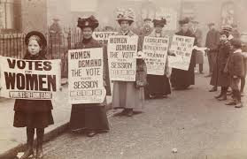
Parliamentary representation
Extended parliamentary representation for men
  Reform Act of 1832
  Middleclass men got the right to vote -> less power to landowners.
Parliamentary representation for women: The suffragette movement
  Advocating for female suffrage (the right to vote)
  Married women over 30 allowed to vote in 1918

Slide 6
Literature
Literature changes as a reaction to Romanticism
Realism (e.g., Charles Dickens – describes the life of the poor)
The novel (and serialised novels) becomes the dominant genre
Advocates the moral duties of the middle classes to help the poor

