Slide 1
The renaissance
1485-1649

Slide 2
Historical and societal context
Renaissance: ‘rebirth’, great changes in Europe
Reformation 1536: Removes power from the church (land, schools, pope)
King James’ Bible 1611 (English, not Latin)
Church services in English
Science:
  Copernicus’ heliocentric world picture 1543 (the sun at the centre) – but not widely accepted
  Navigation -> explorers
  America was ‘discovered’ (late15th century)
  1584: the first British colony in America –Virginia – was established.
Humanism: restore universally human values from classical antiquity by reintroducing the philosophies, languages and literature of ancient Greece and Rome.

Slide 3
The Elizabethan world picture
Queen Elizabeth 1 ruled 1558-1603
Theocentric world view (god at the centre)
Macrocosm: Geocentric physical world ( stationary earth is the centre and is surrounded by spheres)
The music of the spheres indicated the order and harmony considered ideal
Microcosm: Man, whose thoughts, feelings and health are influenced by four humours (determined by liquids in the blood)
  phlegmatic (indifferent, relaxed),
  melancholic (depressive)
  choleric (angry)
  sanguine (sociable) Superstition (witches, spirits, sorcerers, etc)

Slide 4
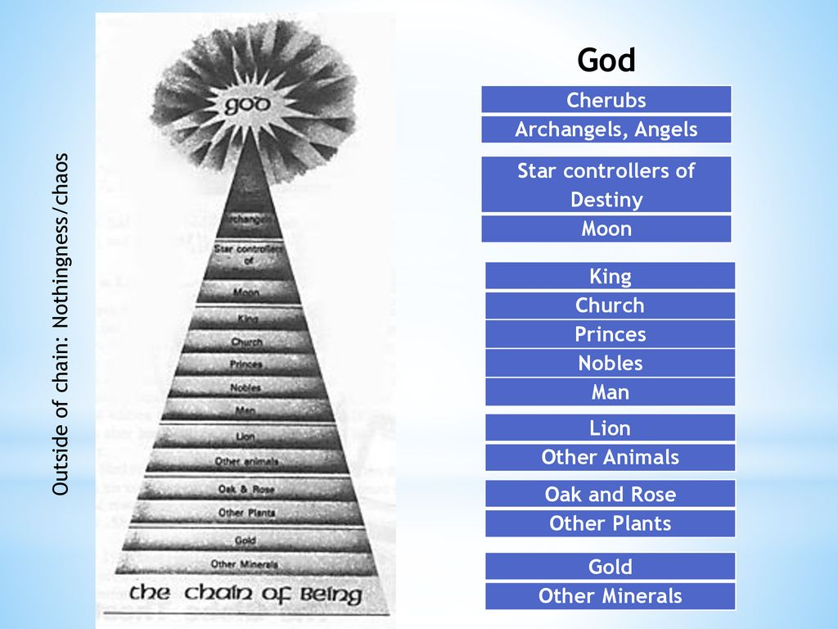
The chain of being
Hierarchical structure reflected in society
Created by laws of nature
Clear view of the functioning of God’s creation and of man’s position within this creation
A way of retaining order, fear of chaos
The position of a king was compared to an eagle among birds and a lion among animals
Change and development were seen very negatively; people were conservative and wanted harmony (accept one’s place, no upward mobility)
Civil law very important: man must obey civil law to establish order, based on the law of nature which is by God → if man obeys the civil law, he creates harmony in society
Women considered weak and unable of conflict-solving, were dependent on the men in their life (father, brothers, husband, sons) and were supposed to be obedient to men
Shakespeare’s plays reflect this order

Slide 5
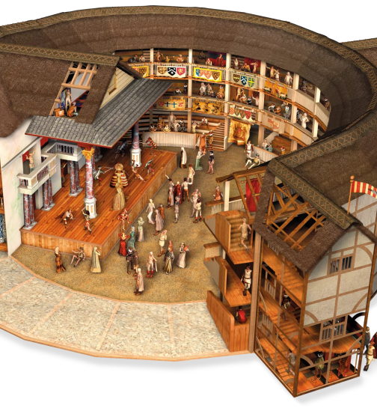
Literary context
Primary genres: poetry and drama
First fixed stage 1576
The Lord Chamberlain’s Men theatre company (all men)
Playwrights: William Shakespeare, Ben Johnson, Christopher Marlowe
The Globe (1599) and similar theatres made drama popular among poor audiences (props, equipment)

Slide 6
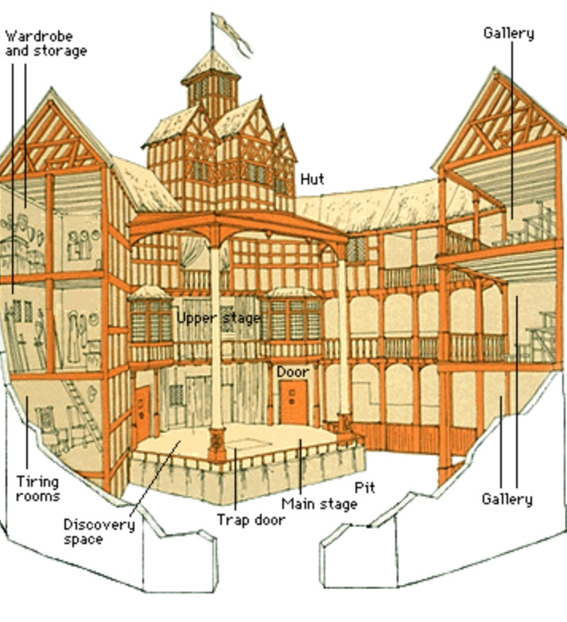
The Globe
Southwark, London
Cheap tickets: 1 penny for groundlings
Burned own in 1613
Second Globe Theatre 1614-1642
All theatres closed 1642-1660 (civil war)
When theatres re-opened, actresses were permitted on stage
Shakespeare’s Globe opened in 1997

Slide 7
William Shakespeare
1564-1616
Born in Stratford-on-Avon
Actor and playwright for the Lord Chamberlain’s Men, later The King’s Men
38 plays (tragedies, comedies, history plays)
154 sonnets published in 1599
The Tragedy of Romeo and Juliet written around 1591-1595 (one of Shakespeare’s early plays)
Shakespeare was influenced by classical Greek and Roman culture (the setting is Verona, the use of sonnets) – just like his fellow Renaissance men.

Slide 8
Verse and prose in Romeo and Juliet
Primarily blank verse (unrhymed iambic pentameter): A vehicle for dramatic poetry and passion
Sonnets within the play: A vehicle for particularly important and lyric content (e.g., prologues to acts 1 and 2, Romeo and Juliet’s first meeting, closing scene)
Prose: In Shakespeare’s early plays, prose is spoken only by low-life and comic characters (nurse, Mercutio) and in formal documents (letters)
Shakespeare, William. Romeo and Juliet. Ed. Henry Norman Hudson. New York: Ginn and Co., 1916. Shakespeare Online. 20 Aug. 2009. http://www.shakespeare-online.com/plays/juliuscaesar/juliushudson.html

