Slide 1
MANIFEST DESTINY

Slide 2
MANIFEST DESTINY
In the 19th century, manifest destiny was a widely held belief in the United States that its settlers were destined to expand across North America (think of ‘Pioneers! Oh Pioneers!). There are three basic themes to manifest destiny:
The special virtues of the American people and their institutions
The mission of the United States to redeem (opfylde/indfri) and remake the west in the image of agrarian (landbrugs-) America
An irresistible destiny to accomplish this essential duty

Slide 3
A NEW HEAVEN
Historian Frederick Merk says this concept was born out of "a sense of mission to redeem the Old World by high example ... generated by the potentialities of a new earth for building a new heaven"

Slide 4
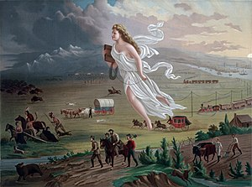
Notes:
manifest destiny, amerikansk politisk doktrin, opstået i 1840'erne. Ifølge manifest destiny var det USA's skæbnebetonede pligt at brede sig over hele det nordamerikanske kontinent. Doktrinen indgik i agitationen for at udvide USA's territorium med Oregon, Mexico, New Mexico, Californien, Texas og senere Cuba og Canada.

