Slide 1
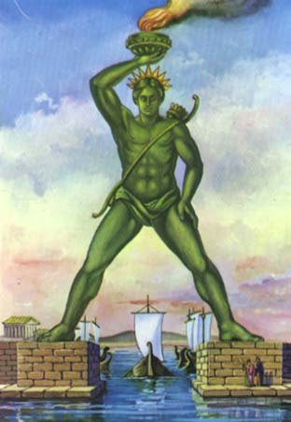
Notes:
The Colossus of Rhodes was a giant statue of the god Helios, erected on the Greek island of Rhodes by Chares of Lindos between 292 BC and 280 BC. It was roughly the same size as the Statue of Liberty in New York, although it stood on a lower platform. It was one of the Seven Wonders of the World.

