Slide 1
Lingua Franca
Say what???

Slide 2
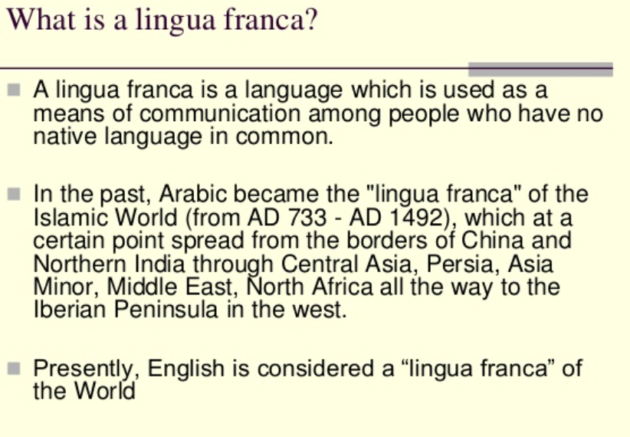
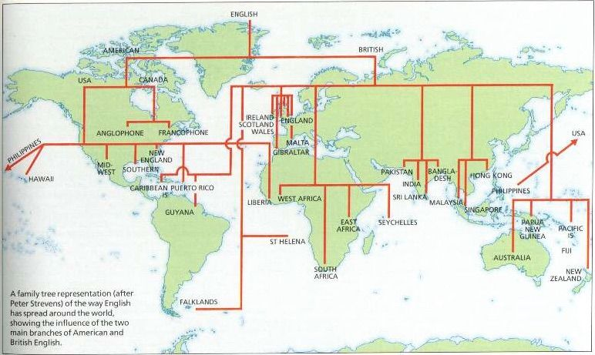

Slide 3
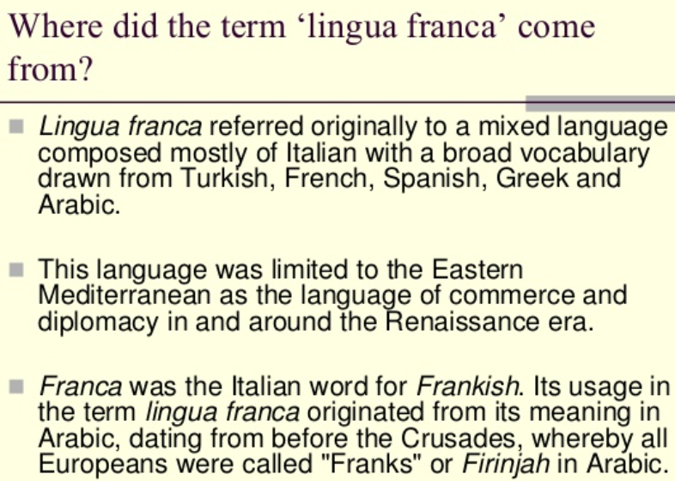

Slide 4
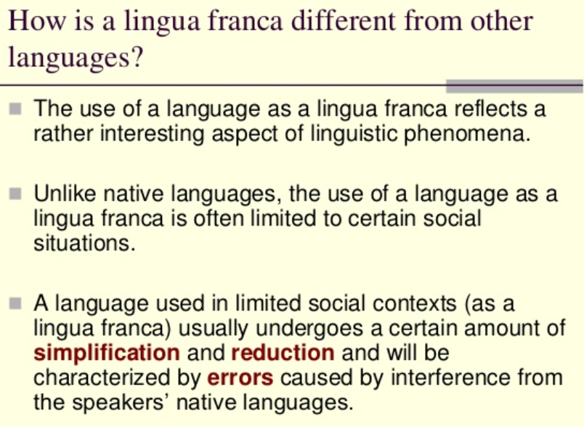

Slide 5
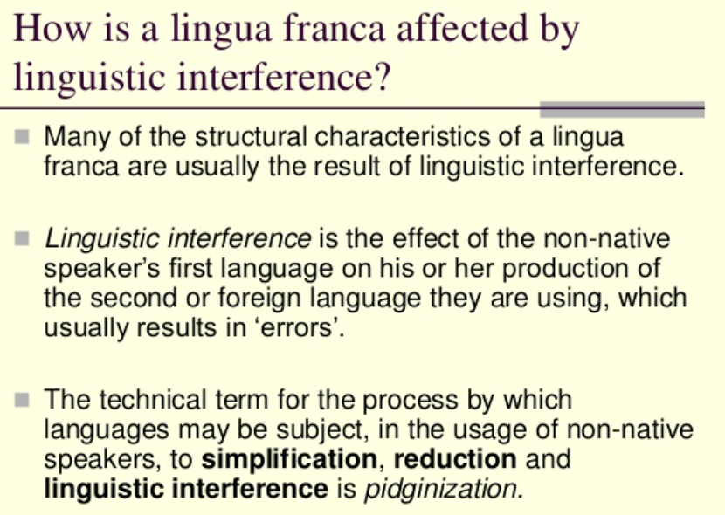

Slide 6
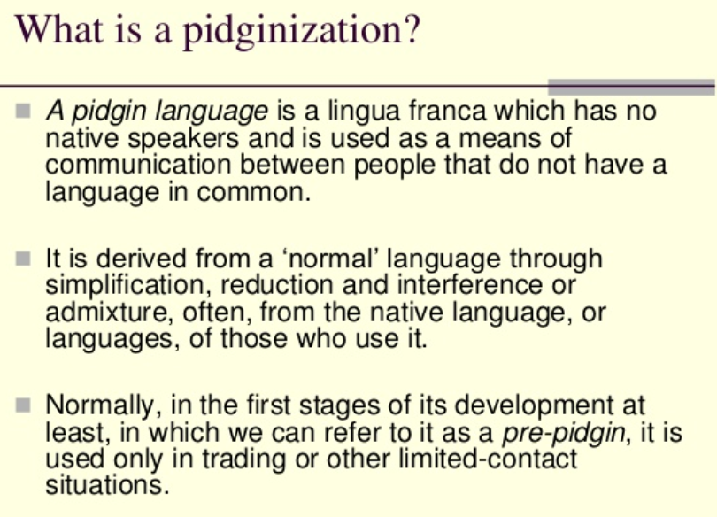

Slide 7
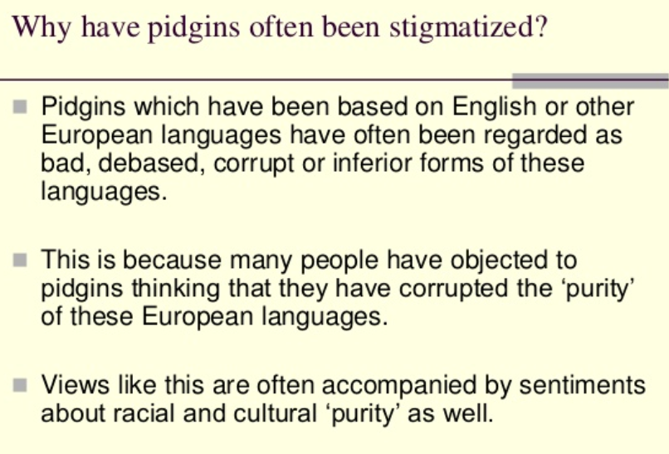

Slide 8
Consider this:
English has official or special status in at least 75 countries, with a total population of more than two billion
One out of four of the world's population speak English to some level of competence
More than two thirds of the world's scientists read in English
Three quarters of the world's mail is written in English
80 per cent of the world's electronically stored information is in English.

Slide 9
As fast as you can, name 10 English words commonly used in Denmark. GO!

Slide 10
Points to discuss:
Which role does English play in Denmark?
How do you, yourself, use English in your daily life?
How do you plan on using it in the future?
Is it your aim to keep using English as a lingua franca
or to improve to a ‘native’ level? (is that even possible?)

