Slide 1
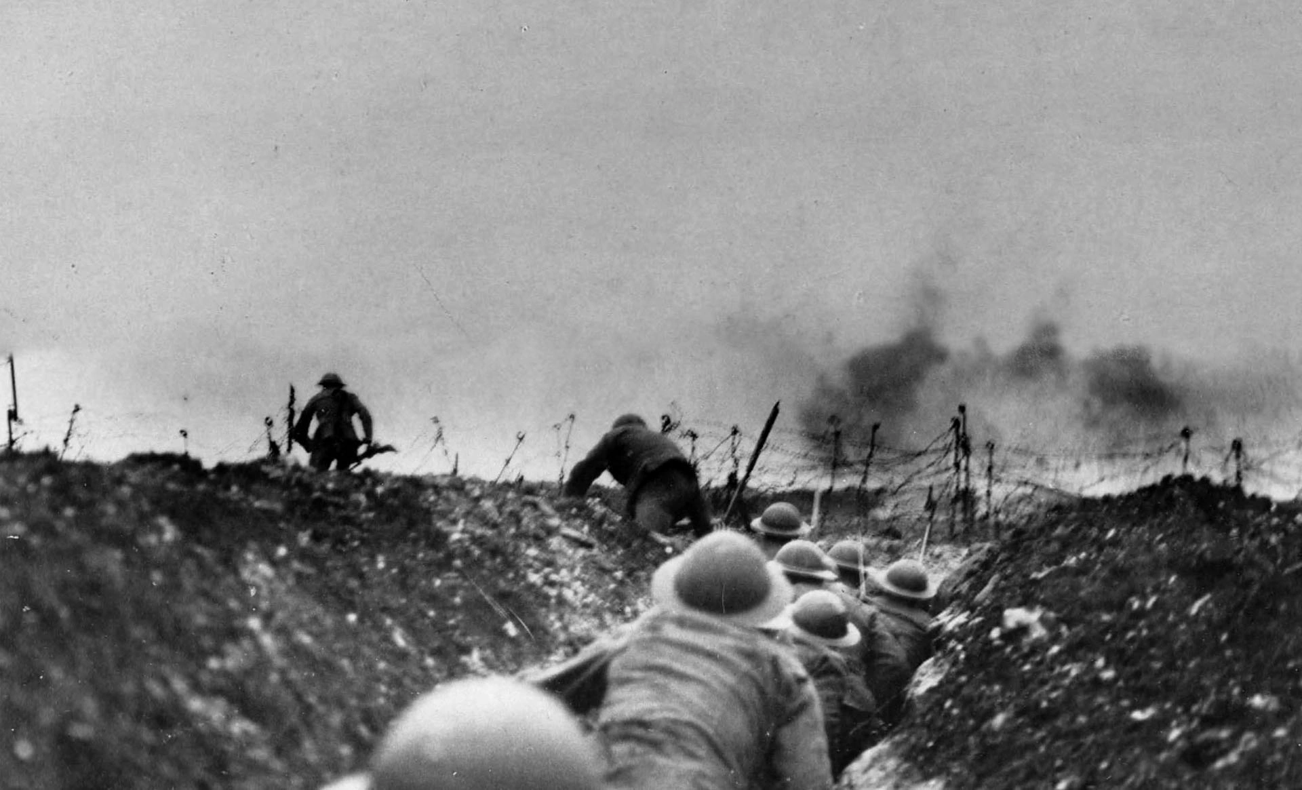
The Great War
1914-1918

Slide 2
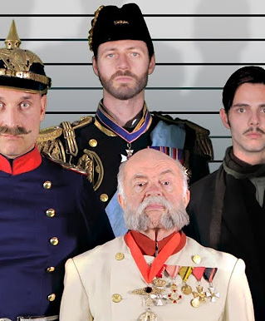
System of alliances
The countries who joined the way were bound by an old system of alliances. The Austrian Archduke Franz Ferdinand was killed in Sarajevo in June 1914, and that made Austria declare war on Serbia with the allies of allies joining up.
https://www.facebook.com/HistoryHit/videos/979723832092675/
Within a month it was a world war – but mainly a European war
Everyone thought it would be over by Christmas – but they did not take all the new inventions into account.

Slide 3
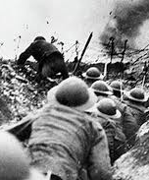
New inventions
Nerve gas
Tanks
Machine guns
Notes:
Industrialisation, not traditional noble war with two armies facing each other at daybreak. These new inventions CHANGE the way wars are fought. Think of present day wars in Syria.

Slide 4
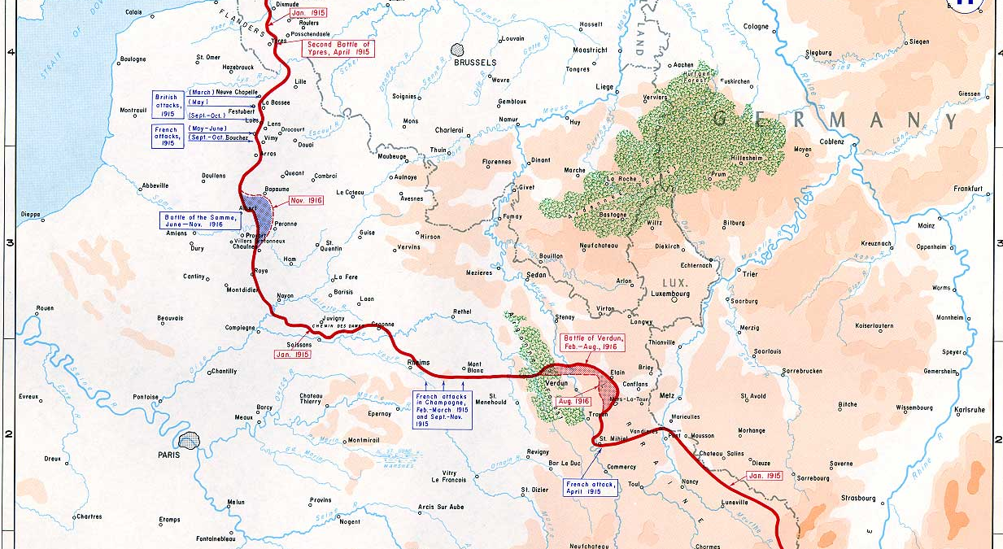
Trench warfare
Notes:
The west front – Germany on the one side and Belgium, France etc on the other.

Slide 5
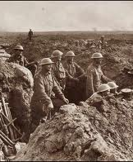
Trenches
Never a straight line
Protect the soldiers
Mud, rats, lice
7000 men died each day
The Battle of the Somme: 58,000 British soldiers died on the first day (1916)

Slide 6
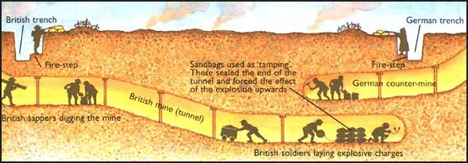
Tunnels
Notes:
Canaries, gas pockets, underground fighting

Slide 7
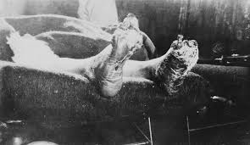
Disease in the trenches
The Spanish influenza (the Covid of 1917 – but more infectious and much more deadly amongst young people)
Trench foot
Trench fever

Slide 8
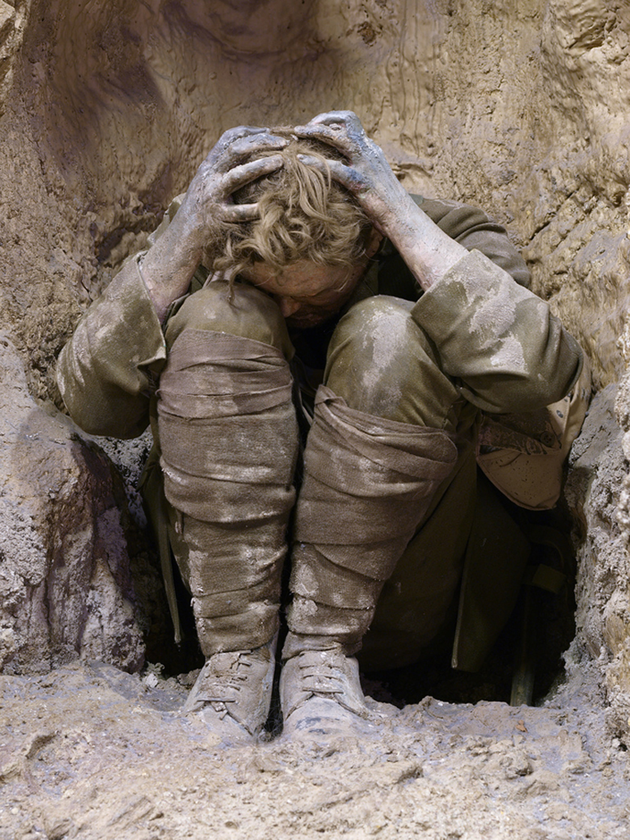
Shell shock
The term for PTSD at the time – a mental illness resulting in physical symptoms (subconsciously to get away from the front)
Not the same as being hit by a blighty bullet that would send you home (sometimes self-inflicted) – but people were accused of faking the symptoms
Symptoms:
  Unable to speak (mutism)
  Unable to walk (paralysis)
  Stuttering
  Nightmares
  Hallucinations
Notes:
Blighty is your home country, England

Slide 9
The end
”The war to end all wars” ended up killing an entire generation of young men in Britain and other places in Europe.

Slide 10
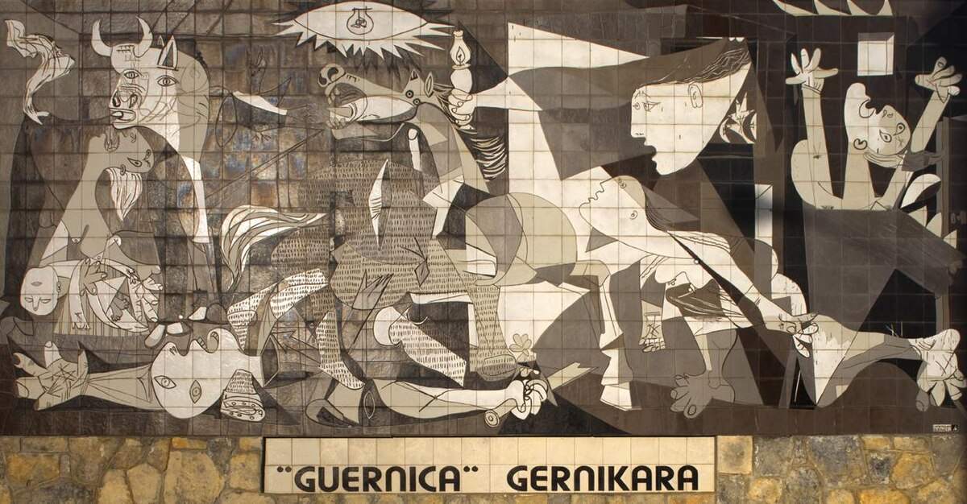
Modernism
Art and therefore also literature must reflect catastrophes and changes in society
  The Great War 1914-1918
  Titanic 1912
  Russian Revolution 1917
Emptiness, meaninglessness, loss of hope, fear of the future
A collective breakdown
W.B Yeats, “The Second Coming” (1920): “Things fall apart, the centre cannot hold”
  Yeats alludes to the second coming of Christ to express the meaninglessness of post-war Europe

Slide 11
Modernism: Literature must reflect life
Vera Brittain said, ‘Writing poetry belongs to another life’, but Wilfred Owen disagreed
Breakdown of form
  classic poetry with a specific type of rhyme and metre is gradually replaced by prose poems/free verse
  formal style of e.g. sonnets is gradually substituted by informal characteristics (vocabulary, grammar)
Breakdown of content
  poetry no longer (only) deals with love and similar pleasant aspects of life
  real-life problems such as war and death are now regarded a legitimate subject-matter of poetry

Slide 12
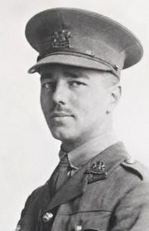
Wilfred Owen and modernism
A poet and relatively untrained soldier who wrote about his experiences.
Born March 1893, killed on November 4, 1918
He was wounded several times, awarded an M. C. (Military Cross)
To some extent writes modernist poetry
Owen’s poetry represents a breakdown of content and to some extent of form (informal language)
He often uses the classic forms of poetry (sonnet, iambic pentameter), possibly as a means to creating order and deal with the meaninglessness of war
Conveys the horror of war through satire and compassion

