Slide 1
News stories – discuss with partner
Which kind of news is the best for you? Why?
  Newspaper?
  Radio?
  Television?
  Social media?
What is the most memorable news you ever watched/read?
What do you think is the most important thing the news should report?
Do you trust the information you get from the news? In Denmark? In other countries?

Slide 2
Different types of news:
The news story (often put all the important information at the beginning of the article (follow the structure of the news triangle (nyhedstrekanten) with the important most relevant news in the beginning – thus, it is possible to cut the story from the bottom. It focuses on some of the basic news criteria:
  Current interest/topicality
  Importance/relevance
  Identification
  Sensation
  Conflict/ conflictbased
  News stories report about factual and real events. We expect news stories to be strictly objective, but they are in fact (more or less) biased – BUT STILL RELIABLE
The feature article (take an in-depth look at a subject in order to explain or analyze the news. Feature articles have another structure than news stories; the writer may appear as an “I”, the first paragraphs would normally aim at capturing the attention of the readers. In the body of the article, the feature writer may examine and illustrate the topic in a number of ways to give evidence in support of the argument of the article. The conclusion sum up the article)
The column or the opinion article (may cover a wide range of topics. It appears regularly, the writer is personally involved, it contains an explicit point of view)
The editorial or leader (is a newspaper’s official opinion or comment on the news. The most common structure of an editorial falls into three parts: the statement of the subject, the development of the argument, the conclusion of the argument)

Slide 3
Broadsheets versus tabloids
Tabloid newspapers are simply and sensationally written, dominated by pictures, and they emphasize topics such as celebrities, sports and crime stories. Tabloid has become synonymous with sensation and drama.
Broadsheet newspapers are generally regarded as more intellectual in content than tabloids. They examine stories in more depth and carry less sensational and celebrity material. Broadsheet is associated with quality, reliability and information.

Slide 4
British national papers are often divided into three kinds (scale of seriousness):
Up-market quality broadsheets: The Telegraph, The Independent, The Times, The Guardian (in the US e.g. The New York Times, Washington Post, The Guardian)
Mid-market tabloids: The Express, The Daily Mail (in the US e.g. USA Today)
Popular down-market tabloids: The Sun, The Mirror, The Star (in the US e.g. Daily News)

Slide 5
Media Bias
bias by omission/selection (leaving out/ignoring/putting more focus on one perspective of the news than another) – FRAMING (Vinkling på dansk)
bias by placement (how prominent the item appears on the page)
bias by photos, headlines and captions (billedtekst på dansk)
bias by word choice and tone
bias by statistics and crowd counts

Slide 6
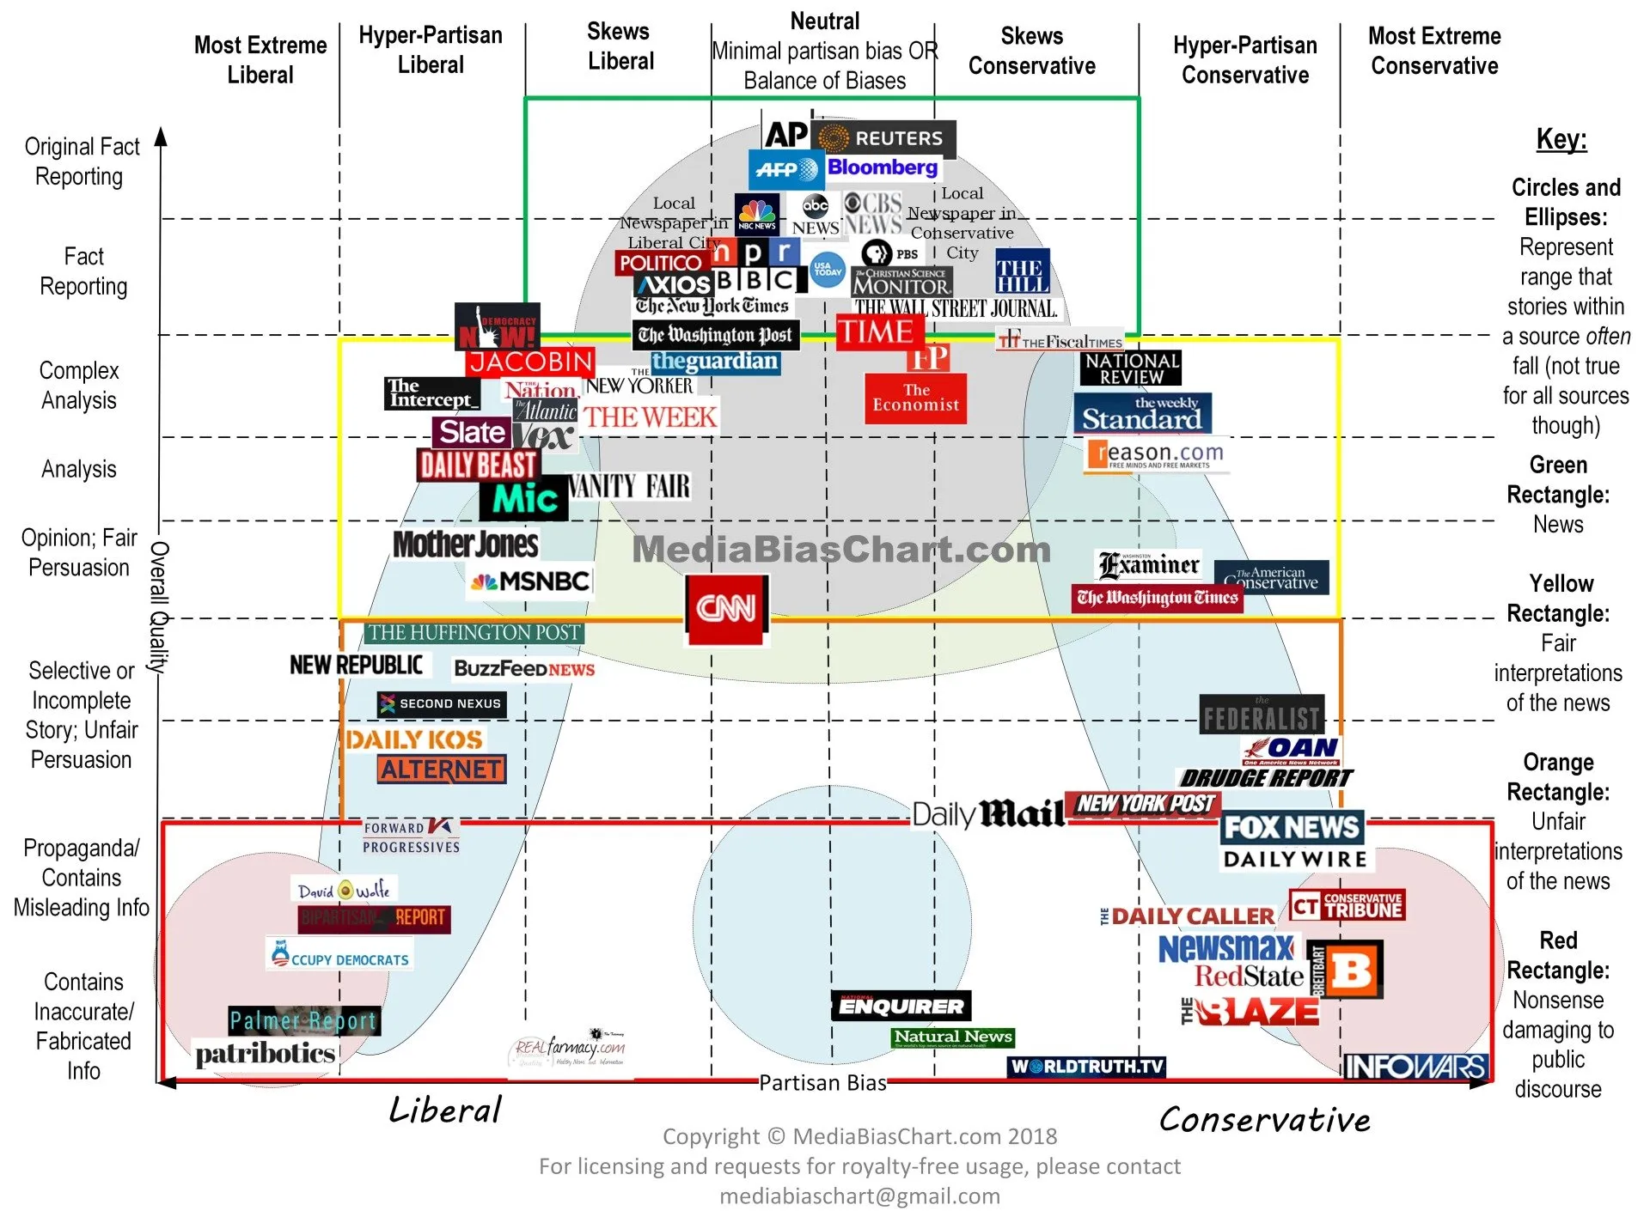
Media Bias - US news
Which of these do you know?
What does the chart tell you?

Slide 7
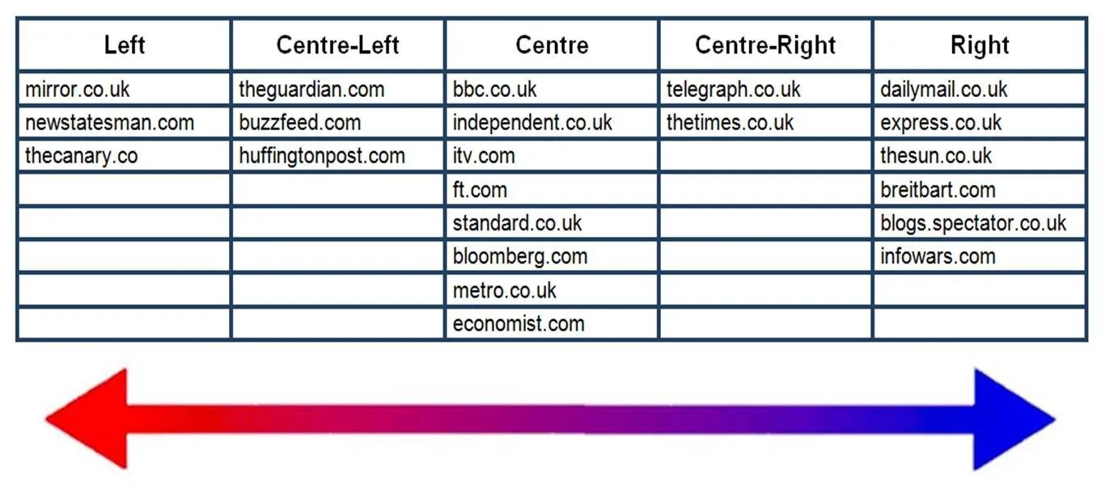

Slide 8
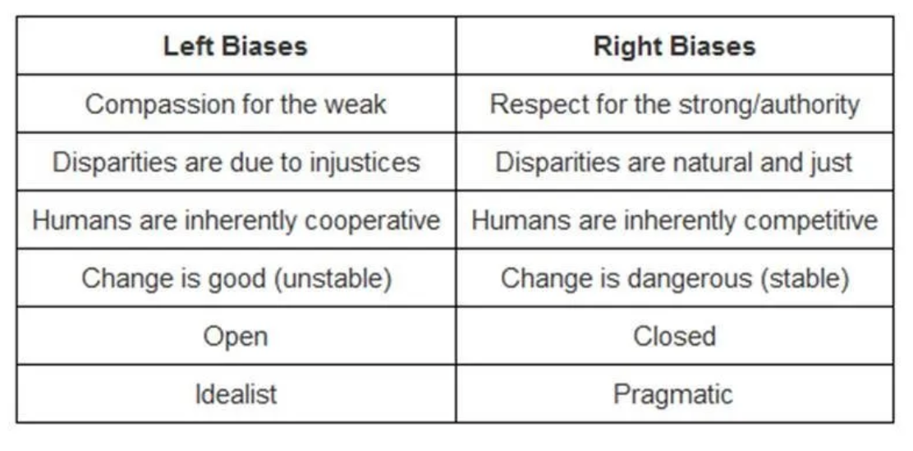
Left/right ideologies – political affiliation/leanings

Slide 9
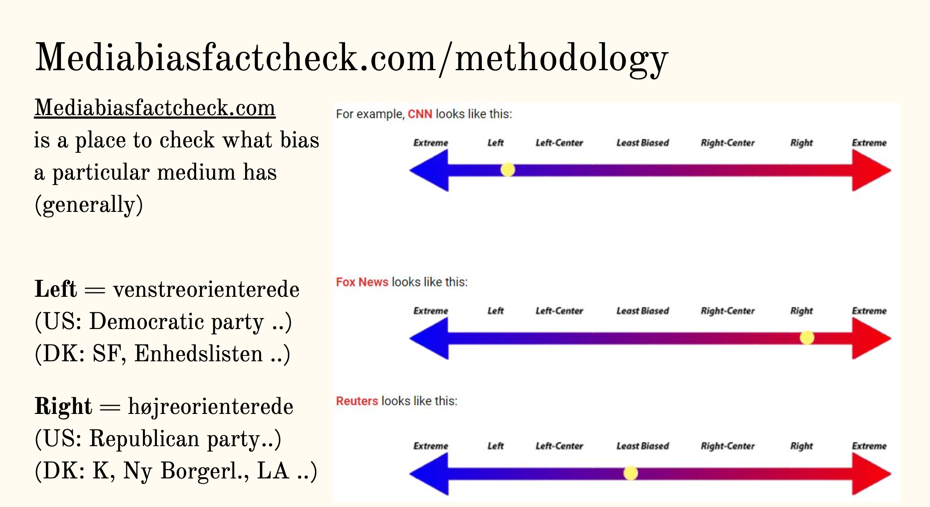

Slide 10
Newspapers/online news platforms/news channels can have a number of purposes:
To give information (hard news stories, news reports)
To explain the news (news analysis, background articles, feature articles)
To give its opinion (letters to the editor, comments and columns, feature articles)
To give advice (reviews, columns)
To entertain (columns, gossip)
And not to forget: to earn money (competition/business)
And they can be more or less descriptive, informative (providing facts), expressive (giving an opinion) or persuasive (trying to influence the reader)

Slide 11
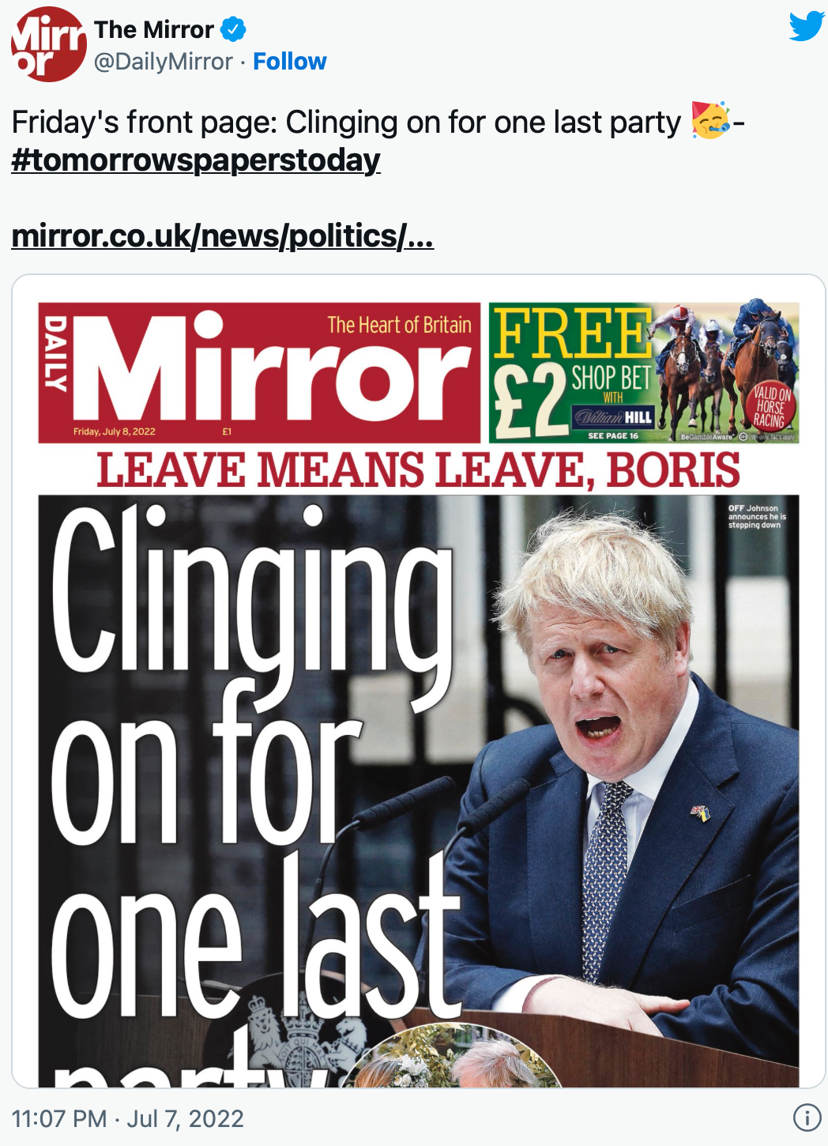
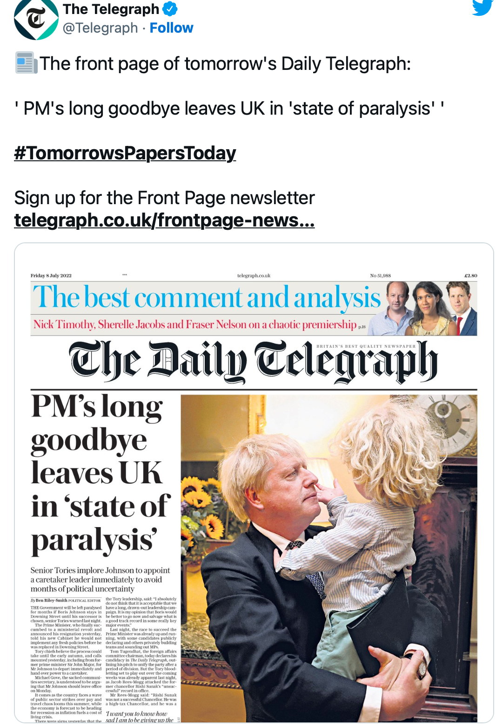
Pairwork: discuss the different framing/media coverage of the same event

