Slide 1
Energi (J, cal, eV, kWh)
1 kalorie = 4,184 Joule
1000 kalorier = 1kcal
1kcal = 4184 Joule

Slide 2
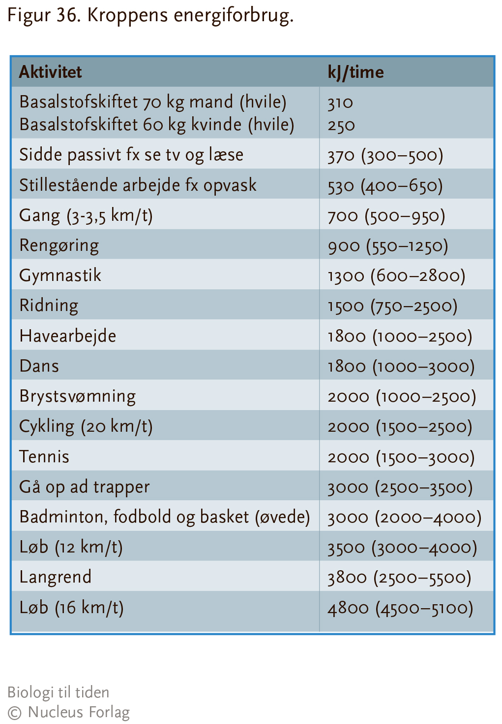

Slide 3
Energiindhold
Kulhydrat 17kJ (4kcal) pr gram
Protein 17kJ (4kcal) pr gram
Fedt 38 kJ (9 kcal) pr gram
Fedtvæv 30kJ (7kcal) pr gram

Slide 4
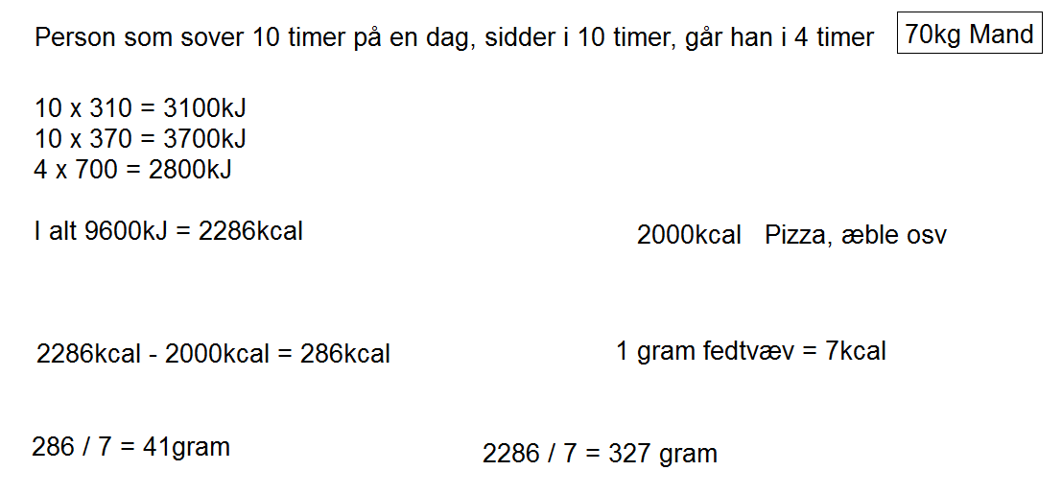
Regneeksempler

Slide 5
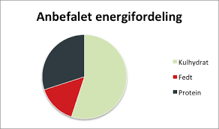
Kulhydrat 60%
Protein 30%
Fedt 10%

Slide 6
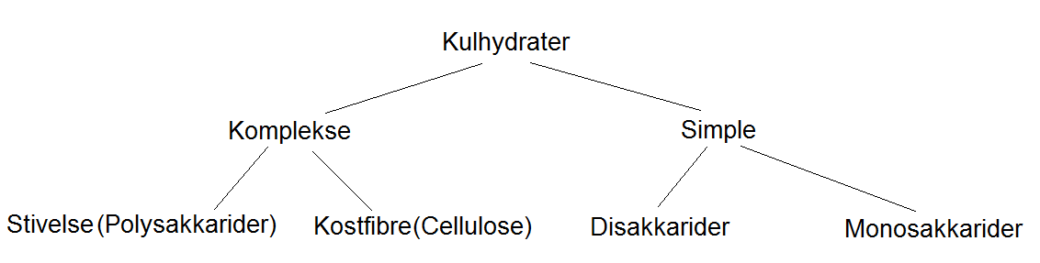

Slide 7
