Slide 1
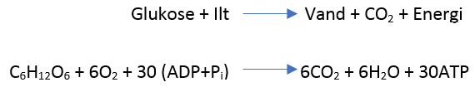
Respiration

Slide 2
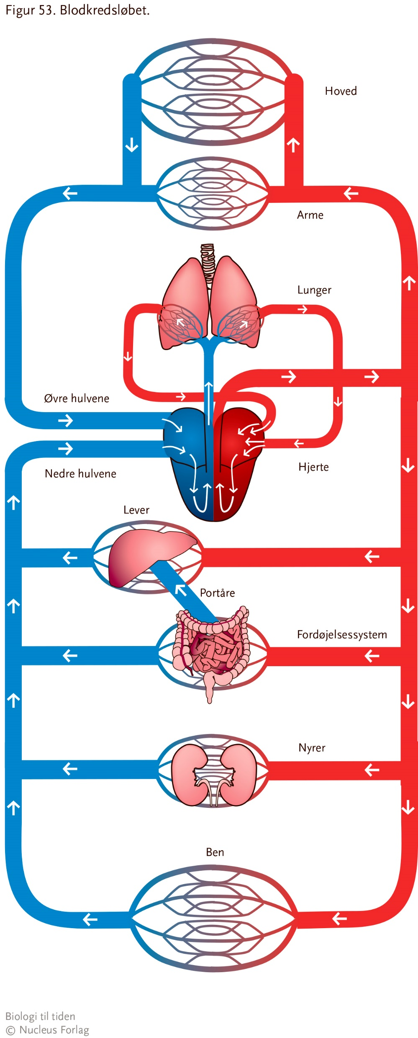

Slide 3
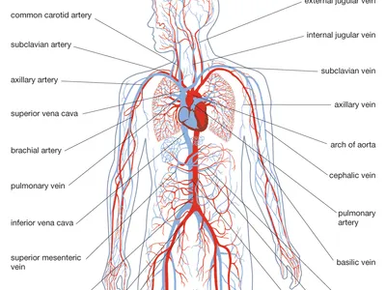

Slide 4
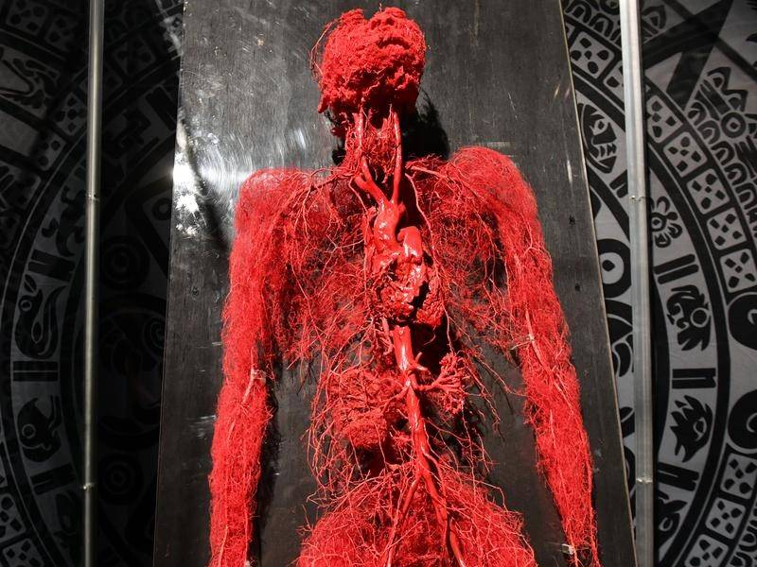

Slide 5
Venepumper
https://www.youtube.com/watch?v=pWBbyAEm5PI

