Slide 1
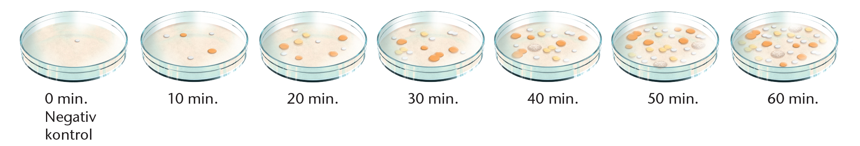

Slide 2
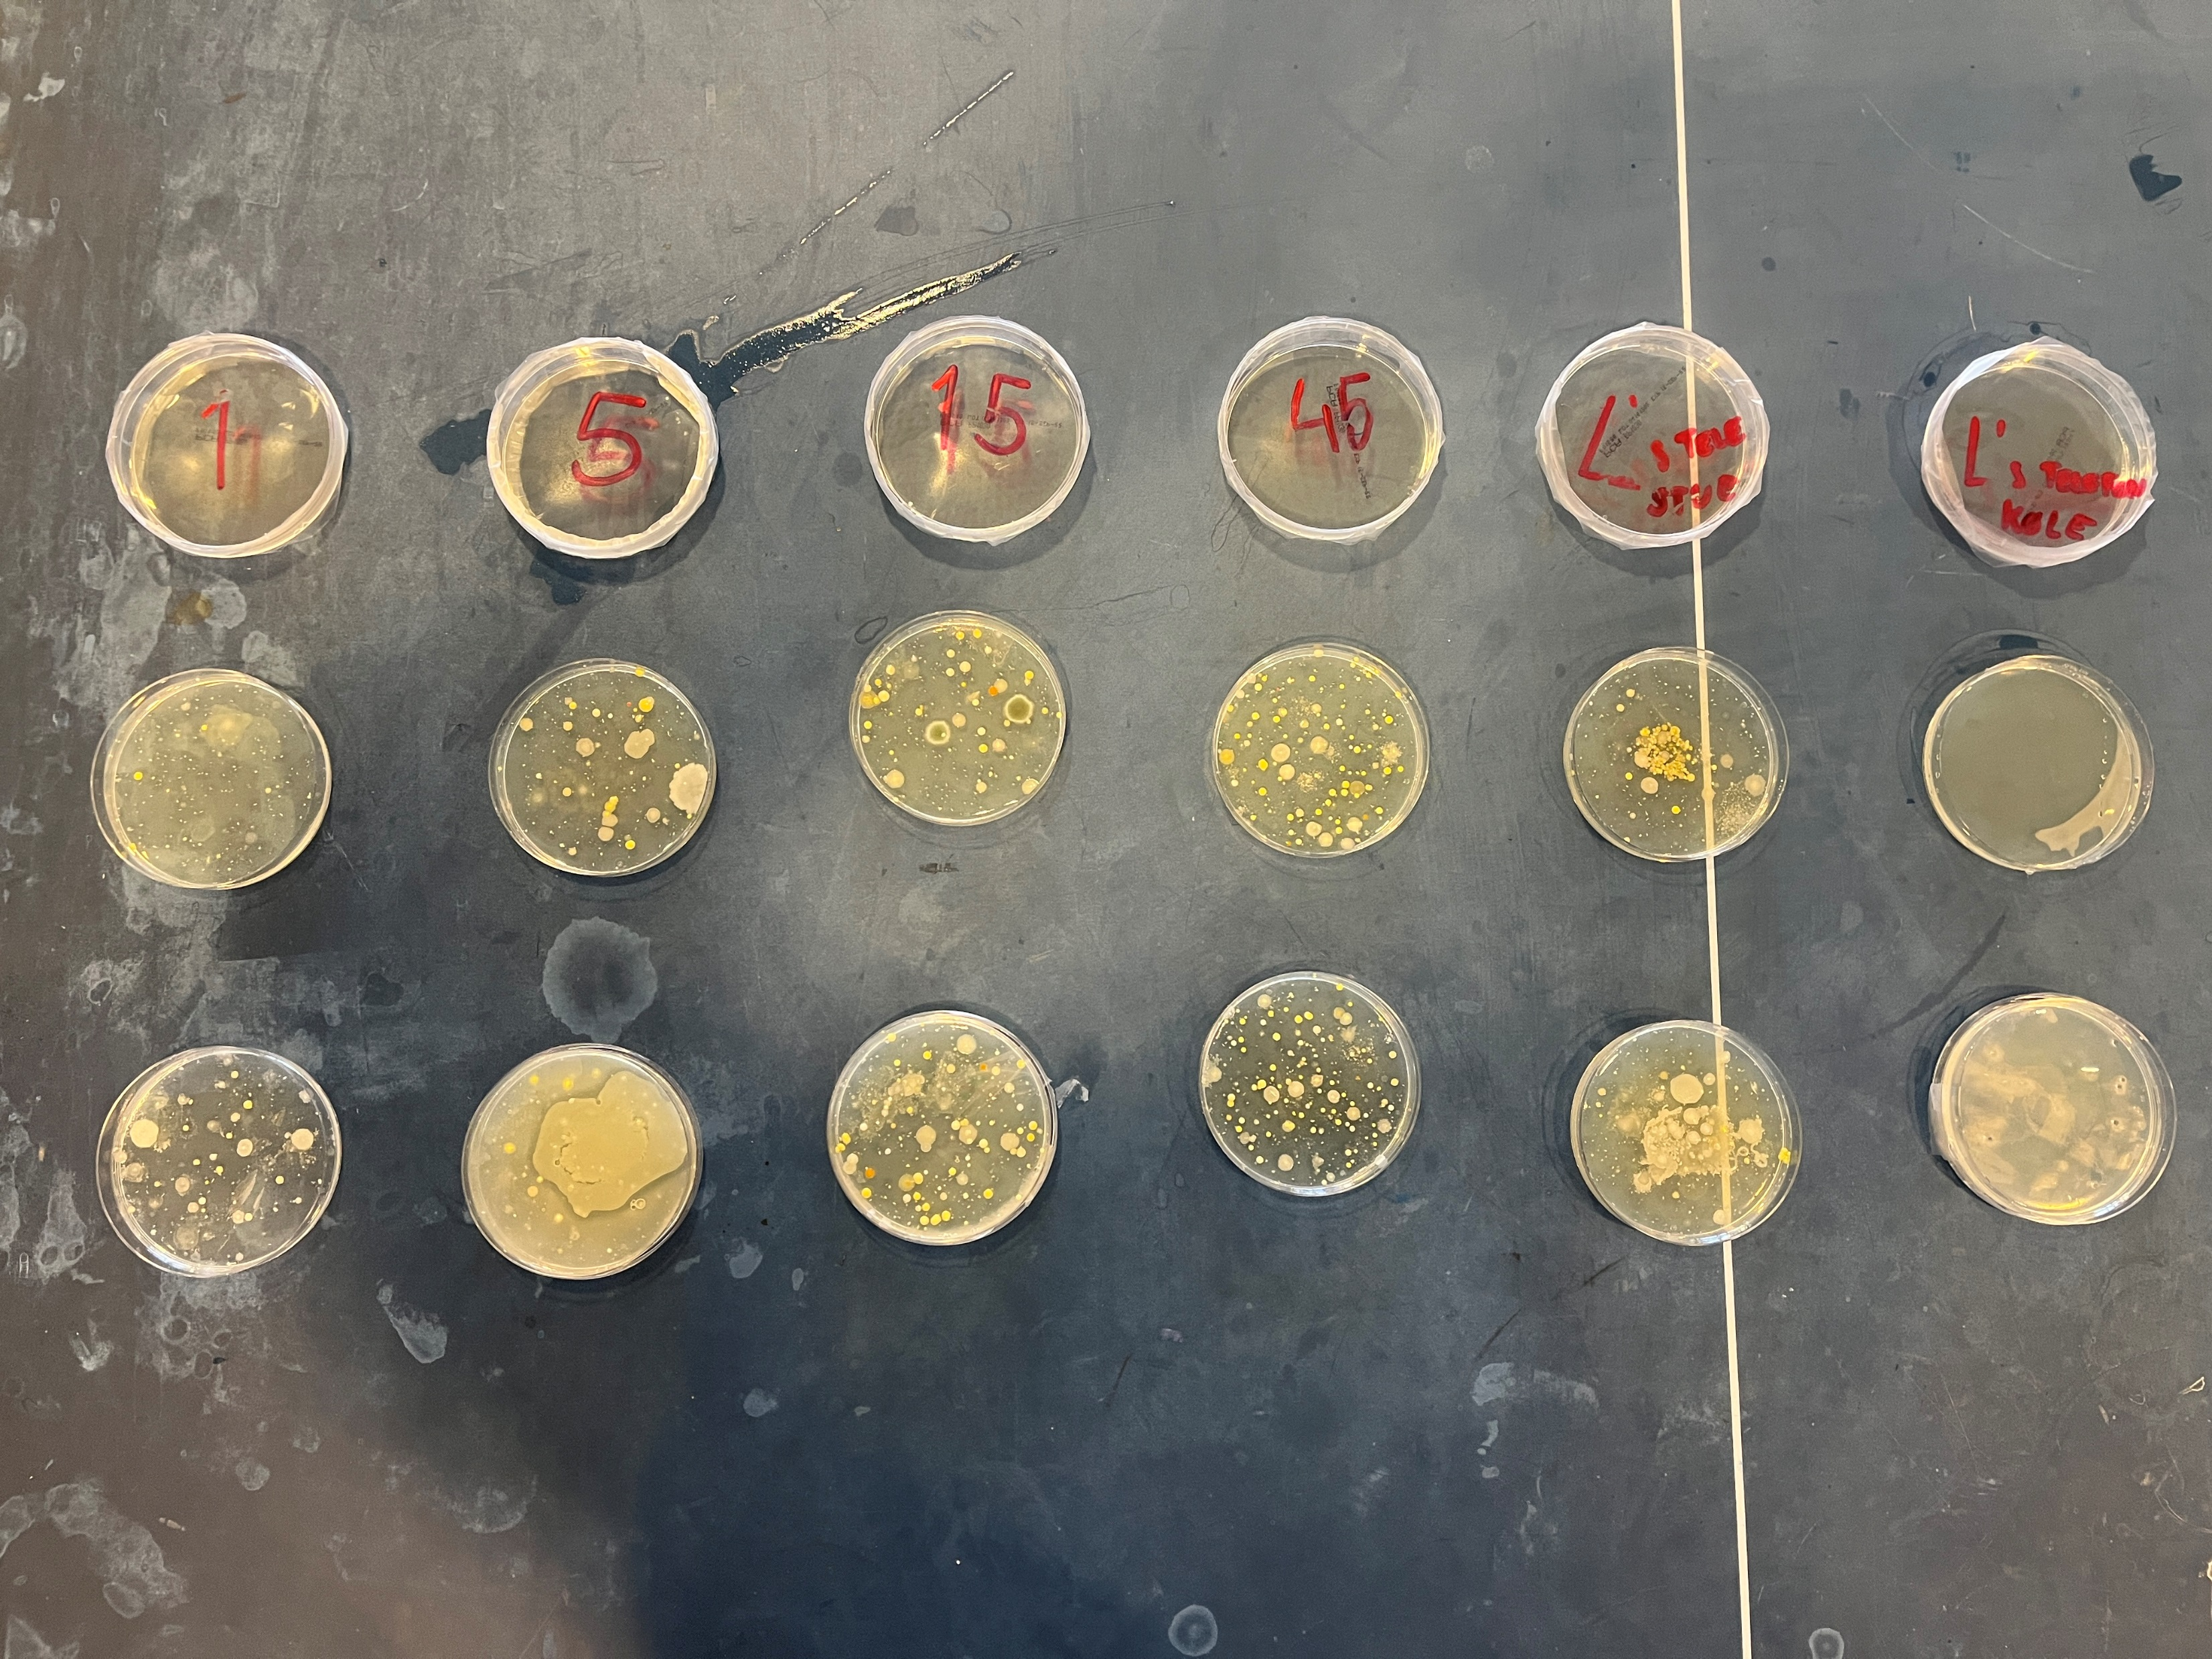

Slide 3
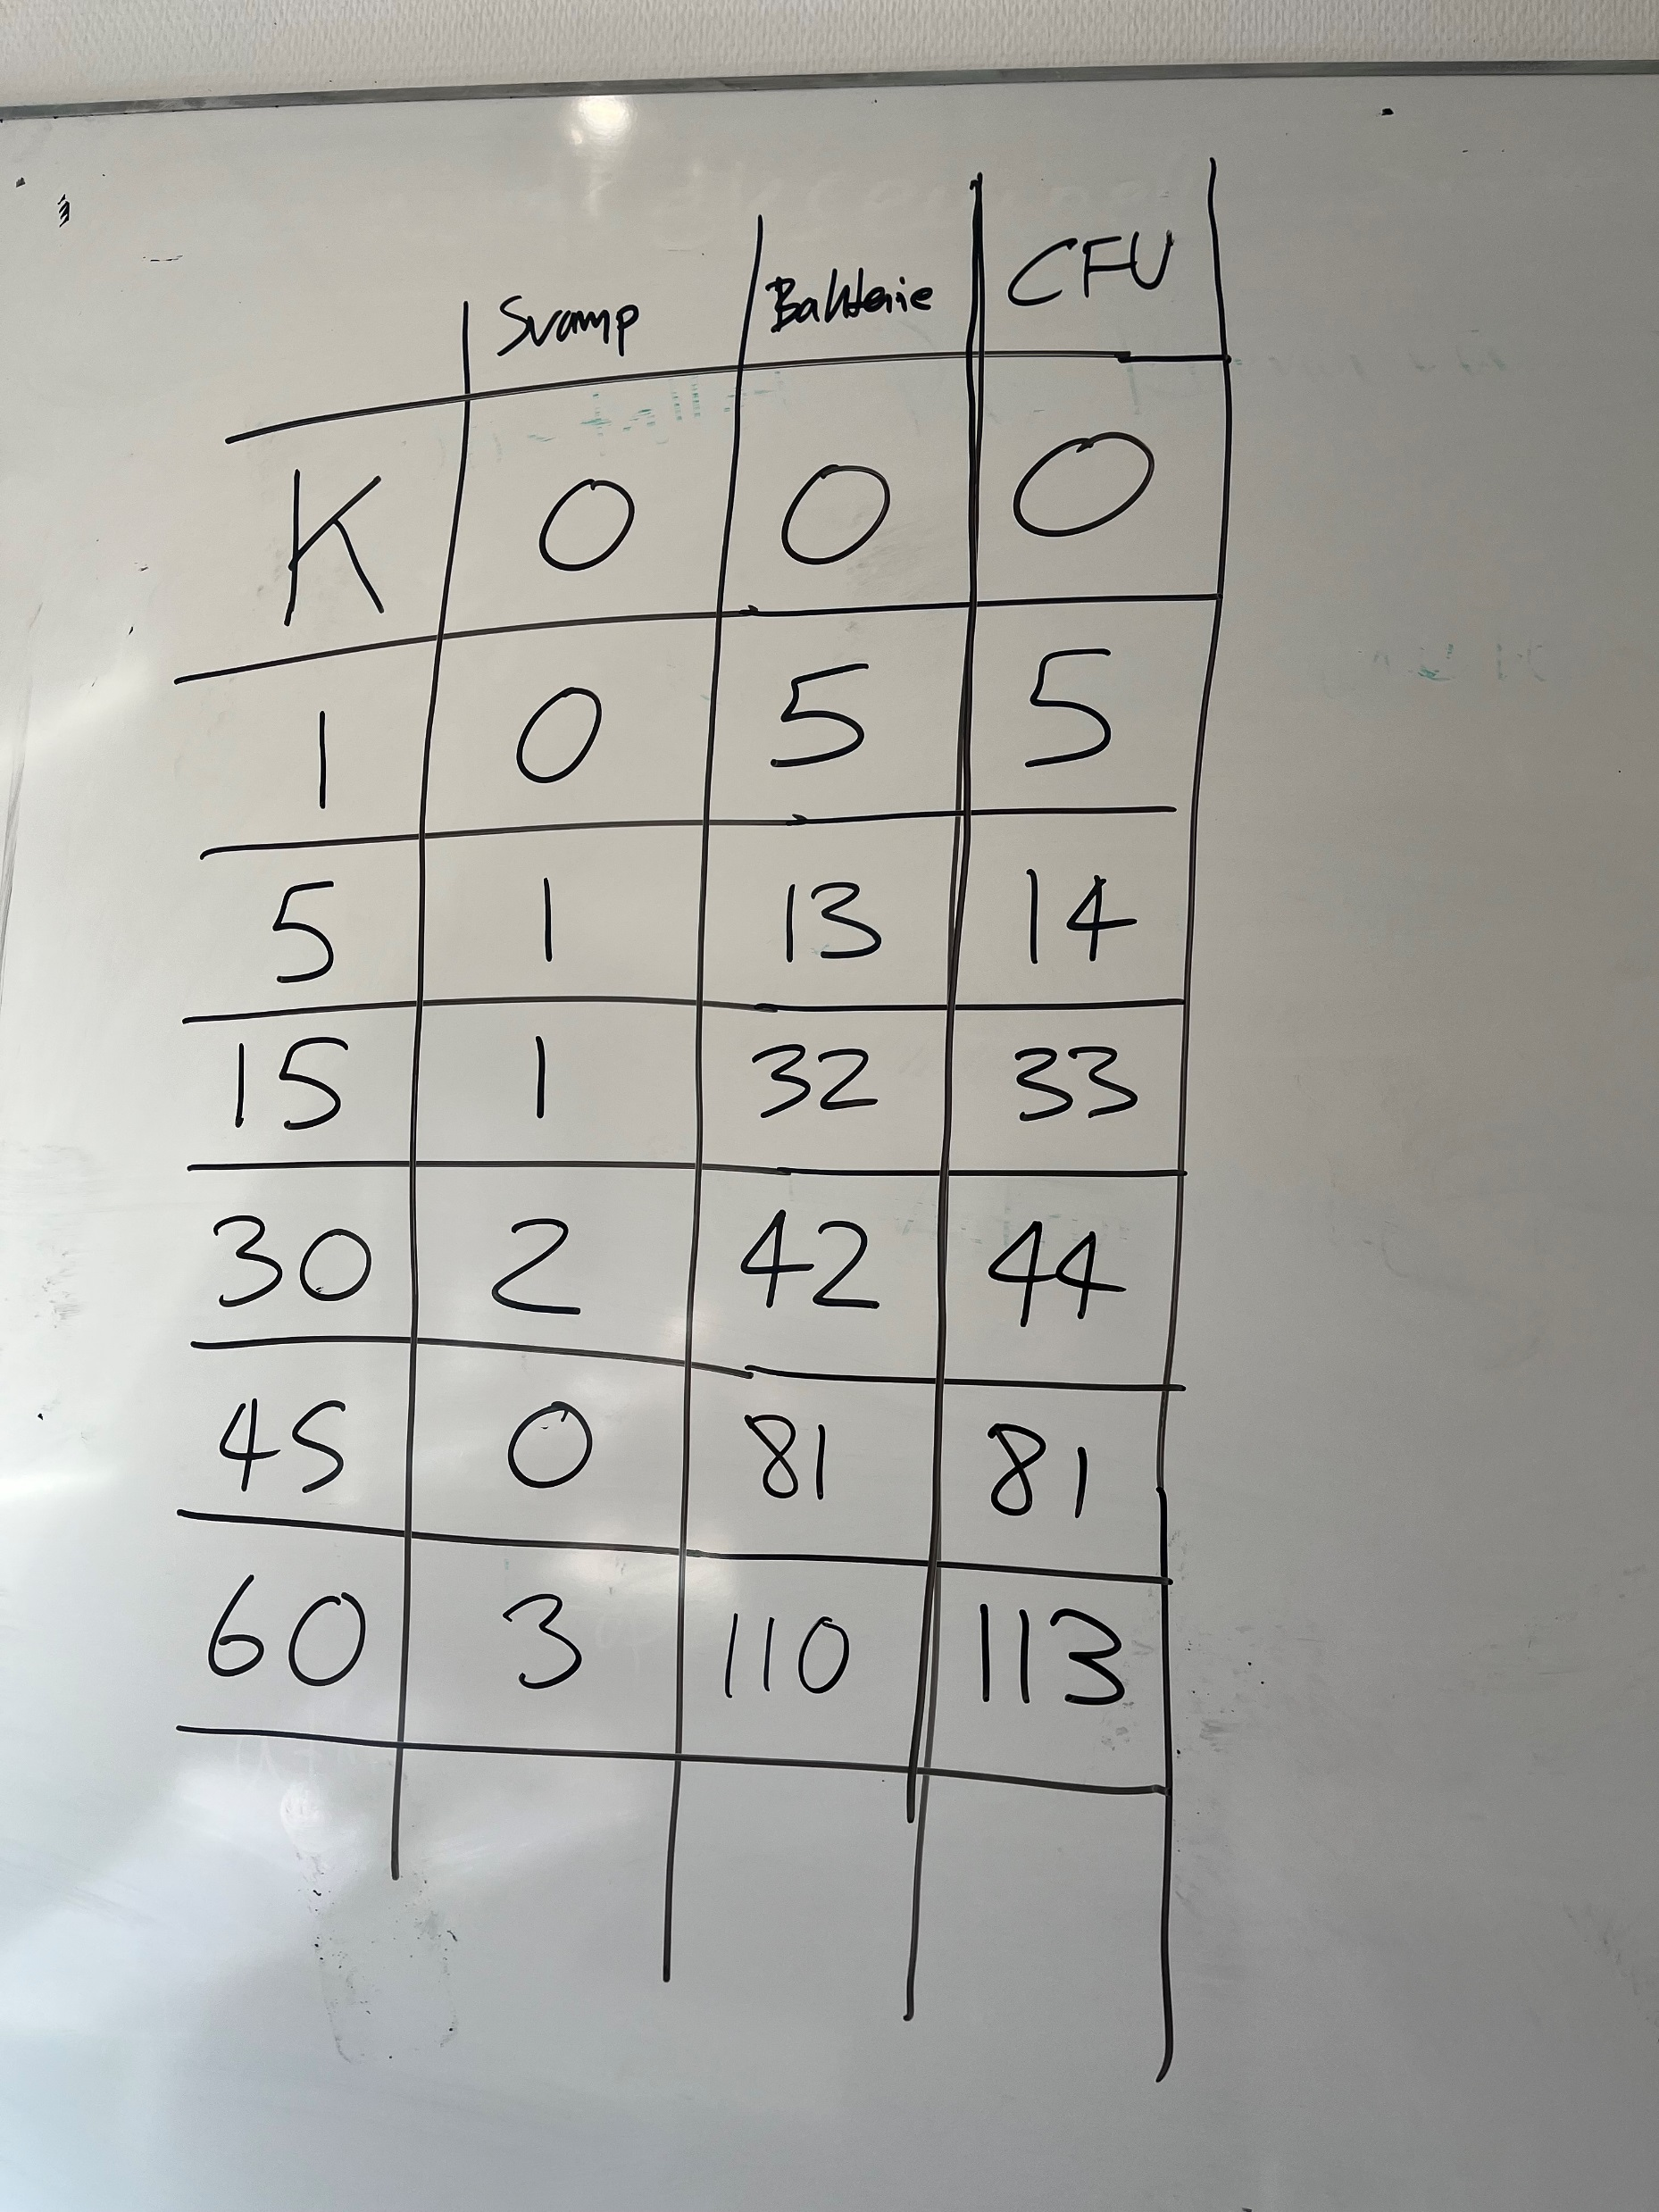

Slide 4
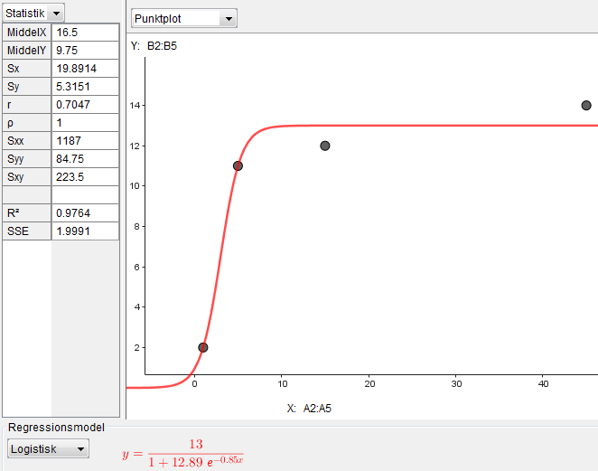
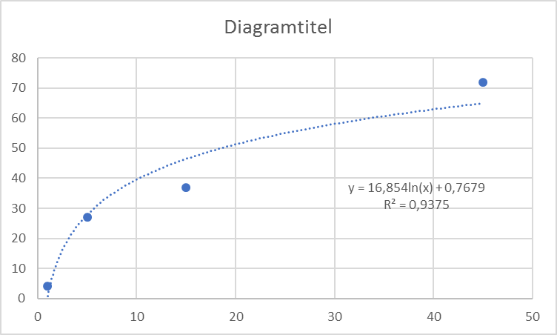

Slide 5
The mean in operational TVC was 10496.5 CFU/m²/h (range = 1415.5-25479.7)

Slide 6
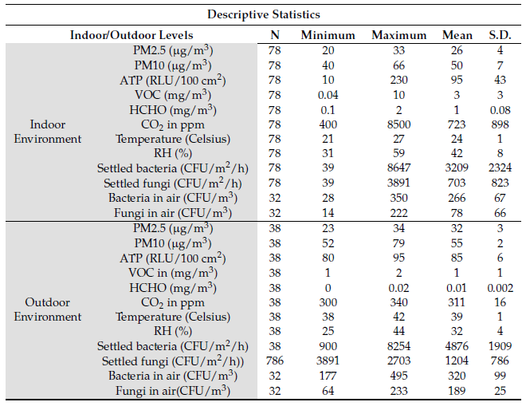

Slide 7
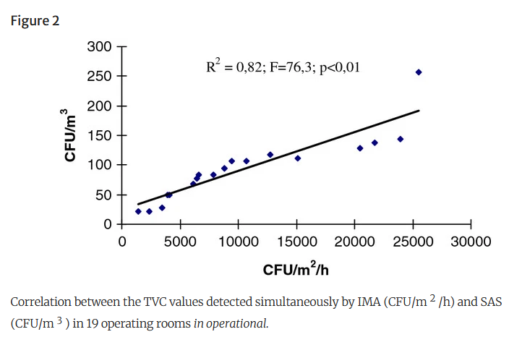

Slide 8
https://bmcpublichealth.biomedcentral.com/articles/10.1186/1471-2458-12-594
M.O.A Mohammad. 2023. Surface Microbial Contamination and Air Quality before and after Regular Cleaning Procedures. Atmosphere. 14, 352

