Slide 1
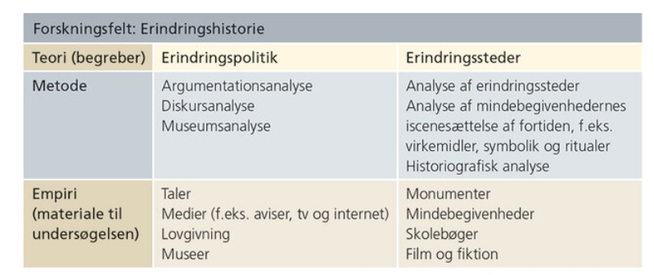

Slide 2
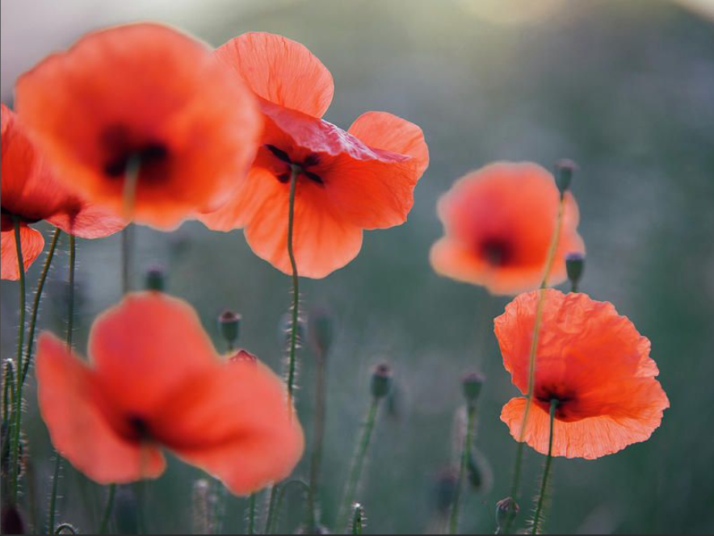

Slide 3
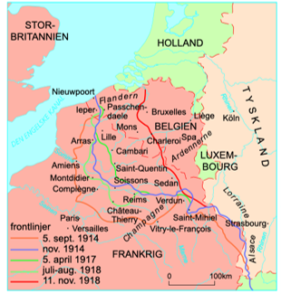
Vestfronten

Slide 4
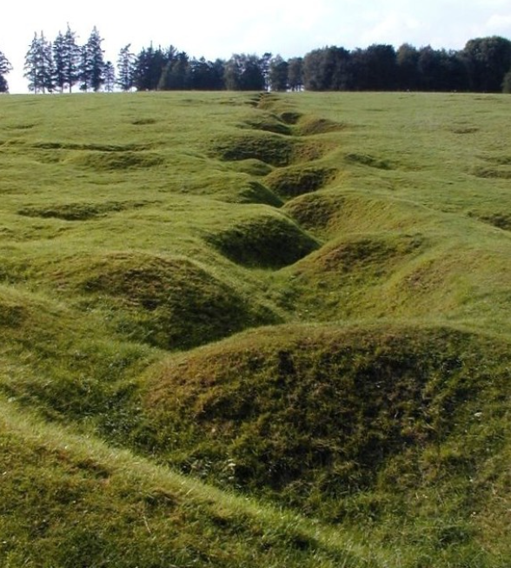
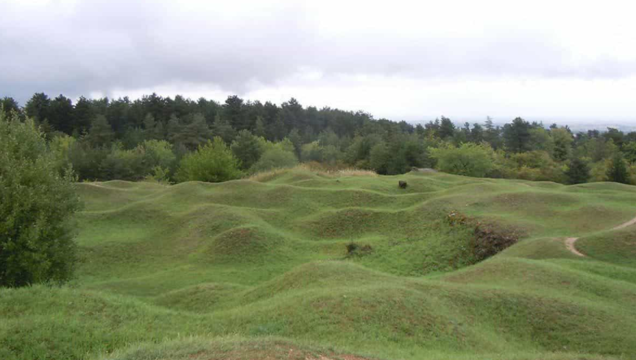
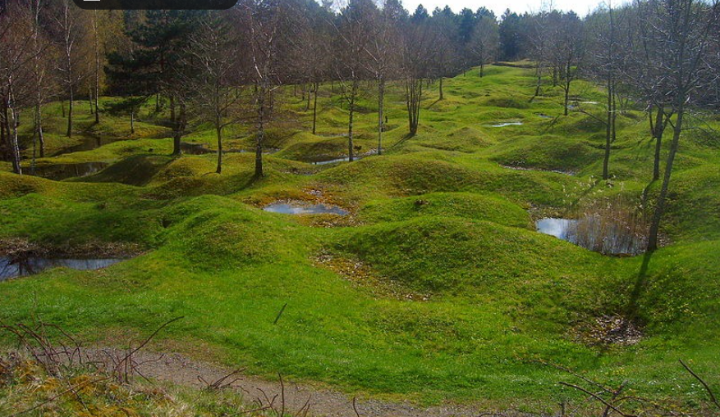
Verdun

Slide 5
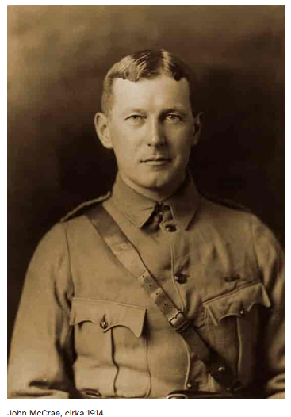
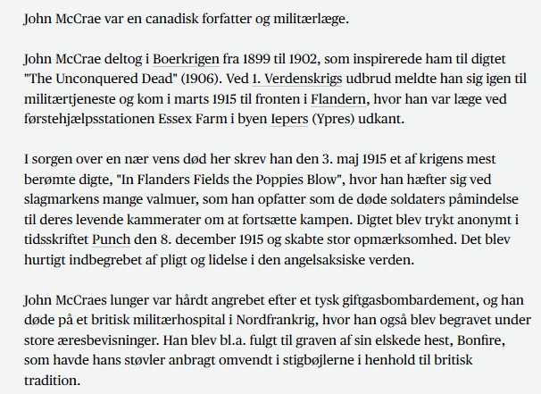
John McCrae 1872-1918

Slide 6
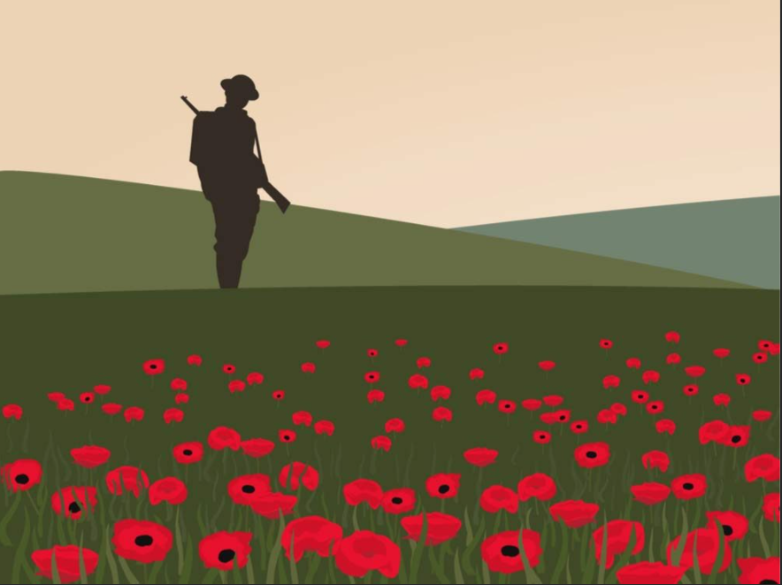
In Flanders Fiels by McCrae
In Flanders fields the poppies blow
Between the crosses, row on row,
That mark our place; and in the sky
The larks, still bravely singing, fly
Scarce heard amid the guns below.
We are the Dead. Short days ago
We lived, felt dawn, saw sunset glow,
Loved and were loved, and now we lie,
In Flanders fields.
Take up our quarrel with the foe:
To you from failing hands we throw
The torch; be yours to hold it high.
If ye break faith with us who die
We shall not sleep, though poppies grow
In Flanders fields.
https://www.youtube.com/watch?v=cKoJvHcMLfc

Slide 7
Derfor bærer briterne en rød valmue i dag - TV 2

