Slide 1
Evaluering af IT-systemer

Slide 2

Definition - usability
For at være brugbart skal et produkt være:
  useful (brugbar funktionalitet)
  effective (god kvalitet, ingen fejl)
  efficient (effektivt, minimalt tidsforbrug)
  learnable (nemt at lære at bruge)
  satisfying (tilfredsstillende)

Slide 3

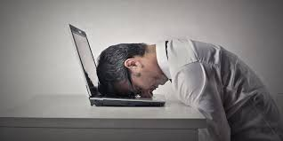
Operationalisering af usability definitionen
Definition – usability problem
Noget ved systemet som
  forhindrer/sinker brugeren i at løse en opgave
  frustrerer brugeren
  ikke er forstået af brugeren

Slide 4

Fx: Usability evaluering

Slide 5

Kategorisering af usability problem
Usability problemerne kategoriseres som værende:
  kosmetiske (bliver forsinket i få sekunder, bliver lidt frustreret, kan udføre opgaven uden helt at forstå hvorfor)
  alvorlige (bliver forsinket i flere sekunder, bliver lettere frustreret, kan kun løse opgaven med hints)
  kritiske (brugeren forhindres i at udføre opgaver, kan kun udføre opgaven med hjælp, forstår ikke systemet, gentager fejl, er meget frustreret - bander)

Slide 6
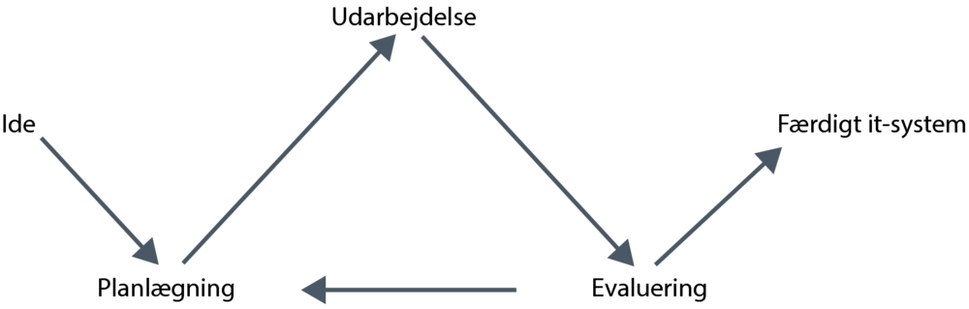
Den iterative arbejdsproces
Vi ønsker høj usability – derfor arbejder vi iterativt (fx vha. SCRUM):

Slide 7
Evaluering
De 4 H’ere:
  Hvorfor? Kan brugerne finde ud af at bruge IT-systemet? Hvad vil man præcis opnå?
  Hvad? Tidlige LOFI prototyper eller et næsten færdigt system?
  Hvor? I laboratorie? I naturlige omgivelser?
  Hvornår? Igennem hele udviklingsprojektet!

Slide 8


Overordnet tre typer af evaluering
Kontrollerede omgivelser (laboratorie) som involverer brugere: typisk usability evaluering
Naturlige omgivelser som involverer brugere: ”in the wild studies”
En hvilken som helst omgivelse som ikke involverer brugere: eksperter gennemgår IT-systemet og kommer med kritik/forslag til forbedringer, f.eks. ”heuristic evaluation”

Slide 9

Heuristic evaluation
Heuristic: ”experience-based techniques for problem solving, learning, and discovery giving solutions which is not guaranteed to be optimal”
Heuristic evaluation involverer ikke brugere
Baseret på Jakob Nielsen 10 bud (usability heuristics)

Slide 10
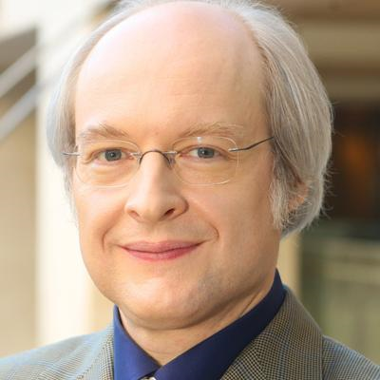
Jakob Nielsen
Ph.d. og leder af ”the Nielsen Norman Group”
Jakob Nielsen 10 bud er baseret på en analyse af 249 usability problemer

Slide 11
Jakob Nielsen 10 bud
Visibility of system status.
Match between system and real world.
User control and freedom.
Consistency and standards.
Error prevention.
Recognition rather than recall.
Flexibility and efficiency of use.
Aesthetic and minimalist design.
Help users recognize, diagnose, recover from errors.
Help and documentation.

Slide 12
Jakob Nielsen 10 bud
Visibility of system status.
Match between system and real world.
User control and freedom.
Consistency and standards.
Error prevention.
Recognition rather than recall.
Flexibility and efficiency of use.
Aesthetic and minimalist design.
Help users recognize, diagnose, recover from errors.
Help and documentation.
Dem skal I arbejde med lige om lidt!

Slide 13
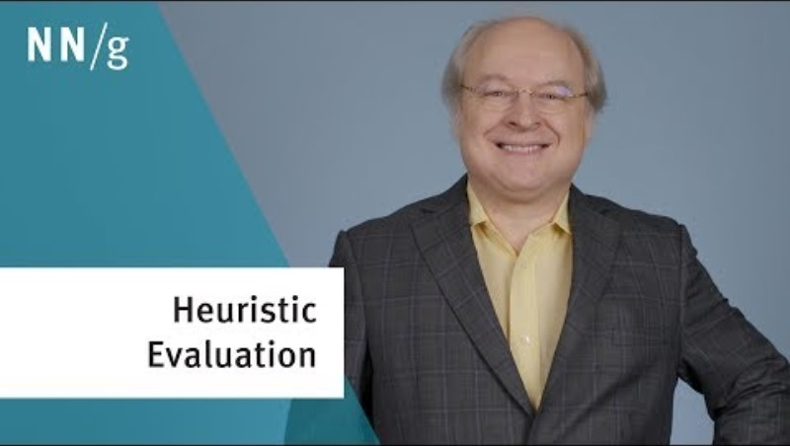
What is heuristic evaluation?

Slide 14

How to do: Heuristic evaluation
Eksperterne briefes – hvad skal de gøre?
Selve evalueringen (typisk 1-2 timer)
  Eksperterne arbejder hver for sig
  Eksperterne tager én gennemgang for at få en fornemmelse af IT-systemet
  Eksperterne tager en anden gennemgang for at fokusere på specifikke dele
Debriefing hvor eksperterne arbejder sammen om at prioritere i problemerne

Slide 15
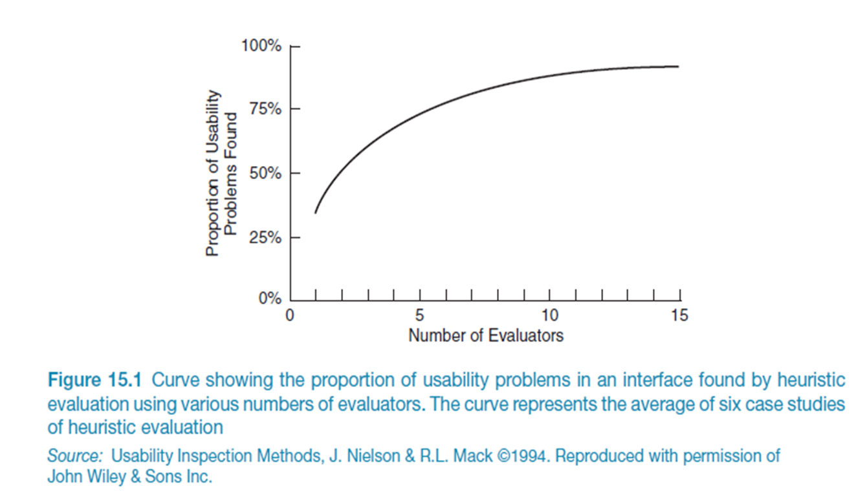
Sammenhængen mellem antal eksperter og problemer

Slide 16
Sammenhængen mellem antal eksperter og problemer
Jakob Nielsen: 5 eksperter vil i gennemsnit finde 75-80% af usability problemerne
Men vigtige problemer kan blive overset!

Slide 17
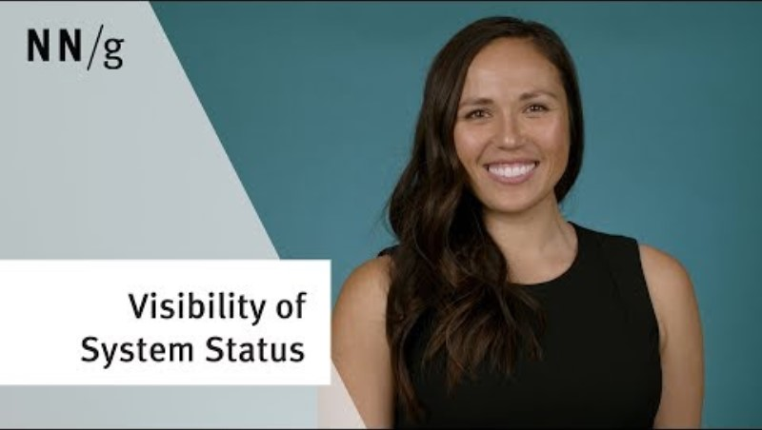
#1: Visibility of system status
Notes:
The system should always keep users informed about what is going on, through appropriate feedback within reasonable time.

Slide 18

#2: Match between system and the real world
Notes:
The system should speak the users' language, with words, phrases and concepts familiar to the user, rather than system-oriented terms. Follow real-world conventions, making information appear in a natural and logical order.
Skeuomorfisme: Skeuomorfisme er det fænomen at man bruger kendt teknologi som metafor i ny teknologi.

Slide 19
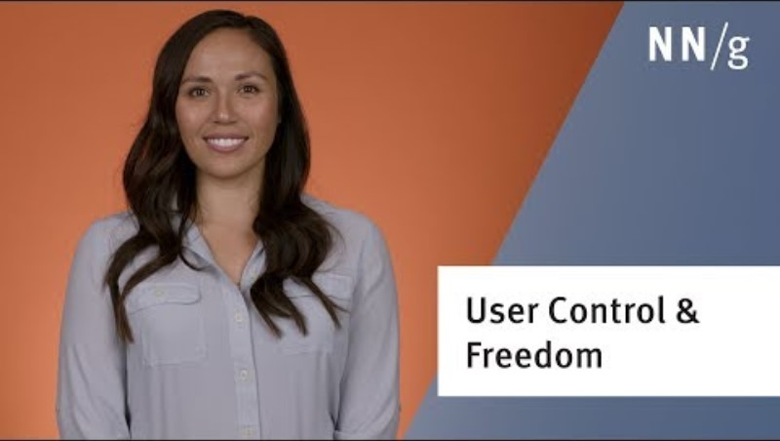
#3: User control and freedom
Notes:
Users often choose system functions by mistake and will need a clearly marked "emergency exit" to leave the unwanted state without having to go through an extended dialogue. Support undo and redo.

Slide 20

#4: Consistency and standards
Notes:
Users should not have to wonder whether different words, situations, or actions mean the same thing. Follow platform conventions.
Intern og ekstern konsistens

Slide 21
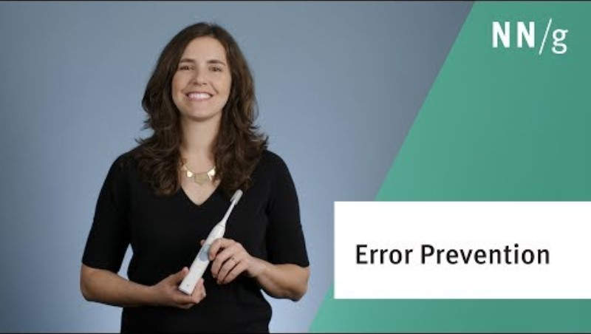
#5: Error prevention
Notes:
Even better than good error messages is a careful design which prevents a problem from occurring in the first place. Either eliminate error-prone conditions or check for them and present users with a confirmation option before they commit to the action.

Slide 22
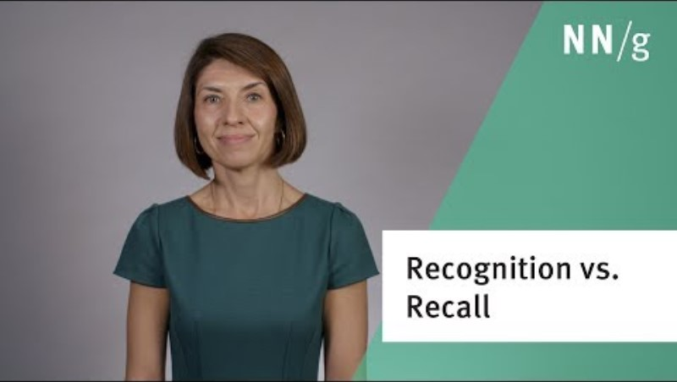
#6: Recognition rather than recall
Notes:
Minimize the user's memory load by making objects, actions, and options visible. The user should not have to remember information from one part of the dialogue to another. Instructions for use of the system should be visible or easily retrievable whenever appropriate.

Slide 23

#7: Flexibility and efficiency of use
Notes:
Accelerators — unseen by the novice user — may often speed up the interaction for the expert user such that the system can cater to both inexperienced and experienced users. Allow users to tailor frequent actions.

Slide 24

#8: Aesthetic and minimalist design
Notes:
Dialogues should not contain information which is irrelevant or rarely needed. Every extra unit of information in a dialogue competes with the relevant units of information and diminishes their relative visibility.

Slide 25
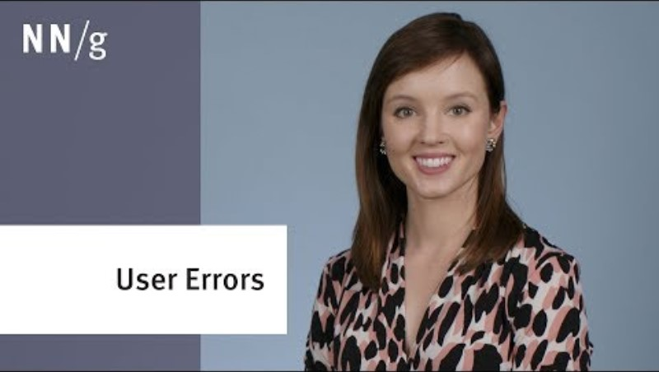
#9: Help users recognize, diagnose, and recover from errors
Notes:
Error messages should be expressed in plain language (no codes), precisely indicate the problem, and constructively suggest a solution.

Slide 26
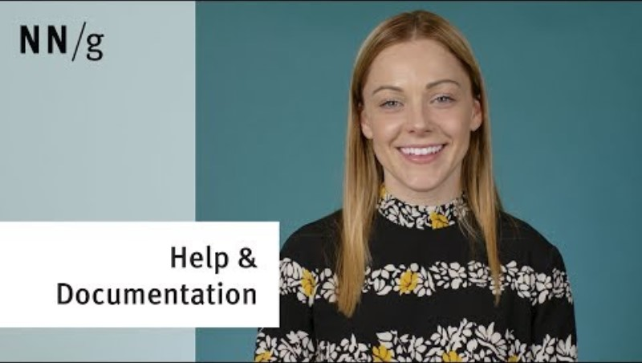
#10: Help and documentation
Notes:
Even though it is better if the system can be used without documentation, it may be necessary to provide help and documentation. Any such information should be easy to search, focused on the user's task, list concrete steps to be carried out, and not be too large.

Slide 27
Husk…
"People spend most of their time on sites other than yours"

Slide 28
Øvelse: Jakob Nielsens 10 bud
I får to bud i hver gruppe
Se den video som hører til det bud, I har fået
Lav en kort præsentation som forklarer buddet og giv konkrete eksempler (gerne dine egne og gerne eksempler hvor buddet overholdes og hvor det ikke overholdes).
Link til Google præsentation: https://docs.google.com/presentation/d/1Tg5Kj7UOA97XcStxQS73oQIoCPweKvOYb9BwZPSwtWg/edit?usp=sharing
Visibility of system status.
Match between system and real world.
User control and freedom.
Consistency and standards.
Error prevention.
Recognition rather than recall.
Flexibility and efficiency of use.
Aesthetic and minimalist design.
Help users recognize, diagnose, recover from errors.
Help and documentation.
Notes:
Indsæt link til Google docs præsentation, som deles.

Slide 29
Fremlæggelser
… med udgangspunkt i jeres fælles præsentation!

Slide 30
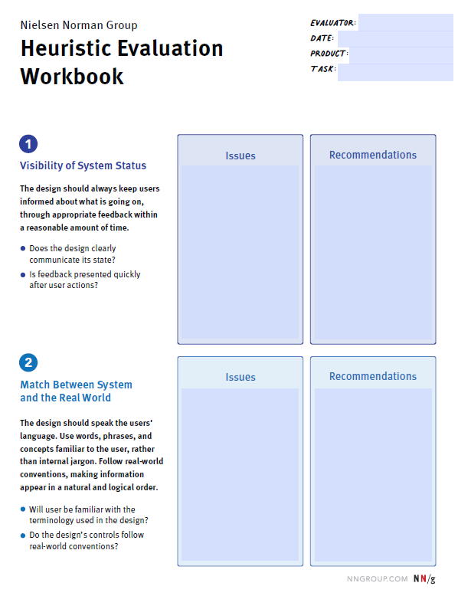
Øvelse
Lav en ”heuristic evaluation” af din yndlings webshop
Udfyld
Notér også gerne eksempler, hvor de 10 bud ikke er overholdt
Dokumenter det i din logbog – husk at indsætte skærmbilleder

