Slide 1

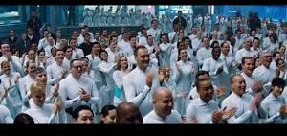
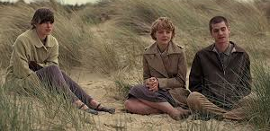

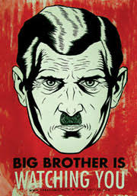
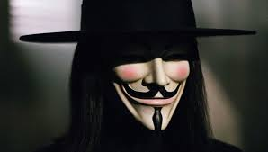
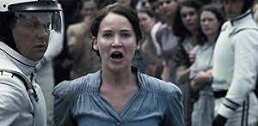

Slide 2
Material
Always bring compendium – and for the first many lessons
V for Vendetta and Getting Graphic as well
Film:
V for Vendetta by James McTeigue, Warner Bros, 2005
Fiction:
V for Vendetta (in excerpts) by Alan Moore, Vertigo, 1989
Non-Fiction:
“Why do we find comfort in terrifying stories?” by Nyshka Chandran, 14th May, 2020
“I Have A Dream” by Martin Luther King Jr, August 28th, 1963
Supporting material:
Getting Graphic, introduction to themes and narratives in graphic novels
The English Handbook
Several episodes from the TV-series Black Mirror“
1984 (Chapter one, part one) by George Orwell, 1949
Imagine by John Lennon, 1971

Slide 3
Scheduling
Lesson 1-3: Intro + film ☺
Lessons 4-5: V for Vendetta in excerpts (the graphic novel)
Lesson 6: Article by Nyshka Chandran, “Why do we find comfort in terrifying stories?”, 2020
Lessons 7-8: Orwell’s 1984
Lesson 9: Lennon’s Imagine and MLK’s I have a dream
Lessons 10-12: Black Mirror + Summing up and Rounding off

