Slide 1

Welcome to English A
What’s the plan, how will we follow it
…and why?

Slide 2









What is English A?
Writing: learning to write essays and business emails
Speaking: training presentations and discussions
Culture: history, politics, and everyday life in English-speaking countries
Business: Marketing, trade and global communication

Slide 3

Why English A matters
1. Access to the latest knowledge
Example: When you are researching global market trends, reading financial news, or studying international case studies, the key resources are almost always in English.
2. Collaborating across countries
Example: You are part of a marketing project with a consultant from Germany, a supplier from China, and a business partner from the US – English is your shared working language.
3. Getting your ideas out into the world
Example: A Danish company wants to expand to new markets and pitch its business plan to potential investors in New York – the presentation, negotiation, and documentation all take place in English.

Slide 4




Themes
Innovation & Entrepreneurship
SoMe & Branding
Area Study UK
Area Study The USA

Slide 5

English A-Exam
Exam (written)
  5-hour written assignment
    Grammar tasks
    Describe a picture
    Formal e-mail
    Essay
Exam (Oral)
  60 minutes of preparation
    Short story
    Article
    Speech
  30-minute exam

Slide 6

Engelsk - grundforløb
Focus on culture – plan for the next 8 lessons
1. What is culture?
2. Stereotypes and Prejudice
3. Cultural theories I
4. Short Story with a cultural issue – how to analyse short stories
5. Cultural theories II
6. Culture and the English language
7. Group work about communicating customs and traditions in Denmark to an American exchange student
8. Group work and group presentations

Slide 7
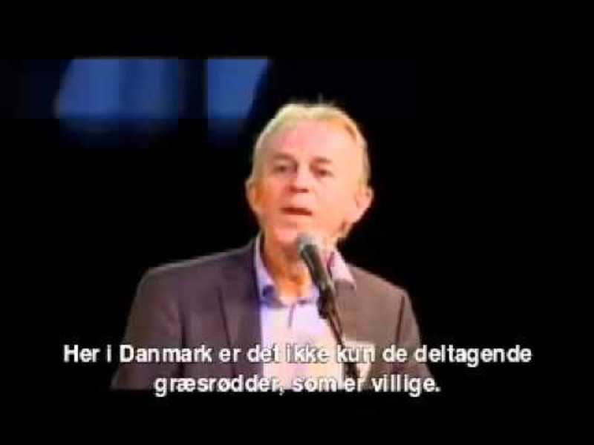
Former minister for foreign affairs, Villy Søvndal (2009)

Slide 8

The Constitution of the Class
Speaking a second language can be a vulnerable thing, but a mistake is a gift to the class.
We ALL make mistakes. To learn a language, you need to use it.
It does not matter what kind of accent or dialect, you use – as long as you speak!
Listen when other people talk/present – both the teacher and your classmates
Stay focused & be kind

Slide 9

SO1
= Studieområde 1
uge 46
Den viden I får om kultur og kulturteorier i grundforløbet, skal I bruge i det projekt, som I skal arbejde med i grupper i uge 46
I får mere information om uge 46, når vi nærmer os ☺

Slide 10

A brief discussion in pairs (”makkerpar”)
How would you define culture?
What is cross-cultural understanding?
Why do we need to know about cultural differences?

Slide 11

What is Culture
https://ccc.systime.dk/?id=207
Culture is defined as:
  the informal and sometimes hidden patterns of human interactions, expressions, and viewpoints that people in one culture share.
Being aware of cultural differences is important as we live in a globalised world and many people travel a lot or communicate with people from different countries every day.
Knowledge about cultural differences is important:
  if we want to sell our products abroad or enter into business with a foreigner,
  if we want to work or study abroad or simply just travel as a tourist.

Slide 12
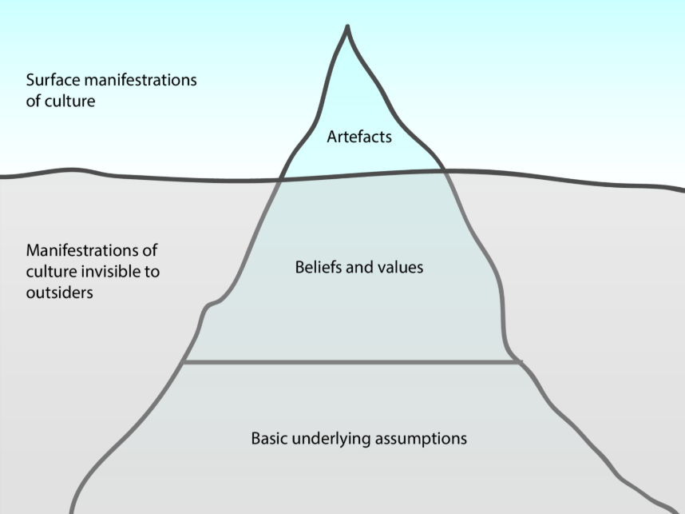
Edgar Schein’s Iceberg Model

Slide 13

What does The Iceberg illustrate?
The iceberg illustrates that there are visible and invisible aspects of culture.
The visible or observable parts of our culture are called artifacts.
Below the surface, we find beliefs and values
Beneath the values basic assumptions. Basic assumptions are things that we take for granted and are elements of a culture that have been formed over many years.

Slide 14
Why is The Iceberg model relevant?
Artifacts
e.g. language, dress codes, buildings, food, jokes etc.
Beliefs and values
e.g. loyalty, customer service, trustworthiness etc.
Basic assumptions
e.g. human relationships, human nature, time, space etc.
Things which are visible in a culture are easy to understand.
The tricky part when it comes to understanding other cultures is the part that is invisible and which therefore may cause cultural clashes.

Slide 15
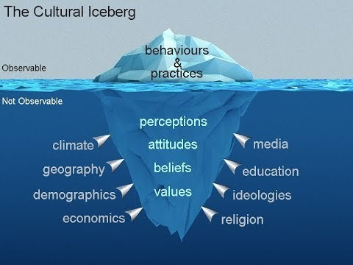
The Cultural Iceberg

Slide 16
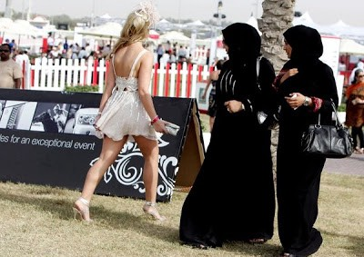
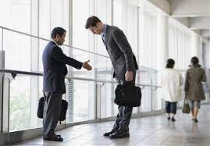
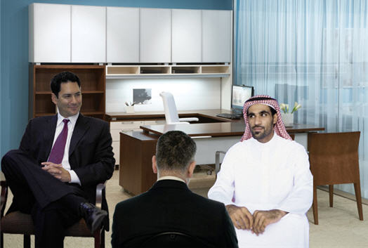
Look at the pictures. Explain the cultural clash illustrated in each picture.

Slide 17
Exercise: Discuss these questions with your ”makker”
Why can culture be illustrated as an iceberg? (see the illustration on the next page)
According to the model, what share of culture is above the surface?
What might happen if you don’t notice the invisible part of the iceberg that is below the surface?
What do you think might happen if you don’t consider the invisible part of a foreign culture? (eg. When you are travelling or doing business abroad).

Slide 18
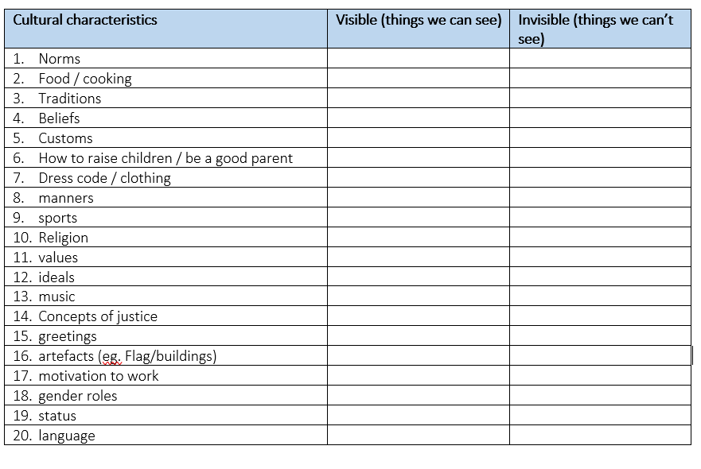
Exercise 1: Visible and invisible cultural characteristics
Determine whether these cultural characteristics are:
visible (above the surface, things we can see)
invisible (below the surface, things we can’t see)

Slide 19
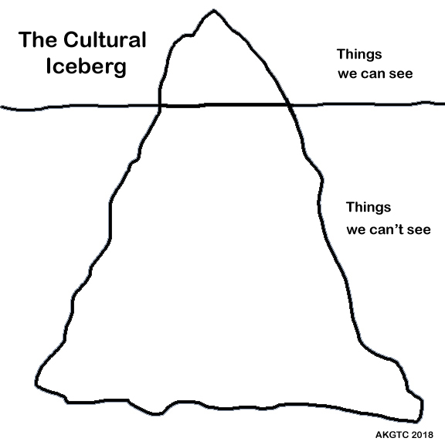
Exercise 2: Danish cultural characteristics
Fill in the iceberg model with specific Danish cultural characteristics
  eg. Dannebrog and maternity/paternity leave
Make sure you place the elements correctly in the model.

Slide 20

The Danish Concept of ”hygge”
Hygge is the Danish concept of relaxation and coziness. You've probably experienced hygge without knowing it.
When you curl up in your sweats, light a candle, put on water for tea, grab a good book, you've got the perfect recipe for a hyggelig evening.
But when hygge reached the U.S., it became more of a commodity than a state of being.
Some Danes take issue with the commercialization of their tradition.
But experts say elements of hygge could be beneficial, regardless of how they're packaged.
From www.cnbc.com

Slide 21

How ”hygge” took over America

Slide 22
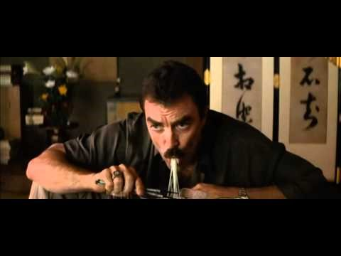
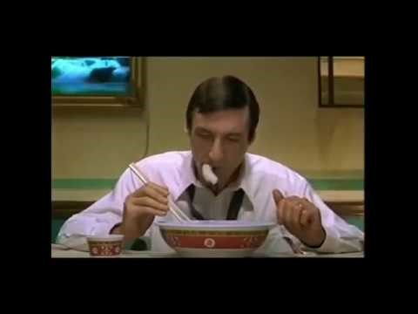
Funny ads with a focus on cultural differences

Slide 23
Intro til notatteknik
https://studievanerpaahhx.systime.dk/?id=131
Formålet med at tage noter er:
at få overblik over en tekst eller et stof
at huske en tekst eller et stof, du har læst
at huske stof, du får gennemgået i klassen
at blive opmærksom på, hvor du har huller i din viden eller forståelse

Slide 24

Our next lesson:
Notatteknik
Thursday 11th https://studievanerpaahhx.systime.dk/?id=131
Noter er et redskab til at huske og strukturere et stof.
Du kan bruge dem i dit arbejde med at forstå, bearbejde og huske en tekst, du arbejder med eller et stof, din lærer gennemgår i klassen.
Når du på et tidspunkt skal til eksamen, kan det være en stor for­del at have gode noter.
Formålet med at tage noter er:
at få overblik over en tekst eller et stof
at huske en tekst eller et stof, du har læst
at huske stof, du får gennemgået i klassen
at blive opmærksom på, hvor du har huller i din viden eller forståelse

Slide 25

Hvorfor tage noter?
Noter er et redskab til at huske og strukturere et stof.
Du kan bruge dem i dit arbejde med at forstå, bearbejde og huske en tekst, du arbejder med eller et stof, din lærer gennemgår i klassen.
Når du på et tidspunkt skal til eksamen, kan det være en stor for­del at have gode noter.

