Slide 1

English – “Grundforløb”
8 lessons
Introduction to culture
1. What is culture?
2. Stereotypes
3. Cultural theories I –
4. Short Story with a cultural issue – how to analyse short stories
5. Cultural theories II
6. Culture and the English language
7. Group work about communicating customs and traditions in Denmark to an American exchange student
8. Group work and group presentations
Notes:
Culture is the shared values, beliefs, norms, and interactions of a group

Slide 2
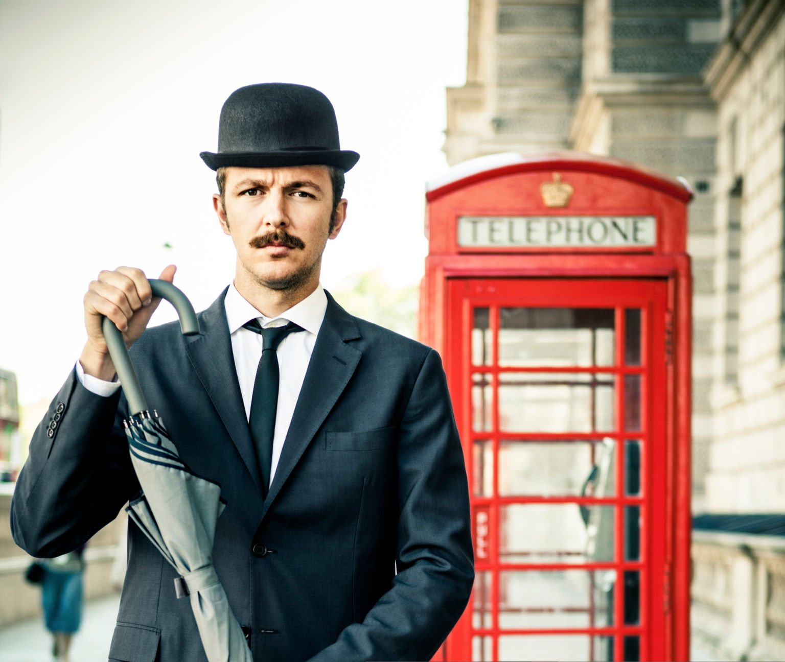
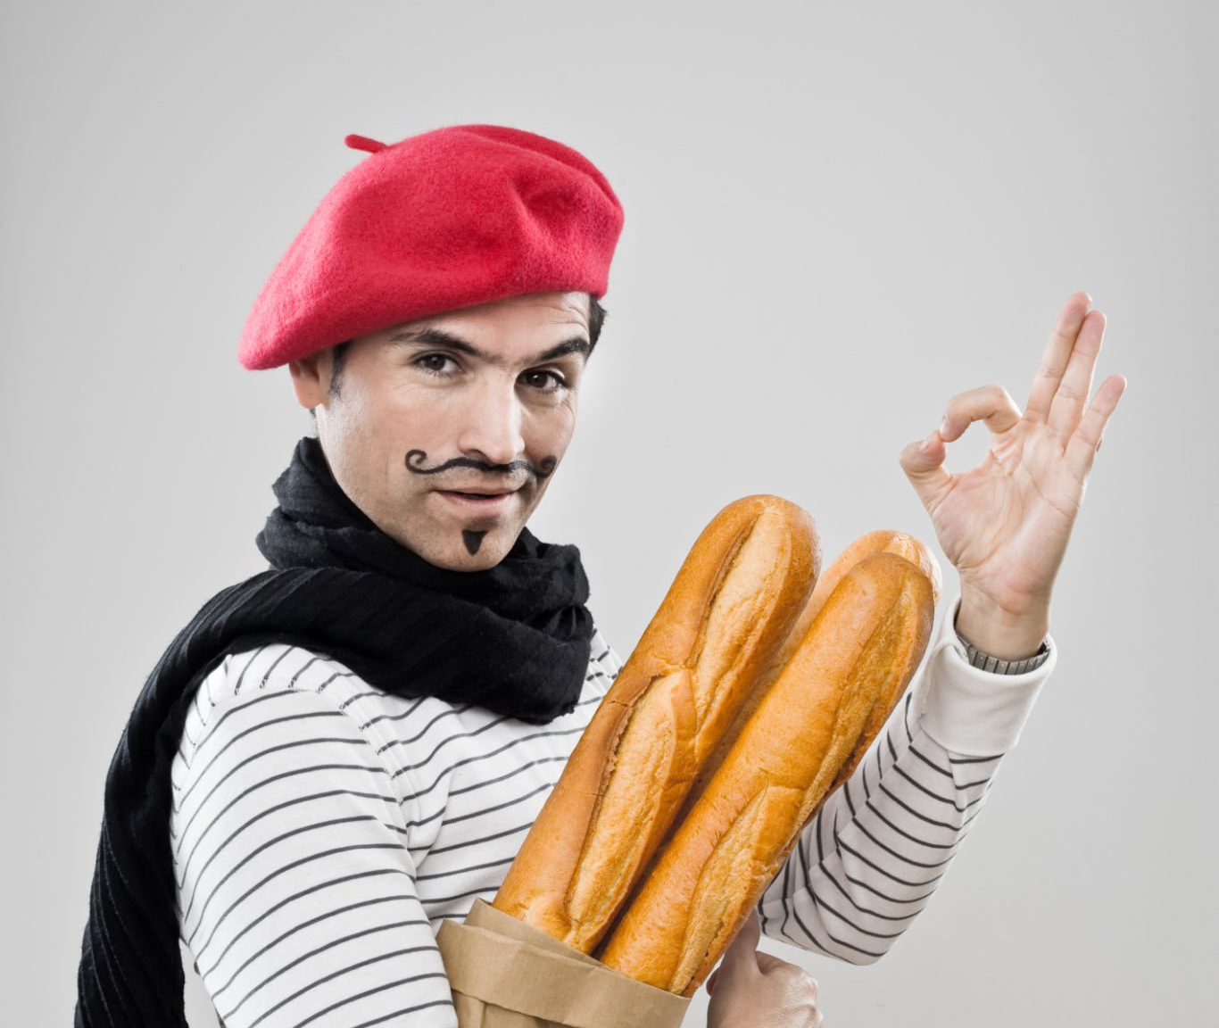
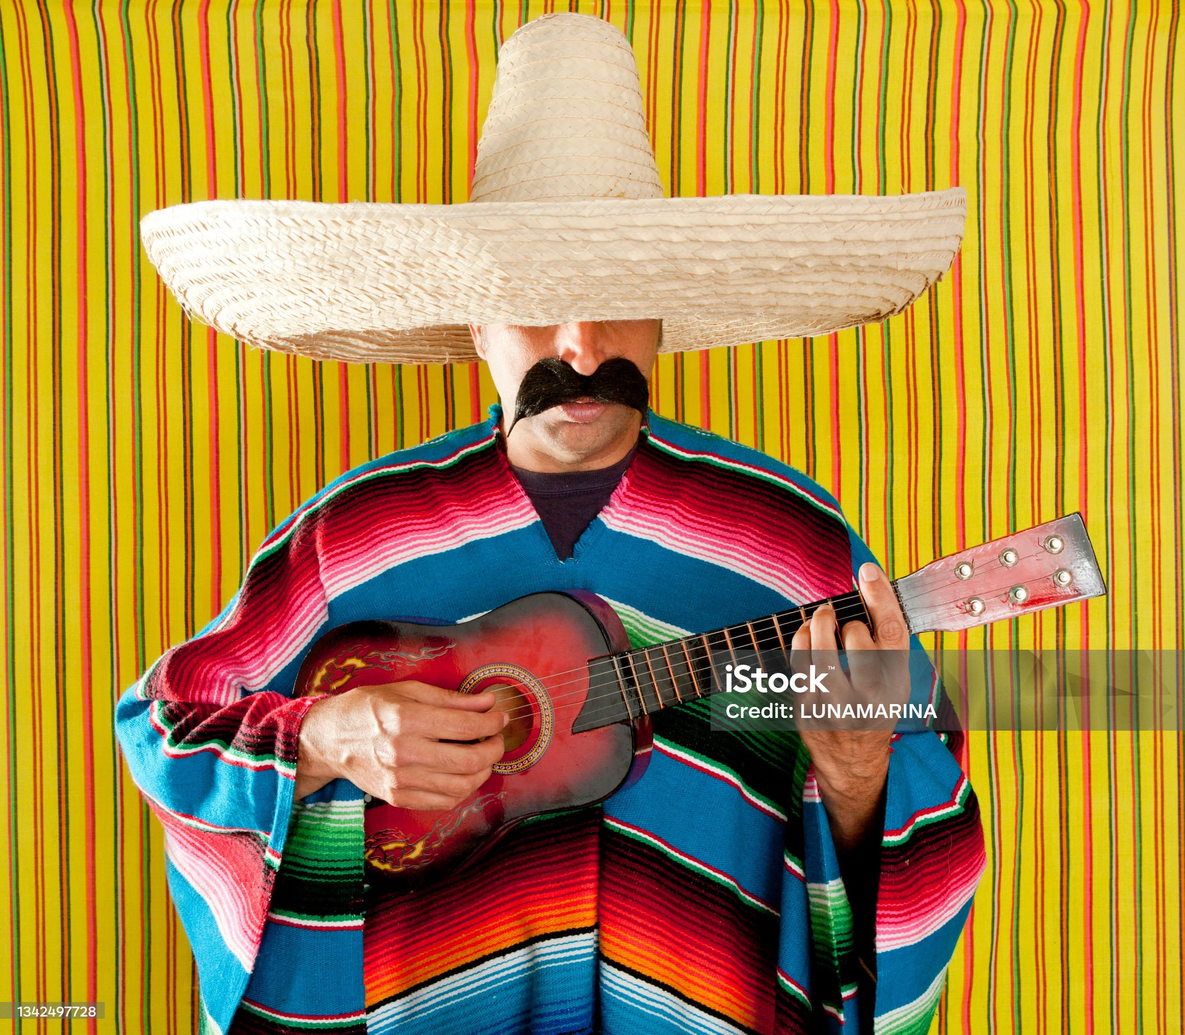
What are stereotypes?
noun
Generalised beliefs about a group of people (or things), often based on nationality, gender, or profession.
Stereotypes are not necessarily incorrect, but they are oversimplified images of other cultures.
“ French people are arrogant” “Lawyers are greedy” “Women are more emotional than men”
Notes:
. Culture shapes stereotypes, stereotypes simplify culture. They can make social interaction easier in some cases, but they also carry the risk of distortion, prejudice, and harm.
Not based on individuals but more generalised traits of a group of people
Stereotypes occur because of cultural differences

Slide 3
Geert Hofstede
Cultural onion model

Slide 4
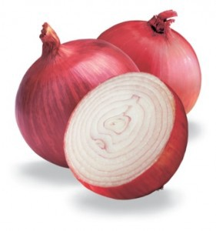
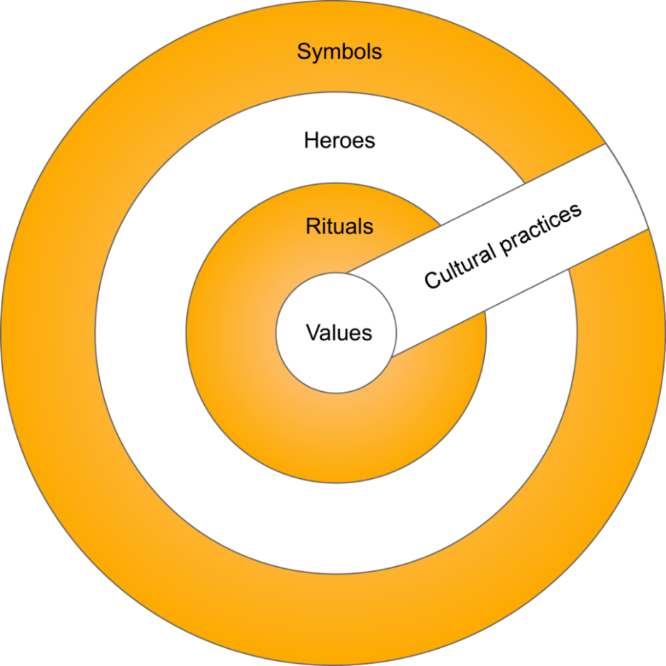
Culture is like an onion….
https://culturalencounters.systime.dk/?id=134
Notes:
When you peel an onion, what do you find?”
“More layers. Culture works the same way — it has layers we can peel back to understand what lies beneath.”

Slide 5
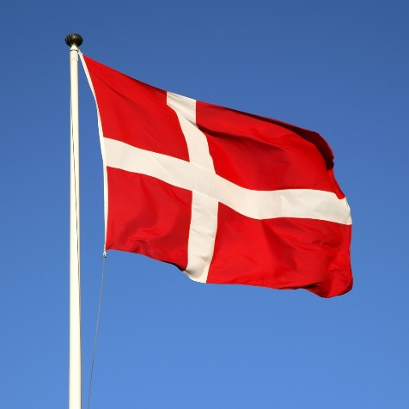
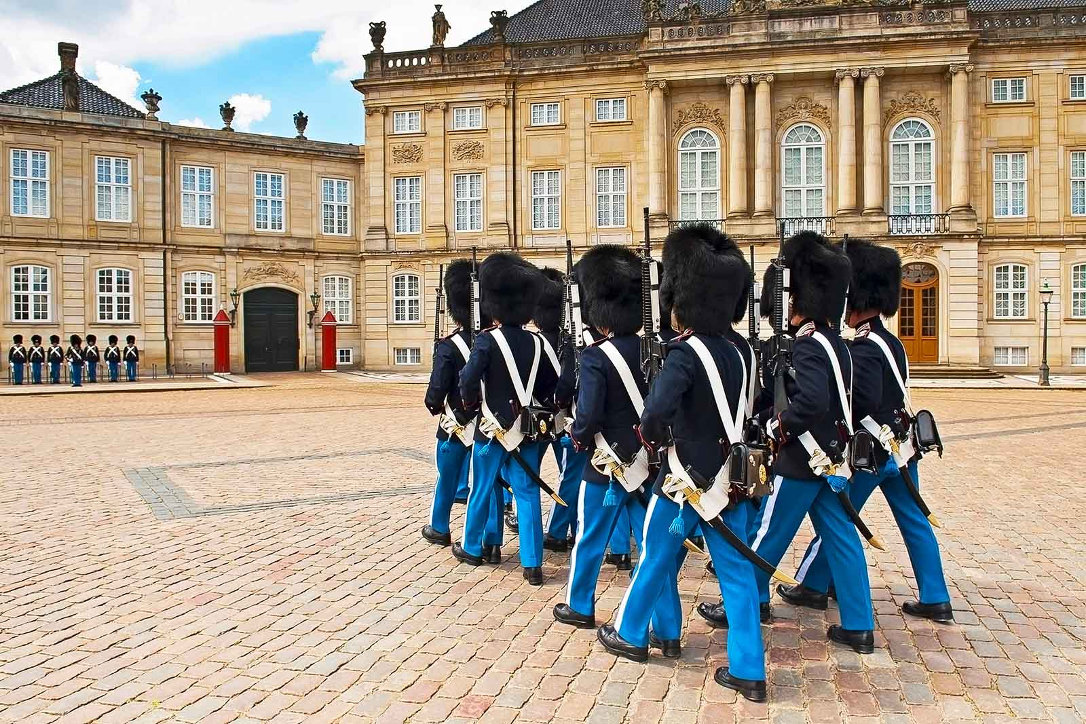
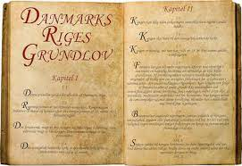
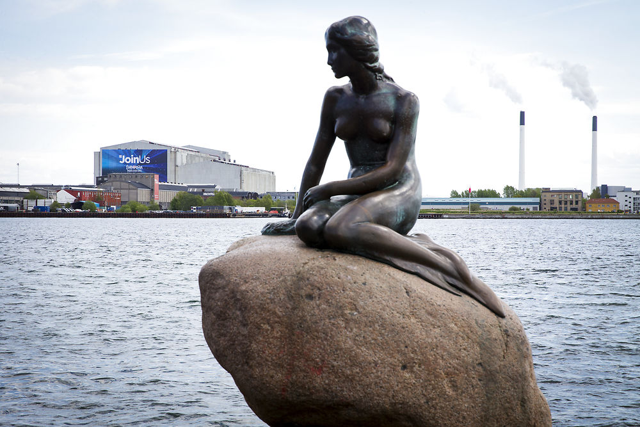
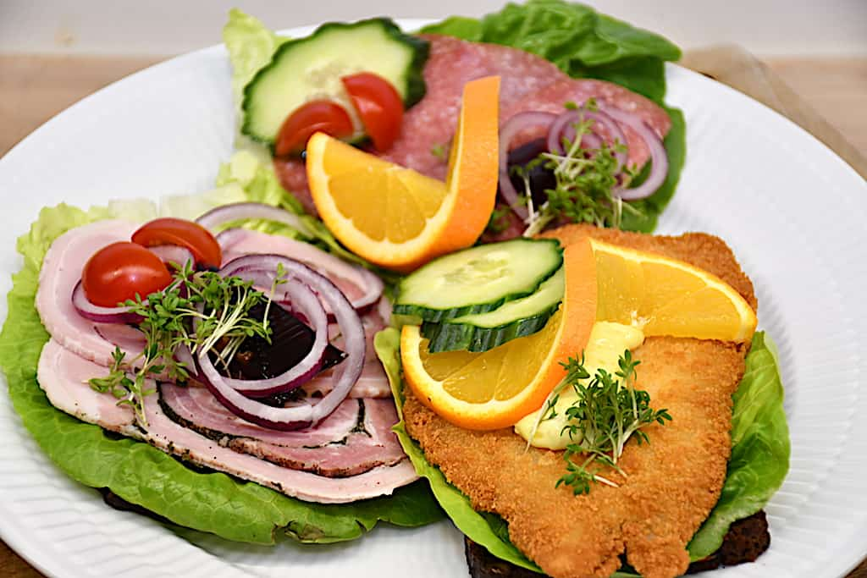
Symbols
The outer layer of culture
Visible artefacts
Have a special importance – carry a meaning to most members of a culture.
  Eg. Flags, buildings, songs, colours, clothes, food etc.

Slide 6
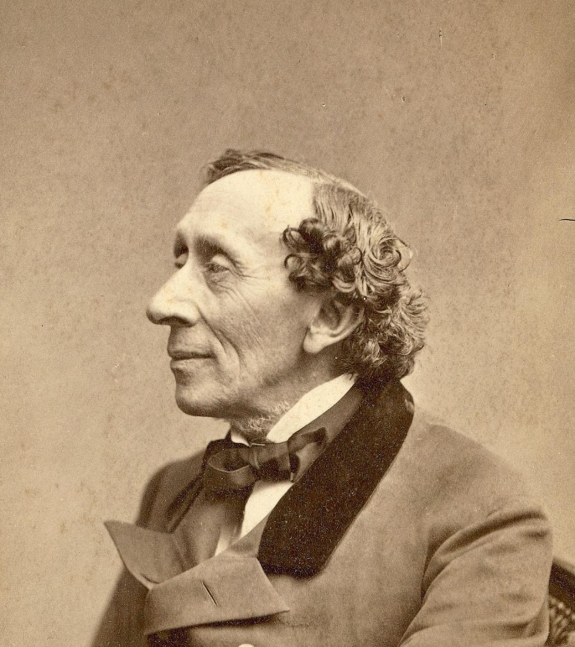
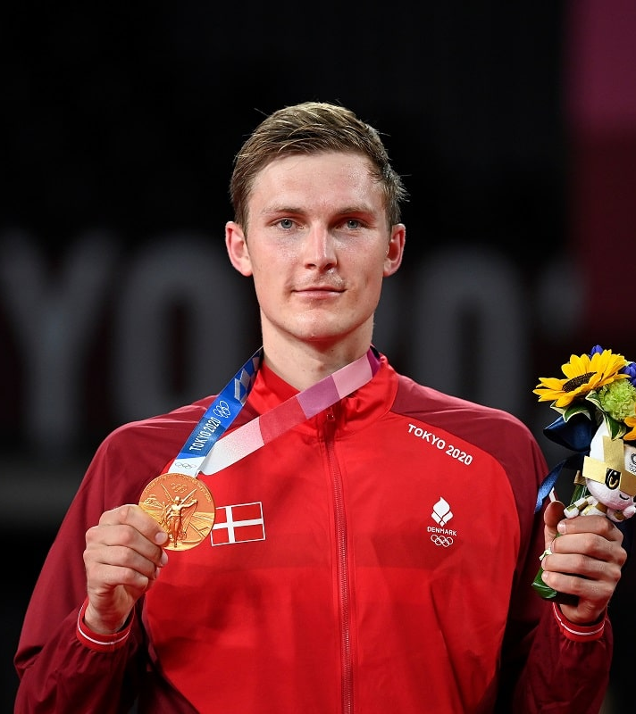
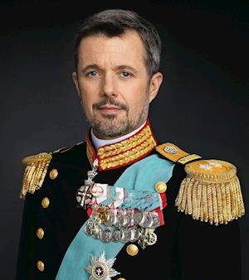
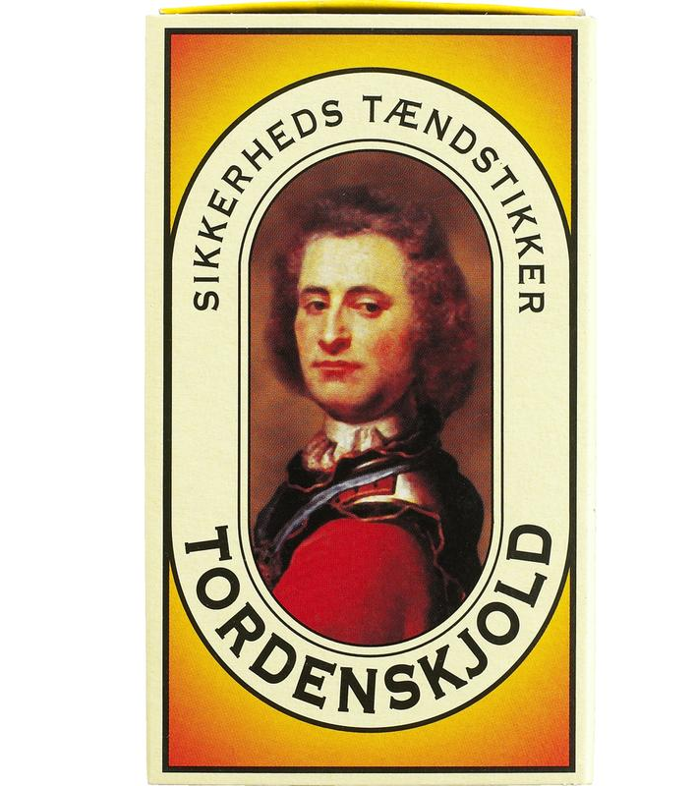
Heroes
Persons who have abilities that are much appreciated in a culture.
Role models to the members of the culture
  Dead / alive
  Real /fictional
Eg. politicians, royalty, athletes, artists, scientists, statesmen.
Some might be heroes at a certain point in time, but lose that status later if they are not relevant anymore or are dead
Can you think of other Danish heroes?

Slide 7
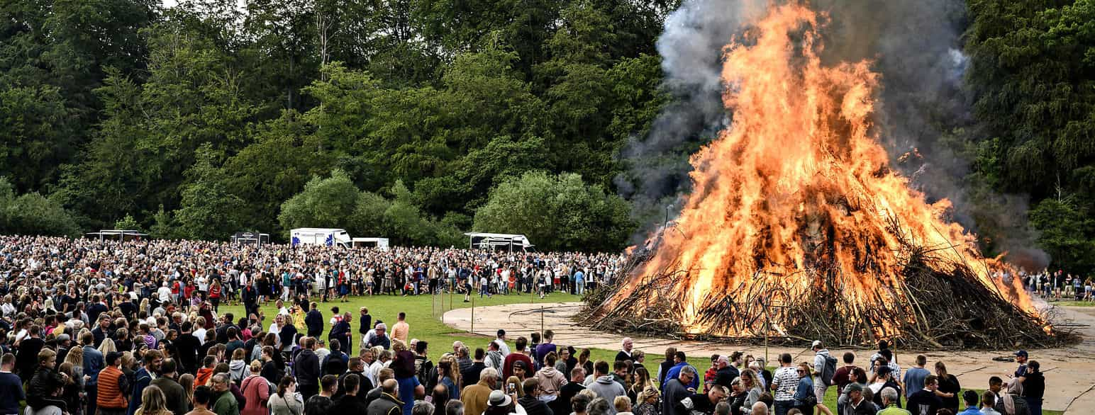
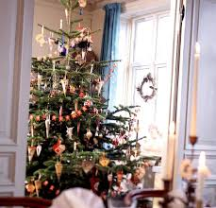
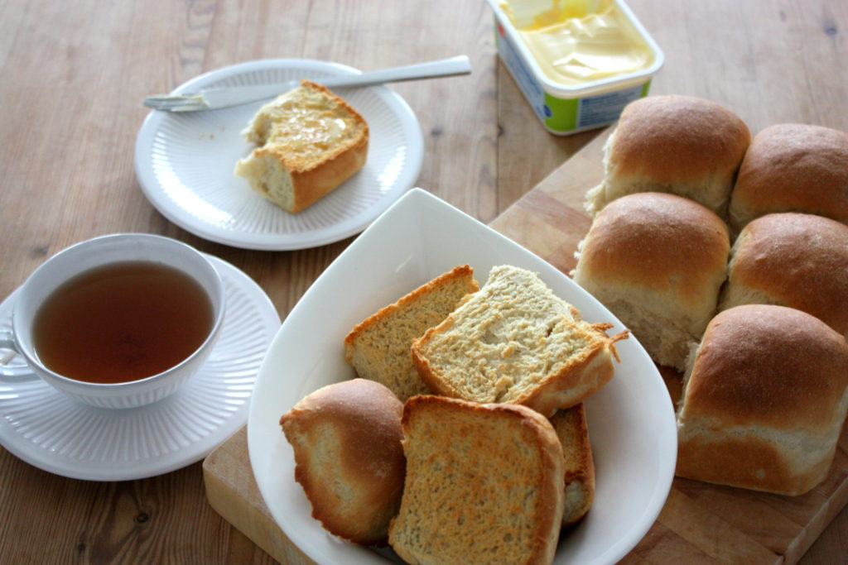
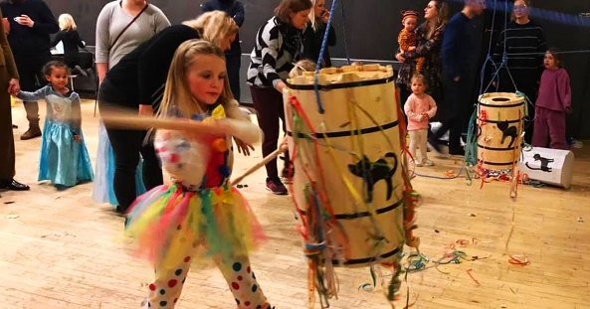
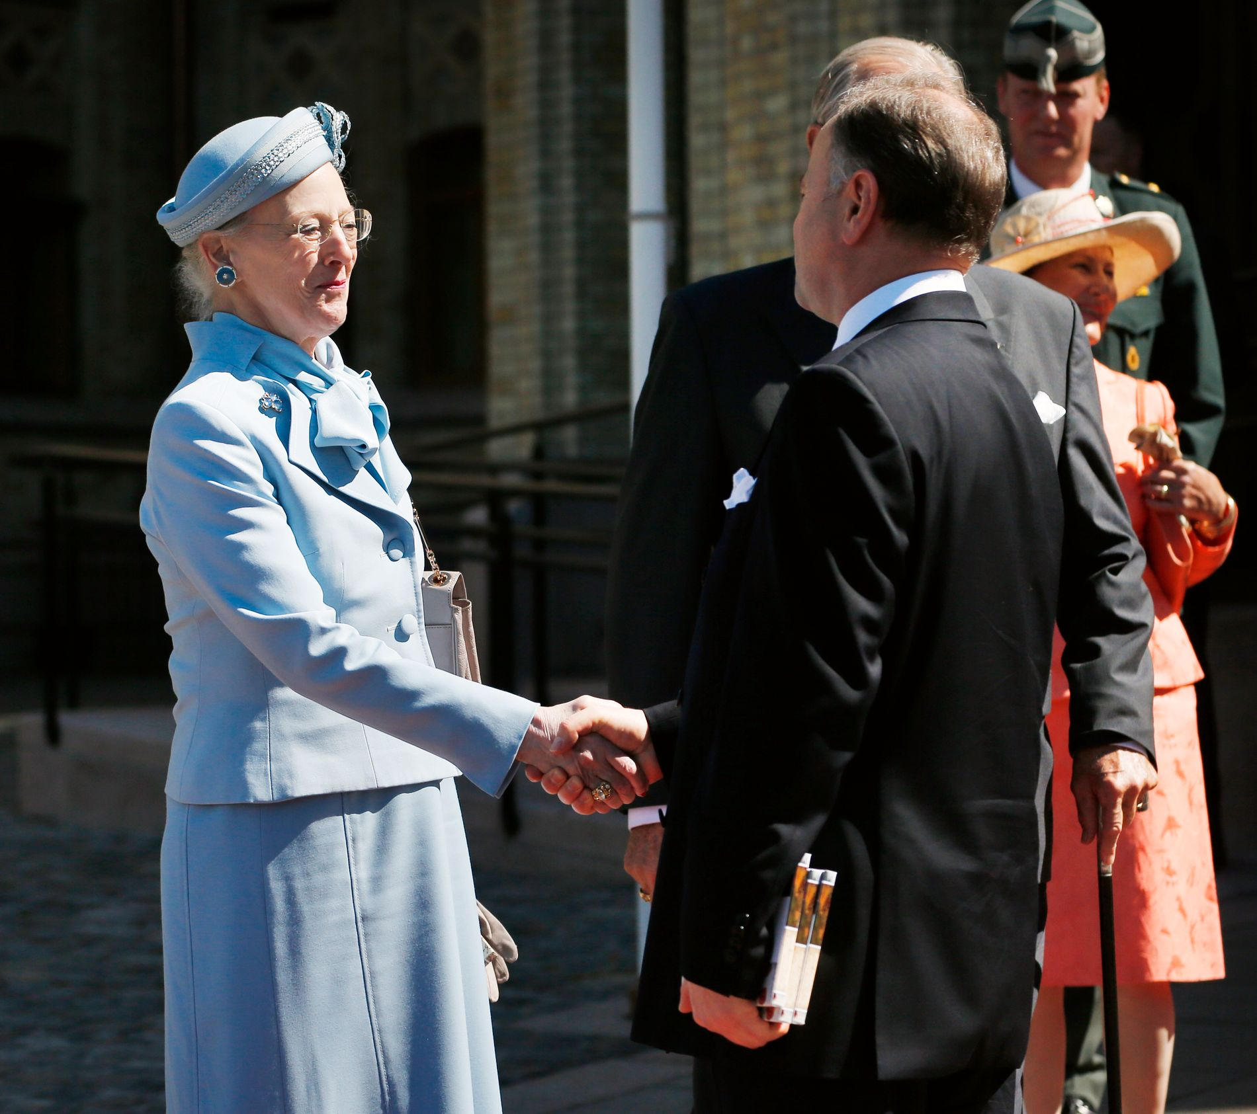
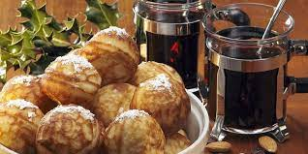
Rituals
Collective activities within a culture
Socially essential to the members of the culture – only carried out for their own sake.
  Traditions
  Eating rituals
  Greeting rituals
  Singing the national anthem etc.

Slide 8
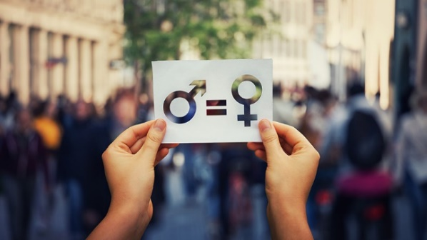
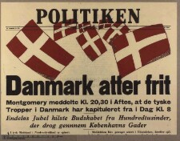
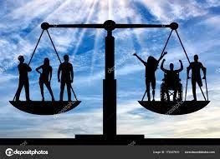
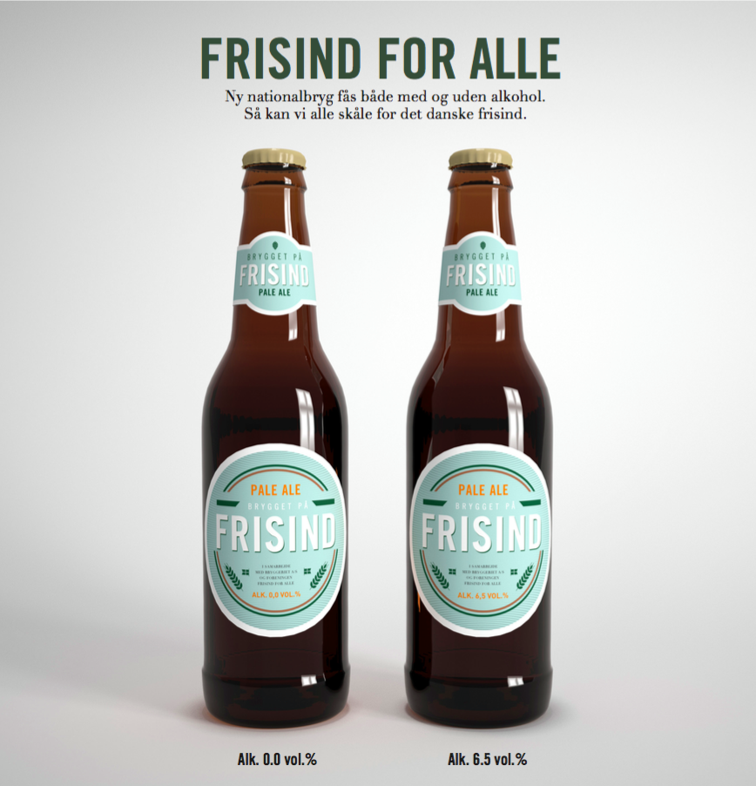

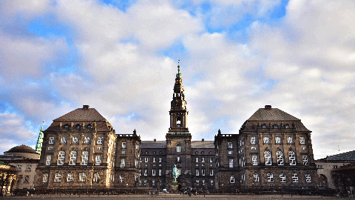
Values
The core of the cultural onion
Invisible – but become visible through our behaviour, rituals etc. (pracitices)
Good or bad
Acceptable / uacceptable
Right / wrong
Desirable / undesirable
Notes:
Deeply held beliefs about right/wrong, good/bad, important/unimportant.
Hardest to see, slowest to change.
Example: individualism vs. collectivism, equality vs. hierarchy.

Slide 9
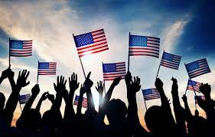
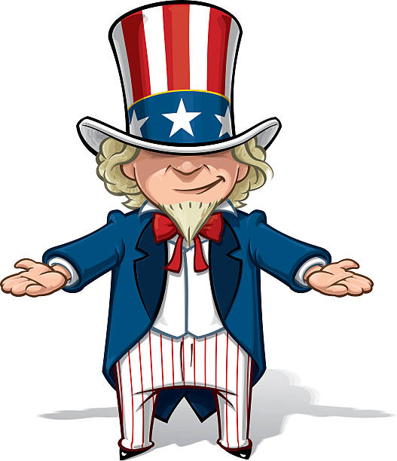
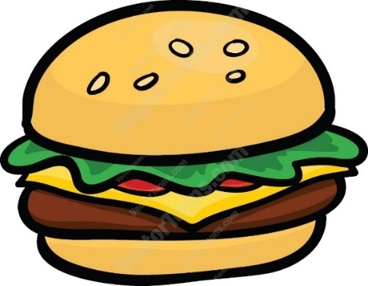
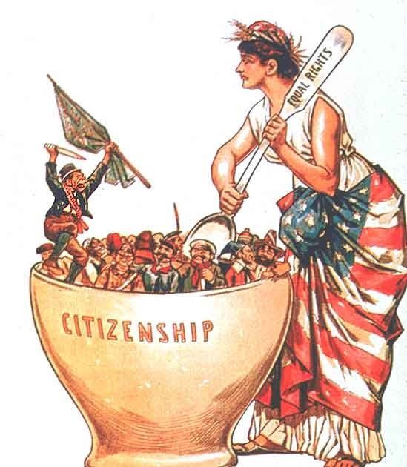
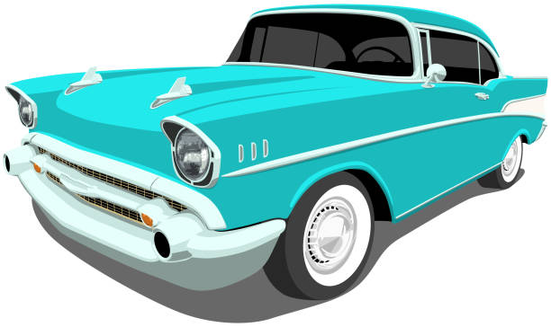
… now it’s your turn
Work in your study groups
Make a poster of Hofstede’s onion model.
Illustrate your poster with American
  Symbols
  Heroes
  Rituals
  Values
Make a presentation in class of your poster

