Slide 1
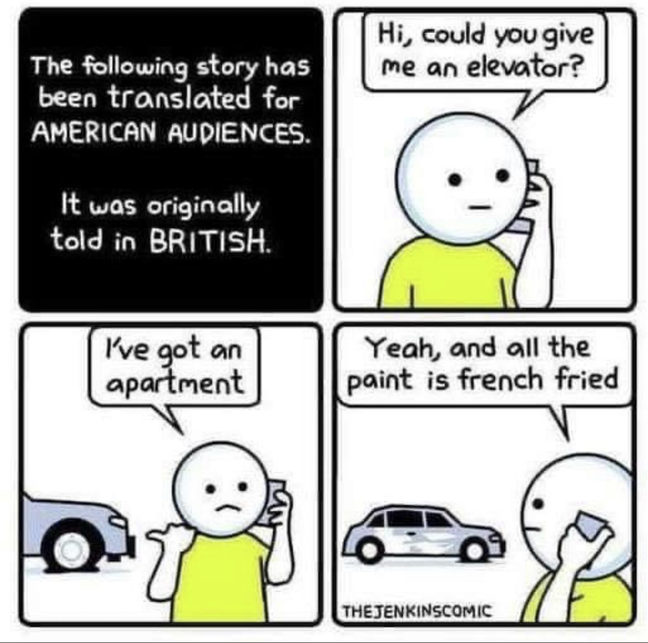

Slide 2
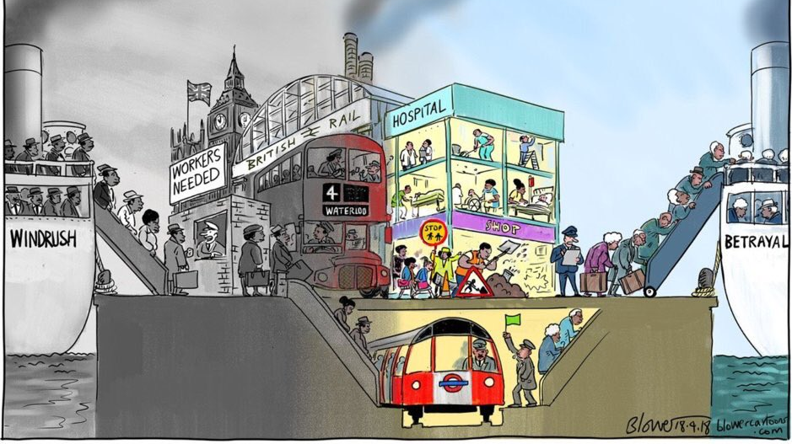
new theme – clash of cultures?

Slide 3
Today’s question + goal: question: why is Britain multicultural? Why are vast parts of the world influenced by british culture? Goal: to obtain knowledge about British colonialism, the spread of English and multiculturalism in Britain

Slide 4
Today’s plan: 1. culture? 2. short video about English in the world 3. a short introduction to: Empire, commonwealth, and multicultural England (PP) + question 4. Multicultural Britain and britishness? 5. break 6. Research former british colonies + group presentations 7. 5 minutes speedwriting + What I have learned today is….

Slide 5

What does culture mean?
Task:
Look up the word culture in the Merriam Webster dictionary (link on lectio)
https://www.merriam-webster.com

Slide 6
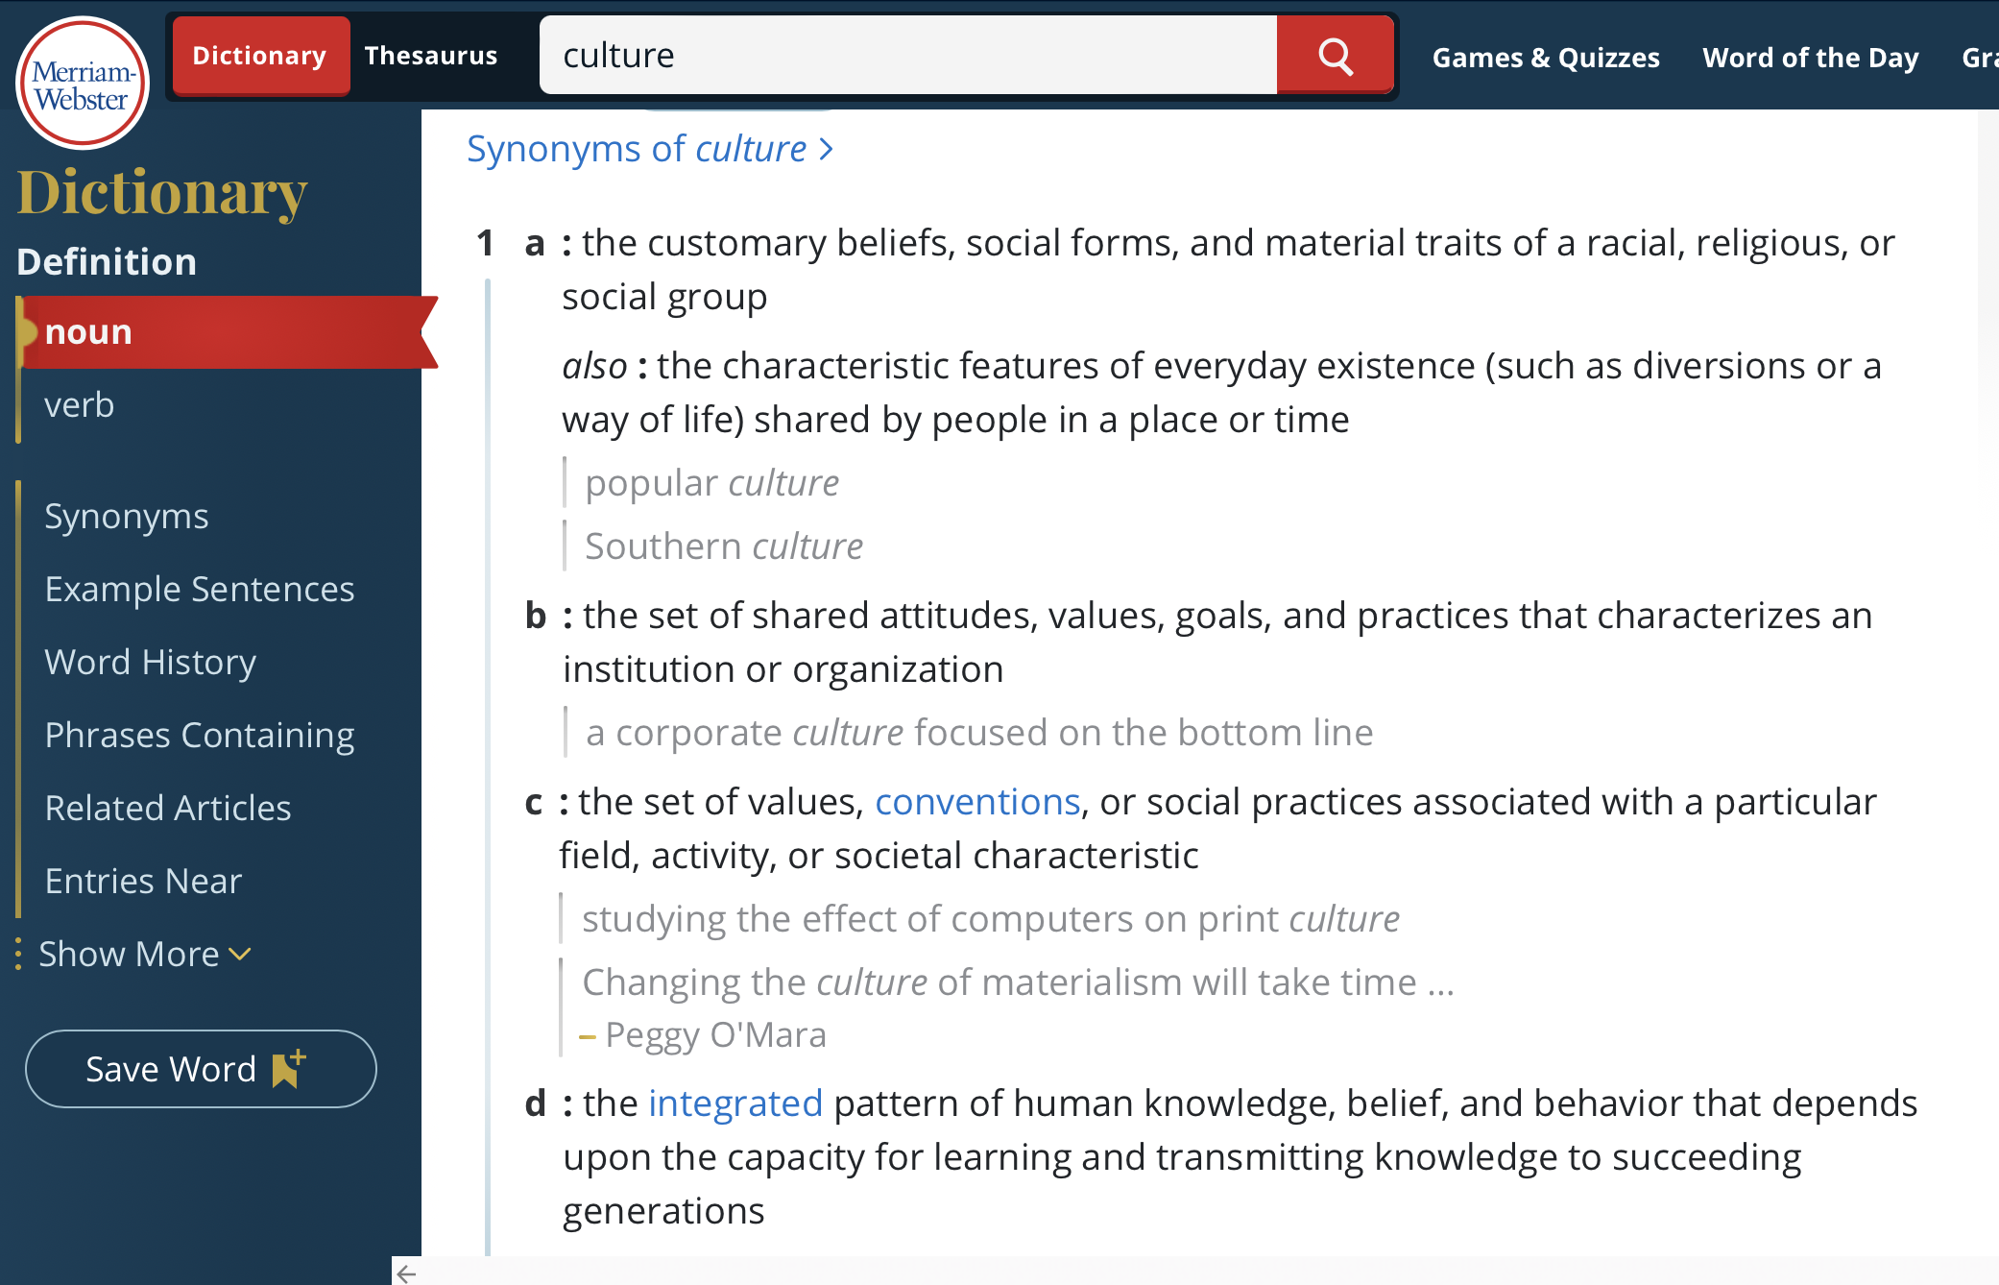

Slide 7

Do you know anything about the origins and the spread of the English language? TASK: List some of the events or people that/who has influenced and shaped the English language and mention reasons to why it has spread?
https://www.youtube.com/watch?v=H3r9bOkYW9s
https://www.youtube.com/watch?v=mTOsxh4OcFU

Slide 8

What do you know (now) about the origins and the spread of the English language?

Slide 9

Now sit back and listen to a short introduction to - Empire, commonwealth, and multicultural England

Slide 10

Multicultural britain
While-watching you must reflect on the following question: What is Britishness /British culture?
https://www.youtube.com/watch?v=Az-mi5_Sbts

Slide 11

Task: In groups, you must research one of the four former british colonies (guided by 4 assigned questions for each country). Use the googledocs-doc to write your group’s notes (answers) the group will present its findings for the rest of the class
- Nigeria
- Australia
- South Africa
- India

Slide 12
Task: speedwriting individually, you must reflect on: - what it means to be british?, - multiculturalism and/or - the former british colonies

Slide 13

In pairs, what i have learned today is….

