Slide 1

Empire, commonwealth, and multicultural England
A compressed history.
Mostly told from a British point of view.

Slide 2
The British Empire – a timeline (part 1)
16th century
Great Britain made its first efforts to establish overseas settlements. These expansions were mainly driven by commercial ambitions.
1600
The East India Company, which traded spices from India, is founded. Trading posts on the west coast of Africa are established.
1607
Founding the English settlement of Jamestown in Virginia in North America.
1623
The first British colony in the West Indies is founded on Saint Christopher Island (St. Kitts)
1759
The start of British rule over Canada following victory over the French.
1776
The 13 North American colonies issue the Declaration of Independence. The United States gained formal independence with the Treaty of Paris in 1783.

Slide 3
The British Empire – a timeline (part 2)
1788
New South Wales in Australia is founded as the first colony for convicts.
1840
The Māori sign a treaty making New Zealand a British colony.
1876
A rebellion in India results in the direct British rule of India.
1884
Africa is divided between the European powers at the Conference of Berlin. Britain gains control of large parts of Africa.
1914–1918
World War I leads to an expansion of British-controlled territories, especially in Africa.

Slide 4
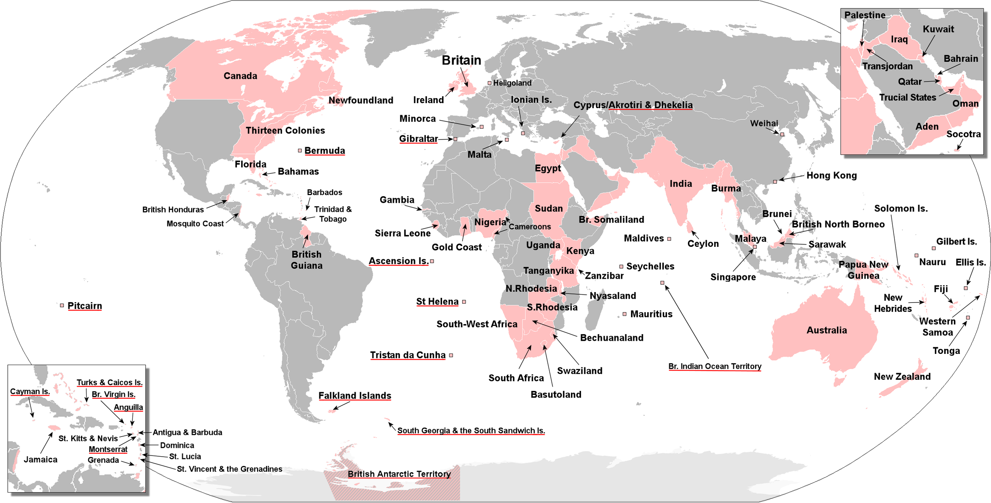
Notes:
The territories that were at one time or another part of the British Empire. The United Kingdom and its accompanying British Overseas Territories are underlined in red.

Slide 5

The Berlin Conference of 1884–1885, regulating the European colonisation and trade in Africa.

Slide 6
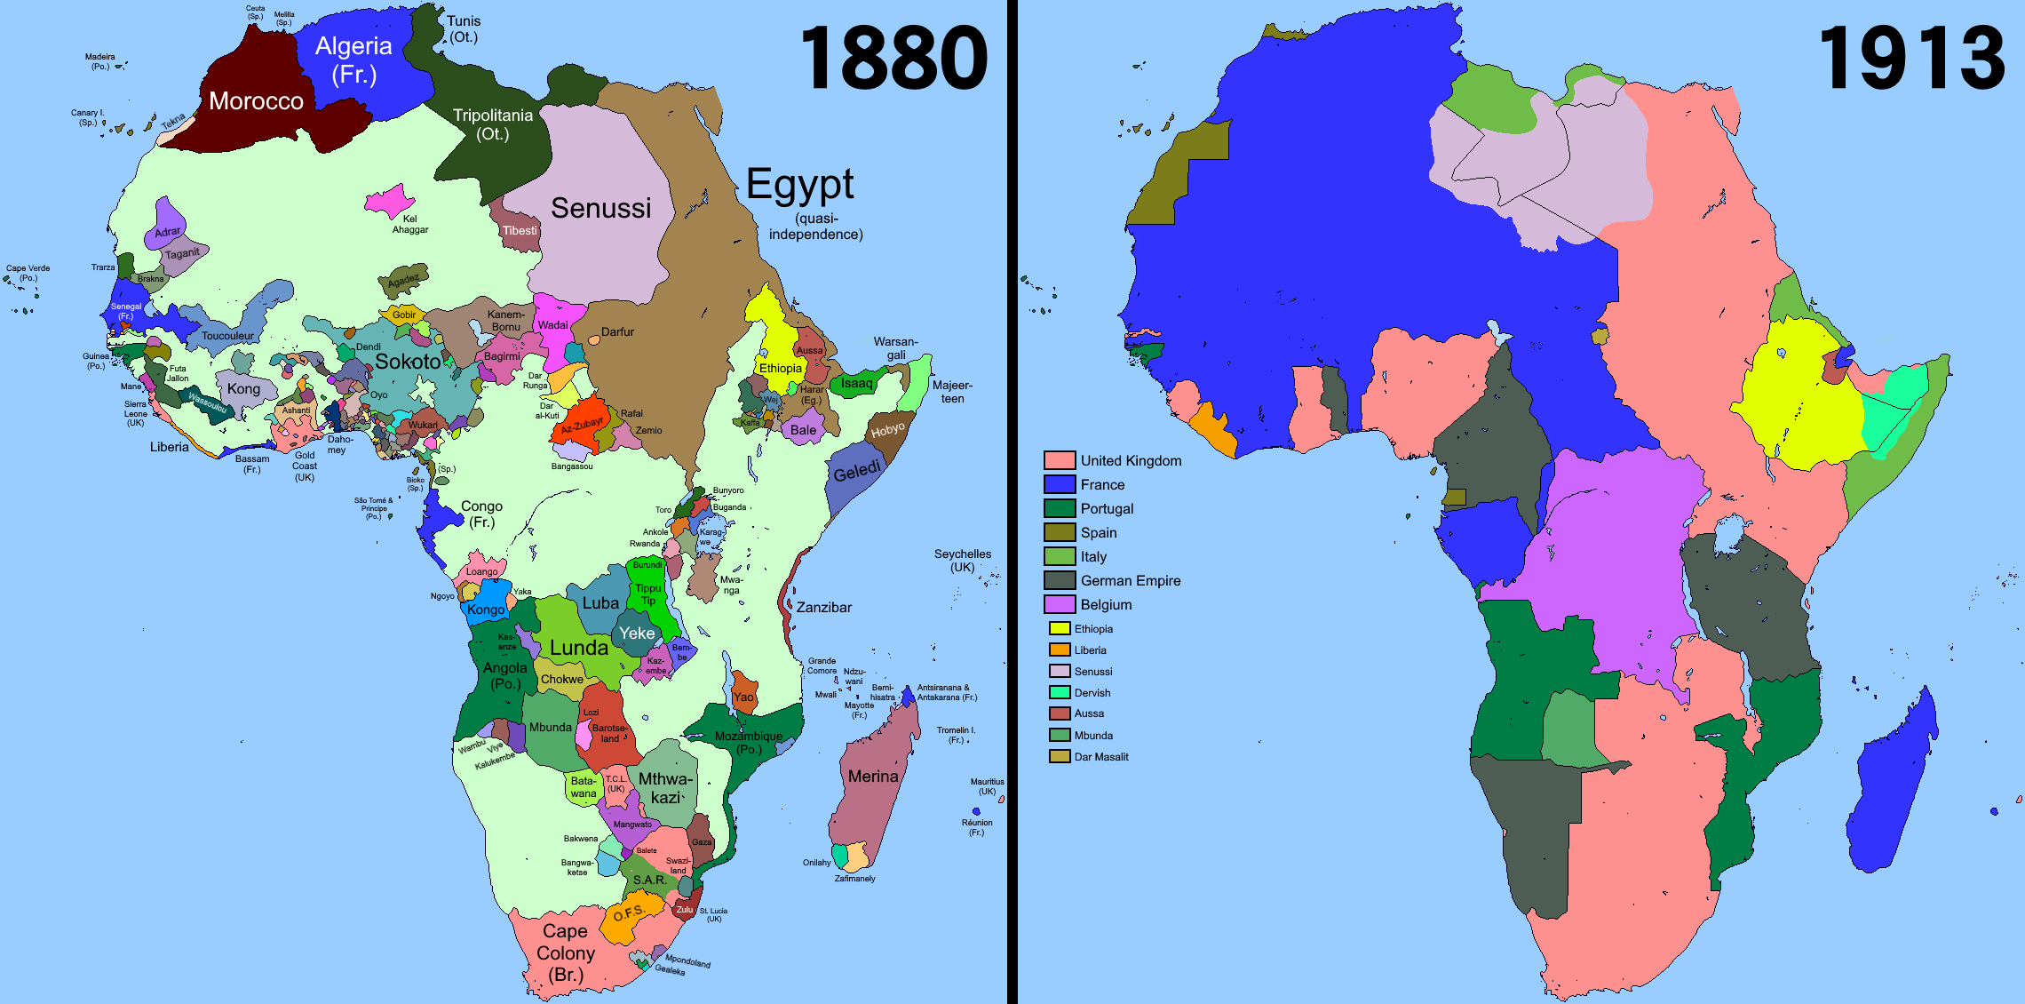

Slide 7
Some of the different types of colonies
Australia was a settler and penal colony. A distant or overseas settlement established for punishing criminals by forced labour and isolation from society.
St. Kitts (an Island in the West Indies). Originally the island produced tobacco but changed to sugar cane production in 1640. The extremely labour-intensive cultivation of sugar cane was the reason for the large-scale importation of enslaved Africans. The forceful displacement of Africans began almost immediately upon the arrival of Europeans to the region.
South Africa was mostly of strategical importance for trade, but it also became a place for mining diamonds.

Slide 8
English(es)
British English adopted foreign words like: Avocado (from the Nahuatl (the language of the Aztecs)), canoe (from Carib), Zombie (from a West African language) and yoga (Sanskrit).
In many of the colonies English adapted to fit the local traditions and cultures, so it could more accurately describe the world. Different Englishes developed locally, and they became lingua franca in many colonies often at the expense of local languages.

Slide 9
Decolonisation and the Commonwealth
World War II contributed to a process of decolonization.
Decolonization is the process by which colonies become independent. Decolonization was gradual and peaceful for some British colonies but violent for others, where native rebellions were energized by nationalism.

Slide 10
The Commonwealth of Nations
With the London Declaration of 1949 the current Commonwealth of Nations came into being.
The Commonwealth is a loose association of former British colonies and current dependencies, along with some countries that have no historical ties to Britain.
The members have no legal or formal obligation to one another; they are held together by shared traditions, institutions, and experiences as well as by economic self-interest. Today there are 54 member states.

Slide 11
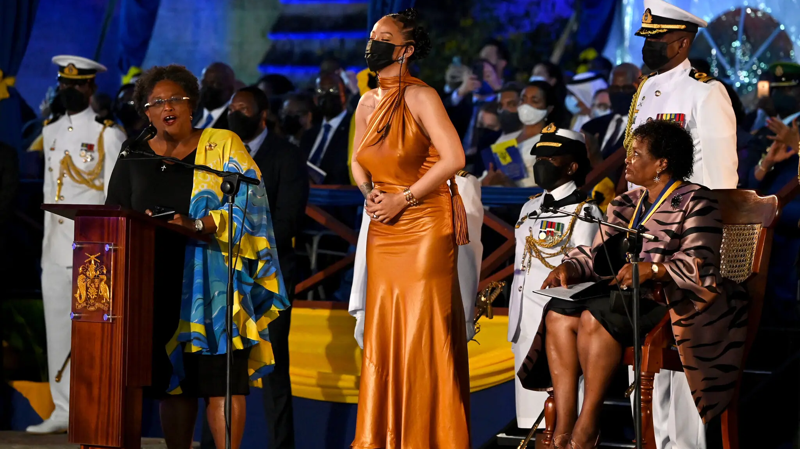
The continuous change of the commonwealth
Slavery was abolished in Barbados in 1834 and the country became fully independent in 1966. In November 2021 Barbados also parted way with the English Queen, making it the world’s newest republic.
Rihanna was declared a national hero during the ceremony.

Slide 12
Immigration
Already by the late 1700s, the British Empire covered vast parts of the planet, and it is estimated a least ten thousand people of African descent lived in Britain, mainly in London.
Post-war immigration. After WWII the size and speed of migration to Britain increased dramatically, owing to both a shortage of labour in Britain and the increased ease of international movement (e.g. motorized ships and air travel). After WWII, all colonial subjects were given the right to freely reside, work and study in Britain as British subjects.
Around three million people arrived between the late 1940s and the beginning of the 1970s (an average of almost 10,000 per month). They were encouraged by the British government.

Slide 13
Immigration
The ship The Empire Windrush has become an icon of the mass arrival of people from the former colonies. It landed the first group of Caribbean immigrants in 1948 at the Tilbury docks on the river Thames just south of London.
However, the era of mass immigration did not last long. Britain’s very welcoming immigration policy was gradually abolished during the 1960s and 1970s. In these years, most of the British Empire was also abolished and, at home in Britain, hostility to immigration kept growing and burst into racial tensions in the country.

Slide 14
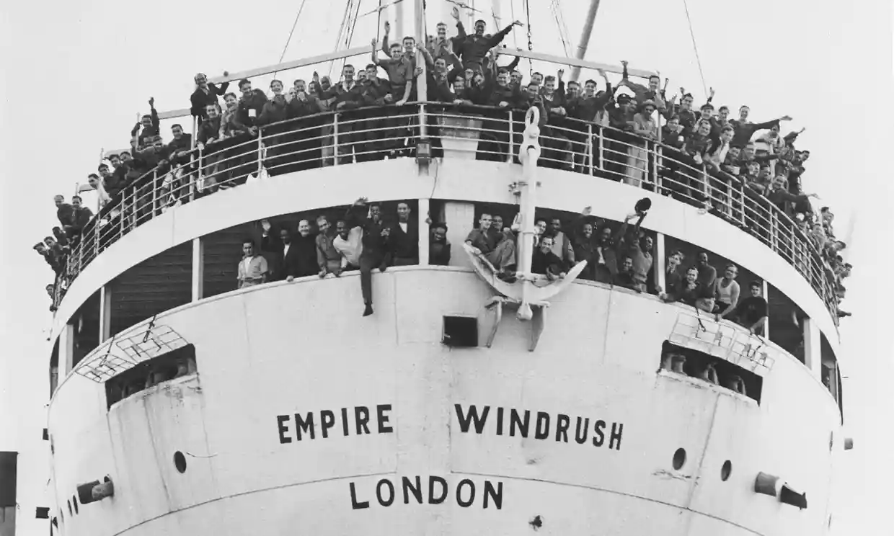
Empire Windrush

Slide 15
The Multicultural Britain
Multicultural (1): the term means that a society or nation consists of two or more cultures and/or ethnic groups. Multiculturalism is often referred to as the acceptance of various cultures living side by side, creating cultural diversity.
Multicultural (2): A society whose common culture is composed of a combination of the interests and origins of its constituent member.
Britishness as a national identity therefore has to be constantly reassessed and adopted to changing circumstances. Many black Britons have struggled to become British, they have found themselves caught between a homeland culture and Britishness. Being an ‘in-between’ has created a variety of problems for black Britons.
Britishness is constantly being discussed and some people try to defend their definition of it. Like the far-right political party The British National Party which restricts its membership to what they call ‘indigenous Brits’.

Slide 16

Integration versus assimilation
In groups of two. Find out and discuss:
What is integration (Merriamwebster.com) and assimilation (Britannica.com)?
What are the main arguments for integration and assimilation?
Do you subscribe to integration or assimilation? What is your main argument?

