Slide 1
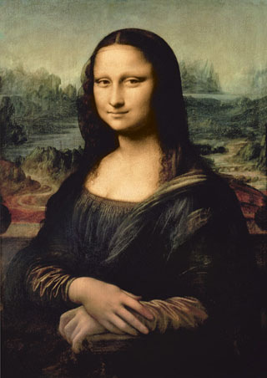
Leonardo Da Vinci:La Gioconda (Mona Lisa), ca 1503. Olie på lærred (77x53 cm), Musée du Louvre, Paris

Slide 2
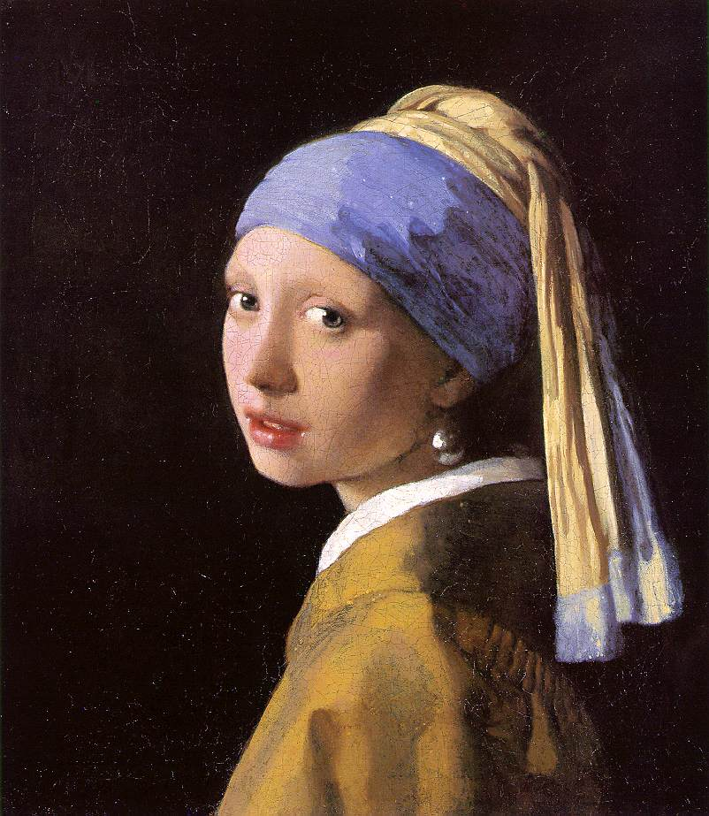
Johannes Vermeer, pige med perleørering c.1665
Oliemaleri
44,5 × 39 cm

Slide 3
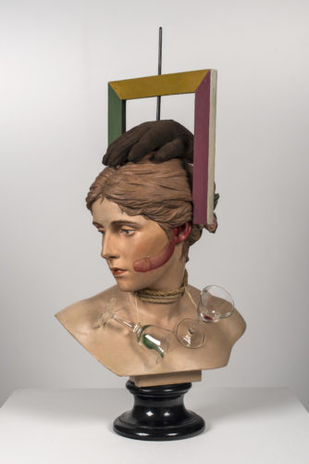
Wilhelm Freddies ”Sex-paralyseappeal” fra 1936.
Objekt 64.5 x 33 x 22 cm
Kvindebuste med påsatte genstande og bemaling

Slide 4
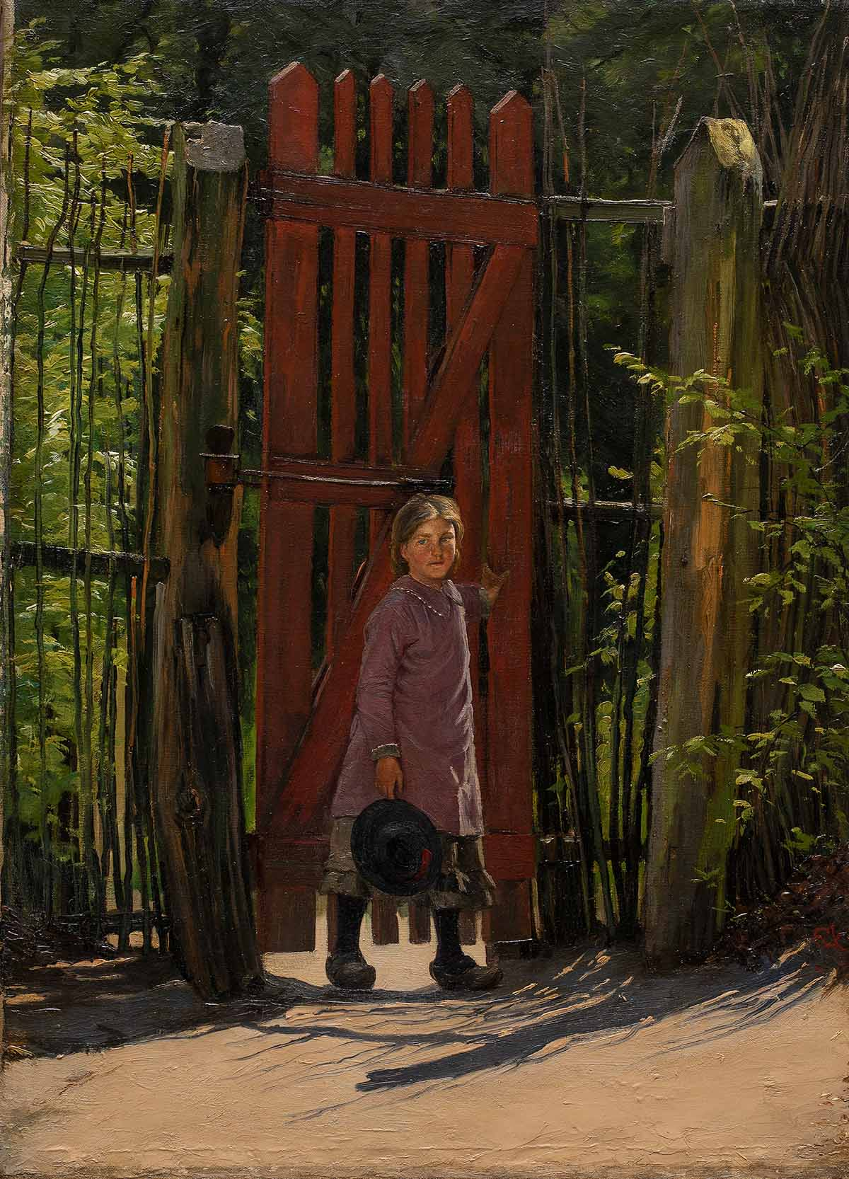
EN LILLE PIGE VED EN RØD LÅGE, U.Å. , 64 X 46 CM, olie på lærred
SOPHIE HOLTEN (1858-1930)

Slide 5
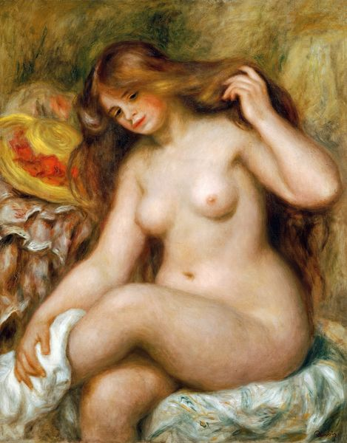
Den badende ' af Pierre-Auguste Renoir, olie på lærred ca. 1880

Slide 6
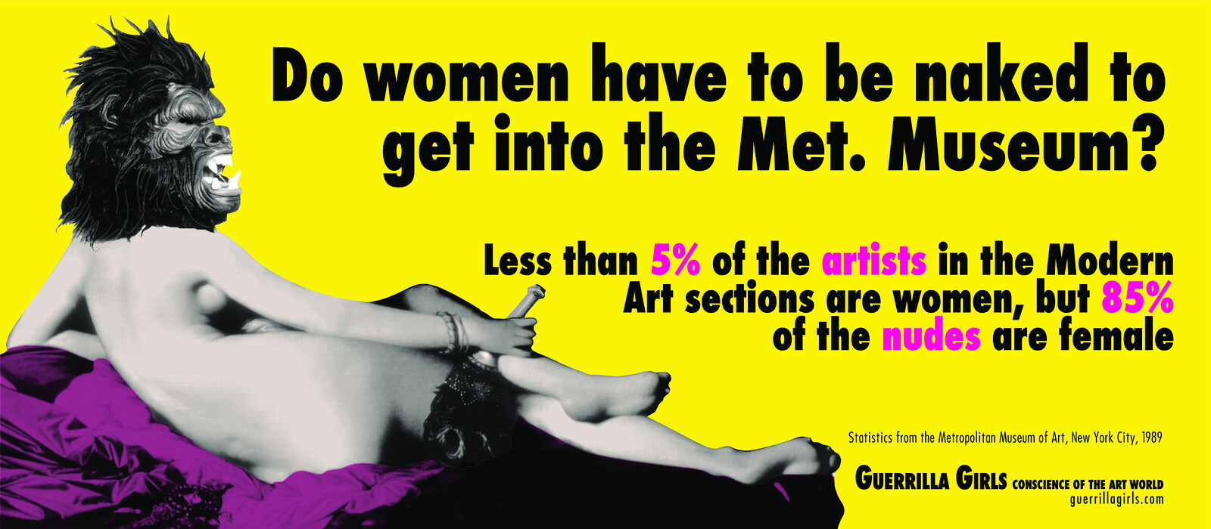
Guerrilla Girls, Do Women Have to Be Naked to Get Into the Met. Museum?, Plakat 1989.

Slide 7
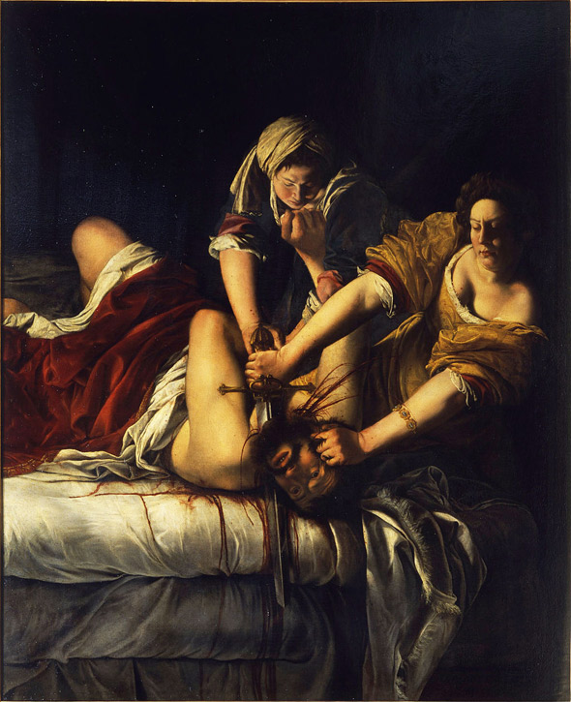
Artemisia Gentileschi (1593–1653 or after): ”Judith halshugger Holofernes”
1614–1620, olie på lærred

Slide 8
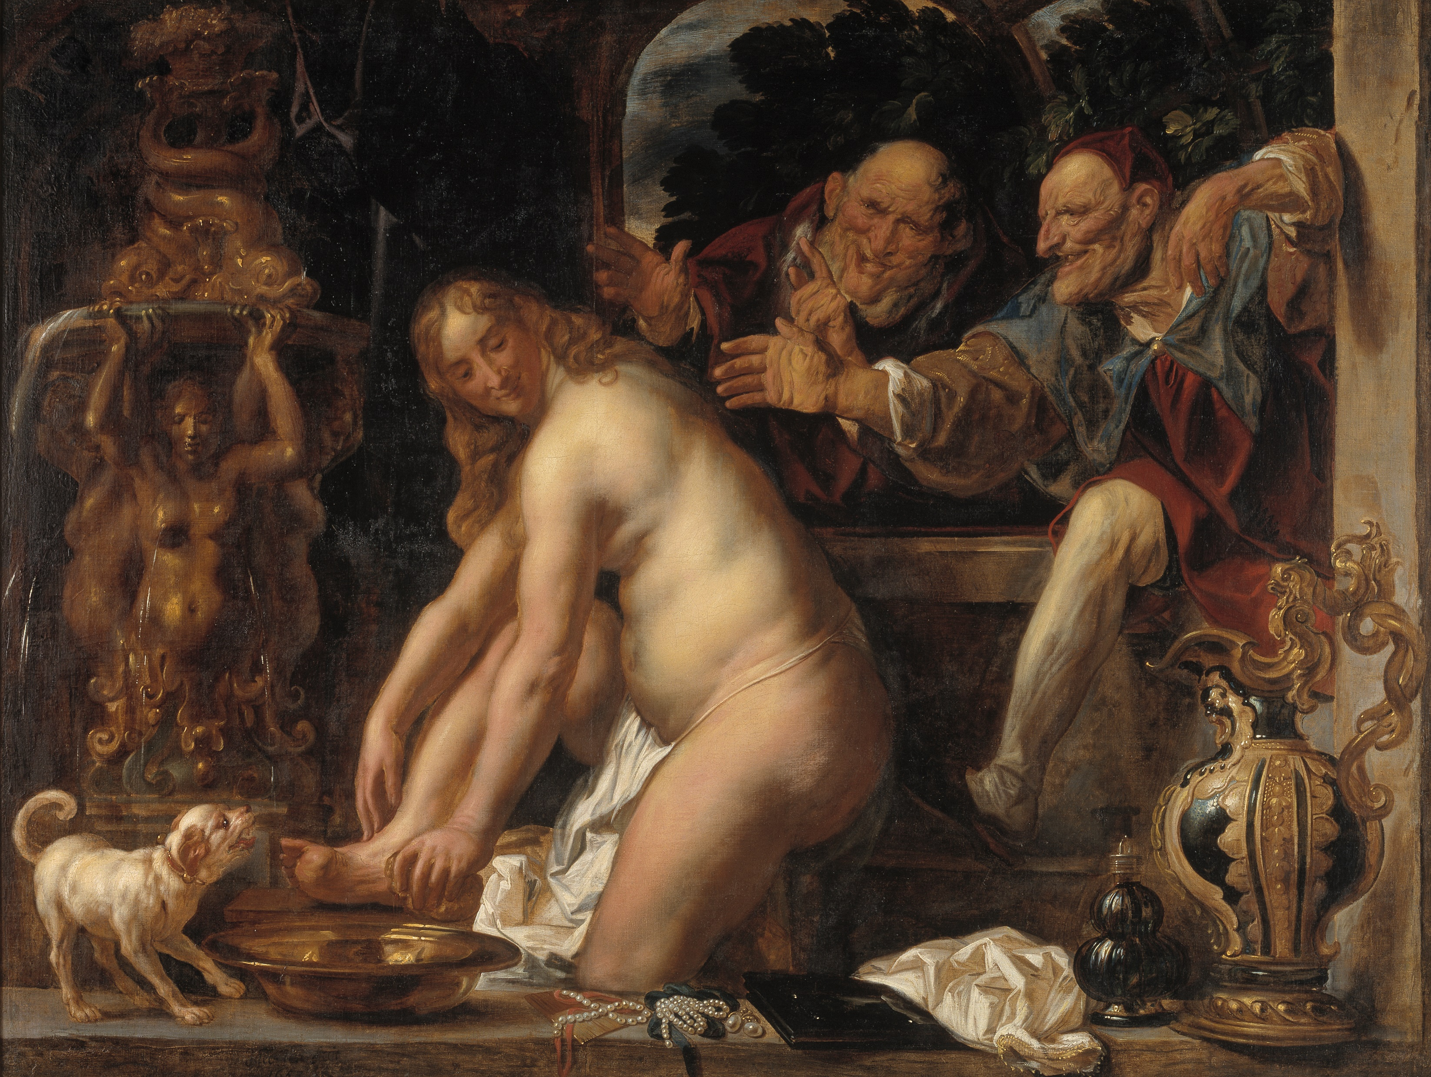
Jacob Jordaens: Susanna og de ældre, Olie på lærred, 153x203, 1663

Slide 9
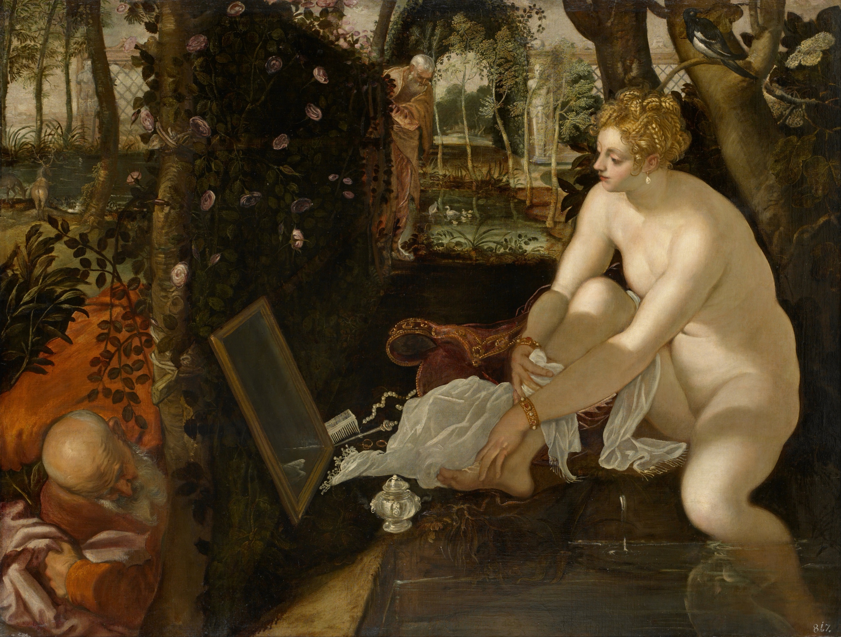
Tintoretto: Susanna og de ældre, olei på lærred, 146x194, 1556

Slide 10
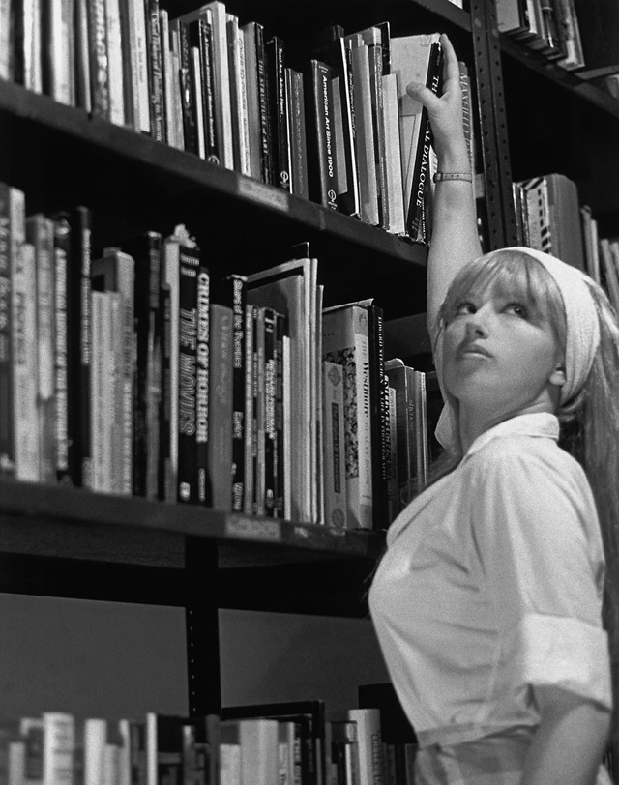
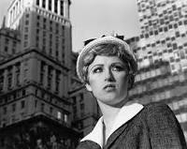
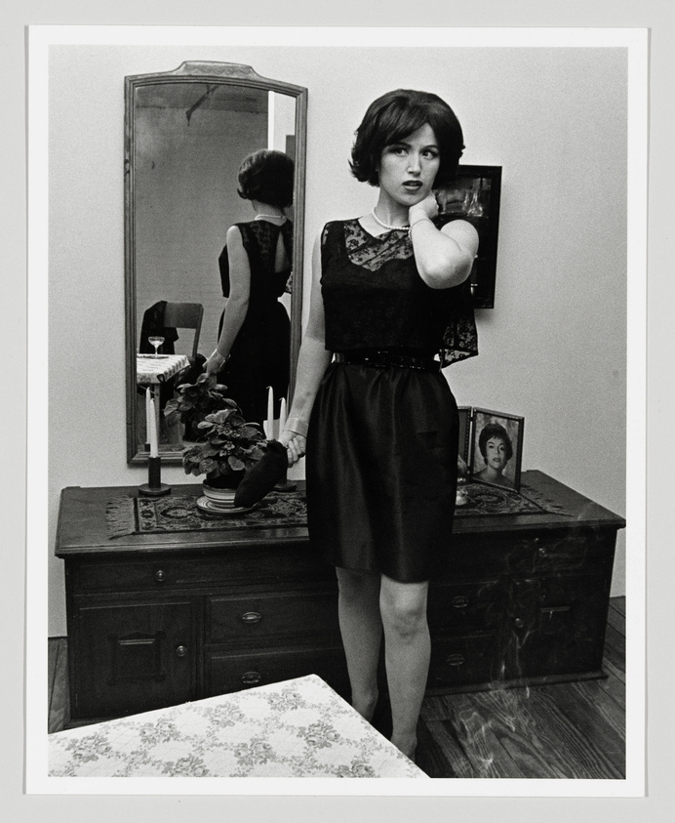
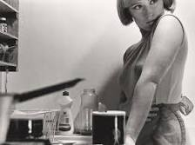
Untitled Film Stills is a series of black and white photographs by American visual artist Cindy Sherman predominantly made between 1977 and 1980, which gained her international recognition. Sherman casts herself in various stereotypical female roles inspired by 1950's and 1960's films. They represent clichés or feminine types "that are deeply embedded in the cultural imagination.“ The characters in all of these photographs are always looking away from the camera and outside of the frame. Sherman casts herself in each of these roles, becoming both the artist and subject in the work.
(Wikipedia)

Slide 11
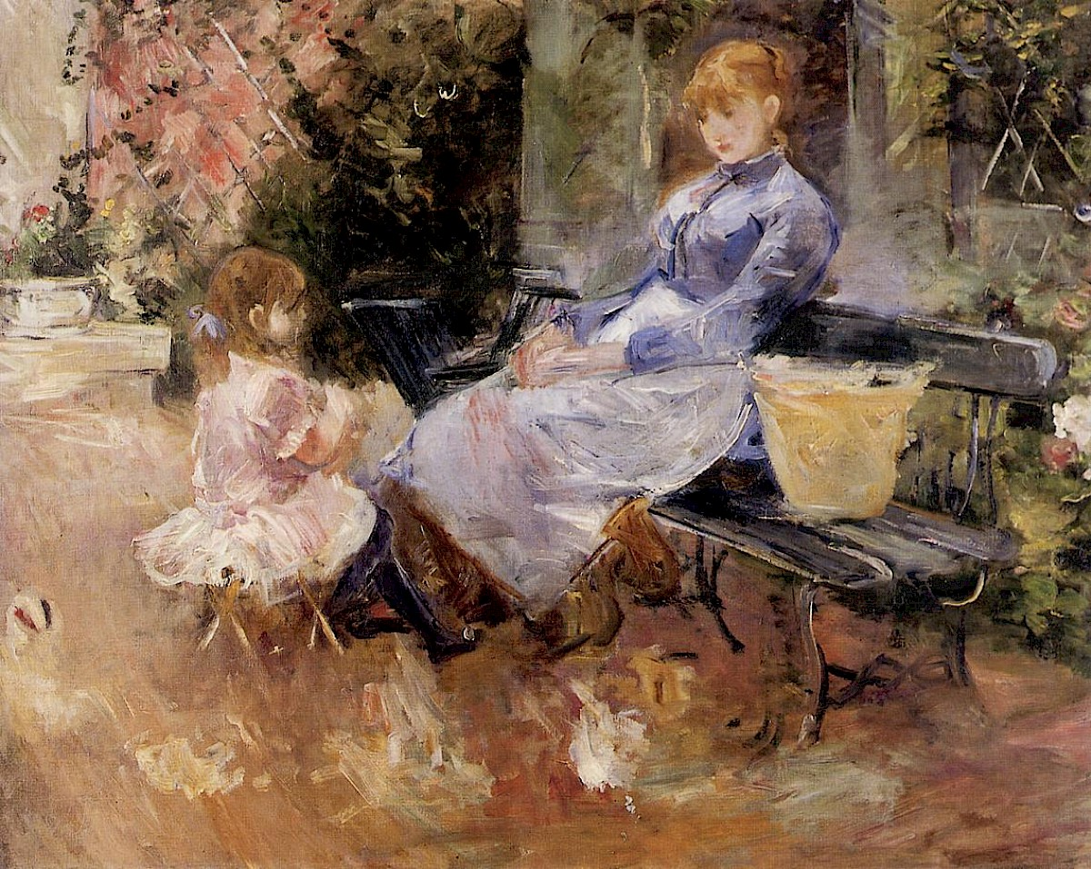
"La Fable", by Berthe Morisot, 1883,

Slide 12
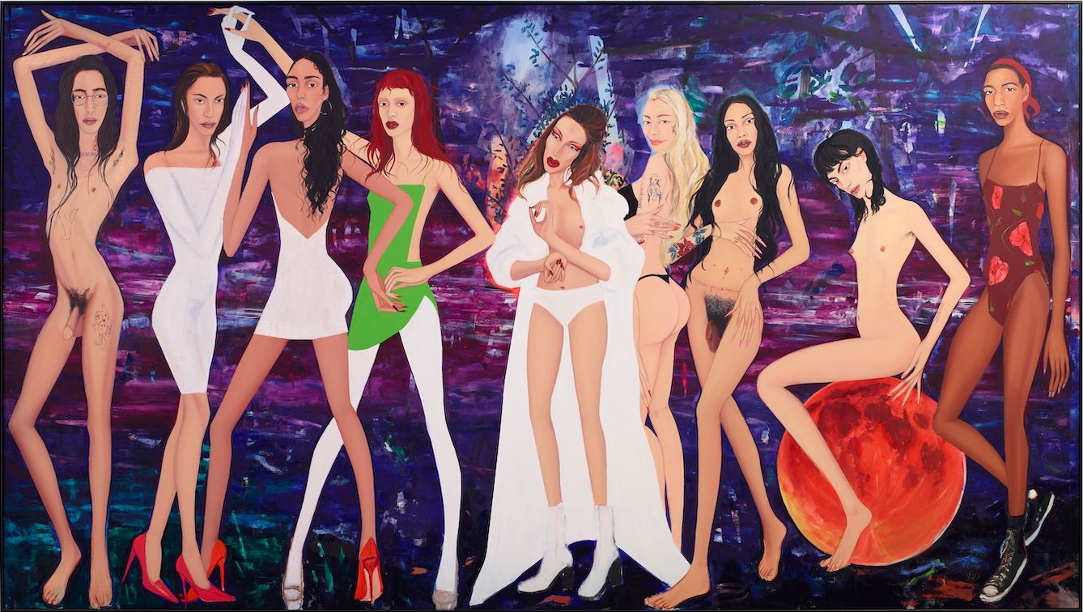

Slide 13
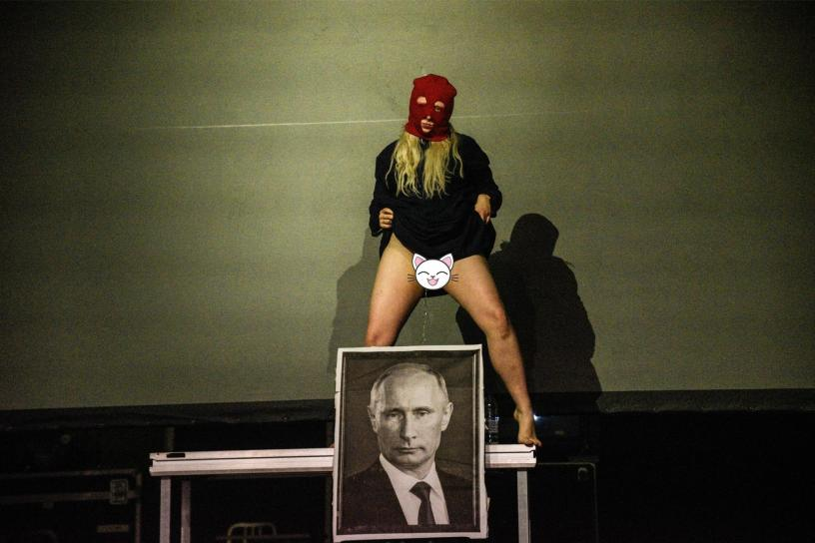
Pussy Riot optræder på Loud Women Fest 2021, hvor et medlem pisser på et billede af Putin

Slide 14
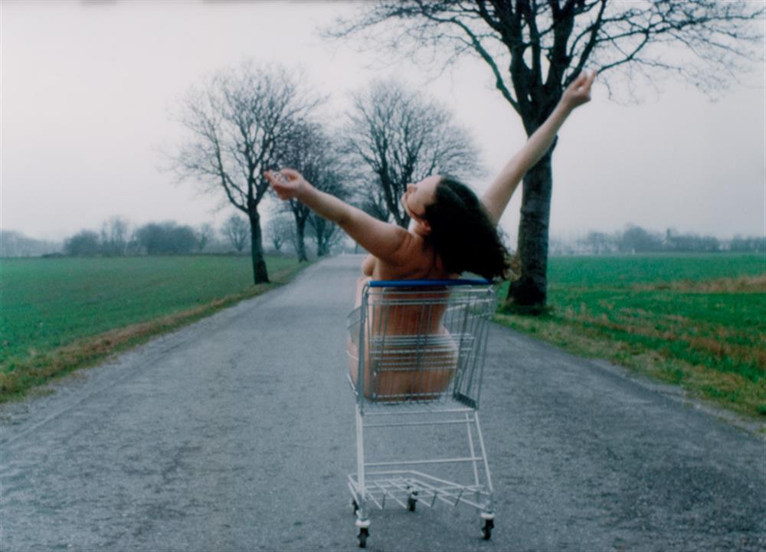
Kirsten Justesen
LUNCH, fotografi, 1975-2009, 124x172 cm

Slide 15
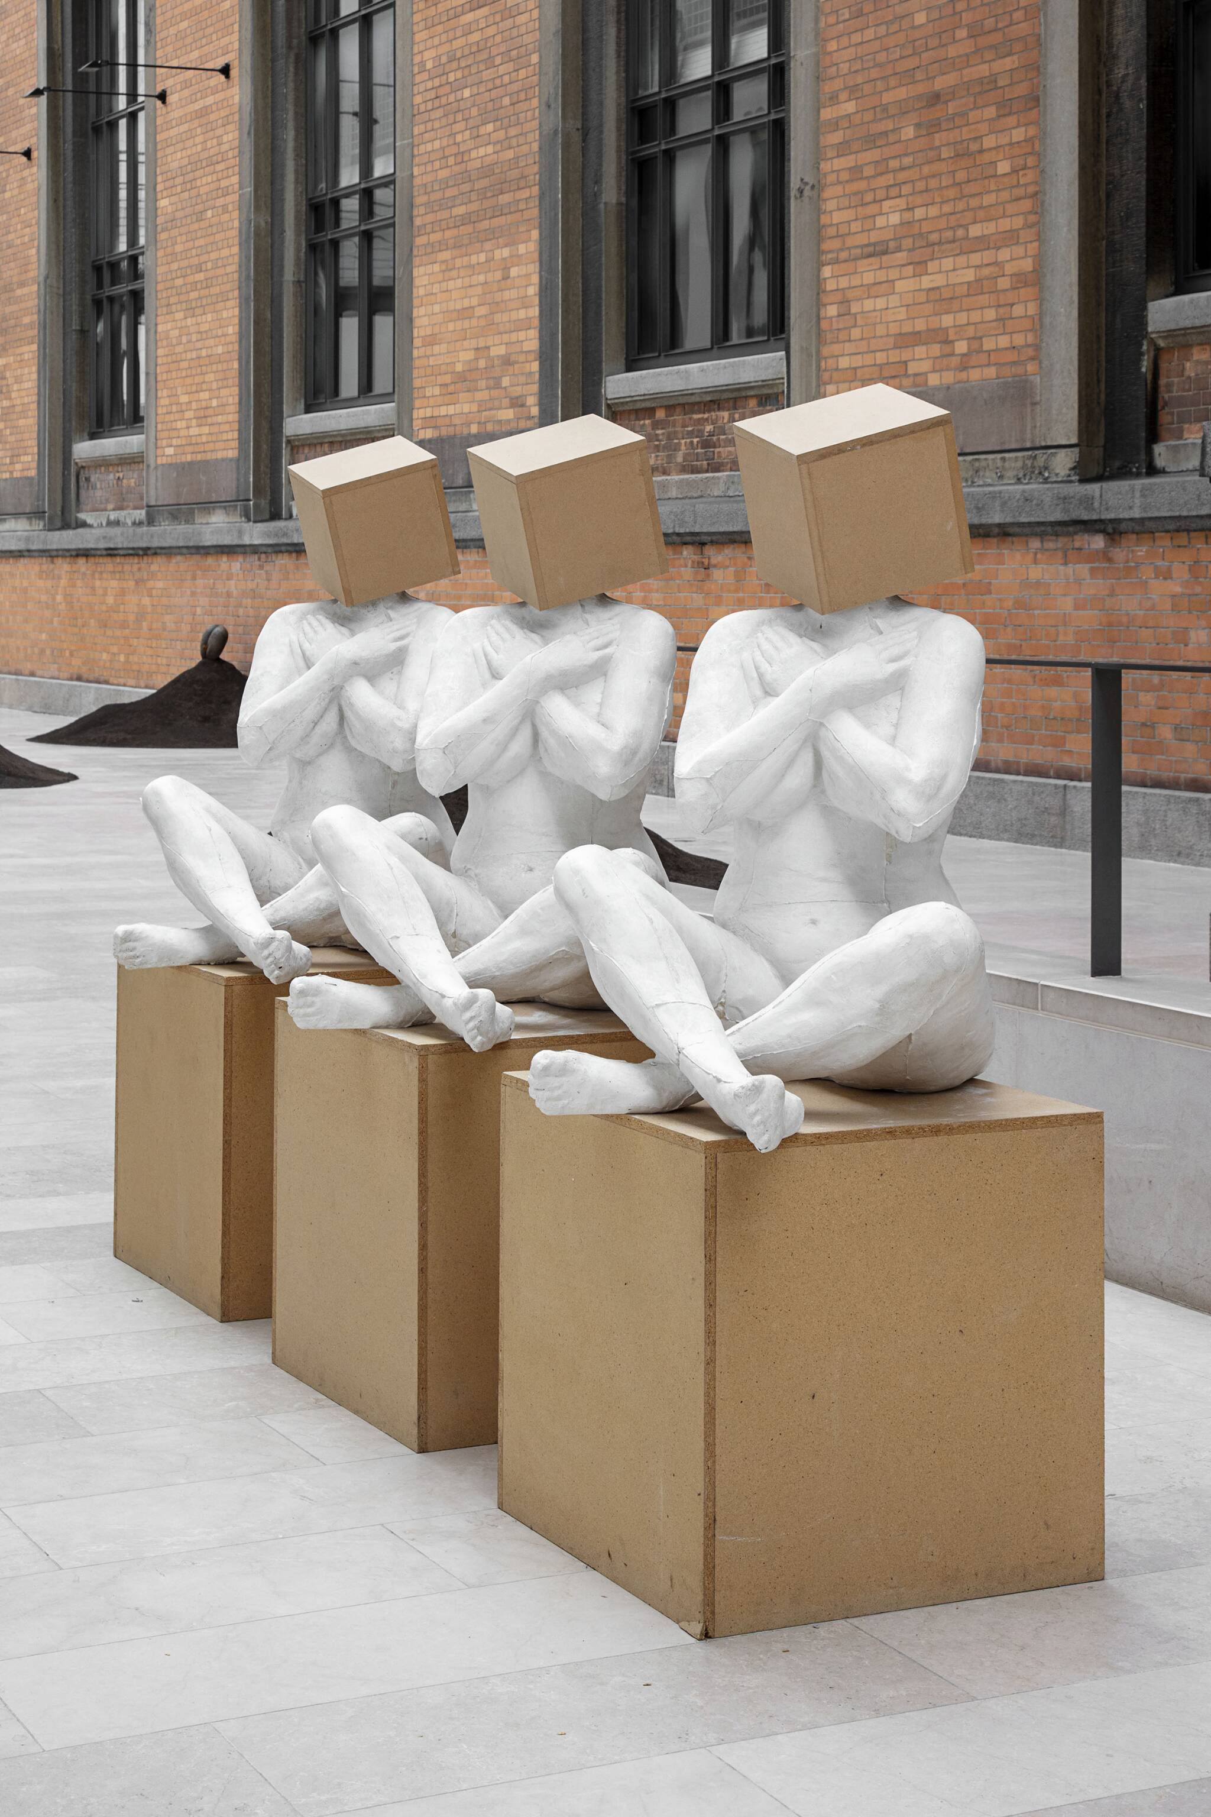
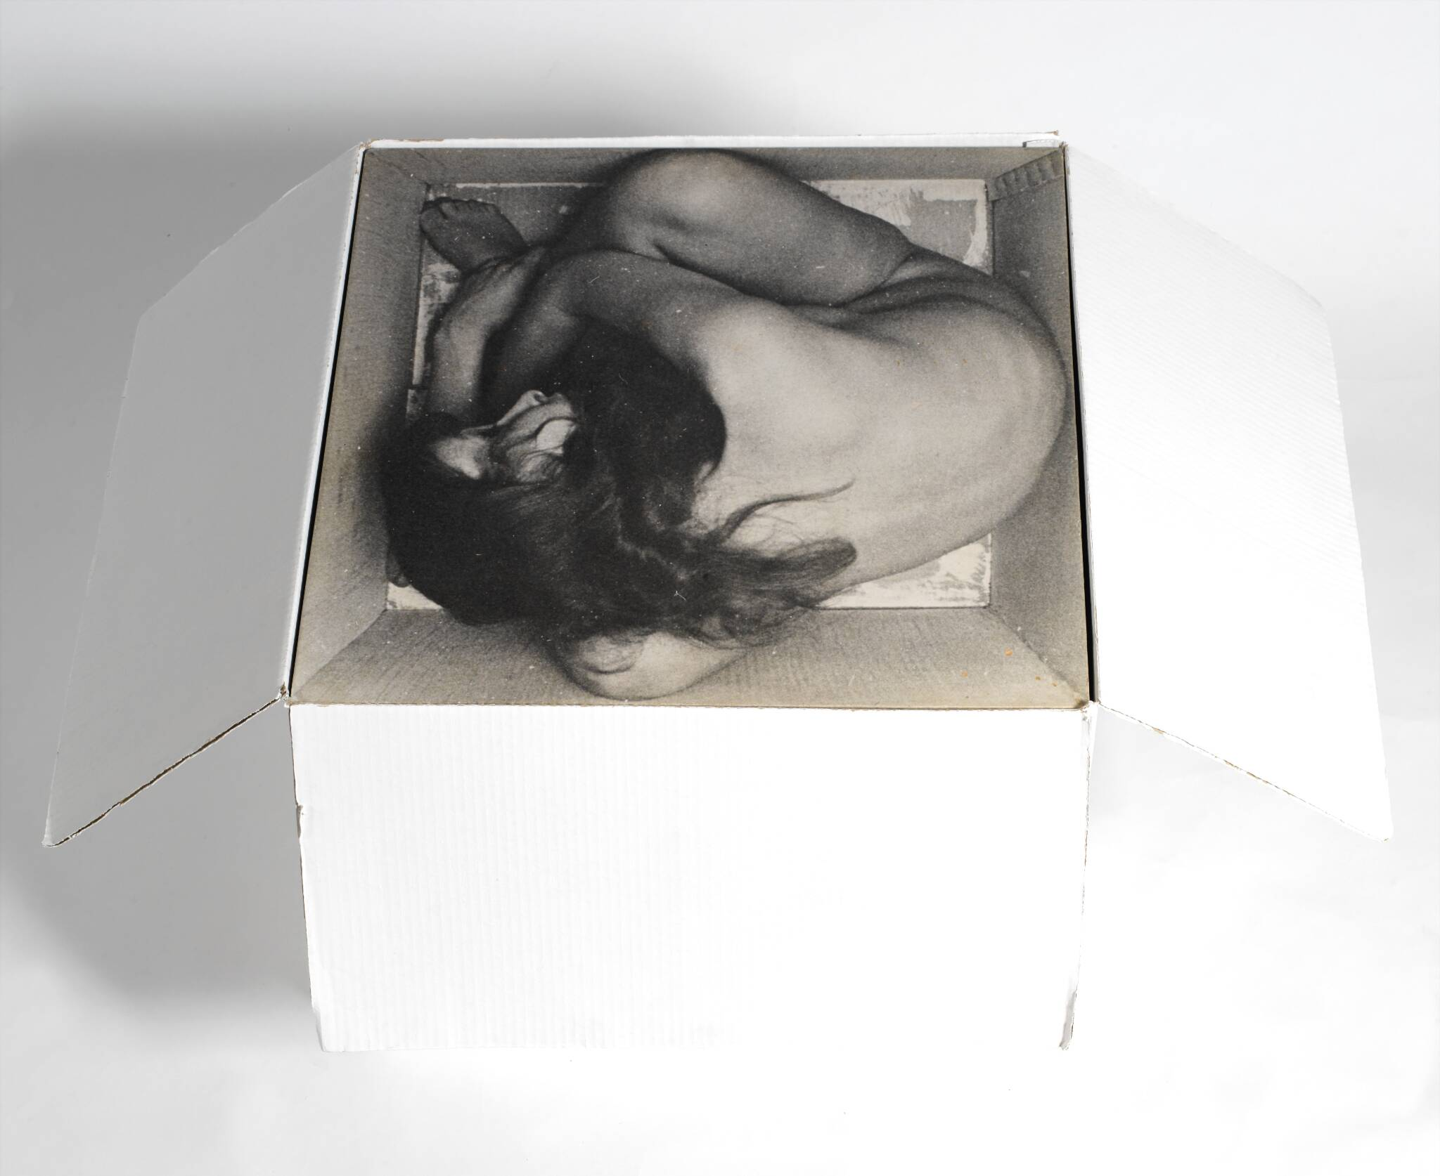
Kirsten Justesen: Skulptur II, 1968, Assemblage, Snor, fotostat, træfinér, træ og papkasse, 50x60x60 cm
Kirsten Justesen: 3 x HVID 1:1:1, 1999, Skulptur i 3 dele, Gips og masonit, 140 x 60 x 60 cm

