Slide 1
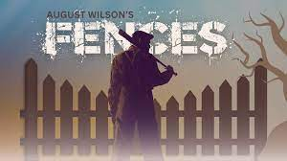
& the historical events to keep in mind when reading the play

Slide 2
History before the play
1776 The declaration of independence ”We hold these truths to be self-evident, that all men are created equal, that they are endowed by their Creator with certain unalienable Rights, that among these are Life, Liberty and the pursuit of Happiness.”
1861 – 1865 Civil war
1863 – 1877 Reconstruction era: abolishment of slavery, the formation of black peoples’ rights (including voting rights), industrialization and the formation of the KKK.
1860s/1870s introduction of Jim Crow laws (until 1968) (segregation in the southern states)
1910-20s and onwards The great migration, a great number of black Americans migrated from southern states to northern mid- or western states (as we seen in Fences).

Slide 3
History during and after the play – Civil Rights Movement
The civil rights movement was a struggle for social justice that took place mainly during the 1950s and 1960s for Black Americans to gain equal rights under the law in the United States.
Brown v. Board of Education (1954) desegregating schools.
1963 March on Washington and Martin Luther King Jr.’s ”I Have a Dream speech”.
The Civil Rights Act of 1964 (banned discrimination on the basis of race, color, religion, sex, and national origin. It addressed voting rights, employment, public accommodations, education, and more.)
1965 Voting Rights Act
Fair Housing Act of 1968

Slide 4
Fences
Fences is a 1985 play by American playwright August Wilson.
Set in the 1950s, it is the sixth in Wilson's ten-part "Pittsburgh Cycle".
Fences explores the evolving African-American experience and examines race relations, among other themes.
The play won the 1987 Pulitzer Prize for Drama and the 1987 Tony Award for Best Play.

Slide 5
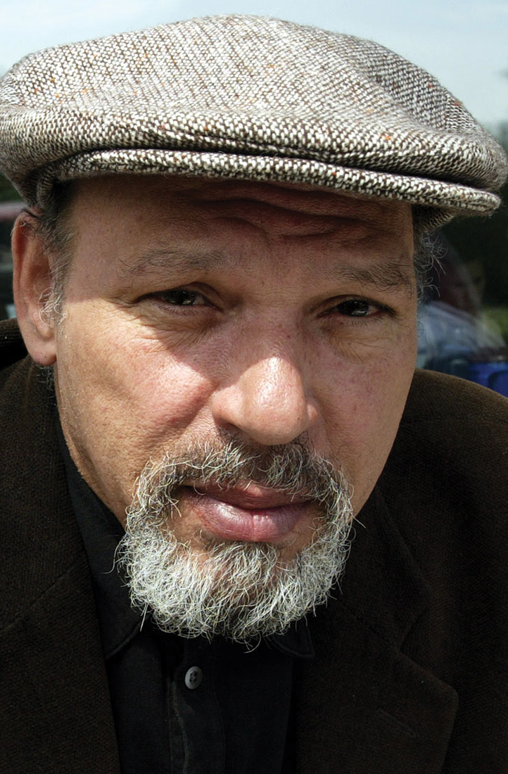
August Wilson, Fences
Exercise: Look up August Wilson
What do we know about Wilson? (upbringing, background, parents etc.)
When does the play Fences take place? When was the play written?
https://en.wikipedia.org/wiki/August_Wilson

Slide 6
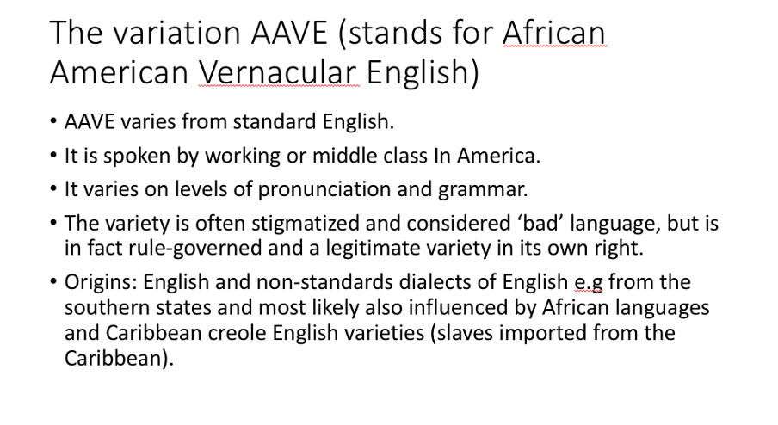
Language - African-American Vernacular English (AAVE)

Slide 7
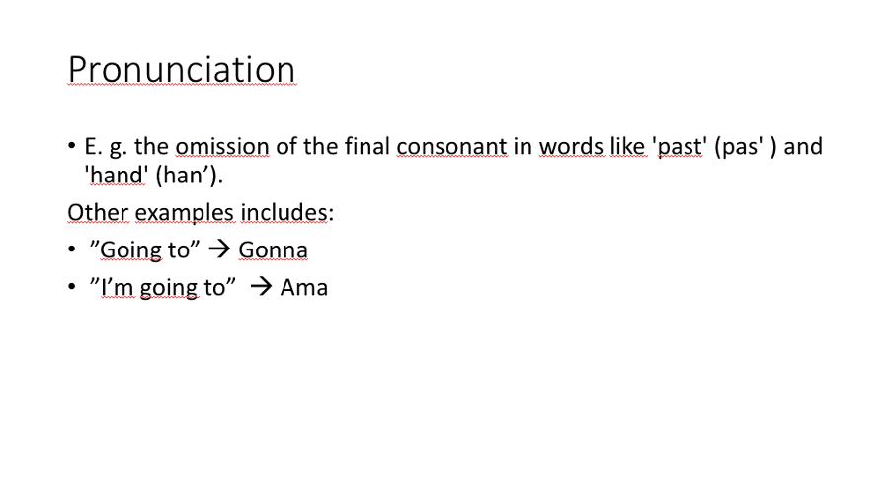

Slide 8
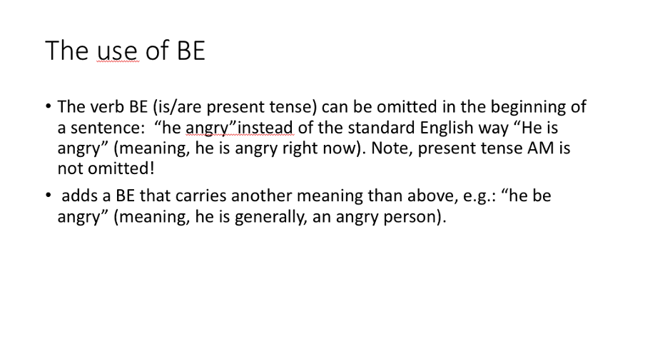

Slide 9
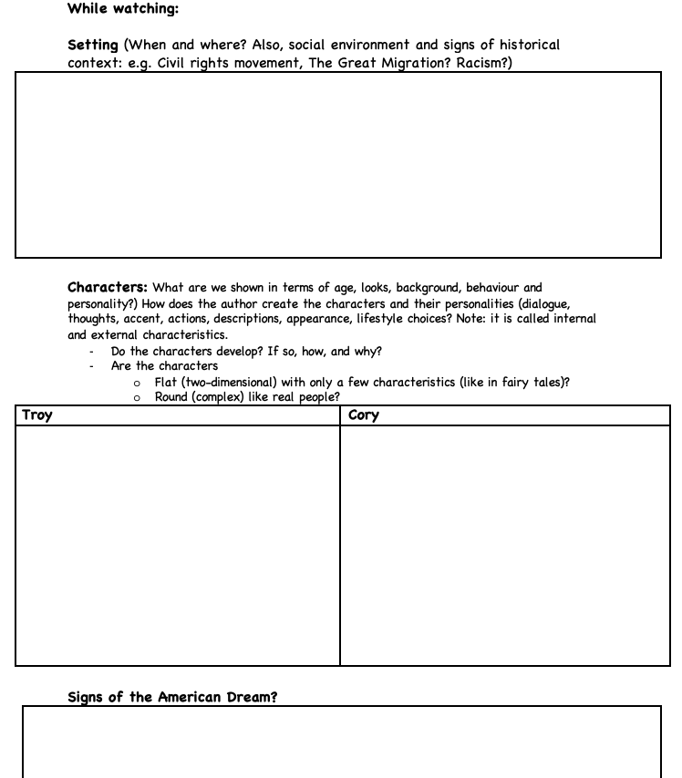
While watching, take notes on:

Slide 10
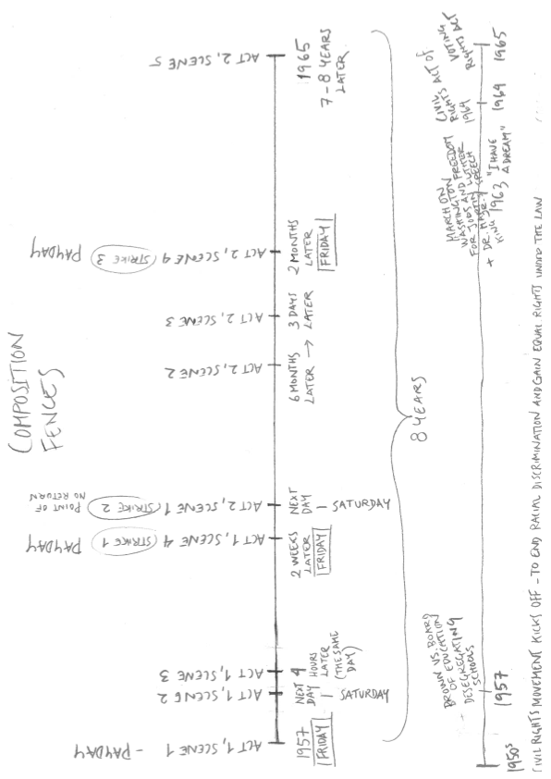
Composition -How can we tell that the story takes place during the Civil Rights Movement?

Slide 11
In pairs, discuss the following statements:
Troy is a good/bad father and cares about his sons, because….
- Cory is similar/not similar to Troy, because….
- The way your parents raise you does/does not affect the way you will raise your own children in the future…
- The American dream is achievable for the different characters in the play in this way:…

