Slide 1
Darkly dreaming dexter

Slide 2
Plan for today
Speech exercise with your partner
Summary of Darkly Dreaming Dexter (DDD) in class
Study questions in groups
New groups
Follow up in class
Crossword

Slide 3
Speech exercise
Talk to your partner for 5 minutes about.. Literally anything! As long as it is in English ☺

Slide 4

Short summery of DDD

Slide 5

Study Questions for DDD
Answer the study questions under today’s class named “Darkly Dreaming Dexter Study Questions 2 okt” in groups - Remember quotes from the text!
When finished upload to “elevfeed” – Remember to write all of your names in the document

Slide 6

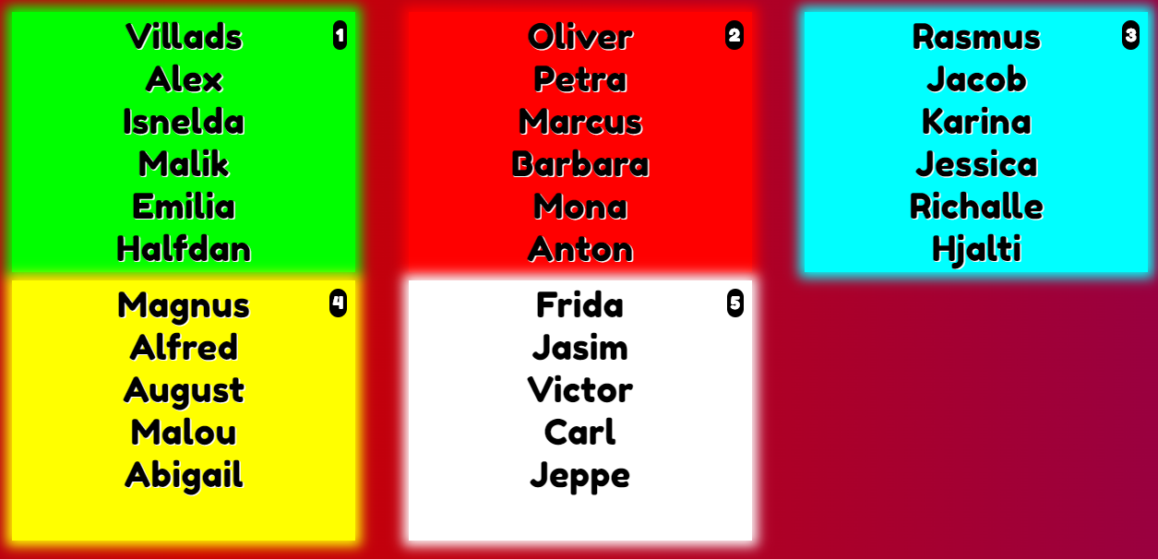
Groups

Slide 7

Represent your old group
Get into a new group where you will explain what you talked about in your old group
Afterwards a follow up in class

Slide 8
Follow up
Characterization of Dexter and Father Donovan
To what extent is Dexter the typical main character in crime fiction?
The story about Dexter focuses on the existential question of what evil is. Why is Dexter an interesting (main) character with which to explore evil as a theme?
Why does Dexter target the priest?
What about Dexter's behavior suggests the theme of morality?

Slide 9
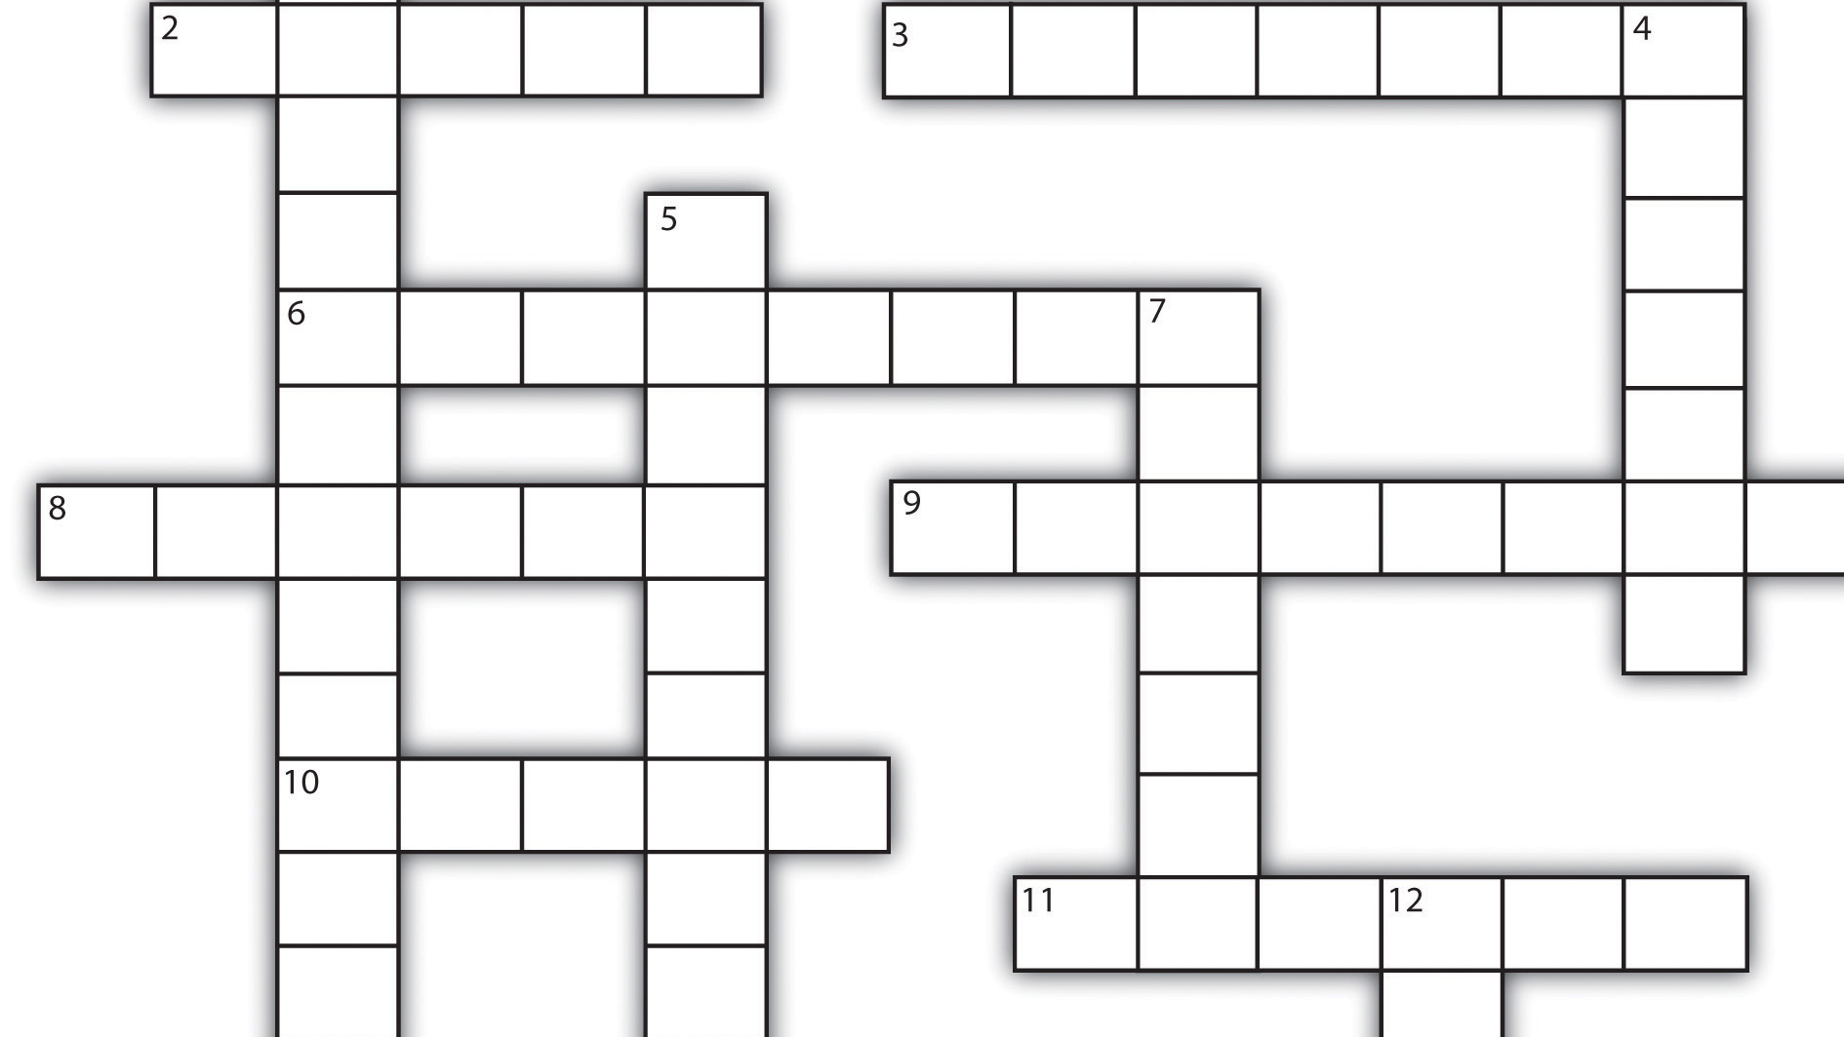
Crossword
Dette billede efter Ukendt forfatter er licenseret under CC BY-SA-NC

