Slide 1
SOCIAL MEDIA
Class 1: How to define Social Media

Slide 2
AIM OF THIS TOPIC
During this topic we will dive into the digital realm and explore how social media shapes our identities.
Goals:
To expand our vocabulary
To practice our written and spoken skills using new vocabulary
To Examine the use of social media in the modern world
To learn how to analyze different types of texts and learn relevant analytical terms
To examine the effect of SoMe on young people
Practice listening skills

Slide 3
01
MIND MAPPING
In groups (made by me):
1)Use the materials to make a mindmap. Write down everything you can think of when you hear the term “Social Media”. You only have 5minutes!
2) Next to your mindmap, write a list of SoMe platforms that you know. Underline the ones you use the most
3)Put your mindmap on the wall when you’re done

Slide 4
Mindmap 2.0
Now each group walk around the room and look at the other mindmaps.
Based on what you saw, write your own definition of social media in your notes.
Each group member must write it down in their Holdnotesbog/ Classnotes (I’ve uploaded a worksheet in the section ”Social Media”), The group must collaborate in writing them ☺
Notes:
We’ll discuss the definitions together ☺

Slide 5
Mindmap 3.0
Definition of Social Media:
Social media is the collective of online communications channels dedicated to community-based input, interaction, content-sharing and collaboration.
Websites and applications dedicated to forums, microblogging, social networking, social bookmarking, social curation, and wikis are among the different types of social media. http://whatis.techtarget.com/definition/social-media (March 9 2017)
Social media is becoming an integral part of life online as social websites and applications proliferate. Most traditional online media include social components, such as comment fields for users. In business, social media is used to market products, promote brands, connect to current customers and foster new business.
Notes:
How does your definitions compare to this??? Class discussion

Slide 6
TWITTER PRESENTATIONS
Using 140 characters or less, describe your partner as though you were writing a classic Tweet!
Read them to one another and see how well you know each other!
I will ask some of you to share what you’ve written

Slide 7

SoMe VOCABULARY TASK:
Individually:
Find the word list in your ”Holdnotesbog” on Teams (If you are still struggling with Teams, download the list from today’s lesson)
Using the dictionary (there is a link attached to the list), write BOTH the danish translation of each word and a definition in English of word as many words you have time for. Work in pairs.
For those who finish quickly: read the poem on the handout on my desk and start looking up some of the words that confuse you …
Notes:
UDGÅET

Slide 8

Why is English so Hard?
We will read the poem aloud together and talk about some of the tricky words ☺
Notes:
UDGÅET

Slide 9
Homework and next time:
Your little task for next time:
Write down how many times you (approximately)
Use Social Media
Post on Social Media
Interact with other users on Social Media (like, comment, share etc.)
You will probably loose track at some point – note when if you give up ☺
Notes:
SKIP HHX?

Slide 10
SOCIAL MEDIA
Class 2: How to define Social Media 2.0

Slide 11
01
02
03
Homework and chat
BREAK
How to keep your things in order
04
05
06
Vocabulary Excercise
Ordklasser
Next time
We will do a little “speed dating” exercise ☺
Break 5/10 minutes
I’ll go through how we work in class from now on ☺ (in Danish)
A task were you will practice dictionary work and presentation
If time: we will talk about ”fill in the blanks” and how we will work with this topic the coming weeks
We’ll talk about next time and evaluate on today’s class
Notes:
20/30min
15min

Slide 12
Homework + “Speed dating”
Face Each Other: Stand in two lines, facing each other.
Talk for 1 Minute: You'll talk to the person in front of you for 1 minute.
Look at the Screen: Check the screen for the question you need to answer.
Both Answer in English: Both of you should answer in English. If you need help, you can ask your partner or use a Danish word if necessary.
Move Down After Each Question: After each question, one row moves down.

Slide 13
How many hours a day do you spend using social media?

Slide 14
Which platforms do you use? Which one is your “heroin”?

Slide 15
Would you say that using the social media is replacing face-to-face communication? Explain.

Slide 16
What do you get out of using the social media?

Slide 17
Do you see any disadvantages in using social media?

Slide 18
CLASS RULES
Always hand in phones on mute
Be respectful towards your classmates we are here to learn, not to be perfect <3
Please raise your hand if you want to speak, and try to be quiet when classmates or teacher speaks
Laptops completely closed when not in use (I will let you know when to use them)
Always feel free to ask questions or tell me if you have suggestions to improve our classes ☺

Slide 19
Digital Tools
I will now go through some of the digital tools we use during class.
Pay attention to the screen and follow the instructions on your own laptop.
I explain this in Danish
By the end of the run-through you need to fill out worksheet A on today’s lesson

Slide 20
SoMe Vocabulary Task:
In pairs:
Worksheet B: Open today's lesson on Lectio and find Worksheet B.
Dictionary Use: Use the attached dictionary link to find Danish translations and English definitions for words (only the ones I assign to you).
Pair Work: Work in pairs. I will specify which words to look up. If you finish quickly look up some of the other words on the list.
Translations Sharing: You'll share your translations with the class by presenting them while the rest writes your answers down.
Notes:
10 min?

Slide 21
Ordklasser
Lad os tale sammen om hvad i ved i forvejen og hvad der er udfordrende
Hvordan er det nu med navneord?

Slide 22
NEXT TIME
Take a moment to write down a few lines about today’s lesson in worksheet A.
What did you like?
What did you not like?
How did you feel you did?
Any other thoughts?
Next time we will be working with film analysis and nouns
See you ☺

Slide 23
01
02
03
Vocabulary task
Film Analysis
BREAK
04
05
06
Film analysis continued
Ordklasser
Next time
We will go through the words from the vocab. task + word of the day
We will watch and analyse the short film ”A Social Life”
Break 5/10 minutes
Suggestion: no phones
Hvis vi har tid taler vi lidt om ordklasser, ellers gemmer vi det til i morgen.
We’ll talk about next time and evaluate on today’s class
We will watch a second short film and compare
Notes:
20/30min
15min

Slide 24
VOCABULARY
Find worksheet B from class 2
We will go through some of the words and chat about your translations and observations

Slide 25
Terminology
Word of the day:
Notes:
Look up the word. 1) translate 2)Define (preferred in english)

Slide 26
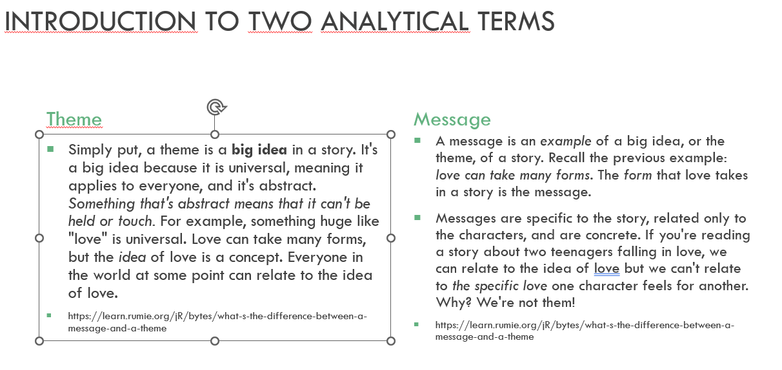
THEME VS MESSAGE

Slide 27
Film Analysis
First we will watch the short film A Social Life
After you will work in groups (makkerpar) with Worksheet A uploaded on today’s lesson

Slide 28
Film Analysis
Worksheet questions:
What is the main point of the film?
How effective is it?
How accurate is it?
To what extend to you agree with this message?
Let’s discuss
Notes:
PAUSE

Slide 29
Film Analysis
Let’s watch a second film: Are you Living an Insta Lie?
In your groups discuss similarities and differences
Notes:
PAUSE

Slide 30
Ordklasser
Lad os tale sammen om hvad i ved i forvejen og hvad der er udfordrende
Hvordan er det nu med navneord, udsagnsord og tillægsord?
Og hvad med bøjninger?
Notes:
Flyttes til næste uge

Slide 31
SOCIAL MEDIA
Class 4: Communication Skills

Slide 32
Navneord/ Substantiver (/Nouns)
Substantiver beskriver fx ting, personer, begreber og abstraktioner (fx car, boy, nature, impressionism).
De fleste substantiver bøjes i enten singularis (ental) eller pluralis (flertal) (boy/boys) og kan stå i genitiv (ejefald) (fx boy's/boys’).
Man kan sætte den ubestemte artikel a/an og den bestemte artikel the foran substantiver.

Slide 33
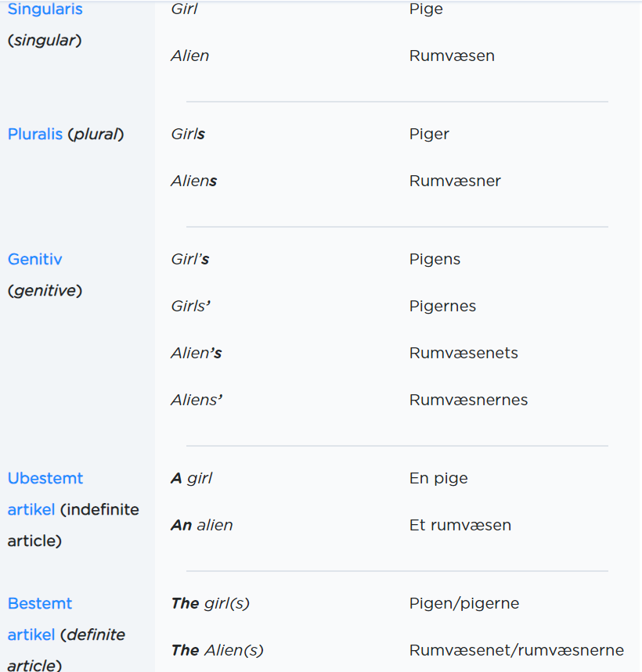
Notes:
15/20 m

Slide 34
Login på www.minlaering.dk
Gå til siden www.minlaering.dk
Login ved at vælge UNI-login → lokalt login. Du bør være tilknyttet holdet 1.j
Lav opgave A: Navneord
Hvis du er turbo kan du lave ekstraopgaven om ordforråd
Notes:
20 min -- PAUSE HEREFTER

Slide 35
Udsagnsord/ Verber (/Verbs)
Funktion: Verber (Udsagnsord) betegner handlinger, aktiviteter og tilstande (fx write, understand, find, talk, be).
Verber optræder i alle sætninger og er den eneste ordklasse, der kan fungere som et såkaldt verballed (Udsagnsled) i sætningsanalyse.
Bøjning: Verber kan bøjes på flere måder: De kan bøjes i forskellige tider, og så kan de bøjes i person efter sætningens subjekt, fx I am, you are, he/she/it is.

Slide 36
Login på www.minlaering.dk
Gå til siden www.minlaering.dk
Lav opgave B: Udsagnsord
Hvis du er turbo kan du lave ekstraopgaven om ordforråd ELLER opgaven i dagens Worksheet
Når du har lavet den må du smutte. OBS: jeg kan se jeres svar, og jeg tjekke om i har svaret tilfredsstillende inden i går – så ikke noget med at springe over hvor gærdet er lavest ☺
Notes:
20 min -- PAUSE HEREFTER

Slide 37
SOCIAL MEDIA
Class 5: Reading a shortstory: Lightbox 1

Slide 38
”Skill”
Word of the day:
Notes:
LAV KUN HVIS TID

