Slide 1

TRADITIONS
NEW UNIT

Slide 2
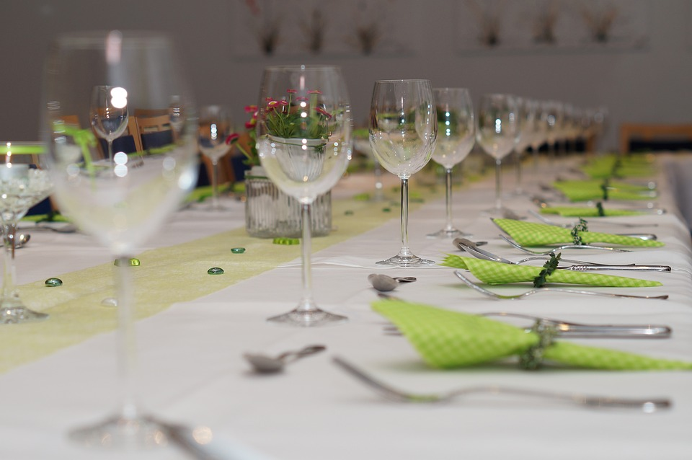
WHATS IN IT?
”DANES LOVE TO SIT FOREVER
AND TALK, AND THEY HAVE
SPEECHES AND SONGS AND FOOD
AND IT TAKES FOREVER”

Slide 3
QUESTIONS TO DISCUSS:
HOW DOES TRADITIONS FORM US?
WHY ARE TRADITIONS IMPORTANT?
WHICH TRADITIONS FROM YOUR HOME COUNTRY DO YOU LIKE?
CREATE A TRADITION FROM THE GROUND
WHAT ARE THE TRADITIONS AROUND WEDDING AND X-MAS?
HOW DOES TRADITIONS RELATE TO MANNERS AND HABITS?
ARE OUR TRADITIONS RELIGIOUS?
BEING NEW IN A COUNTRY, WHICH TRADITIONS SHOULD WE FOLLOW AND CELEBRATE?

Slide 4
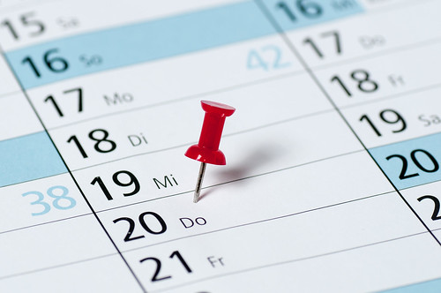
THE YEAR IN DENMARK
FASTELAVN
VALENTINES DAG
PÅSKE
MAJ
4. MAJ
PINSE
GRUNDLOVSDAG
SANKT HANS
HALLOWEEN
ADVENT
JULEAFTEN
NYTÅR
Dette billede efter Ukendt forfatter er licenseret under CC BY

Slide 5
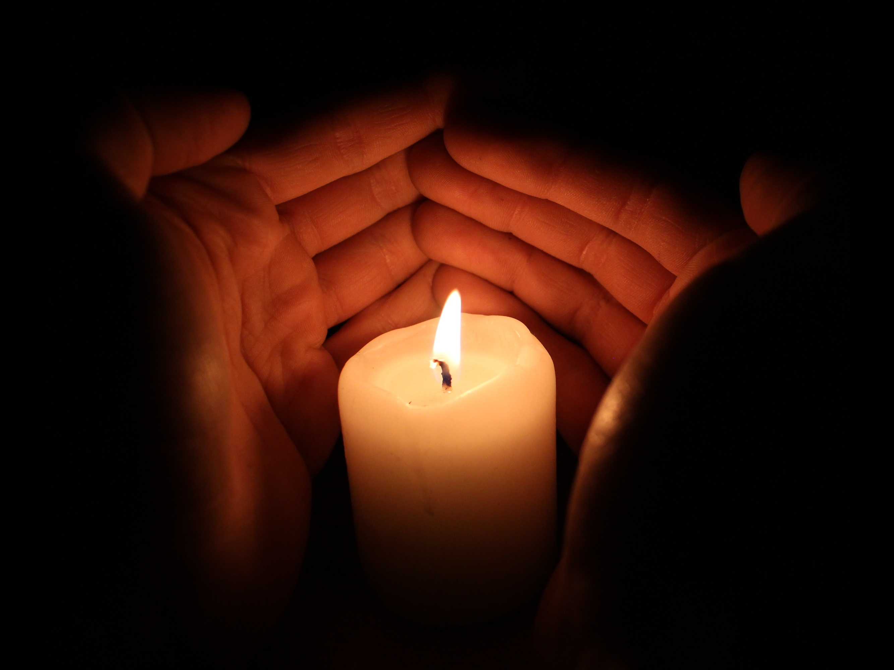
IT IS ALL ABOUT: LIGHT IN THE DARKNESS

Slide 6
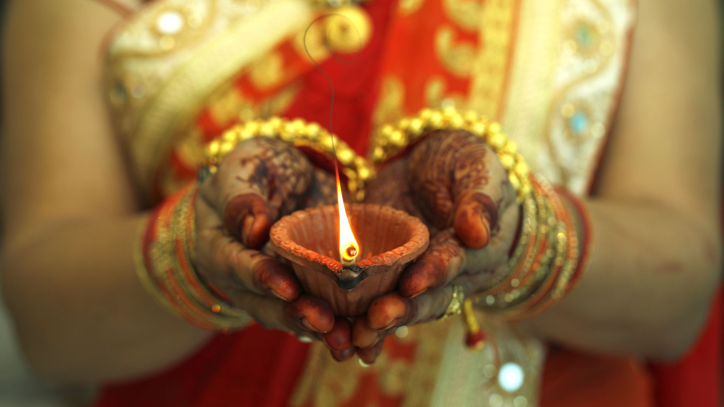
WEDDING TRADITIONS

Slide 7
Weddings in Denmark
BEFORE THE PARTY
AT THE PARTY
AFTER THE PARTY

Slide 8
WHAT THEY DO AT WEDDINGS
1. BEFORE
TOWN HALL OR CHURCH?
RICE, FERTILITY
2. AT THE PARTY
FORK AND KNIFE IN THE PLATE: THEY KISS
IF THE BRIDE LEAVES THE ROOM, THE MEN KISSES HER ON THE CHEEK, AND SAME WITH THE GROOM
WALZ BEFORE MIDNIGHT
THEY WILL CUT A WHOLE IN THE GROOM’S SOCK
WEDDING CAKE CUT WITH BOTH THE GROOM AND THE BRIDE
3. AFTER THE PARTY
CAINS ON THEIR CAR ON THEIR WAY HOME
BRIDE HAS TO BE CARRIED OVER THE DOORSTEP

Slide 9
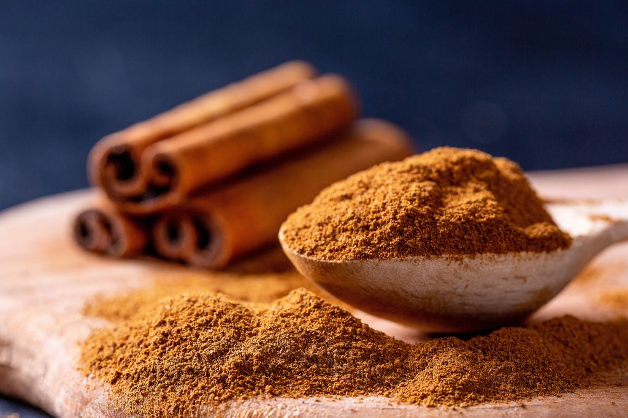
A STRANGE TRADITION
IF YOU ARE 25 AND NOT MARRIED
YOU WILL GET CINNAMON (KANEL)
OVER YOU
HVIS DU ER 25 OG ENDNU IKKE GIFT
FÅR DU KANEL OVER DIG
Dette billede efter Ukendt forfatter er licenseret under CC BY

Slide 10
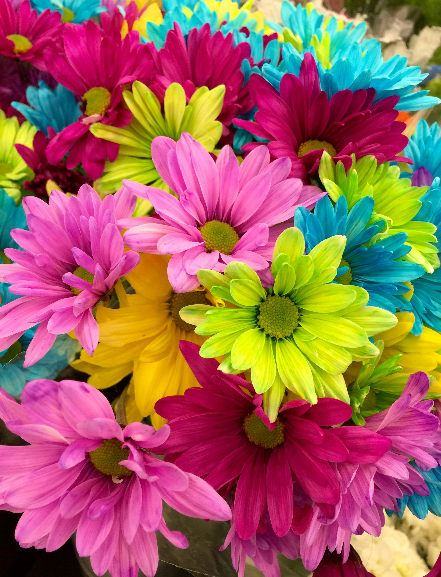
A TRADITION YOU LIKE
BE MY VALENTINE

