Slide 1
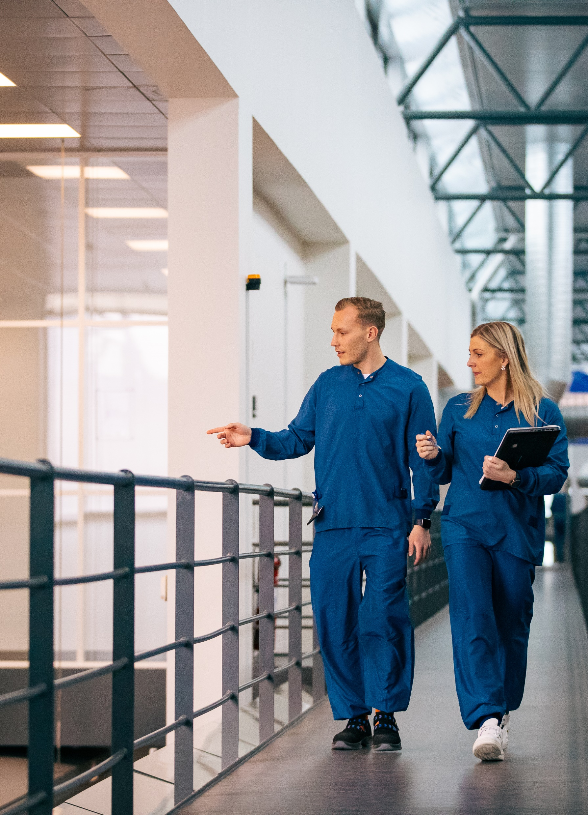
Guidelines for factory visits
This guideline is to be sent to all guests before visiting
AM Hillerød, Brennum Park 25A, DK-3400 Hillerød
AM Hillerød

Slide 2
Dear guest
On behalf of Novo Nordisk, we are excited about the opportunity to welcome you to AM Hillerød (25A) and taking you on a guided tour of this Danish production facility.
All visits to AM Hillerød (25A) are governed by several GMP (Good Manufacturing Practise) guidelines and Standard Operating Procedures (SOPs) and full compliance is mandatory.
Hence, you are kindly requested to read and comply with the instructions in this presentation on `Guidelines for factory visit´ as well as any guidance given on-site.
Thank you for your co-operation,
PS Aceptic Manufacturing, Hillerød (AM Hi)

Slide 3
General guidelines when visiting AM Hillerød
Kindly familiarize yourself with your visit program and be timely
Bring as few personal belongings as possible
Jackets & bags must be left in the locker during the visit
Dress casually and wear comfortable shoes (No sandals/open shoes or stilettos) legs must be covered and socks/stockings are mandatory
It will not be possible to use the restrooms in the factory
Kindly use facilities where the general presentation takes place – prior to/after the visit to the production facilities
Food is not allowed at the visitor's corridor and no catering is provided
Cell phones and other electronic devices are not allowed in the production facility and should be left in the locker
Cameras are not allowed in the production facilities
Smoking is not allowed on any of the Novo Nordisk premises

Slide 4
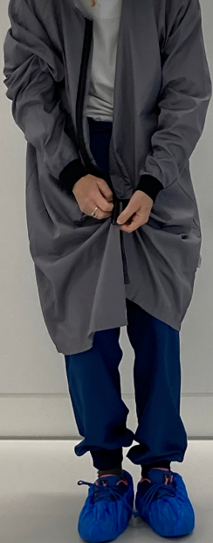
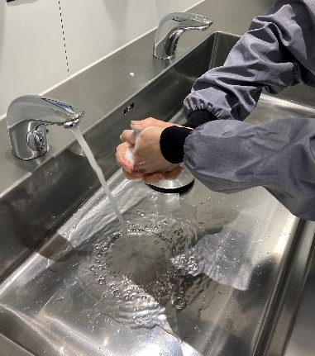
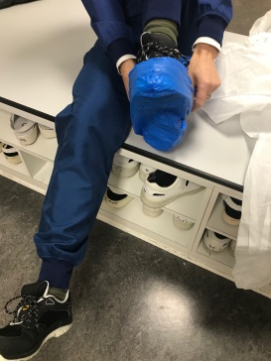
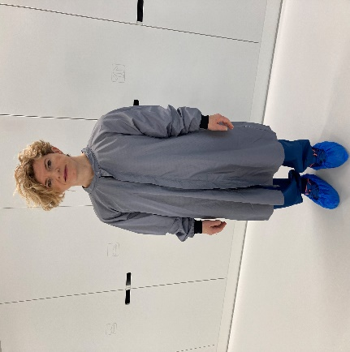
Specific gowning procedures – Site Hillerød
When you arrive at AM Hillerød, 25A you must be capable of:
Walking to the first floor – no elevator is available
Wait patiently for the assigned guide to come and let you and your group in.
Leave your jacket on the hanger and lock your bag and cell phone inside the locker
Use the ”swing-over-bench” as per instructions given by your host
Put shoe covers on your shoes and put on a grey smock/lab coat
Wash your hands with soap and/or use of ethanol before entering the production facilities
Ready to visit our production
Unclean side Clean side Clean side Clean side

Slide 5
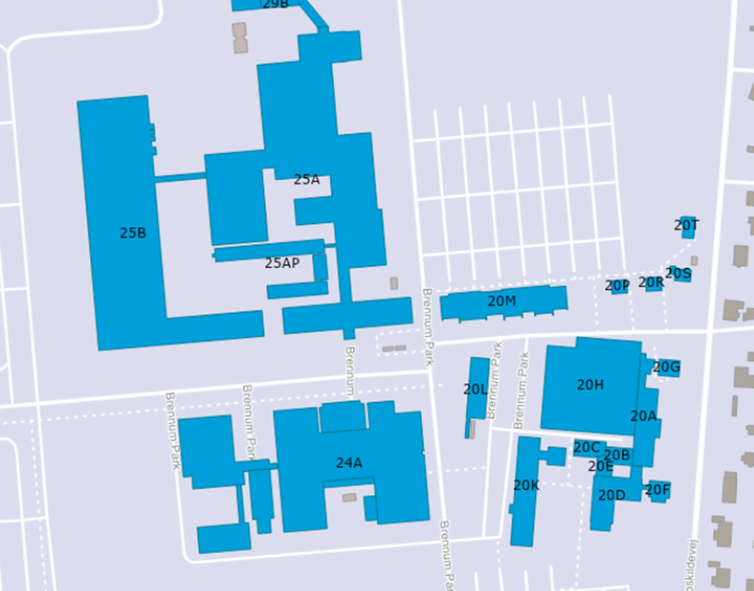
25A Entrance –
Please go to the 1st floor where the guide will meet you - Be patient. The guide will let you in when he/she is ready
Parking
Parking
25A Guest Entrance
Parking
Parking

